Slide 1
CSE-609 – Software Design
Lecture-07
Dr. Fazal-e-Malik
Assistant Professor , Computer Science Department,
Iqra National University, Peshawar.

Slide 2
Outline
Introduction to software architecture and design
Architectural Representation
  Using UML
  Using ADL

Slide 3
Software Architecture
is the description of elements from which system is built, interactions among those elements, patterns that guide their composition, and constraints on the patterns.
Considers system as a collection of components and their interactions.

Slide 4
Components & their Interactions
Components are such things as clients and servers, databases, layers, etc.
Interactions among components can be procedure calls, shared variable access, etc.

Slide 5
Software Architecture
the fundamental organization of a system embodied in its components, their relationships to each other, and to the environment, and the principles guiding its design and evolution [IEEE standard 1471–2000 ].

Slide 6
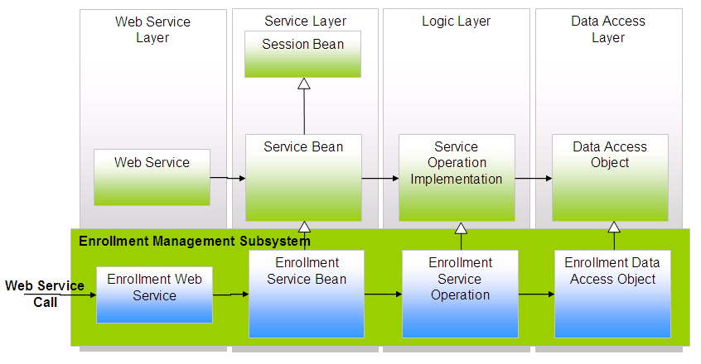
Software Architecture
What is the nature of the elements?
What are the responsibilities of the elements?
What is the significance of the connections?
What is the significance of the layout?

Slide 7
Where does architecture design come from?
The architecture design representation is derived from the system requirement specification and the analysis model.

Slide 8
Who is responsible for developing the architecture design?
Software architects and designers are involved in this process by translating (mapping) the software system requirements into architecture design.

Slide 9
Why is software architecture design so important?
A poor design may result in a deficient product that
  does not meet system requirements,
  is not adaptive to future requirement changes,
  is not reusable,
  exhibits unpredictable behavior, or
  performs badly.

Slide 10
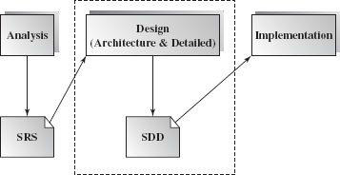
When is software design conducted?
Software design is an early phase of the Software Development Life Cycle (SDLC).

Slide 11
What is the outcome of the software architecture design?
Simply put, it is an overall representation of the software to be built.
A complete software architecture specification must describe not only
  the elements and connectors between elements, but also the
  constraints and runtime behaviors
so that developers know what and how the design should be implemented.

Slide 12
Architectural Representations
Software architecture specifies a high level of software system abstraction by employing decomposition, composition, architecture styles, and quality attributes.

Slide 13
Architectural Representations
Every software architecture must describe its collection of components and the connections and interactions among these components.
It must also specify the deployment configuration of all components and connections.
Additionally, a software architecture design must conform to the project's functional and nonfunctional requirements.

Slide 14
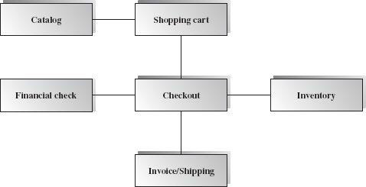
Architectural Representations
– Box diagrams
Box-and-line diagrams are often used to describe the business concepts and processes during the analysis phase of the software development lifecycle.

Slide 15
Box diagrams
These diagrams come with descriptions of components and connectors, as well as other descriptions that provide common intuitive interpretations.

Slide 16
Unified modeling language

Slide 17
UML for Software Architecture
The Unified Modeling Language (UML) is a graphical language for
  visualizing,
  specifying,
  constructing, and
  documenting
the artifacts of a software-intensive system.
UML offers a standard way to draw a system's blueprints.

Slide 18
Architecture View Models
a model is a complete, simplified description of a system from a particular perspective or viewpoint.
There is no single view that can present all aspects of complex software to stakeholders!!!

Slide 19
View Model
View models provide partial representations of the software architecture to specific stakeholders such as
  the system users,
  the analyst/designer,
  the developer/programmer,
  the system integrator, and
  the system engineer.

Slide 20
View Model
Software designers can organize the description of their architecture decisions in different views.

Slide 21
The 4 +1 View Model
The 4+1 view model was originally introduced by Philippe Kruchten (Kruchten, 1995).
The model provides four essential views:
  the logical view,
  the process view,
  the physical view, and
  the development view
and fifth is the scenario view

Slide 22
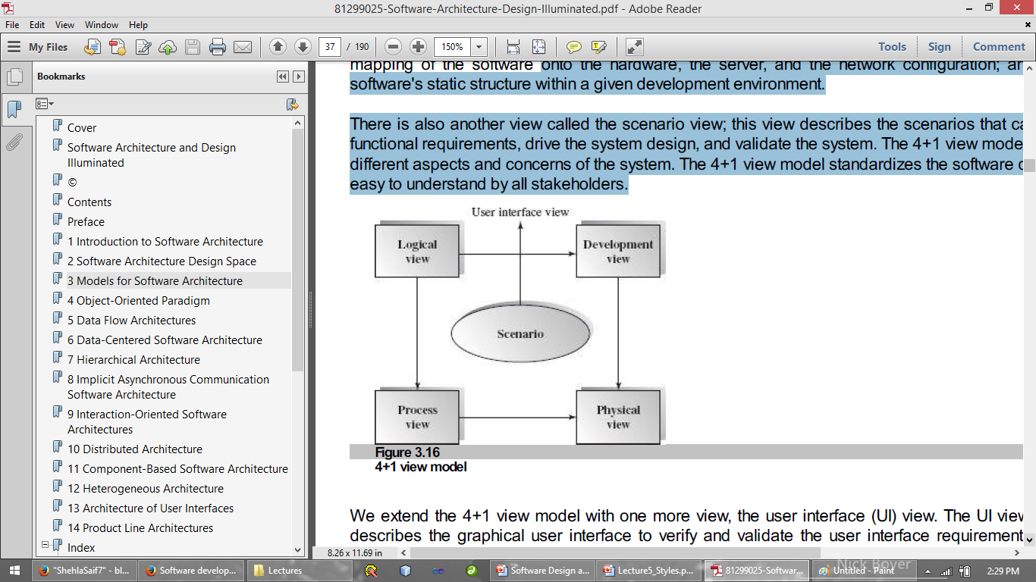
The 4+1 view model
multiple-view model that addresses different aspects and concerns of the system.
standardizes the software design documents and makes the design easy to understand by all stakeholders.

Slide 23
The Scenario View
The scenario view describes the functionality of the system, i.e., how the user employs the system and how the system provides services to the users.
It helps designers to discover architecture elements during the design process and to validate the architecture design afterward.
  The UML use case diagram and other verbal documents

Slide 24
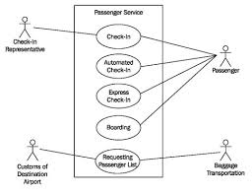

Slide 25
The Logical or Conceptual View
The logical view is based on application domain entities necessary to implement the functional requirements.
The logical view specifies system decomposition into conceptual entities (such as objects) and connections between them (such as associations).

Slide 26
The logical view
The logical view is typically supported by
  UML static diagrams including class/object diagrams and
  UML dynamic diagrams such as the interaction overall diagram, sequence diagram, communication diagram, state diagram, and activity diagram.

Slide 27
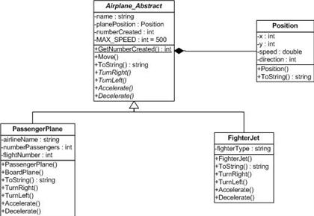

Slide 28
The Development or Module View
The development view derives from the logical view and describes the static organization of the system modules.
Modules such as class library, subsystem, or packages are building blocks that group classes for further development and implementation.
UML diagrams such as package diagrams and component diagrams are often used to support this view.

Slide 29
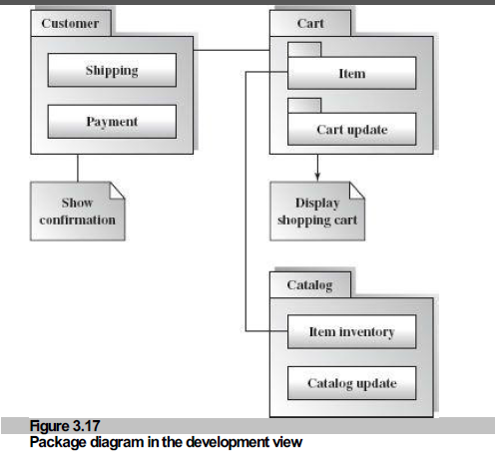

Slide 30
The Process View
The process view focuses on the dynamic aspects of the system, i.e., its execution time behavior.
This view maps functions, activities, and interactions onto runtime implementation.
The process view takes care of the concurrency and synchronization issues between subsystems.
The UML activity diagram and interaction overview diagram support this view.

Slide 31
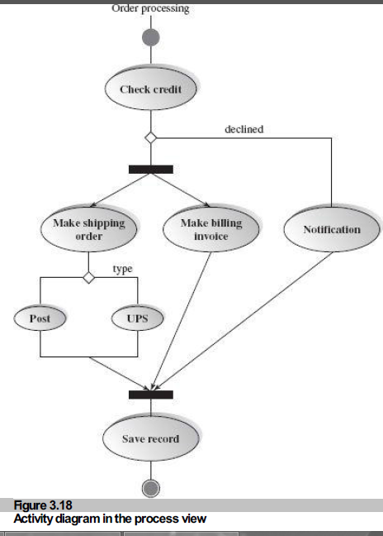

Slide 32
The Physical View
The physical view describes installation, configuration, and deployment of the software application.
It concerns itself with how to deliver the deploy-able system.
The physical view shows the mapping of software onto hardware.
  It is particularly of interest in distributed or parallel systems.
The UML deployment diagrams and other documentation are often used to support this view.

Slide 33
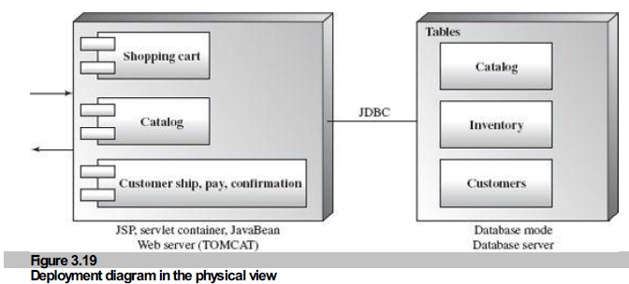

Slide 34
The User Interface View
The User Interface (UI) view is an extended view that provides a clear user-computer interface view and hides implementation details.
This view may be provided as a series of screen snapshots or a dynamic, interactive prototype demo.
Any modification on this view will have direct impact on the scenarios view.

Slide 35
4+1 view model
The 4+1 view is an architecture verification technique for studying and documenting software architecture design.

Slide 36
Architecture Description language

Slide 37
What is an Architecture Description Language?
It is a modeling notation to support architecture-based development
  used to define and model system architecture prior to detailed design and implementation

Slide 38
Many ADLs
Architecture Description Languages (ADLs) can be used to specify an architecture
UML (OMG) - general-purpose
SADL (SRI)
Aesop (Carnegie Mellon University)
Acme (CMU) – and interchange format
Rapide (Stanford University)
Wright (CMU)
Darwin (Imperial College London)

Slide 39
Parts of an ADL
Architecture Style =
  {Component/Connector Vocabulary, Topology,Semantic Constraints}
Components (locus of computation),
  filter, data store, object, process, server
Connectors (interactions between components),
  procedure call, RPC, pipe, TCP/IP
Key issue - tool support

Slide 40
Acme: a generic ADL
n Developed by David Garlan and others (CMU) and David Wile (USC)
  Simple, generic language for describing software architectures and families of architectures
  Intended to be standard representation for tools

Slide 41
Tools – ACME Studio
ACME Studio - a viewer and editor for ACME descriptions.
Text and graphical views supported.

Slide 42
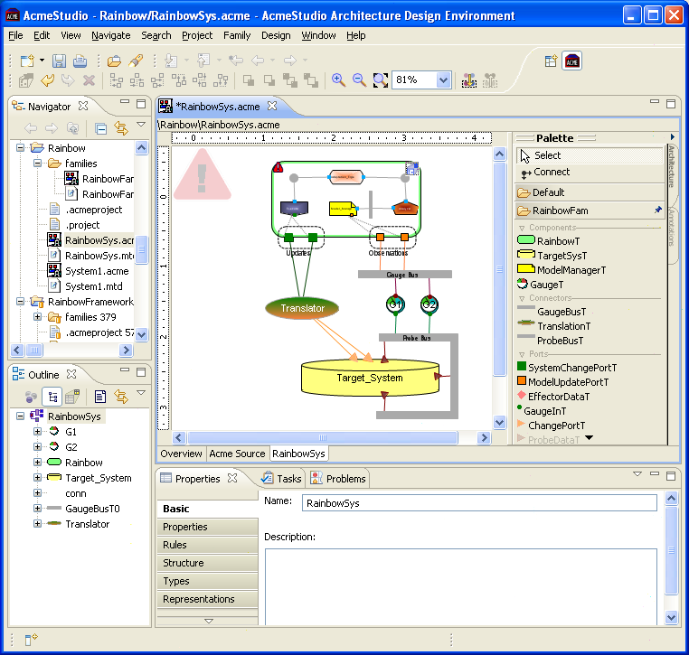

Slide 43
Elements of Components and Connectors view
Components model principal run-time elements that have a set of ports
Ports model component’s interfaces through which component interacts with other components via connectors
Connectors model the pathways of communication between components and have a set of roles
Roles model the specifications of behavior requires of the components that use a given connector

Slide 44
Example of Component and Connector (C&C) Model in Acme ADL
Simple-cs system consist of a single client and a single server, interacting through rpc based connector
In this representation we can analyze our C&C model to see if there are any unattached roles or ports, name collisions and etc.

Slide 45
Modeling Architectural Properties in Acme ADL
Properties are name-value pairs that can be associated with any architectural element: component, port, connector
Sync-request port property indicates if rpc-request port is synchronous or asynchronous, max-transactions-per-second and max-clients-supported component properties indicate maximum properties of server component and protocol property of rpc connector indicates the name of the communication protocol

Slide 46
Summary
Architectural Representation
  Using UML
  Using ADL

