Slide 1
CSE-609 – Software Design
Lecture-06
Dr. Fazal-e-Malik
Assistant Professor , Computer Science Department,
Iqra National University, Peshawar.

Slide 2
Outline
Software design methods
Design Paradigms
Typical Design Trade-offs

Slide 3
Software Design Methods

Slide 4
Software Design Methods
In a Software development process, the Software Design Methodology (SDM) refers to specific set of procedures used to manage and control the SDLC (Software Development Life Cycle).

Slide 5
Software Design Methods
The choice of the SDM primarily depends upon several factors, namely,
the type of the software (such as standalone or distributed and networked; Strategic or operational etc.)
the scope of the development project (such as revamp(renewal) of the existing system or new system, the number of modules involved, underlying complexity of the coding, system testing and implementation etc),
the resources constraints (such as time, money, expertise)

Slide 6
Approaches To Developing A Software Design.
Systematic approaches to developing a software design.
Structured Design
Function-Oriented
Object-Oriented
Data-Oriented (Data-structure-centered)
Component-based
Formal Methods

Slide 7
Approaches … continue…
Structured Methods
These conceptualize problem into several well-organized elements of solution.
it gives better understanding of how the problem is being solved.
These also make it simpler for designer to concentrate on the problem more accurately.
Mostly based on ‘divide and conquer’ strategy where a problem is broken into several small problems and each small problem is individually solved until the whole problem is solved.
These modules are arranged in hierarchy and communicate with each other.
These methods follows some rules for communication among multiple modules, namely -
Cohesion - grouping of all functionally related elements.
Coupling - communication between different modules.
A good structured design has high cohesion and low coupling arrangements.
Function Oriented
the system consists of many smaller sub-systems known as functions, performing significant task in the system.
These methods inherit some properties of structured design using divide and conquer methodology.
the whole system is divided into smaller functions, which provides hiding the information and their operation.
functional modules can share information among themselves by means of information passing and using information available globally.
Another characteristic of functions is that when a program calls a function, the function changes the state of the program, which sometimes is not acceptable by other modules.
Function oriented design works well where the system state does not matter and program/functions work on input rather than on a state.

Slide 8
Approaches … continue…
Object-Oriented
develop an object model of a system
works around the entities and their characteristics instead of functions involved in the software system.
This design strategy focuses on entities and its characteristics.
The whole concept of software solution revolves around the engaged objects (entities).
Objects are identified and grouped into classes on the basis of similarity in attribute characteristics.
Class hierarchy and relation among them is defined.
Application framework is defined.
Data-Oriented
Entities are determined for each sub-system, then entity inter-relationships are examined to develop the additional entities needed to support the relationships.

Slide 9
Approaches … continue…
Component-based
Divide the system into components
Formal Methods
Requirements and programs are translated into mathematical notation

Slide 10
Which method to choose?
Data oriented design is useful for systems that process lots of data, e.g. database and banking applications
Structured design is useful for process intensive systems that will be programmed using a procedural language such as C.
OO methods are useful for any system that will be programmed using an object oriented language such as C++.

Slide 11
Which method to choose?
Component-based Methods are used for the large systems that can be modularized.
Formal methods are considered to be an alternative to OO and classical design methods,
but their use is expensive and claims of reduced errors remain unproven.
However, the ability to formally validate the correctness of a software artifact is appealing and research on formal methods is ongoing.

Slide 12
Design Paradigms

Slide 13
Software Design Paradigms
Structured Design/Function Oriented Design
Object-Oriented Design

Slide 14
Structured/Procedural Paradigm
Focus on procedures and functions.
Design the system by decomposing it based on the processes and functions.
Top-down algorithmic decomposition.
This approach separates data from procedures.

Slide 15
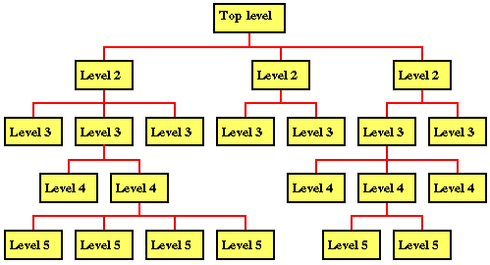
Structured/Procedural Paradigm

Slide 16
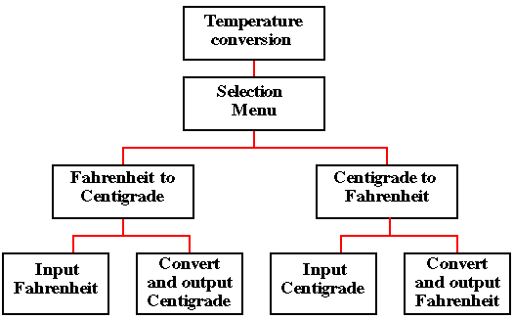
Example:
Structured/Procedural Paradigm

Slide 17
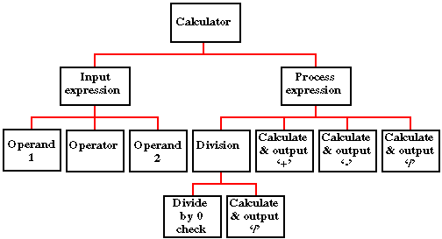
Example:
Structured/Procedural Paradigm

Slide 18
Drawbacks
Interdependencies between various functions and processes.
Cannot be reused easily.
Data related to each function is not attached.

Slide 19
Object-Oriented Paradigm
Describing the software solution in terms of collaborating objects, with responsibilities.
Objects,
classes,
encapsulation,
States,
inheritance,
composition,
polymorphism

Slide 20
Object-Oriented Design
Bottom-up
Encapsulate data and procedures in objects and classes.
Refinement in classes lead to a composed larger system.

Slide 21
Benefits
Enjoys all the benefits of Modular approach
Dependencies can be handled by finding the commonalities through inheritance and polymorphism.
Naturalness
OO paradigm models the real world better because everything in real world is an object.
Reusability
Using the existing classes or components in future design, without much effort.

Slide 22
If OO design is incorrect, the implementation derived from the design in an OOP language would be very complex.

Slide 23
Case Study : Fire Alarm
The owner of a large multi-stored building wants to have a computerized fire alarm system for his building.
Smoke detectors and fire alarms would be placed in each room of the building.
The fire alarm system would monitor the status of these smoke detectors.

Slide 24
Whenever a fire condition is reported by any of the smoke detectors, the fire alarm system should determine the location at which the fire condition is reported by any of the smoke detectors, the fire alarm system should determine the location at which the fire condition has occurred and then sound the alarms only in the neighbouring locations.

Slide 25
The fire alarm system should also flash an alarm message on the computer console. Fire fighting personnel man the console round the clock.
After a fire condition has been successfully handled, the fire alarm system should support resetting the alarms by the fire fighting personnel.

Slide 26
Function-Oriented Approach
/* Global data (system state) accessible by various functions */
BOOL detector_status[MAX_ROOMS];
int detector_locs[MAX_ROOMS];
BOOL alarm_status[MAX_ROOMS];
/* alarm activated when status is set */
int alarm_locs[MAX_ROOMS];
/* room number where alarm is located */
int neighbor-alarm[MAX_ROOMS][10];
/* each detector has atmost 10 neighboring locations */

Slide 27
Function-Oriented Approach
The functions which operate on the system state are:
interrogate_detectors();
get_detector_location();
report_fire_location();
determine_neighbor();
ring_alarm();
reset_alarm();

Slide 28
Object-Oriented Approach
class detector
attributes
status, location, neighbours
operations
create, sense-status, get-location, find-neighbors
class alarm
attributes
location, status
operations
create, ring-alarm, get_location, reset-alarm

Slide 29
Structured vs. OO Paradigm
In structured design, data and functions are kept separately.
Usually all of the data are placed before any of the functions are written.
Sometimes, it is not intuitively known which data works with which function.

Slide 30
Structured vs. OO Paradigm
In OO design, the related data and functions of an object are placed together within one unit.
In Structured approach abstraction exists in functions unlike OO approach where abstraction is in terms of objects

Slide 31
Design Goals and trade-offs

Slide 32
List of Design Goals
Reliability
Modifiability
Maintainability
Understandability
Adaptability
Reusability
Efficiency
Portability
Traceability of requirements
Fault tolerance
Backward-compatibility
Cost-effectiveness
Robustness
High-performance
Good documentation
Well-defined interfaces
User-friendliness
Reuse of components
Rapid development
Minimum # of errors
Readability
Ease of learning
Ease of remembering
Ease of use
Increased productivity
Low-cost
Flexibility

Slide 33
Relationship Between Design Goals

Slide 34
Typical Design Trade-offs
Functionality vs. Usability
Cost vs. Robustness
Efficiency vs. Portability
Rapid development vs. Functionality
Cost vs. Reusability
Backward Compatibility vs. Readability

Slide 35
Summary
Software design methods
Design Paradigms
Typical Design Trade-offs

