Slide 1
Evidence based practice

Slide 2
SELECTING DESIGNING & DEVELOPING QUESTIONAIRRE
Anybody can write down a list of questions and photocopy it, but producing worthwhile and generalizable data from questionnaires needs careful planning and imaginative design
The great popularity with questionnaires is they provide a “quick fix” for research methodology.

Slide 3
Questionnaires offer an objective means of collecting information about people’s knowledge, beliefs, attitudes, and behavior.
Do our patients like our opening hours?
What do teenagers think of a local antidrug campaign and has it changed their attitudes?
Why don’t doctors use computers to their maximum potential?
Questionnaires can be used as the sole research instrument (such as in a cross sectional survey) or within epidemiological studies etc.

Slide 4
Randomized trials are subject to strict reporting criteria, but there is no comparable framework for questionnaire research.
Hence, despite a wealth of detailed guidance in the specialist literature, methodological errors are common.
Inappropriate instruments and lack of rigor lead to poor quality data,
misleading conclusions, and
woolly recommendations.

Slide 5
AIM
To present practical guide that will enable us to do questionnaire research that is well designed, well managed, and non- discriminatory and which contributes to a generalizable evidence base.
We start with selecting and designing the questionnaire.

Slide 6
Selecting and designing the questionnaire.
What information are you looking for?
You and/or your co-researchers may have different assumptions about precisely what information you would like your study to generate.
A formal scoping exercise will ensure that you clarify goals and if necessary reach an agreed compromise. It will also flag up potential practical problems—
for example, how long the questionnaire will be and how it might be administered.

Slide 7
As a rule of thumb, if you are not familiar enough with the research area or with a particular population subgroup to predict the range of possible responses, and especially:
If such details are not available in the literature, you should first use a qualitative approach (such as focus groups) to explore the territory and map key areas for further study.

Slide 8
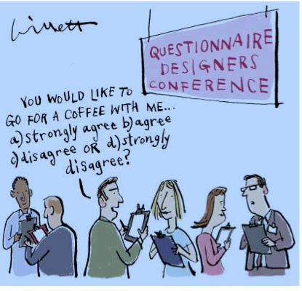
IS QUESTIONNAIRE APPROPRIATE People often decide to use a questionnaire for research questions that need a different method.

Slide 9
Research participants must be able to give meaningful answers (with help from a professional interviewer if necessary).
Particular physical, mental, social, and linguistic needs
need to be addressed.

Slide 10
Could you use an existing instrument?
Using a previously validated and published questionnaire will save you time and resources;
you will be able to compare your own findings with those from other studies,
you need only give outline details of the instrument when you write up your work, and you may find it easier to get published (box 1).
Increasingly, health services research uses standard questionnaires designed for producing data that can be compared across studies.

Slide 11
For example, clinical trials routinely include measures of patients’ knowledge about a disease, satisfaction with services, or health related quality of life.
The validity of this approach depends on whether the type and range of closed responses reflects the full range of perceptions and feelings that people in all the different potential sampling frames might hold.

Slide 12
If there is no “off the peg” questionnaire available, you will have to construct your own.
Using one or more standard instruments alongside a short questionnaire could save you the need to develop and validate a long list of new items.

Slide 13
Is the questionnaire valid and reliable?
A valid questionnaire measures what it claims to measure.
In reality, many fail to do this. For example, a self completion questionnaire that seeks to measure people’s food intake may be invalid because it measures what they say they have eaten, not what they have actually eaten.
Similarly, responses on questionnaires that ask general practitioners how they manage particular clinical conditions differ significantly from actual clinical practice.
An instrument developed in a different time, country, or cultural context may not be a valid measure in the group you are studying

Slide 14
Reliable questionnaire
Reliable questionnaires yield consistent results from repeated samples and different researchers over time.
Differences in results come from differences between participants, not from inconsistencies in how the items are understood or how different observers interpret the responses.
A standardized questionnaire is one that is written and administered so all participants are asked precisely the same questions in an identical format and responses recorded in a uniform manner.
Standardizing a measure increases its reliability.

Slide 15
Just because a questionnaire has been piloted on a few of your colleagues, used in previous studies, or published in a peer reviewed journal does not mean it is either valid or reliable.
The detailed techniques for achieving validity, reliability, and standardization are beyond the scope of this class.

Slide 16
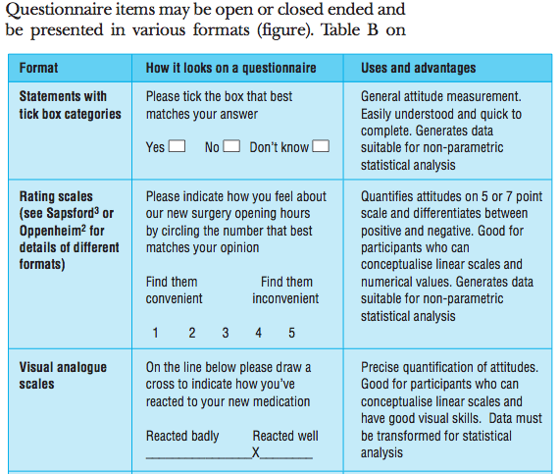
How should you present your questions

Slide 17
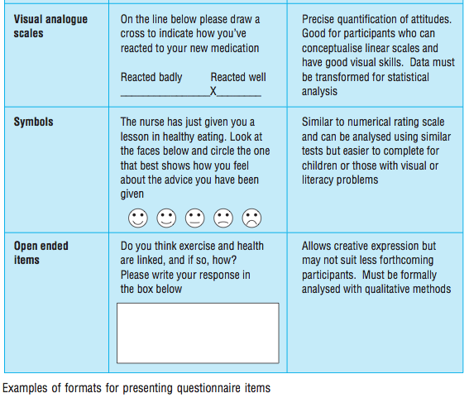

Slide 18
Two words that are often used inappropriately in closed question stems are
frequently and regularly.
“I frequently engage in exercise,” and offer a Likert scale giving responses from “strongly agree” through to “strongly disagree.” But
“frequently” implies frequency,
Most appropriate would be:
frequency based rating scale (with options such as at least once a day, twice a week, and so on)

Slide 19
“Regularly,” on the other hand, implies a pattern. One person can regularly engage in exercise once a month whereas another person can regularly do so four times a week.
Other words to avoid in question stems include commonly, usually, many, some, and hardly ever.

Slide 20
Closed ended designs enable researchers to produce aggregated data quickly, but
the range of possible answers is set by the researchers not respondents, and the richness of potential responses is lower.
Closed ended items often cause frustration, usually because researchers have not considered all potential responses. (box page 21)

Slide 21
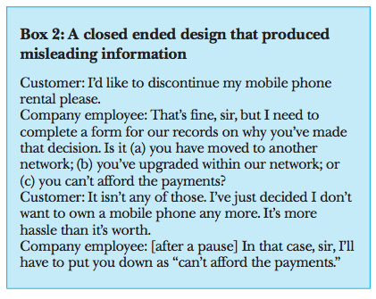
Incomplete Information

Slide 22
Ticking a particular box, or even saying yes, no, or maybe can make respondents want to explain their answer.
such free text annotations may add richly to the quantitative data.
You should consider inserting a free text box at the end of the questionnaire (or even after particular items or sections).
Note that participants need instructions (perhaps with examples) on how to complete free text items in the same way as they do for closed questions.

Slide 23
Open ended questions
If you plan to use open ended questions or invite free text comments, you must
plan in advance how you will analyze these data
You must also build into the study design adequate time, skills, and resources for this analysis; otherwise
you will waste participants’ and researchers’ time.

Slide 24
Beware
Some respondents (known as yea Sayers) tend to agree with statements rather than disagree.
For this reason, do not present your items so that strongly agree always links to the same broad attitude.
For example, on a patient satisfaction scale, if one question is “my GP generally tries to help me out,” another question should be phrased in the negative, such as “the receptionists are usually impolite.”

Slide 25
Apart from questions what else should you include
A common error committed by questionnaire designers for the first time, is simply to hand out a list of the questions they want answered.
It is particularly important to provide an introductory letter or information sheet for participants to take away.

Slide 26
What should the questionnaire look like?
Researcher rarely spend time to look at the physical lay-out of the questionnaire because they believe that,
the science lies in the content of the questions and not in such details as the font size/colour.
studies have shown that it results in:
low response rates (due to participants being unable to read/follow the questionnaire (box 3).
In general, questions should be short and to the point (around 12 words or less), but for issues of a sensitive and personal nature, short questions can be perceived as abrupt and threatening, and longer sentences are preferred.

Slide 27
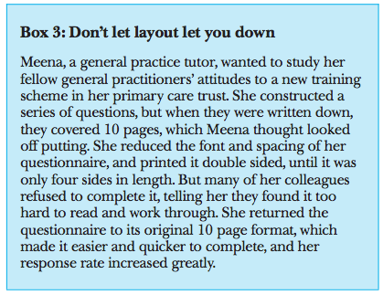
Importance of physical layout

Slide 28
Selection of sample size
Different sampling techniques will affect the questions you ask and how you administer your questionnaire. For more detailed advice on sampling, see Bowling and Sapsford.
If you are collecting quantitative data with a view to testing a hypothesis or assessing the prevalence of a disease or problem (for example, about inter-group differences in particular attitudes or health status), seek statistical advice on the minimum sample size.

Slide 29
What approvals do you need before you start?
Unlike other methods, questionnaires require relatively little specialist equipment or materials, which means that inexperienced and unsupported researchers sometimes embark on questionnaire surveys without completing the necessary formalities.

Slide 30
Approval by the appropriate research ethics committee.
In addition, if your questionnaire study is part of a formal academic course (for example, a dissertation), gaining written approval from your supervisor is a must.
A study is unethical if it is scientifically unsound,
causes undue offence or trauma, breaches confidentiality, or wastes people’s time or money.
details of the study design, copies of your questionnaire, and any accompanying information or covering letters must be presented
If the questionnaire is likely to cause distress, you should include a clear plan for providing support to both participants and researchers.
Remember that just because you do not find a question offensive or distressing does not mean it will not upset others.

Slide 31
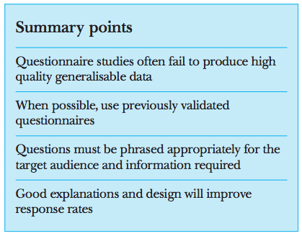
Summary points

