Slide 1
Proprioceptive Neuromuscular Facilitation
Dr. M.Jaffar PT
DPT(NCS,KMU), MSNMPT(RIU)*

Slide 2
Introduction
Proprioceptive, means receiving stimulation within the tissues of the body.
Neuromuscular, means pertaining to the nerves and muscles.
Facilitation, means the effect produced in nerve tissue by the passage of an impulse.
An afferent impulse travelling up from peripheral receptors in the ms cause an impulse volley result in the discharge of limited number of specific motor neurons as well as the discharge of additional surrounding motor neurons in the firing area.
An impulse causing the recruitment and discharge of additional motor neurons within the subliminal fringe is said to be facilitatory

Slide 3
Definition
Stimulation of the proprioceptors for increasing demand on the neuromuscular mechanism to obtain and facilitate its response.
Developed by Dr Herman Kabat 1946 and 1951.
Facilitation and inhibition
Any stimulus that causes motor neuron to drop out of the discharge zone and away from subliminal fringe is inhibition.
Facilitation result in increased excitability of motor neuron and inhibition result in decreased extensibility of motor neurons.
Thus the function of weak ms would be aided by facilitation and ms spasticity would be decreased by inhibition.

Slide 4
Cont…
The discharge of motor neurons can be facilitated by peripheral stimulation which causes afferent impulses to make contact with excitatory neurons and result in increased ms tone or strength of voluntary contraction.
Motor neuron can also be inhibited by peripheral stimulation which causes afferent impulses to make contact with inhibitory neurons thus resulting in ms relaxation and allowing for stretching of ms.
To indicate any technique in which input from peripheral Facilitation and inhibition receptors is used to facilitate or inhibit,PNF tech should be used

Slide 5
Neurophysiological mechanism of stretch reflex
Involve two types of receptors
1. muscle spindle that are sensitive to a change in length as well as the rate of change in length of the muscle fiber.
2.GTO detect change in tension.
Stretching increases frequency of impulses transmitted to the spinal cord from ms spindle. Which in turn produces an increase in the frequency of motor nerve impulse, returning to that same muscle thus reflexively resisting the stretch. however the development of excessive tension within the ms activates GTO whose sensory impulses are carried back to the spinal cord. These impulses have an inhibitory effect on the motor impulses returning to the ms and thus cause that ms to relax.

Slide 6
Autogenic inhibition and reciprocal inhibition
Inhibition mediated by afferent fibers from a stretched ms acting on the alpha motor neuron supplying to that ms thus causing it to relax.
Motor neuron of agonist ms receive excitatory impulses from afferent nerves ,the motor neuron that supply the antagonist ms are inhibited by afferent impulses. Thus contraction or extended stretch of the agonist ms must elicit relaxation or inhibit the antagonist. For faci or inhi motion pnf relies heavily on the action of these agonist and antagonist ms group.

Slide 7
Introduction
Uses proprioceptive, cutaneous, and auditory input
Used for increasing strength, flexibility, and ROM
Replicates normal movement pattern
Therefore, PNF can be defined as, methods of promoting or hastening the response of the neuromuscular mechanism through stimulation of the proprioceptors.
Patient must be taught the PNF patterns regarding the sequential movements from starting position to terminal position
Patient should look at the moving limb Visual stimuli Verbal cues
Manual contact with appropriate pressure

Slide 8
PNF stretching techniques
Increase strength
Increase coordination
Facilitate mobility
Contract relax, hold relax

Slide 9
PNF Strengthening
Isometric and Isotonic pnf strengthening
Use manual contact to produce motor response by stimulation of skin and other receptors.
This resistance is meant to facilitate the muscle to contract improve motor control and strength

Slide 10
Components of pnf
A. principle
B. procedure
C. patterns
D. techniques

Slide 11
A. principle
Patient must be taught the pattern.
Have the patient watch the moving limb moved passively.
The patient must give proper verbal command.
Manual contact with appropriate pressure is very important.
Contraction of the muscle group is facilitated by hand placement.
Apply maximal resistance throughout ROM.
Resistance will change.
Rotation of movement will change throughout ROM
Distal movement should occur first .

Slide 12
Procedure
Treatment applied is always positive.
Basic tools of facilitation
Efficiency depends on voluntary effort
following procedure can be used,
1.Resistence
2.Irridiation
3.Manual contacts
4.Body position
5.Verbal Commands
6.Vision
7.Traction and approximation
8.Stretch
9.Timing

Slide 13
1.Resistance
Appropriate or optimal resistance
Tension produced activates ms spindle and GTO.
Produce smooth movement
Should not cause pain or fatigue
Avoid holding breath
Therapeutic goals
Facilitate the ability to contract
Increase strength
Awareness of movement

Slide 14
2.Irradiation
The spread of response to stimulus.
The response to stimulus increase in intensity and duration
Properly applied resistance leads to irradiation and reinforcement.
Increase facilitation in the synergistic pattern of movt.
No perfect rule b/c each pt react differently.
For example hip flexion ____abdomanlis
Supinator/pronator__rotators

Slide 15
3 .Manual contacts
Grips stimulate pt skin receptors and pressure receptors
Guide for direction of movt
Pressure on the muscle_ms contract
Verbal:
Instruction before starting treatment
Feedback/command
preparatory
motion
correction

Slide 16
5. Vision
Imp sense of movt, and stability
Acts as feedback
Motion with visual feedbak_movt get easier
Motion more purposeful
6.Traction /approximation
Traction is elongation or separation of joint
Acts as stretch stimulus by elongating the receptor in the joint. Stimulate stretch receptor.
Applied throughout R0M
Promotes extension
Approximation increase the muscular response, promotes stability ,assist isotonic contraction,

Slide 17
7.Stretch
Stretch stimulus activate when ms elongate
Preparatory procedure
Stretch applied in the pattern
Timing:
Sequence of motion
Normal motion require timing of sequence i.e what ms to be activated first.
Mostly movement takes place distal to proximal

Slide 18
B. pattern of motion
Mass patterns of movement is the base of pnf techniques because mass movement is characteristic of all motor activity.
Patterns of movement are spiral and diagonal and they are closely allied to normal functional movements.
Observed in every day use
e.g. taking hand to the mouth, chopping activity,

Slide 19
C. Techniques of movement
Coordination b/w ago and anta ms=rhythmic movement
1 .rhythmic initiation 2.repeated stretch
3.Slow reversal 4. slow reversal hold
5.Rythmic stabilization 6.Contract and hold relax
Rhythmic Initiation:
To facilitate initiation of movement ,speed of contraction and direct movement.
Sequence of movt,teach pattern, model movement
Visual /kinesthetic/passive-active assisted-active-resisted
Difficulty In initiating movement

Slide 20
2. Repeated contraction
To assist initiation and enhance strength
Indicated for Weakness fatigue and decrease awareness
Correction of imbalance
Pt move isotonically against resistance repeatedly until fatigue is achieved in weaker ms ,a stretch at that point in range should facilitate weaker ms, result in smooth and more coordinated movt.

Slide 21
3.Slow reversal
Isotonic contraction of the antagonist followed immediately by an isotonic contraction of agonist.
The initial contraction facilitate agonist contraction
Slow reversal hold:
Isotonic contraction of agonist followed immediately by an isometric contraction, which hold command given at the end of each active movt.
Strength at specific point

Slide 22
5.Rhythmic stabilization
Isometric contraction of agonist followed by isometric contraction of antagonist to produce contraction and stability of the two opposing ms.
Command is always hold.

Slide 23
6.Contract and hold relax
Stretching tech
Contracture, tightness and flexibility
Isotonic resistance to antagonist ms,pt relax and passively moved into agonist pattern.
In Hold relax isometric contraction of antagonist against resistance followed by a concentric contraction of the agonist

Slide 24
PNF
Three component of movements
Flexion-extension
Abduction-adduction
Internal-external rotation

Slide 25
Component of movement
Each pattern of movement has 3 components,
The pathway is specific and in the line of action of main muscle components responsible for movement.
Two components of the movement are angular and third is rotatory. The rotatory component is of major importance because it gives direction to the movement as a whole. Each pattern is named according to the movt which take place at the proximal joint or joints of the part moved e.g flex,add,er

Slide 26
Components of movement
Movt in distal joints follows the direction of that in the proximal joints but intermediate joint may move in either direction.
e.g in flex-add with ext rot of the leg the foot dorsiflex, adduct and invert the knee either flexes or extend.

Slide 27
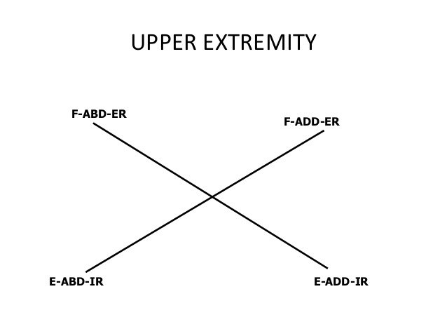

Slide 29
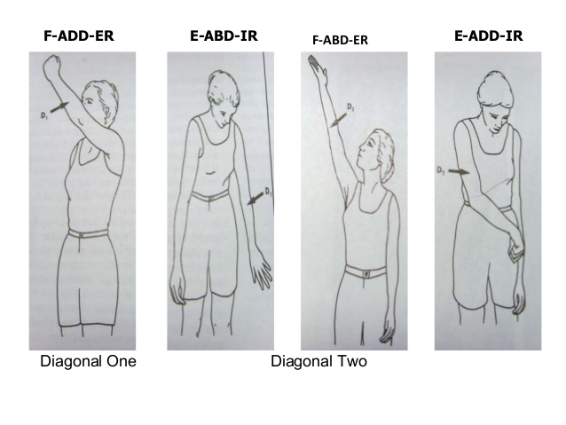

Slide 30
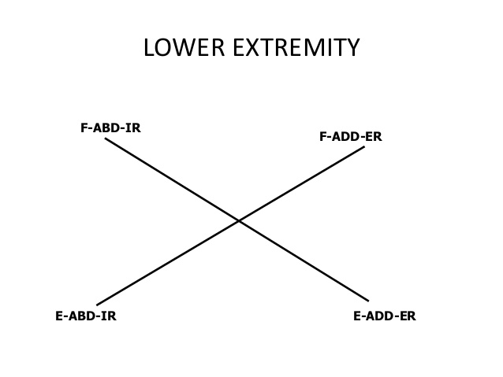

Slide 32
PNF Patterns Continued
Pattern is initiated with the muscle groups in lengthened position
Muscle group is contracted, moving the body part through the ROM to shortened position
Diagonal 1 (D1)
Diagonal 2 (D2)

Slide 33
PNF Strengthening Diagonal Patterns
D1 Flexion Upper Extremity

Slide 34
D1 Flexion Upper Extremity Joint Specific Movements
Shoulder | Flexion
 | External Rotation
 | Adduction
Forearm | Supination
Wrist | Radial Deviation
Fingers | Flexion

Slide 35
PNF Strengthening Diagonal Patterns
D1 Extension Upper Extremity

Slide 36
D1 Extension Upper Extremity Joint Specific Movements
Shoulder | Extension
 | Internal Rotation
 | Abduction
Forearm | Pronation
Wrist | Ulnar Deviation
Fingers | Extension

Slide 37
PNF Strengthening Diagonal Patterns
D2 Flexion Upper Extremity

Slide 38
D2 Flexion Upper Extremity Joint Specific Movements
Shoulder | Flexion
 | External Rotation
 | Abduction
Forearm | Supination
Wrist | Radial Deviation
Fingers | Extension

Slide 39
PNF Strengthening Diagonal Patterns
D2 Extension Upper Extremity

Slide 40
D2 Extension Upper Extremity Joint Specific Movements
Shoulder | Extension
 | Internal Rotation
 | Adduction
Forearm | Pronation
Wrist | Ulnar Deviation
Fingers | Flexion

Slide 41
PNF Strengthening Diagonal Patterns
D1 Flexion Lower Extremity

Slide 42
D1 Flexion Lower Extremity Joint Specific Movements
Hip | Flexion
 | Adduction
 | External Rotation
Ankle | Dorsiflexion
 | Inversion
Toes | Extension

Slide 43
PNF Strengthening Diagonal Patterns
D1 Extension Lower Extremity

Slide 44
D1 Extension Lower Extremity Joint Specific Movements
Hip | Extension
 | Abduction
 | Internal Rotation
Ankle | Planar Flexion
 | Eversion
Toes | Flexion

Slide 45
PNF Strengthening Diagonal Patterns
D2 Flexion Lower Extremity

Slide 46
D2 Flexion Lower Extremity Joint Specific Movements
Hip | Flexion
 | Abduction
 | Internal Rotation
Ankle | Dorsiflexion
 | Eversion
Toes | Extension

Slide 47
PNF Strengthening Diagonal Patterns
D2 Extension Lower Extremity

Slide 48
D2 Extension Lower Extremity Joint Specific Movements
Hip | Extension
 | Adduction
 | External Rotation
Ankle | Plantar Flexion
 | Inversion
Toes | Flexion

Slide 49
Proprioceptive Training for Lower Extremities
Proprioceptive training improves a patient's static and dynamic equilibrium. The static proprioceptive re-education is begun when patients proceed to weight bearing without crutches and consists of six stages:
1-Recovery of sense of body position muscle contraction and joint movement.
2-Transition from bilateral to unilateral activities
3-Transition from eyes-open to eyes-closed activities.
4-Transition from activities on a stable support, such as the ground, to unstable surfaces, such as a soft mattress, a trampoline and Freeman's boards, or more modern equipment, such as the kinesthetic ability trainer
5-Throwing and catching a football to take the patient's mind off active control of his balance.
6-Balance recovery exercises are carried out different joint positions to evoke different responses from the tendon and muscle receptors.

Slide 50
Balance and control proprioceptive exercise
1. Stand on one leg. 2. Stand on one leg with eyes closed. 3. Stand on one leg – throw and catch a ball. 4. Stand on one leg – bend and straighten knee
5. Stand on one leg- pick up item from floor.
6. Hold knee dip – throw and catch a ball
7: Stand on one leg – move other leg to side, front and back.
8. Push up onto toes (2 legs) and hold.
9. Push up onto toes with eyes closed.
10. Push back onto heels, balance and hold.
11. Push up on toes on one leg.

