Slide 1
Power Semi – Conductor Devices
Engr. Muhammad Aamir Aman
Lecturer

Slide 2
Insulated Gate Bipolar Transistor – IGBT
◆ IGBTs are preferred devices for voltages above 300V and below 5kV.
◆ Three terminal device: Gate, Source, Drain.
◆ They are turned on and off by applying low voltage pulses to their gate.
◆ Combination of BJT and MOSFET characteristics.
◆ Other names: Gain Enhanced MOSFET (GEMFET); COMFET (Conductivity
Modulated FET); Insulated Gate Transistor (IGT).
◆ Superior on – state characteristics, good switching speed and excellent safe operating area (SOA).
◆ Advantage: High current capability of BJTs and easy control of MOSFET.

Slide 3
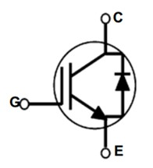
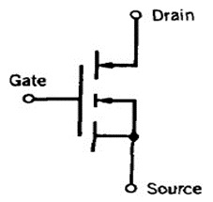
Insulated Gate Bipolar Transistor
◆ IGBTs are preferred devices for voltages above 300V and below 5kV.
◆ They are turned on and off by applying low voltage pulses to their gate.
◆ Combination of BJT and MOSFET characteristics.
◆ Gate behaviour similar to MOSFET - easy to turn on and off.
◆ Low losses like BJT due to low on-state Collector - Emitter voltage (2-3V).
◆ Ratings: Voltage: V CE < 3.3kV, Current,: I C < 1.2 kA currently available.
◆ Latest: HVIGBT 4.5 kV/1.2 kA.
◆ Switching frequency up to 100 KHz.
◆ Typical applications: 20-50 KHz.

Slide 4
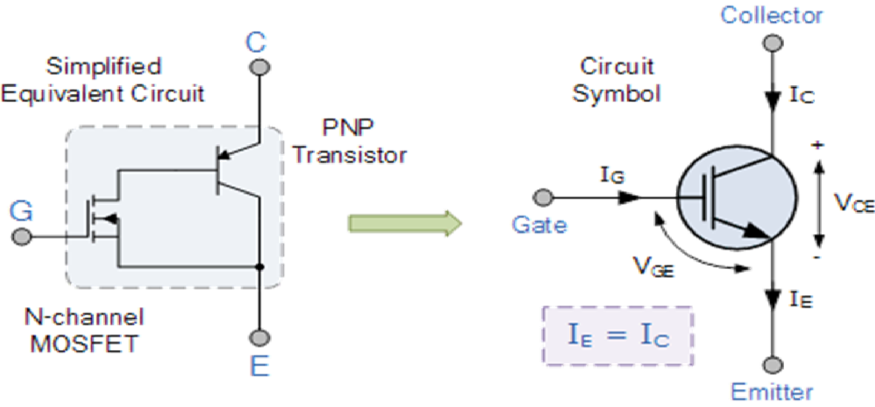
IGBT Equivalent Circuit

Slide 5
IGBT Characteristics Curve
◆ IGBT are classified as
◆ (i) Non Punch Through IGBT (NPT IGBT) or symmetrical IGBT.
◆ (ii) Punch Through IGBT (PT IGBT) or asymmetrical IGBT.
◆ IGBTs having n + buffer layer are termed as Punch Through (PT IGBT)s.
◆ IGBTs not having n + buffer layer in known as Non Punch Through (NPT IGBT)s.
◆ A symmetrical IGBT is one having equal forward and reverse breakdown voltages which are normally used in AC applications.
◆ In the asymmetrical IGBT, the reverse breakdown voltage is less than the forward breakdown voltage which are normally used in DC circuits where the device does not need to provide support in the reverse direction.

Slide 6
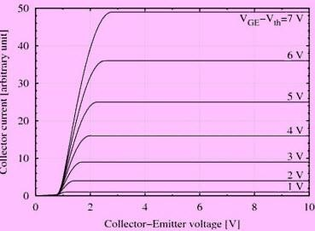
IGBT Characteristics Curve

Slide 7
IGBT – Merits & Demerits
◆ Merits
Voltage controlled device
Less On state loss
High switching frequency
No commutation circuit.
Gate has full control over operation
Flat temperature coefficient.
◆ Demerits:
Static charge problem.
Costlier than BJT and MOSFET.

Slide 8
IGBT – Comparison
Device Characteristic | Power Bipolar | Power MOSFET | IGBT
Voltage Rating | High <1kV | High <1kV | Very High >1kV
Current Rating | High <500A | Low <200A | High >500A
Input Drive | Current, h_{FE} 20-200 | Voltage, V_{GS} 3-10V | Voltage, V_{GE} 4-8V
Input Impedance | Low | High | High
Output Impedance | Low | Medium | Low
Switching Speed | Slow (uS) | Fast (nS) | Medium
Cost | Low | Medium | High

Slide 9
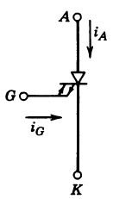
Gate turn-off Thyristor (GTO)
◆ Behave like normal thyristor, but can be turned off using gate signal
◆ However turning off is difficult.
◆ Need very large reverse gate current (normally 1/5 of anode current).
◆ Gate drive design is very difficult due to very large reverse gate current at turn off.
◆ Ratings: Highest power ratings switch:
◆ Voltage: V AK < 5 kV; Current: I A < 5 kA. Frequency < 5 KHz.
◆ Very stiff competition:
Low end-from IGBT. High end from IGCT

Slide 10
Classification - GTO
Asymmetrical GTO:
◆ The Asymmetrical type GTOs are the most common type on the market.
◆ This type of GTOs are normally used with a anti-parallel diode.
◆ They do not have high reverse blocking capability.
◆ They are used in Voltage Fed Converters.
Symmetrical GTO:
◆ The symmetrical type GTOs have an equal forward and reverse blocking capability.
◆ They are used in Current Fed Converters.

Slide 11
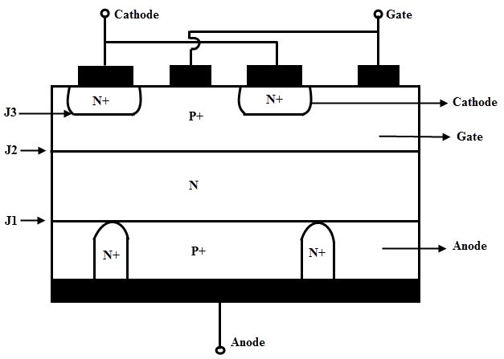
Construction - GTO
◆ Almost similar to SCR.
◆ In this, n + layer at the cathode end is highly doped to obtain high emitter efficiency.
◆ Dur to this, breakdown voltage of the J3 junction is low (20 to 40 V).
◆ The doping level of p type gate is highly graded as trade off between high emitter efficiency (low doping required) good turn off properties (high doping required).

Slide 12
Construction - GTO
◆ Junction between p+ anode and N base is called anode junction.
◆ Heavily doped p+ anode region is required to obtain high efficiency on turn on property.
◆ But turn Off property is affected.
◆ This problem is solved by introducing heavily doped n+ layers at regular intervals in p+
anode layer.
◆ This is called anode shorted GTO structure.
◆ This causes the electrons to travel from base N to anode metal contact directly without causing hole injection from p+ anode.
◆ But reverse blocking capacity of GTO is reduced and speeds up turn Off mechanism.

Slide 13
Working - GTO
◆ The Gate turn off thyristor (GTO) is a four layer PNPN power semiconductor switching device that can be turned on by a short pulse of gate current and can be turned off by a reverse gate pulse.
◆ This reverse gate current amplitude is dependent on the anode current to be turned off.
◆ There is no need for an external commutation circuit to turn it off.
◆ So inverter circuits built by this device are compact and low-cost.
◆ The device is turned on by a positive gate current and it is turned off by a negative gate cathode voltage.

Slide 14
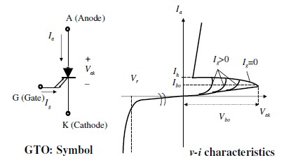
GTO Characteristics Curve

Slide 15
GTO V – I Characteristics:
◆ It is similar to SCR during turn on.
◆ The 1st quadrant characteristics are similar to that of SCR.
◆ Latching current and holding current are considerably higher than SCR.
◆ The gate drive can be removed if anode current is more than the holding current.
◆ It is though not recommended as cathode is subdivided into small finger elements
causing the anode current to go below the holding current hence destroying the device.
◆ GTO is turned off by applying reverse gate current in either ramp or step mode.
◆ The dashed line in the figure shows i-v trajectory during the turn OFF for an inductive load.
◆ dV/dt triggering is avoided by placing a rated resistor between gate and cathode or by
means of a reverse bias voltage.

Slide 16
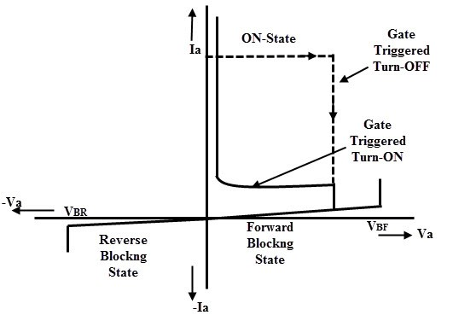
GTO V – I Characteristics:
◆ A symmetric GTO has higher reverse blocking capability than an asymmetric type.
◆ After a small reverse voltage (20 to 30 V) GTO starts conducting in the reverse
direction due to anode short structure.

Slide 17
GTO Turn OFF Current Gain:
◆ The Turn Off Current Gain of a GTO is defined as the ratio of anode current prior to
turn off to the negative gate current required for turn off.
◆ It is typically very low (4 or 5).
◆ It means a 6000A rating GTO requires 1500A gate current pulse.
◆ However, the gate pulse duration and the power loss due to the gate pulse is small.
◆ It can be supplied by low voltage power MOSFETs.
◆ This gate turn off capability is advantageous because it provides increased flexibility in circuit application.
◆ Now it becomes possible to control power in DC circuits without use of elaborated
commutation circuitry.

Slide 18
Summary GTO
◆ Advantages of GTO:
High blocking voltage capabilities.
High over current capabilities during turn off. .
Exhibits low gate currents.
Fast and efficient turn off.
Better static and dynamic dv/dt capabilities.
Enhanced Safe Operating Area during turn off.
◆ Disadvantages:
Magnitude of latching, holding currents is several times more than thyristors.
On state voltage drop and the associated loss is more.
Due to multi cathode structure of GTO, triggering gate current is higher than that required
for normal SCR.
Gate drive circuit losses are more.
Its reverse voltage blocking capability is less than the forward voltage blocking capability.

Slide 19
Summary GTO
◆ Applications of GTO:
Motor drives,
static VAR compensators (SVCs)
AC/DC power supplies with high power ratings.
DC circuit breakers
Induction heating
Low power applications.
DC choppers.

Slide 20
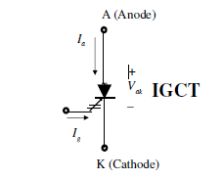
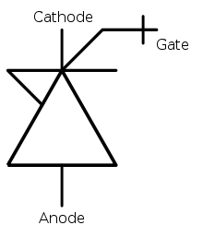
Insulated Gate-Commutated Thyristor (IGCT)
◆ Among the latest Power Switches.
◆ Conducts like normal thyristor (latching), but can be turned off using gate signal,
similar to IGBT turn off; 20 V is sufficient.
◆ Power switch is integrated with the gate-drive unit.
◆ Ratings:
Voltage: V AK < 6.5 kV; Current: I A < 4 kA.
◆ Frequency < 1 KHz. Currently 10kV device is being developed.
◆ Very low on state voltage: 2.7V for 4kA device.

Slide 21
Insulated Gate-Commutated Thyristor (IGCT)
Specifications | GTO | IGCT | IGBT
Full Form | Gate Turn-Off Thyristor | Insulated Gate Commutated Thyristor | Insulated Gate Commutated Thyristor
Advantages | Controlled turn-off ability. Relatively high overload capacity. Series connection possibility. Working frequency of hundreds of Hz. | Controlled turn-off ability. Relatively high overload capacity. Low on-state losses. Working frequency of kHz. Series connection possibility. High cyclic resistance. | Controlled turn-off ability. Minimum working frequency up to 10 kHz. Very low control power.
Disadvantages | Higher on-state losses. High control power. |  | Very high on-state losses. Relatively low cyclic resistance.
Applications | High power drives Static compensators Continuous supply sources Induction heating sources | High power drives Supply inverter sources for DC transmissions Big frequency converters | Choppers Continuous supply sources Statical compensators and active filters Switching sources

Slide 22
References
◆ Chapter 1; Power Electronics and Drives (Version 3-2003). Dr. Zainal Salam, UTM-JB.
◆ Introduction to Power Electronics - A Tutorial, Burak Ozpineci, Power Electronics and Electrical Power Systems Research Center, Oak Ridge National Laboratory, US Dept. of Energy.
◆ http://www.completepowerelectronics.com/
◆ Power Electronics A to Z/POWER SEMICONDUCTOR DEVICES/Comparison of MOSFET with BJT
◆ http://www.rfwireless-world.com/Terminology/GTO-vs-IGCT-vs-IGBT.html

