Slide 1
Polyneuropathies part 2

Slide 3
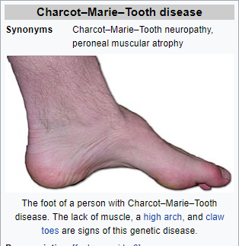
Charcot-marie-tooth disease
Charcot–Marie–Tooth disease (CMT) is one of the hereditary motor and sensory neuropathies.
Slowly progressive distal weakness, foot deformity, areflexia , distal sensory loss.
Upper limb ataxia, tremor, peripheral hypertrophy.
CMT was previously classified as a subtype of muscular dystrophy.
Charcot–Marie–Tooth disease is caused by mutations that cause defects in neuronal proteins.
Most mutations in CMT affect the myelin sheath, but some affect the axon

Slide 4
Alcoholic polyneuropathy:
Alcoholic polyneuropathy (A.K.A alcohol leg) is a neurological disorder in which multiple peripheral nerves throughout the body malfunction simultaneously.
This nerve damage causes an individual to experience pain and motor weakness, first in the feet and hands and then progressing centrally.
Pathophysiology:
Decreased in the level of thiamine / B1 vit decreased metabolism of glucose decreased ATP production decreased neuronal function and growth
In addition, the consumption of alcohol may lead to the build up of certain toxins in the body.
For example, in the process of breaking down alcohol, the body produces acetaldehyde, which can accumulate to toxic levels in alcoholics.
This suggests that there is a possibility ethanol (or its metabolites) may cause alcoholic polyneuropathy
Notes:
Vitamin B1, thiamin, or thiamine, enables the body to use carbohydrates as energy. It is essential for glucose metabolism, and it plays a key role in nerve, muscle, and heart function. Vitamin B1 is a water-soluble vitamin, as are all vitamins of the B complex

Slide 5
Examination/Evaluation
Thorough history taking  Observation of skin colour, integrity, temperature  Presence of pressure points or ulceration?
Strength testing
ROM/flexibility testing
Neurological testing  Reflexes  Sensation  Proprioception
Balance/coordination
Foot wear assessment

Slide 6
HELPFUL diagnosis
Electro diagnostic studies including EMG and NCS remains the most important first tests in diagnosing polyneuropathies.
NCS helps to differentiate between axonal and demyelinating neuropathies.
Sural nerve biopsy for determining the cause of neuropathies.
Biopsy of Cutaneous nerves in skin.
Muscles biopsies.
Lumber puncture.

Slide 7
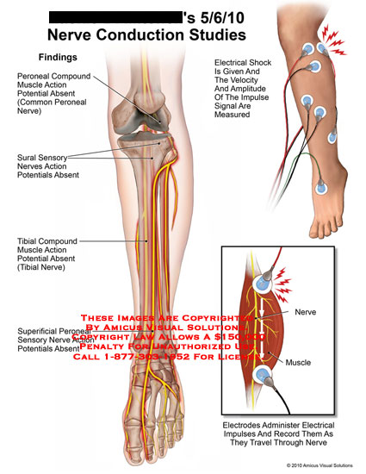

Slide 8
Functional limitations
Patients with peripheral neuropathy face a number of potential functional limitations.
Individual presented with gait limitations and unsteadiness.
If pain is prominent symptoms it affects ADL (activity of daily living).
Night pain → sleep disturbance.

Slide 9
Functional LIMITATION ( Cont..)
Patients hereditary Charcot-Marie-Tooth disease presented with walking restrictions dyspnoea and nocturnal hypoventilation.
Sensory deficits can limits one’s ability to button shirts, to turn a key in a lock, to tie shoelaces, or to type on a computer
Notes:
Nocturnal Hypoventilation Syndrome is related to sleep apnoea, but is due to the brain's respiratory control centre not sending out enough nerve impulses to the breathing muscles

Slide 10
treatment
• The goal of treatment is to manage the underlying condition causing the neuropathy and repair damage, as well as provide symptom relief.
Medical management – Analgesics . – antiepileptic drugs, including gabapentin, phenytoin, and carbamazepine – some classes of antidepressants, including tricyclics such as amitriptyline. – Mexiletine – local anaesthetics such as lidocaine or topical patches containing lidocaine – Codeine/oxycodone
MECHANICAL AIDS
Mechanical aids can help reduce pain and lessen the impact of physical disability. – Hand or foot braces can compensate for muscle weakness or alleviate nerve compression. – Orthopaedic shoes can improve gait disturbances and help prevent foot injuries in people with a loss of pain sensation. • If breathing becomes severely impaired, mechanical ventilation can provide essential life support.

Slide 11
Surgical intervention
can provide immediate relief from mononeuropathies caused by compression or entrapment injuries.
Repair of a slipped disk can reduce pressure on nerves where they emerge from the spinal cord;
the removal of benign or malignant tumours can also alleviate damaging pressure on nerves.
Nerve entrapment often can be corrected by the surgical release of ligaments or tendons.
The most common surgical techniques include external neurolysis, end-to-end repair, nerve grafting, and nerve transfer from somewhere else in the body.
Notes:
Neurolysis may refer to the application of physical agents (heat or freezing) or chemicals (such as phenol, alcohol or glycerol) to a nerve to cause the temporary degeneration of the nerve's fibers in order to interrupt the transmission of nerve signals, usually for pain relief (a neurolytic block). Some authors use the term to denote just chemical neurolytic blocks, and use neurotomy to refer to neurolytic block by heat or freezing
In peripheral nerve surgery neurolysis is the process of 'releasing the nerve from its neuroma [or mass of disconnected, regenerating nerve tissue] and surrounding scar tissue

Slide 12
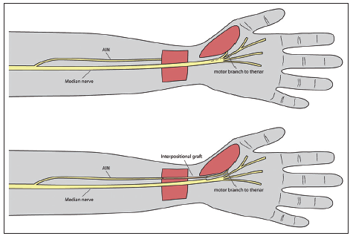

Slide 13
physical therapy intervention
 Aerobic conditioning
 Progressive flexibility/stretching exercises
 Progressive strengthening exercises
 Balance/coordination
 Gait training
 Alternative :
i) Vibrating insoles
ii) Tai Chi
Notes:
Tai chi, short for T'ai chi ch'üan or Tàijí quán, is an internal Chinese martial art practiced for both its defense training, its health benefits and meditation

Slide 14
rehabilitation
Physical therapy may be recommended to improve mobility, muscle strength, and balance.
Gait training may consists of balance exercise and use of assistive devices.
Physical therapist can review falls precautions e.g. using a chair in shower
Monitoring of skin to prevent breakdown when a brace use is critical.
Customs shoes with extra depth and width may be beneficial.
Occupational therapy to maximize the function of hands and arms.
If pain is an issue therapeutic modalities may be used to alleviate the pain such as TENS.
If sensations are compromised caution the patients not to use heat or ice.

Slide 16
Strength training

Slide 17
Flexibility exercises

Slide 18
Think Discuss Understand

