Slide 1
Planning, Writing & Completing Analytical Reports

Slide 2
Analytical Reports
Analytical Reporting is the type of business reporting that is used to make decisions. Analytical reports offer both information and analysis, but they also include recommendations. Offering recommendations is the biggest difference between informational and analytical reporting.

Slide 3
Benefits :
Quick Access and easy to understand Data
Better Understanding of Operational & Business Activities
Data visualization enables users to view & understand large amounts of information regarding operational and business conditions.
One of the greatest Advantage of data visualization is it brings triable insights to the surface. Unlike one-dimensional tables and charts that can only be viewed, data visualization tools enable users to interact with data.

Slide 4
Analytical reports use data to power decision making
An analyst reviews data, considers its meaning and makes suggestions based on his interpretation.
But that’s a pretty boring definition. In practice, analytical reports are an incredible tool that guide important decisions made by many of the biggest organizations in the world.
They use powerful data visualizations and give us insights into the way the world works. Insights that we probably wouldn’t get anywhere else.

Slide 5
They take our data from boring to fascinating. They put our data into action.
They’re also a big part of almost every important decision you can think of.
Is the president deciding to invade a country? He’ll definitely be looking at analytical repots.
Deciding which features to put in the new iPhone? That’ll be analytical reports galore.
Developing a new cancer drug? Analytical reports will be a major part of your decision making.

Slide 6
An analytical report is a type of a business report that uses qualitative and quantitative company data to analyze as well as evaluate a business strategy or process, while empowering employees to make data-driven decisions based on evidence and analytics.
While analytical reporting is based on statistics, historical data and can deliver predictive analysis of a specific issue, its usage is also spread in analyzing current data in a wide range of industries.

Slide 7
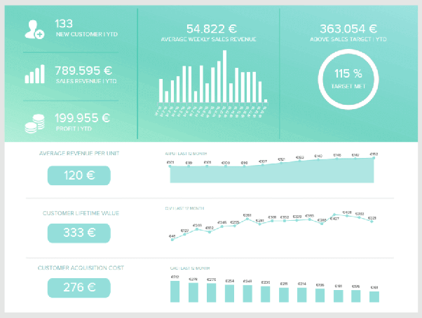

Slide 8
For the analytical report:
Step 1: Analyze the issue.
Step 2: Gather information.
Step 3: Analyze data.
Step 4: Draw conclusions.
Step 5: Make Recommendations.

Slide 9
Formatting the Report
While analytical reports may vary slightly based on need and audience, they often share common elements: a title page, a table of contents, an introduction, a methodology section, body sections, conclusions and recommendations, a bibliography, and an appendices section. Each section is noted by a heading, and subheadings are utilized when necessary. Page numbers are also attributed to each page, either centered or right-side aligned on the bottom of the page.

Slide 10
Gathering Information
Writing analytical reports goes beyond descriptive writing toward synthesis and critique. To achieve this end, begin by collecting data and gathering resources. The research process should produce sufficient information that you feel comfortable with all aspects of concept: the pros and cons, counter-arguments, and proposals. Quality research will enable you to analyze the information and put forth quality recommendations and solutions to problems. Research should be compiled from high-quality, industry-relevant sources.

Slide 11
Organizing, Analyzing, Synthesizing
After collecting the appropriate research, synthesize the information. Synthesis involves critiquing a source’s argument, validity or methodology based on your own research and findings in an effort to present new information, draw conclusions, or present findings. Report information accurately and in context. Synthesized research should result in clear and logical findings, with recommendations if called for. In this stage, you should also determine how to organize and present the information: chronologically, geographically, spatially, categorically, or by importance or comparison.

Slide 12
Conclusions and Recommendations
Once the data is collected, the information is processed, and conclusions have been drawn, the composition process begins. While the bulk of the report will present and analyze your findings, most reports focus on one of three elements: conclusions, an argument's logic, or recommendations. For example, a mining geologist's field report analyzing drill-hole data will most likely focus on recommendations regarding the material available to be mined. The audience determines the degree of formality in language and tone. Technical jargon should be avoided when a report is issued beyond technical support personnel. The information should be presented using simple sentences with clear, common language.

Slide 13
What Should be in a Basic Analytical Report?
An analytical report must be complete so that its usage can be maximized. More so, a comprehensive analytical report can impact businesses and other entities on a bigger scale. If you want to have an analytical report that is complete with all the details included in it, here are some of the information that you should not forget to include in the formal report document:
A title page which includes the main purpose of the analytical report or the topic as to which the report will revolve.
The table of contents arranged based on the chronological and/or logical order of discussion.
A clause where the methods used for the activity are specified and presented accordingly.

Slide 14
The main discussion of the analytical report broken down into actual and specific sections varying on the scope of the undertaking, which includes:
The heading of the particular discussion.
A sub-heading for a more defined topic presentation.
The body of the discussion.
The conclusions based on the gathered information and results showcased in the analytical report.

Slide 15
The recommendations should be given by the person who made the report varying on the conclusions identified.
Sections for appendices and bibliography, especially when requested or is necessary.

Slide 16
Tips in Analytical Report Development
For you to develop a great analytical report, there are some things that you need to be aware of. Some tips can make the entire process of analytical report development easier, faster, and more efficient. A few of the tips that we are sure can be useful when making an analytical report are as follows:
Always refer to information that is of quality. You have to ensure that you have a strong foundation so that your analytical report will not look weak during presentation and assessment. You can do this be using sources that are related to the industry where your business belongs.

Slide 17
Make sure that the process of your research can help you have the needed information for you to specify concepts and other parts of the discussion in a precise and fact-based manner.
Ensure that the research that you will refer to are done by professionals who have already provided an impact on your field of expertise.
Use references or report examples while conducting an analytical report. Be keen when selecting the samples and templates that you will use as guides as these documents can influence the development process of your own analytical report.

Slide 18
Direct Approach

Slide 24
The man killed the boy with stick

