Slide 1
Planning Reports-Applying Three Step Writing Process to Business Reports

Slide 2
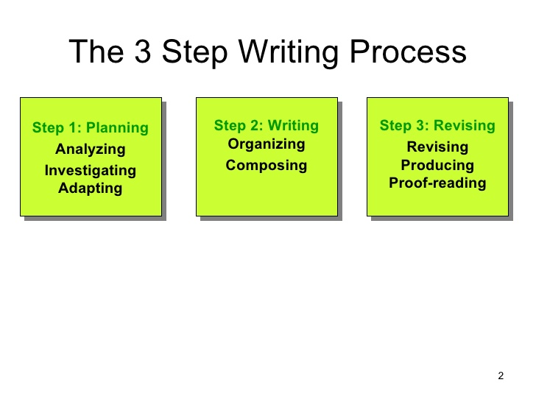

Slide 3
1. Planning
The first step is PLANING. Planning is one of the most important step in writing business messages out of the three-step process and also the longest step. A lot of people out there things that writing is the most important when it comes to writing a message but that’s not true nor correct. Planning is just as important and a well-written message requires a lot of planning. When planning a business message there are four basic steps you need to follow:

Slide 4
1) Analyze the Situation- Defining you purpose and developing an audience profile. Knowing what your audience needs.
2) Gather Information- Determine your audience needs and obtain the information necessary to satisfy those needs.
3) Selecting the Right Medium- Selecting the best medium (oral, written, visual, or electronic) for delivering your message.
4) Organize the Information- Define your main idea, limit your scope, select a direct or an indirect approach, and outline your content.

Slide 5
2. Writing
The second step in the three-step writing process is the actual WRITING. The actual writing as you can see comes after the planning which makes it the second most important part of writing a business message. When writing a business message the most important thing to keep in mind is whom you are writing the message to. And when writing the message there is only two things you have to keep in mind in mind:

Slide 6
1) Adapt to your Audience- Be sensitive to audience needs by using a “you” attitude, politeness, positive emphasis, and unbiased language. Build a strong relationship with your audience by establishing your credibility and projection your company’s preferred image. Control your style with a conversational tone, plain English, and appropriate voice.
2) Compose the Message- Choose strong words that will help you create effective sentence and coherent paragraphs.

Slide 7
3. Completing
The third and final process in the three-step process for writing a business message is COMPLETING. Completing a written message is a very important process in writing a message and also requires a lot of work. When you complete a message there are four major things you need to keep in mind to do after you complete the message. Theses steps are:

Slide 8
1) Revise the Message- People often skip this step when it come to writing a message due to their high confidence in themselves that they are good writers. Everyone should always revise his or her written work. By revising the writer will see his or her mistakes and make the necessary corrections they need to make. When revising your message you must evaluate content and review readability, edit and rewrite for conciseness and clarity.
2) Produce the Message- In this area you want to make sure you use an effective design elements and suitable layout for a clean, professional appearance for your audience.
3) Proofread the Message- This is where you check your message for any errors in layouts, spelling, grammar, and mechanics before distributing it to your audience.

Slide 9
4) Distribute the Message- This is forth and final and most important step in the three-step process business message writing. When distributing the message you want to make sure you deliver your message using the chosen medium (oral, written, visual, or electronic) you also want to make sure that all your documents and relevant files are in the correct format and are distributed to your audience successfully.

