Slide 1
p e r c e p t i o n

Slide 2
After studying this module, you should be able to:
O B J E C T I V E S
understand how two people can see the same thing and interpret it differently
describe how shortcuts can assist in or distort our judgment of others
Perception: implications for managers
L E A R N I N G

Slide 3
What Is Perception, and Why Is It Important?
Perception
A process by which individuals organize and interpret their sensory impressions in order to give meaning to their environment.
People’s behavior is based on their perception of what reality is, not on reality itself.
Human mind assembles, organizes and categorizes information

Slide 4
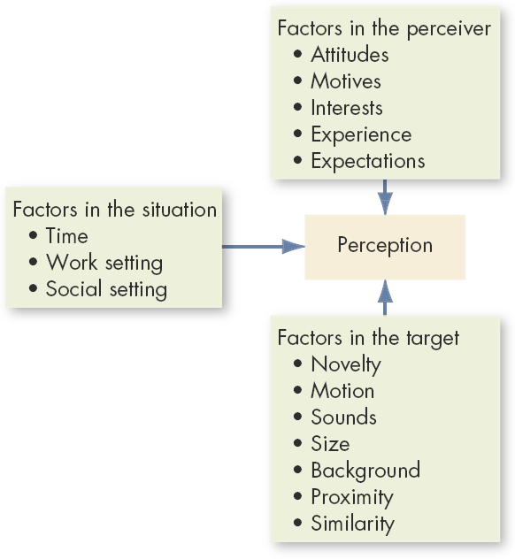
Factors That Influence Perception
All these factors will be discussed in the subsequently

Slide 5
Perception process: 6 Steps
Stimuli
Organising (or Receiving Stimuli)
Selective Attention (or Selecting Stimuli)
Perceptual Organisation
Interpreting
Response

Slide 6
1. Stimuli
We live in the world of objects, therefore we are constantly bombarded with stimuli
We are often subject to the influence of stimuli
Stimuli can be external and internal
External: sound waves, light waves, mechanical energy or pressure, and chemical energy from objects that we can smell and taste
Internal: energy generated by muscles, food passing through the digestive system, and glands secreting behavior-influencing hormones

Slide 7
2. Organising (or Receiving Stimuli)
Stimuli enter in our organism through sensory organs: vision, hearing, smell, touch, taste and kinaesthetics
In other words – stimuli are received by us through these organs
Sensory organs perceive not only physical objects but also the events or the objects that have been repressed

Slide 8
3. Selective Attention (or Selecting Stimuli)
Not all the stimuli received by the human organism are accepted by it
Some stimuli are noticed and some are screened out
➢
❖
Example:
A nurse working in a post-operative care might ignore the smell of recently disinfected instruments or the sound of coworkers talking nearby, but she would immediately notice the flashing red light bulb on the nurse station console.
Boy happily studying with full concentration even while the TV is on
❖
The process of filtering information received by or sense is called selective attention (or selecting stimuli)
Several factors influence selective attention; some of these factors are external and other are internal to our body
Lets discuss some of these external factors

Slide 9
Quick snap-shot of external factors:
o o o o o o o o
Nature Location Colour Size Contrast Movement Repetition
Novelty and familiarity

Slide 10
3. Selective Attention (or Selecting Stimuli)
Not all the stimuli received by the human organism are accepted by it
Some stimuli are noticed and some are screened out
➢
❖
Example:
A nurse working in a post-operative care might ignore the smell of recently disinfected instruments or the sound of coworkers talking nearby, but she would immediately notice the flashing red light bulb on the nurse station console.
Boy happily studying with full concentration even while the TV is on
❖
The process of filtering information received by or sense is called selective attention (or selecting stimuli)
Several factors influence selective attention; some of these factors are external and other are internal to our body
Lets discuss some of these internal factors

Slide 11
Quick snap-shot of internal factors:
o o o o o o
Learning Needs
Age difference Interest Ambivalence Paranoid perception

Slide 12
Quick snap-shot of internal factors:
Learning: is a cognitive factor, has considerable influence on perception. It creates expectancy in people, and expectancy makes him see what he wants to see.
Needs: needs play a significant role in perceptual selectivity. Usual things often look real because of deprived needs. E.g. a thirsty person in desert gets illusion of water.
Age difference: young ones take cycling as fun, whereas older may take it as helpful cardiovascular exercise

Slide 13
4. Perceptual Organization
Perceptual organization is the process by which people group stimuli into recognizable patterns
➢
❖
❖
Example:
What mental picture do you have for a wooden object with 4 legs?
When people actually see the above wooden object having these characteristics, they are able to organize information into meaningful whole and recognize the object to be a chair
Following factors help understand the perceptual organization:
Ambiguous figures
Figure background
Perceptual grouping (including: similarity, closure, continuity and area)
Perceptual constancy

Slide 14
5. Interpreting
After data has been received and organised, the perceiver interprets or assigns meaning to the information.
In fact, perception is said to have taken place only after the data have been interpreted

Slide 15
Perception: Implications for Managers
Helps understand the difference between perceived world and real world
Plays decisive role in employee hiring
Key role in performance appraisal
Helps determine loyalty of employees
Treating employees under Theory Y
Individual decision making

Slide 16
Managing Perceptual Process

Have a high level of self-awareness: Individual needs, experience, and expectations can all affect perceptions. The successful manager knows this and is able to identify when he or she is inappropriately distorting a situation because of such perceptual tendencies.

Seek information from various sources to confirm or disconfirm personal impressions of a decision situation: The successful manager minimizes the biases of personal perceptions by seeking out the viewpoints of others. These insights are used to gain additional perspective on situations and the problems or opportunities they represent.

Slide 17
Managing Perceptual Process
» Be empathetic-that is, be able to see a situation as it is perceived by other people: Different people will define the same situation somewhat differently. The successful manager rises above personal impressions to understand problems as seen by other people.
»
Influence perceptions of other people when they are drawing incorrect or incomplete impressions of events in the work setting: People act in terms of their perceptions. The successful manager is able to influence the perceptions of others so that work events and situations are interpreted as accurately as possible and to the advantage of all concerned.

Slide 18
Managing Perceptual Process
» Avoid common perceptual distortions that bias our views of people and situations: These distortions include the use of stereotypes and halo effects, as well as selective perception and projection. Successful managers are self-disciplined and sufficiently self-aware so that the adverse impacts of these distortions are minimized.
»
Avoid inappropriate attributions: Everyone has a tendency to try and explain why events happened the way they did or why people behaved as they did. The successful manager is careful to establish the real reasons why things happen and avoid quick or inappropriate attributions of casualty.

Slide 19
Managing Perceptual Process
» Diversity management programmes: As firms globalize themselves, diversity management assumes greater relevance. The challenge for corporate executives is to leverage the benefits of this diversity while minimizing the perceptual and behavioral problems that tend to accompany heterogeneity. OB experts have designed diversity management programmes. Typically, these training programmes serve two purposes. First, they communicate the value of diversity. Second, these programmes help participants become aware of their personal biases and give them more accurate information about people with different backgrounds, thus avoiding perceptual distortions.
» Know yourself: Apply the Johari window to know the real self. A powerful way to minimize perceptual biases is to know and become more aware of one’s values, beliefs, and prejudice.

Slide 20
Thank you

