Slide 2
Project Management
Zaighum Abbas MS (Project Management)
SZABIST Islamabad
MS (Management Sciences)
COMSATS University Islamabad (Attock campus)

Slide 3
Project
Project is a temporary endavor which produce unique product, service or result
Unique ( Attributes)
Endavor (Effort)
Temorary= start and end or time
Product, Service ,or Result

Slide 4
Projects

Slide 5
Mangement
Plan
Organise
Lead
Control (Monitoring and Control)

Slide 6
Project Management
Project management is the application of knowledge, skills, tools, and techniques to project activities to meet the project requirements.
Knowledge ( Project Management knowledge areas, process groups and processes)
Skills ( Interpersonal skills, Leadership skills, communication skills, team management skills, stakeholder management skills, Networking skills)
Tools and Techniques ( meetings with stakeholders, expert judgments, Alternative identification, Decomposition )

Slide 7
Operations
Operations are concerned with on going production of products and services.
Operations continue efficiently by using the optimal resources needed to meet customer demands.

Slide 8
PMI & PMP
PMI
American Inst (Project Management Institute)
Generally recognized Good practices (compile in book called PMBOK)
Standard of Project Mangament
PMP ( certification)

Slide 9
PMP Certified Forecasted Demand

Slide 10
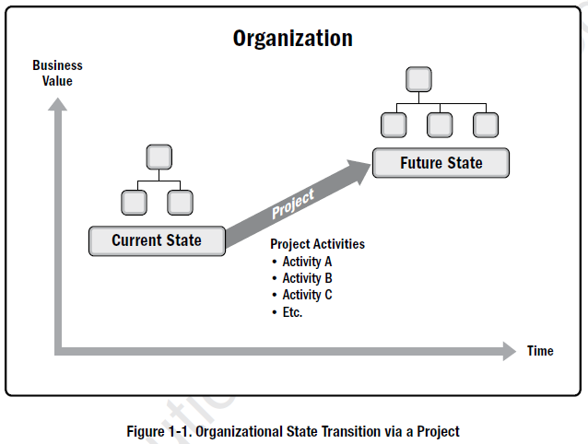
Purpose of Project Management
Drive Change
Business Value addition for stakeholder
Tangible (Monetary, Share value, New Product)
Intangible ( Goodwill, Brand recognition, Reputation )

Slide 11
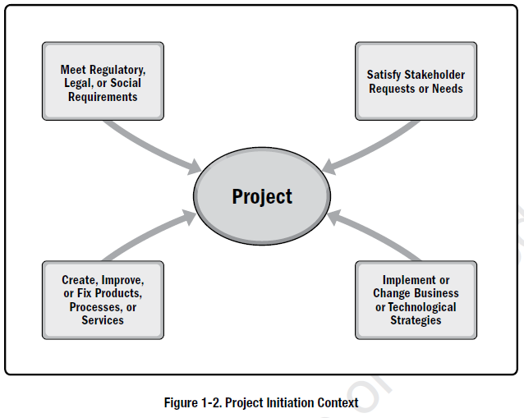
Project Management Initiation

Slide 12
Real Life Organization Need for Project Management
Technological Advancement | Business Process Improvement
Competitive Forces | Strategic Opportunity
Raw Material Issues | Business Need
Political Change | Social Need
Market Demand | Environmental Consideration
Economic Change | Security Need
Customer Request | Legal Requirement
Stakeholders Demand | Organizational Transformation

Slide 13
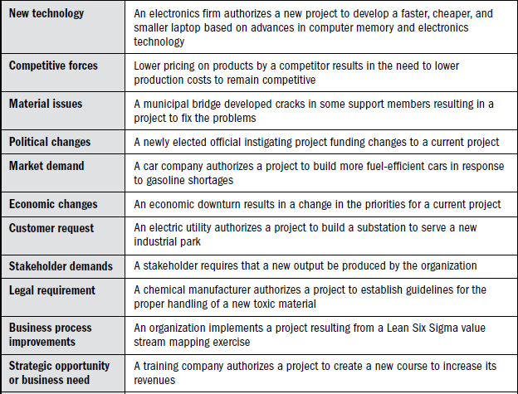

Slide 14
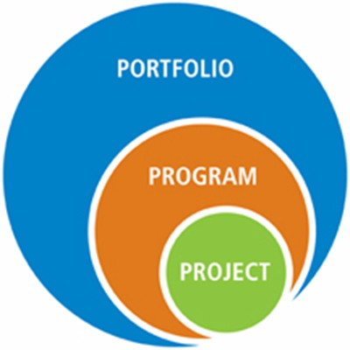

Slide 15
Strategic Management & PM
Project in Allign with your organizational strategy
Portfolio
Program
Project
Portfolio management aligns portfolios with organizational strategies by selecting the right programs or projects, prioritizing the work, and providing the needed resources.
Program management harmonizes its program components and controls interdependencies in order to realize
Project management enables the achievement of organizational goals and objectives.

Slide 16
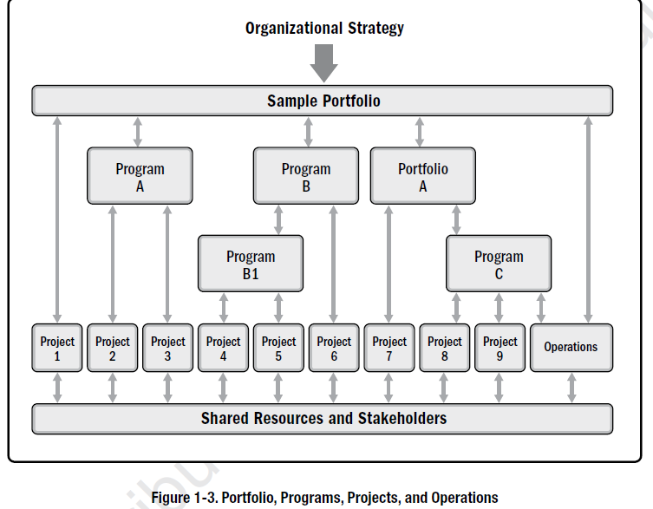
Source: PMBOK 6th Edition

Slide 17
Organizational Project Management
Source: PMBOK 6th Edition

Slide 18
Project Selection Criteria
These financial measures may include but are not limited to:
Net present value (NPV)
Return on investment (ROI)
Internal rate of return (IRR)
Payback period (PBP)
Benefit-cost ratio (BCR)
Corporate Social Responsibility ( CSR)
Social wellbeing

Slide 19
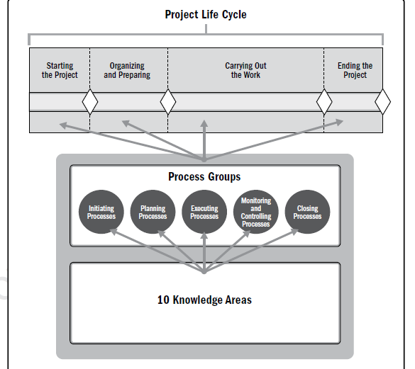

Slide 20
Project Lifecycle
A project life cycle is the series of phases that a project passes through from its start to its completion.
CONSTRUCTION
PL
PHARMA
PL
IT PL
Requirement Gathering
Analysis
Design
Development
Testing
Feasibility
Planning & Design
Production
Turnover
Discovery
Screening
Pre Clinical Development
Registration workup
Post Submission Activities

Slide 21
Project Management Process Groups
Initiation
Planning
Execution
Monitoring and control
Closing

Slide 22
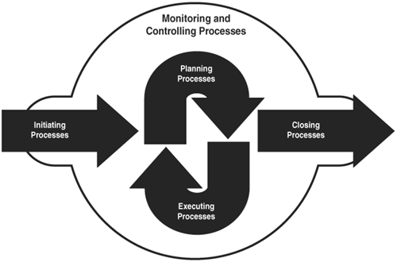

Slide 23
Initiation
The initiation process group consist of those processes which are performed to define a new project or new phase of existing project by obtaining authorization to start the project or phase.
Key Elements
Project Charter
Stakeholder Register

Slide 24
Planning
Planning process consists of those processes which performed to establish the total scope of the effort, define objectives and develop the course of actions required to attain those objectives.
Key Elements
Project management plan
Scope management plan
Requirements management plan
Schedule management plan
Cost management plan
Quality management plan
Resources management plan
Communication management plan cont.……………
8. Risk management plan
Procurement management Plan
Stakeholders management plan
Integration management plan
Change management plan
Configuration management plan

Slide 25
Planning
Key Elements
Baselines
Scope baselines (scope statement +WBS+WBS Dictionary)
Schedule baselines
Cost baselines
Registers
Lesson learned register
Risk Register
Stakeholder Register

Slide 26
Execution (Direct & Manage Work)
This process of leading and performing the work defined in the project management plan and implement the approved changes to achieve the project objectives.
Key Elements
It provides overall management of the project work and deliverables, thus improving the probability of project success.
Work performance Data
Change request
Issue log

Slide 27
Monitoring and Control
Monitor and Control Project Work is the process of tracking, reviewing, and reporting the overall progress to meet
the performance objectives defined in the project management plan.
Key Elements
This process is performed throughout the project.
Work performance information
Change request (Corrective action, preventive action, correction)
Data Analysis ( Cost benefit analysis, Earned value analysis, Variance analysis, Root cause analysis, Trend analysis, Alternative analysis)

Slide 28
Closing
Close Project or Phase is the process of finalizing all activities for the project, phase, or contract.
Key Elements
This process is performed once or at predefined points in the project.
Final updated Project documents.
Final product, service, or results transition.
Closure of agreements.
Release of resources.

Slide 29
Reasons For Project Closure
The project’s objectives have been achieved;
The objectives will not or cannot be met;
Funding is exhausted or no longer available for allocation to the project;
The need for the project no longer exists (e.g., the customer no longer wants the project completed, a change in strategy or priority ends the project, the organizational management provides direction to end the project)
Resources (HR, raw material)are no more available.
The project is terminated for legal cause or convenience.

Slide 30
Successful VS Unsuccessful Projects Management
Successful Project Management | Unsuccessful Project Management
Meet business objectives | Absence of management
Satisfy stakeholder expectations | Missed deadlines
Deliver the right products at the right time | Cost overruns
Resolve problems and issues | Poor quality
Respond to risks in a timely manner | Rework
Optimize the use of organizational resources | Uncontrolled expansion of the project
Balance the influence of constraints on the project | Loss of reputation for the organization
Manage change in a better manner | Unsatisfied stakeholders

Slide 31
Constraint

Slide 32
PROJECT MANAGEMENT KNOWLEDGE AREAS
Project Integration Management | Project Resource Management
Project Scope Management | Project Communications Management
Project Schedule Management | Project Risk Management ?
Project Cost Management | Project Procurement Management
Project Quality Management | Project Stakeholder Management

