Slide 1
Programming Fundamentals
Lecture 12
Dr. Fazal-e-Malik
Assistant Professor , Computer Science Department,
Iqra National University, Peshawar.

Slide 2
Today’s lecture outline
Sorting techniques – a program
2 Dimensional Array
Initializing 2 Dimensional array
Memory map of 2-D array

Slide 3
Sorting program
Sorting means arranging element of array in ascending or descending order
After arranging array elements in ascending order
After arranging array elements in descending order
0
1
2
3
4
5
24
34
12
44
56
17
500
504
508
512
516
520
0
1
2
3
4
5
12
17
24
34
44
56
500
504
508
512
516
520
0
1
2
3
4
5
56
44
34
24
17
12
500
504
508
512
516
520

Slide 4
Sorting techniques
Selection sort
Bubble sort
Insertion sort

Slide 5
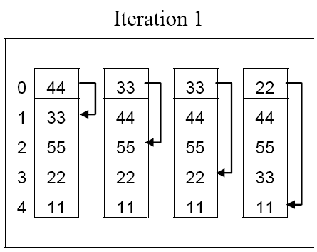
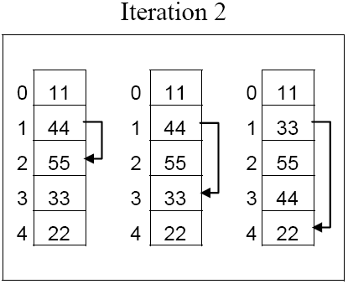
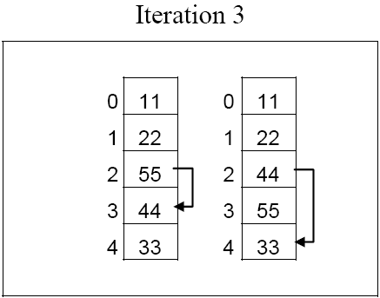
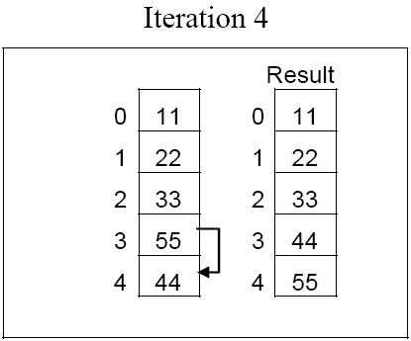
Selection sort

Slide 6
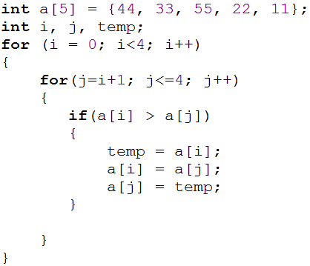
C program – Selection sort
0
1
2
3
4
44
33
55
22
11
i = 0
j = 1
if ( 44 > 33)
true
0
1
2
3
4
33
44
55
22
11
j = 2
if ( 33 > 55)
false
j = 3
if ( 33 > 22)
true
0
1
2
3
4
22
44
55
33
11
j = 4
if ( 22 > 11)
true
0
1
2
3
4
11
44
55
33
22

Slide 7
Cont.
0
1
2
3
4
11
44
55
33
22
i = 1
j = 2
if ( 44 > 55)
false
j = 3
if ( 44 > 33)
true
0
1
2
3
4
11
33
55
44
22
j = 4
if ( 33 > 22)
true
0
1
2
3
4
11
22
55
44
33

Slide 8
Cont..
0
1
2
3
4
11
22
55
44
33
i = 2
j = 3
if ( 55> 44)
true
0
1
2
3
4
11
22
44
55
33
j = 4
if ( 44 > 33)
true
0
1
2
3
4
11
22
33
55
44

Slide 9
Cont…
0
1
2
3
4
11
22
33
55
44
i = 3
j = 4
if ( 55 > 44)
true
0
1
2
3
4
11
22
33
44
55
Go to program

Slide 10
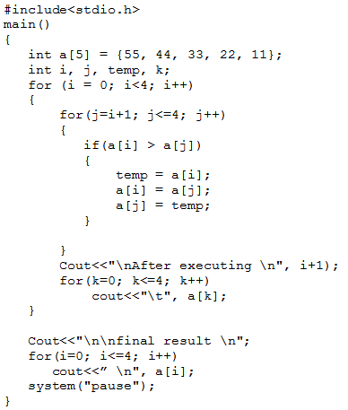
Program

Slide 11
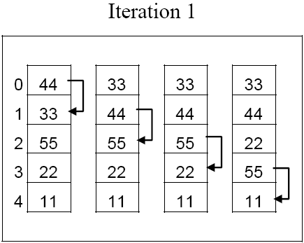
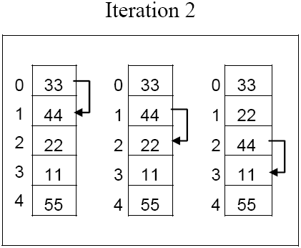
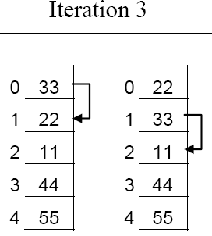
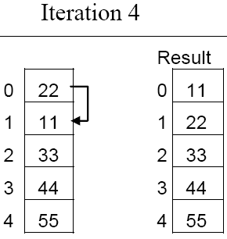
Bubble sort

Slide 12
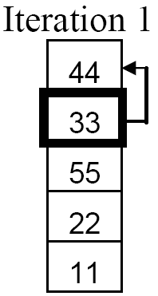
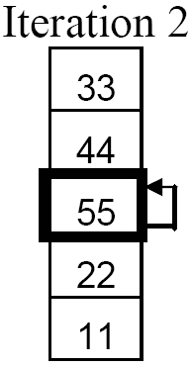
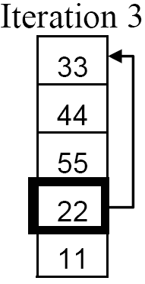
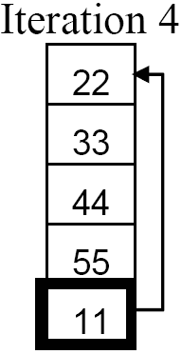
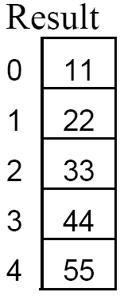
Insertion sort

Slide 13
Two Dimensional Arrays
It is also possible for arrays to have two or more dimensions
For example you want to input roll no and mark of 4 students.
Since we know 1D array, so for this problem we can have two 1D array
One for roll number
Second for marks
One 2D array can be used to store these values

Slide 14
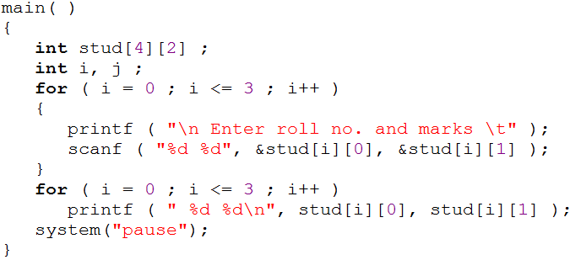
Example program
row
column
Cout<<“\n Enter roll no. and marks \t ” ;
Cin>stud[i][0] , stud[i][1] ;
Cout<<“\n”,stud[i][0] , stud[i][1] ;
0
1
0
10
85
1
12
65
stud[3][1]
stud[2][1]
stud[0][1]
stud[2][0]
stud[1][1]
stud[3][0]
stud[0][0]
stud[1][0]
2
13
89
3
14
92
Go to program
Roll Number
Marks

Slide 15
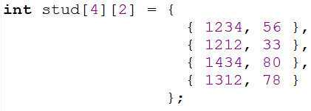
Initializing a 2-Dimensional Array

Slide 16
Example program
Write a program that adds two 4 x 4 matrices.
3 | 5 | 6 | 1
5 | 3 | 2 | 9
1 | 0 | -3 | 4
7 | 2 | 3 | -9
4 | 2 | -7 | 0
5 | 7 | 3 | 1
6 | 3 | -1 | 0
8 | 9 | -2 | 3
7 | 7 | -1 | 1
10 | 10 | 5 | 10
7 | 3 | -4 | 4
15 | 11 | 1 | -6
+
=
Write a program

Slide 17
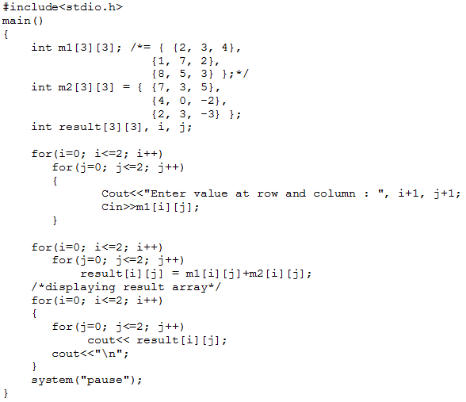
Program

Slide 18
Initializing a 2-Dimensional Array

Slide 19
Memory map of 2D array
Remember student array int s[4][2];
But actually memory allocated is continuous
0
1
0
10
85
1
12
65
2
13
89
3
14
92
s[0][0]
s[0][1]
s[1][0]
s[1][1]
s[2][0]
s[2][1]
s[3][0]
s[3][1]
10
85
12
65
13
89
14
92

