Slide 1
Programming Fundamentals
Lecture 10
Dr. Fazal-e-Malik
Assistant Professor , Computer Science Department,
Iqra National University, Peshawar.

Slide 2
Previous lecture
for loop
break statement
continue statement
do while loop

Slide 3
Today’s lecture outline
Example program – nested loop
break and continue statement
case control structure

Slide 4
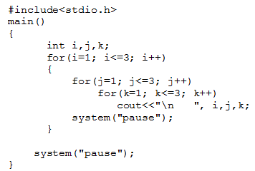
Example program
Write a program to generate all combinations of 1, 2 and 3 using for loop.
i
j
k
1 1 1
1 1 2
1 1 3
1 2 1
1 2 2
1 2 3
1 3 1
1 3 2
1 3 3
2 1 1
2 1 2
2 1 3
2 2 1
2 2 2
2 2 3
2 3 1
2 3 2
2 3 3
3 1 1
3 1 2
3 1 3
3 2 1
3 2 2
3 2 3
3 3 1
3 3 2
3 3 3

Slide 6
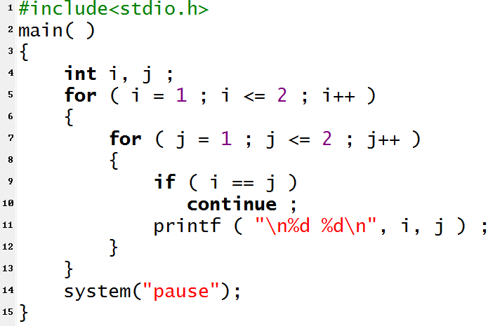
continue statement
cout<<“\n \n”,I,j;

Slide 7
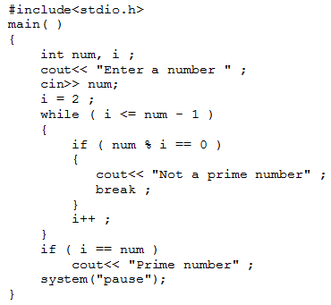
break statement

Slide 8
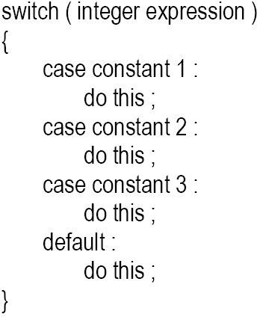
Case control structure
The control statement that allows us to make a decision from the number of choices is called a switch

Slide 9
Sequence of execution
First, the integer expression following the keyword switch is evaluated
The value it gives is then matched, one by one, against the constant values that follow the case statements
When a match is found, the program executes the statements following that case
and all subsequent case and default statements as well
If no match is found with any of the case statements, only the statements following the default are executed

Slide 10
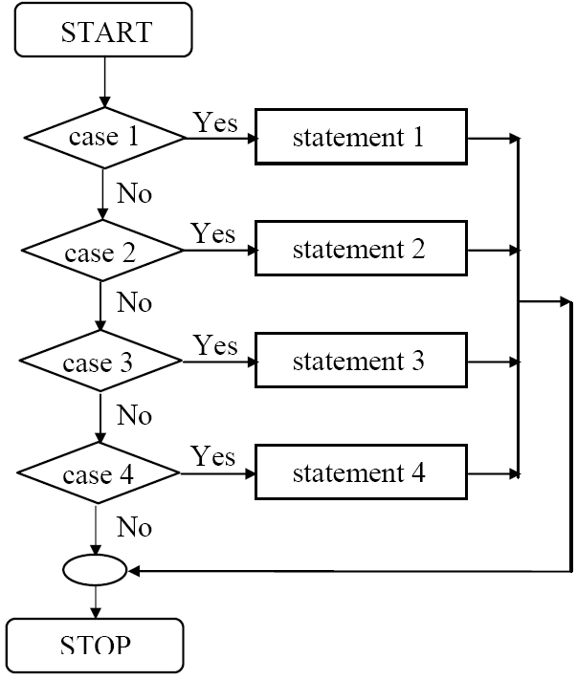
Flowchart – case control structure

Slide 11
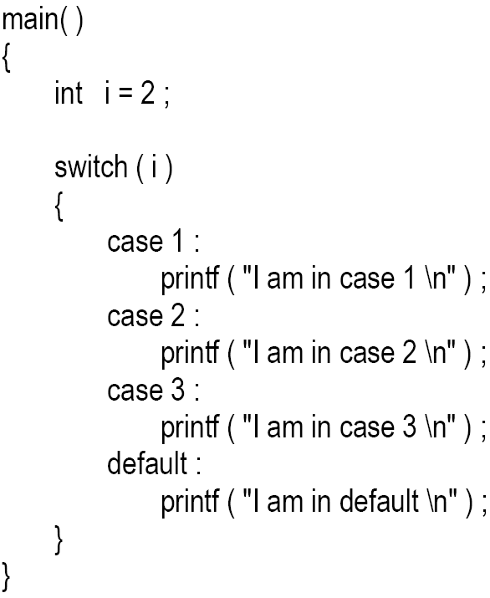
C code – case control structure
switch(2)
cout<<“I am in case 1\n”;
cout<<“I am in case 2\n”;
cout<<“I am in case 3\n”;
cout<<“I am in case 4\n”;

Slide 12
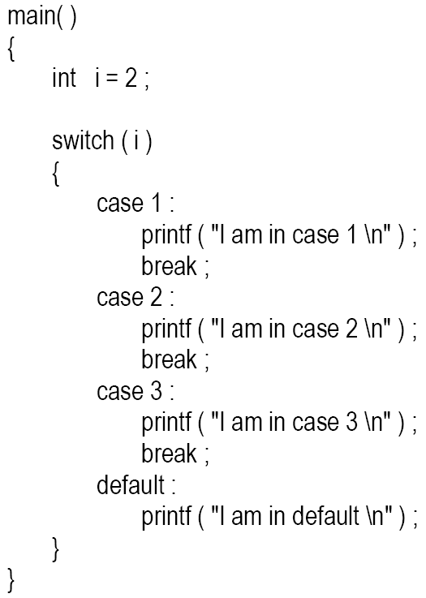
Cont.
cout<<“I am in case 1\n”;
cout<<“I am in case 2\n”;
cout<<“I am in case 3\n”;
cout<<“I am in default\n”;

Slide 13
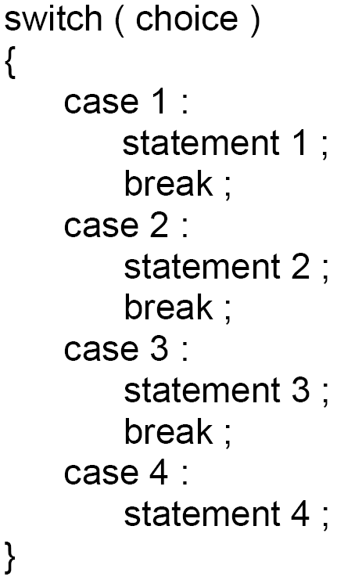
Flow chart vs C code

Slide 14
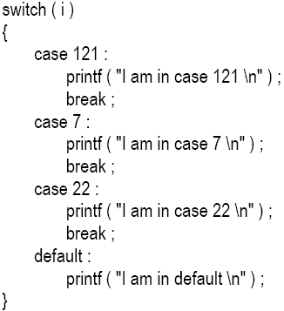
Tips and traps
case can be used in any order
cout<<
cout<<
cout<<
cout<<

Slide 15
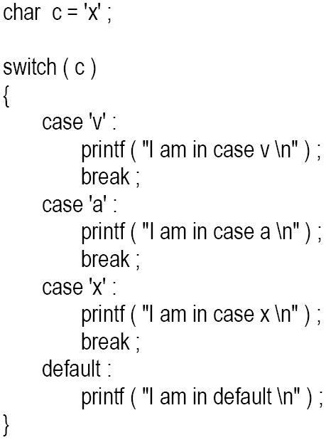
Cont.
You are also allowed to use char values in case and switch
cout<<
cout<<
cout<<
cout<<

Slide 16
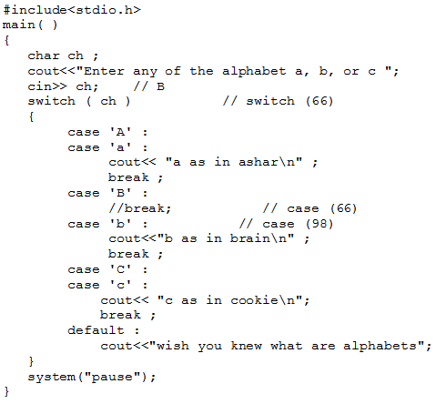
Cont.
At times we may want to execute a common set of statements for multiple cases

Slide 17
Cont.
Even if there are multiple statements to be executed in each case there is no need to enclose them within a pair of braces
It is possible to have a switch without a default case
float is not allowed in case statement
e.g. case 5.5:

Slide 18
Cont.
The break statement in a switch takes the control outside the switch
However, use of continue will not take the control to the beginning of switch
Switch can be nested
The switch statement is very useful while writing menu driven programs

Slide 19
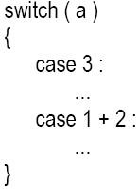
switch Versus if-else Ladder
A float expression cannot be tested using a switch
Cases can never have variable expressions (for example it is wrong to say case a +3 : )
Multiple cases cannot use same expressions. Thus the following switch is illegal:

Slide 20
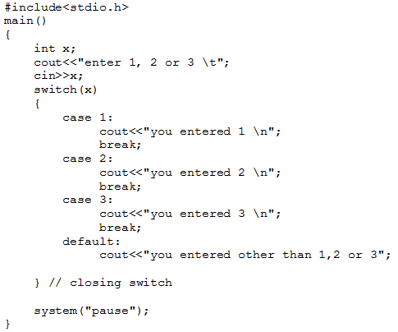
Example program
Write a program to determine that the input integer is 1, 2, 3 or other than 1, 2 or 3 using switch case statement

