Slide 1
Programming Fundamentals
Lecture 06
Dr. Fazal-e-Malik
Assistant Professor , Computer Science Department,
Iqra National University, Peshawar.

Slide 2
Previous lecture
C++ character set
Basic constants and variables
Output function – cout
Input function – cin
C++ instructions
Integer to float conversion
Hierarchy of operator
Control instructions

Slide 3
Today’s Lecture outline
Example programs – cout<<, cin>>
Decision control structure
Relational operator in C++
if statement
if-else statement
Nested if else statement
Logical operator in C++

Slide 4
Example program 1
Ahmad’s basic salary is input through the keyboard. His dearness allowance is 40% of basic salary and house rent is 20% of basic salary. Write a program to calculate his gross salary and display on screen
Inputs:
Processing:
Output:
basic salary
calculate dearness allowance, house rent and gross salary
display gross salary on screen

Slide 5
Example program 2
If a five digit no is input through a key board, write a program to calculate the sum of its digits
Inputs:
Processing:
Output:
A five digit no.
Separating its all digits, and then calculate sum of these digits
Display the sum

Slide 6
Decision control structure

Slide 7
Selection/Decision Control
By default execution of a program is sequential
Mostly we want instructions to be executed according to situation.
This issue is dealt in C++ programs using decision controls

Slide 8
Selection/Decision Control
The if statement
The if-else statement
Decision depend upon conditions
The conditional operators
Equality
Relational

Slide 9
Relational Operators
Standard algebraic
Relational Operator
>
<
≥
≤
Equality operators
=
≠
C++ equality
>
<
>=
<=
==
!=
Example
x > y
x < y
x >= y
x <= y
x == y
x != y
Meaning
x is greater than y
x is less than y
x is greater than or equal to y
x is less than or equal to y
x is equal to y
x is not equal to y

Slide 10
If Statement
if (this condition is true )
execute this statement ;
Single-entry/single-exit
Nonzero is true, zero is false

Slide 11
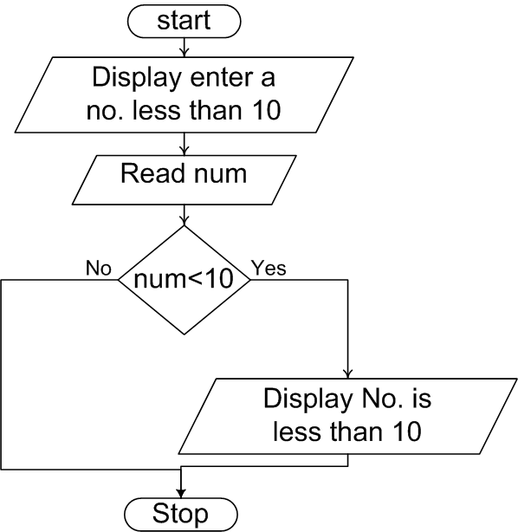
If Statement Flowchart – 1
Go to program

Slide 12
If Statement Flowchart – 2
While purchasing items, a discount of 10% is offered if the quantity is more than 1000. If the quantity and price per item is input through a keyboard, write a program to calculate and display the total expense
Input : quantity, price
Processing: calculating discount and expense
Out put : display discount

Slide 13
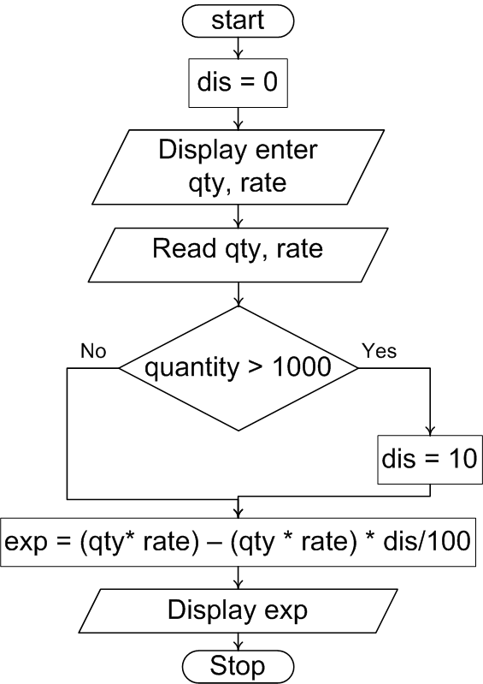
If Statement Flowchart..
Go to program

Slide 14
Quick Test
if ( 3 + 2 % 5 )
cout<<“Print : This works";
if ( a = 10 )
cout<<" Print : This works ";
if ( -5 )
cout<<" Print : This works ";
if ( (2+ 2) % 5 )
cout<<" Print : This works ";

Slide 15
Multiple statement within if
More than one statement can be executed if the condition in if statement is true
Example program
Current year and year of joining is input through key board. If the no of year the employed has served the organization is greater then 3 then a Bonus of Rs. 2500/- is given to employ. Otherwise the program should do nothing

Slide 16
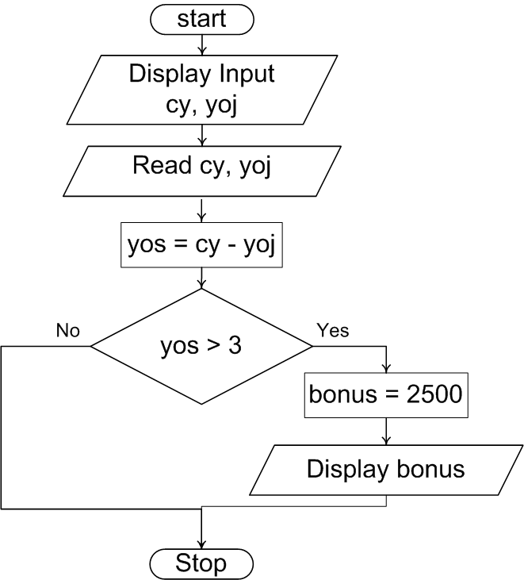
Compound Statements..

Slide 17
The if-else Statement
if-else
Different actions if conditions true or false
Example
if student’s grade is greater than or equal to 60
Display message “Passed”
else
Display message “Failed”
C++ Code
if ( grade >= 60 )
cout<<("Passed“);
else cout<<("Failed“);

Slide 18
Example
In a company employee are paid as under
If employ’s basic salary is less then 1500 then HRA = 10% of basic salary and DA is 90% of basic salary. If his salary is either equal to or above 1500, then HRA = 500 and DA is 98% of basic salary. If an employee salary is input through keyboard write a program to calculate his gross salary

Slide 19
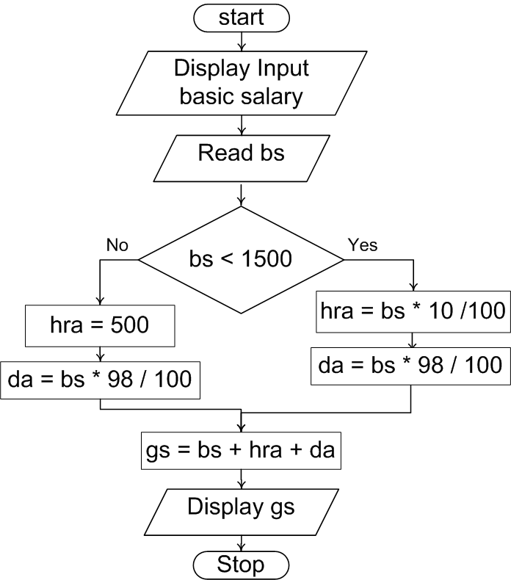
Flowchart
Go to program
da = bs * 90 / 100

Slide 20
Nested if else
It is possible to write an entire if-else with either the if statement block or else statement block

Slide 21
Nested if else flowchart
Start
Enter either 1 or 2
Read x
Go to program
x == 1
x == 2
Display you entered 1
Display you entered other than 1 or 2
Display you entered 2
End

Slide 22
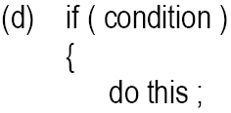
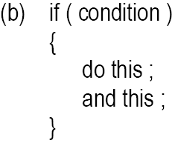
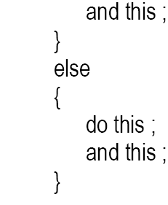
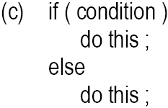
Forms of if statement

Slide 23
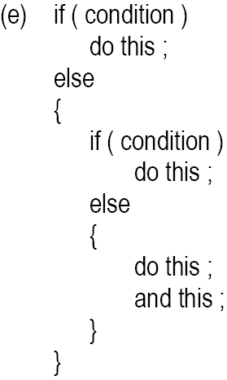
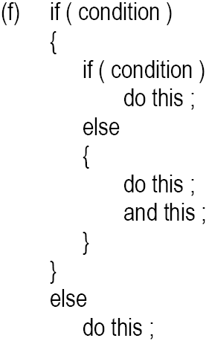
Cont.

Slide 24
Logical Operators
&& (logical AND)
Used to combine two conditions
true if both conditions are true
if ( gender == 1 && age >= 65 ) senior++;
|| (logical OR)
true if either of condition is true
if (semesterAvg >= 90 || finalExam >=90 ) cout<<("Student grade is A“);

Slide 25
Cont.
! (logical NOT, logical negation)
Returns true when its condition is false, & vice versa
if ( !( grade == 20 ) ) cout<<“hello world“);
Alternative:
if ( grade != 20 ) cout<<“hello world“);

Slide 26
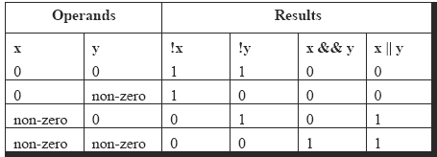
Logical Operators..
1

Slide 27
Sample Program
To calculate the division
Input: marks of 2 different subjects
Rules
Percentage above or equal to 60 - First division
Percentage between 50 and 59 - Second division
Percentage between 40 and 49 - Third division
Percentage less than 40 – Fail
Solution
Nested if-else
Logical operators
Go to Program
Go to Program

Slide 28
Using Logical Operators
A company insures its drivers in the following cases:
If the driver is married
If the driver is unmarried, male & above 30 years of age
If the driver is unmarried, female & above 25 years of age

Slide 29
Using Logical Operators..
if ( ms == 'M' )
cout<<"Driver is insured";
else
{
if ( sex == 'M' )
{
if ( age > 30 )
cout<<"Driver is insured" ;
else
cout<<"Driver is not insured" ;
}
else
{
if ( age > 25 )
cout<<"Driver is insured" ) ;
else
cout<<"Driver is not insured" ) ;
}
}
if ( ( ms == 'M') || ( ms == 'U' && sex == 'M' && age > 30 ) ||
( ms == 'U' && sex == 'F' && age > 25 ) )
cout<<"Driver is insured" ) ;
else
cout<<"Driver is not insured" ) ;

Slide 30
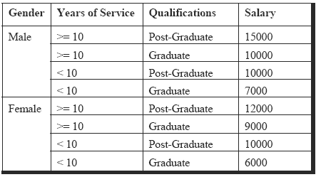
Salary Calculation Example

Slide 31
Salary Calculation Example..
char g ;
int yos, qual, sal ;
cout<<"Enter Gender, Years of Service and Qualifications ( 0 = G, 1 = PG ):";
cin>> g,yos,qual ;
if ( g == 'm' && yos >= 10 && qual == 1 )
sal = 15000 ;
else if ( ( g == 'm' && yos >= 10 && qual == 0 ) ||( g == 'm' && yos < 10 && qual == 1 ) )
sal = 10000 ;
else if ( g == 'm' && yos < 10 && qual == 0 )
sal = 7000 ;
else if ( g == 'f' && yos >= 10 && qual == 1 )
sal = 12000 ;
else if ( g == 'f' && yos >= 10 && qual == 0 )
sal = 9000 ;
else if ( g == 'f' && yos < 10 && qual == 1 )
sal = 10000 ;
else if ( g == 'f' && yos < 10 && qual == 0 )
sal = 6000 ;

Slide 32
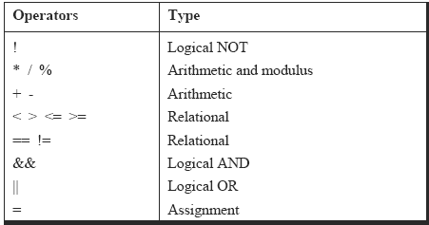
Revised Hierarchy

Slide 33
Confusion
Between assignment /equality operator
if ( i = 5 )
cout<<"You entered 5";
else
cout<<"You entered something other than 5";
Null statement
if ( i == 5 ) ;
cout<<"You entered 5"

