Slide 1
Programming Fundamentals
Lecture 05
Dr. Fazal-e-Malik
Assistant Professor , Computer Science Department,
Iqra National University, Peshawar.

Slide 2
Previous lecture
Escape sequences
C++ compiler
Directives
Common errors

Slide 3
Today’s lecture outline
C++ character set
Basic constants and variables
Output function – cout<<
Input function – cin>>
C++ instructions
Integer to float conversion
Hierarchy of operator
Control instructions

Slide 4
Learning C/C++

Slide 5
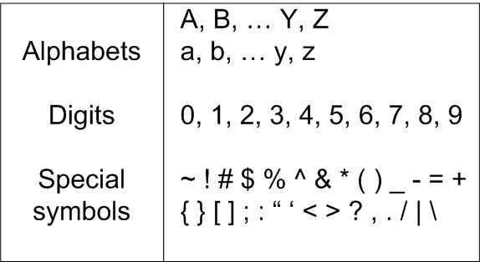
C++ Character Set

Slide 6
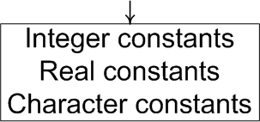
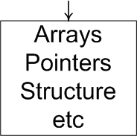
Constants
Constant is an entity that doesn’t change

Slide 7
Integer Constants
Rules:
Must have at least one digit
It must not have a decimal point
It can be either positive or negative
If there is no sign an integer constant is assumed to be positive
No commas or blanks are allowed within an integer constant
Examples: 135, -67, 3401, -5670

Slide 8
Real Constants
Rules:
Also called Floating Point constants
A real constant must have at least one digit
It must have a decimal point
It could be either positive or negative
Default sign is positive
No commas or blanks are allowed within a real constant
Examples: +325.34, 426.0, -32.76, -48.5792

Slide 9
Character Constants
A character constant is a
single alphabet
a single digit
or a single special symbol
Enclosed within single inverted commas, ‘ ’
Both the inverted commas should point to the left
The maximum length can be 1 character
Examples: ’A’, ‘I’, ‘5’, ‘=‘

Slide 10
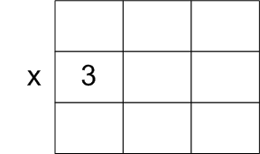
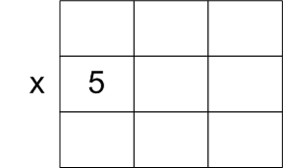
Variables
An entity that may change during program execution
These are names given to locations in memory

Slide 11
Variables..
Series of characters (letters, digits, underscores)
Must begin with a letter or underscore
Case sensitive
Meaningful naming scheme

Slide 12
Variables..
No commas or blanks are allowed within a variable name.
No Special symbol are used in name.
Examples: Interger1, Sum, _FirstNum
Invalid variable names
#sum, 12x, first name

Slide 13
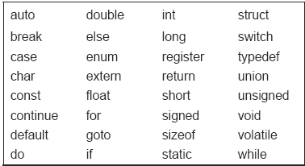
Keywords
These are reserved words
Compiler knows their meaning
Cannot be used as variable name
Cannot be changed

Slide 14
Writing C/C++ Programs
Program consists of Instructions as statements
Statements must be in Order
Each statement must end with a ;
Blanks for readability or clarity
Case-Sensitive

Slide 15
Gross salary C++ Program
/* Gross salary calculation program*/
#include<iostream>
#include<conio.h>
main()
{
int hours, payrate, grosspay;
hours = 40;
payrate = 10;
grosspay = hours * payrate; cout<<"your gross pay is \n", grosspay; system("pause");
}
Go to program

Slide 16
Variable declaration
Any variable used in the program must be declared first before using it.

Slide 17
Output function
cout<< function is used to display/output data on screen to user during program execution
cout<<“ text ", <list of variables> ;
cout<< 3, 3 + 2, c, a + b * c – d ;

Slide 18
Input
To make gross salary calculation program general, the program ask the user to input value of hours and payrate during execution
cin>> function is used to input value from user during program execution

Slide 19
Gross salary C++ Program
/* Gross salary calculation program */
#include<iostream>
#include<conio.h>
main()
{
int hours, payrate, grosspay;
cout<<"How many hours did you work? ";
cin>>hours;
cout<<"How much do you get paid per hour? ";
cin>>payrate;
grosspay = hours*payrate;
cout<<"your gross pay is \n", grosspay;
system("pause");
}
Go to program

Slide 20
C++ Instructions
Type Declaration Instruction
To declare the type of variables used in a C++ program.
Arithmetic Instruction
To perform arithmetic operations between constants and variables
Control Instruction
To control the sequence of execution of various statements in a C++ program.

Slide 21
Type Declaration Instruction
This instruction is used to declare the type of variables being used in the program.
The type declaration statement is written at the beginning of main( ) function.
Syntax:
Type variable1, variable2,….
int hours, payrate, grosspay;
float salary;
char name;

Slide 22
Variations of type declaration instruction
Initializing at declare time
int x =10, y = 20;
float a = 1.25, b = 1.99*2.4+1.5;
Order of variable declaration
int i = 10, j = 25 ;
is same as
int j = 25, j = 10 ;
However,
float a = 1.5, b = a + 3.1 ;
is alright, but
float b = a + 3.1, a = 1.5 ;

Slide 23
Cont.
The following statements would work
int a, b, c, d ;
a = b = c = 10 ;
However, the following statement would not work
int a = b = c = d = 10 ;

Slide 24
Arithmetic Instruction
C++ arithmetic instruction consists of
variable name on the left hand side of =
and variable names & constants on the right hand side of =.
E.g Area=Length * width
The variables and constants appearing on the right hand side of = are connected by arithmetic operators like +, -, *, and /.

Slide 25
Example
int ad ;
float kot, deta, alpha, beta, gamma ;
ad = 3200 ;
kot = 0.0056 ;
deta = alpha * beta / gamma + 3.2 * 2 / 5 ;
The variables and constants together are called ‘operands’ that are operated upon by the ‘arithmetic operators’

Slide 26
Types of arithmetic statement
Integer mode arithmetic statement
This is an arithmetic statement in which all operands are either integer variables or integer constants.
Example:
int i, king, issac, noteit ;
i = i + 1 ;
king = issac * 234 + noteit - 7689 ;

Slide 27
Cont.
Real mode arithmetic statement
This is an arithmetic statement in which all operands are either real constants or real variables.
Example.
float x, y, si, prin, anoy, roi ;
x = y + 23.123 / 4.5 * 0.3442 ;
si = prin * anoy * roi / 100.0 ;

Slide 28
Cont..
Mixed mode arithmetic statement
This is an arithmetic statement in which some of the operands are integers and some of the operands are real.
Example.
float si, prin, anoy, roi, avg ;
int a, b, c, num ;
si = prin * anoy * roi / 100.0 ;
avg = ( a + b + c + num ) / 4 ;

Slide 29
Arithmetic instructions
C++ allows only one variable on left-hand side
Modular operator (%)
This operator returns the remainder on dividing one integer with another
Expression 10 / 2 yields 5 whereas, 10 % 2 yields 0
Expression 10 / 3 yields 3 whereas 10 % 3 yields 1
An arithmetic instruction is often used for storing character constants in character variables.
char a, b, ;
a = 'F' ;
b = 'G' ;

Slide 30
Cont.
Arithmetic operations can be performed on ints, floats and chars.
char x, y ;
int z ;
x = 'a' ;
y = 'b' ;
z = x + y ;

Slide 31
Cont..
No operator is assumed to be present. It must be written explicitly.
a = c.d.b(xy)
b = c * d * b * ( x * y )

Slide 32
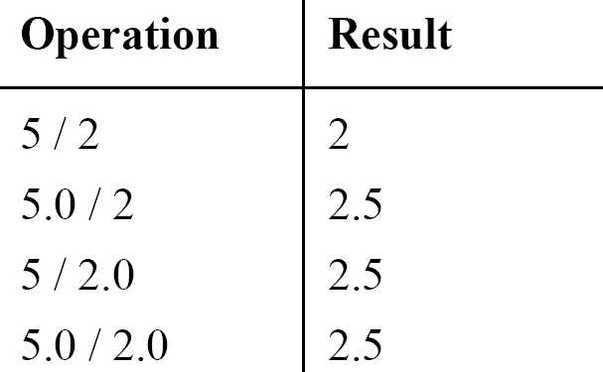
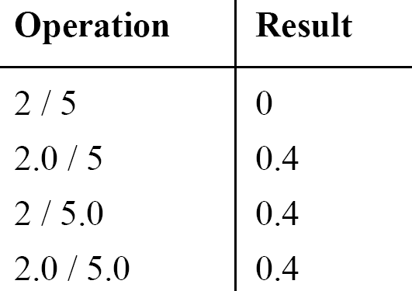
Integer and float conversions
An arithmetic operation between an integer and integer always gives an integer result
An operation between a real and real always gives a real result
An operation between an integer and real always gives a real result

Slide 33
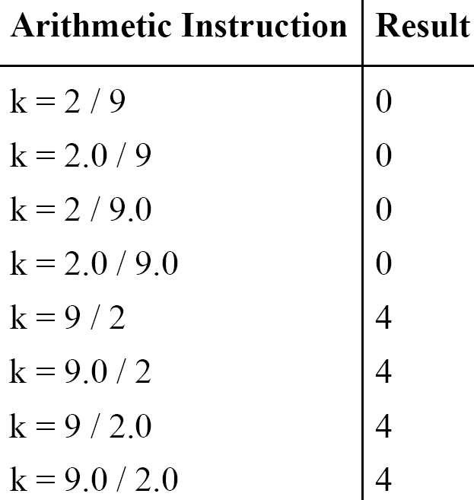
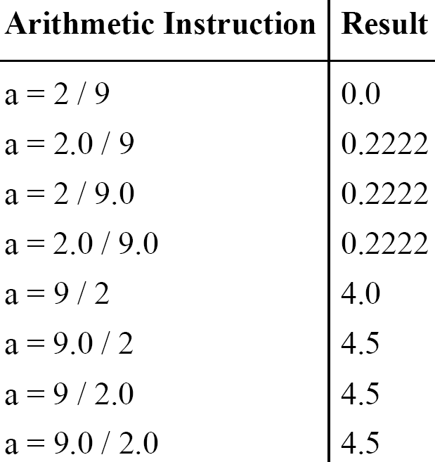
Type Conversion in Assignments
k is int and a is float

Slide 34
Hierarchy of Operations
The operation is performed in the following priority order from left to right

Slide 35
Example
i = 2 * 3 / 4 + 4 / 4 + 8 - 2 + 5 / 8
i = 6 / 4 + 4 / 4 + 8 - 2 + 5 / 8 operation: *
i = 1 + 4 / 4 + 8 - 2 + 5 / 8 operation: /
i = 1 + 1+ 8 - 2 + 5 / 8 operation: /
i = 1 + 1 + 8 - 2 + 0 operation: /
i = 2 + 8 - 2 + 0 operation: +
i = 10 - 2 + 0 operation: +
i = 8 + 0 operation : -
i = 8 operation: +

Slide 36
Association of Operators
When an expression contains two operators of equal priority the tie between them is settled using the associativity of the operators
It can be of two types
Left to right
Right to left

Slide 37
Example
Consider the expression
a = 3 / 2 * 5 ;
Left to right:
a = 3 / 2 * 5
a = 1 * 5
a = 5
Right to left :
a = 3 / 2 * 5
a = 3 / 10
a = 0

Slide 38
Control Instructions in C++
Enable us to specify the order in which the various instructions in a program are to be executed by the computer.
Sequence Control Instruction
Selection or Decision Control Instruction
Repetition or Loop Control Instruction
Case Control Instruction

Slide 39
Cont.
Sequence Control Instruction
The Sequence control instruction ensures that the instructions are executed in the same order in which they appear in the program.

Slide 40
Cont..
Selection or Decision Control Instruction
Decision instructions allow the computer to take a decision as to which instruction is to be executed next.
Repetition or Loop Control Instruction
The Loop control instruction helps computer to execute a group of statements repeatedly.

Slide 41
Cont…
Case Control Instruction
same as decision control instruction.

Slide 42
Which are invalid variables
BASICSALARY
_basic
basic-hra
#MEAN
group.
422
population in 2006
over time

Slide 43
Point out the errors
int = 314.562 * 150 ;
name = ‘Ajay’ ;
varchar = ‘3’ ;
3.14 * r * r * h = vol_of_cyl ;
k = ( a * b ) ( c + ( 2.5a + b ) ( d + e ) ;
m_inst = rate of interest * amount in rs ;
count = count + 1 ;

Slide 44
Summary
The three primary constants and variable types in C++ are integer, float and character
Do not use a keyword as a variable name
An expression may contain any sequence of constants, variables and operators
Operators having equal precedence are evaluated using associativity
Input/output in C++ can be achieved using cin>> and cout<< functions.

