Slide 1
Introduction to Programming

Slide 2
while loop
We have seen that there may be certain situations when the body of while loop doesnot execute even a single time. This occurs when the condition in while is false.
In while loop, the condition is tested first and the statements in the body are executed only when this condition is true. If the condition is false, then the control goes directly to the statement after the closed brace of the while loop.
So we can say that in while structure, the loop can execute zero or more times.
There may be situations where we may need that some task must be performed at least once.

Slide 3
while loop
while (condition)
{
statements; :
}
statements;

Slide 4
while loop
For example, a computer program has a character stored from a-z.
It gives to user five chances or tries to guess the character.
In this case, the task of guessing the character must be performed at least once.
To ensure that a block of statements is executed at least once, program need some structure.

Slide 5
While loop executes zero
or more times. What if we
want the loop to execute
at least one time?

Slide 6
do-while

Slide 7
Do while loop execute on
or more times

Slide 8
Syntax of do-while loop
do
{
statements ;
}
while ( condition ) ;

Slide 9
Example-Guessing game
char c ;
int tryNum = 1 ;
do
{
cout << "Please enter your guess by pressing a character key from a to z “ ;
cin >> c ;
if ( c == 'z‘ )
{
cout << "Congratulations! you guessed the right answer“ ;
tryNum = 6 ;
}
else
tryNum = tryNum + 1 ;
} while ( tryNum <= 5 ) ;

Slide 10
Flow chart for do-while loop
Do-while
Process
condition
false
Exit
true

Slide 11
Relational Operators
char c ;
int tryNum , maxTries ;
tryNum = 1 ;
maxTries = 5 ;
cout << "Guess the alphabet between a to z “ ;
cin >> c ;
while ( ( tryNum <= maxTries ) && ( c! = ‘z‘ ) )
{
cout << "Guess the alphabet between a to z “ ;
cin >> c ;
tryNum = tryNum + 1 ;
}

Slide 12
LOOPS
Let’s see what we do in a loop.
In a loop, we initialize variable(s) at first.
Then we set a condition for the continuation/termination of the loop.
To meet the condition to terminate the loop, we affect the condition in the body of the loop.
If there is a variable in the condition, the value of that variable is changed within the body of the loop.
If the value of the variable is not changed, then the condition of termination of the loop will not meet and loop will become an infinite one.

Slide 13
LOOPS
there are three things in a loop structure i.e.
(i) initialization,
(ii) a continuation/termination condition and
(iii) changing the value of the condition variable, usually the increment of the variable value.
To implement these things, C provides a loop structure known as for loop.
This is the most often used structure to perform repetition tasks for a known number of repetitions.

Slide 14
for Loop

Slide 15
For loop
for ( initialization condition ; termination condition ; increment condition )
{
statement ( s ) ;
}

Slide 16
For loop
We see that a 'for statement' consists of three parts.
In initialization condition, we initialize some variable while in continuation condition,
we set a condition for the continuation of the loop.
In third part, we increment the value of the variable for which the termination condition is set.
Let's suppose, we have a variable counter of type int. We write for loop in our program as

Slide 17
Example
int counter ;
for( counter = 0 ; counter < 10 ; counter = counter + 1 )
cout << counter;
Output
0123456789

Slide 18
Table for 2
2 x 1 = 2
2 x 2 = 4
2 x 3 = 6
:
:
2 x 10 = 20

Slide 19
Example - Calculate Table for 2
#include <iostream.h>
main ( )
{
int counter ;
for ( counter = 1 ; counter <= 10 ; counter = counter + 1 )
{
cout << "2 x " << counter << " = " << 2* counter << "\n“ ;
}
}

Slide 20
Output
2 x1 = 2
2 x 2 = 4
2 x 3 = 6
:
:
2 x 10 = 20

Slide 21
Flow chart for the ‘Table’ example
Start
counter=1
While
counter <=10?
No
Exit
yes
Print 2*counter
Counter =
counter + 1
Stop

Slide 22
Example: Calculate Table- Enhanced
#include <iostream.h>
main ( )
{
int number ;
int maxMultiplier ;
int counter ;
maxMultiplier = 10 ;
cout << " Please enter the number for which you wish to construct the table “ ;
cin >> number ;
for ( counter = 1 ; counter <= maxMultiplier ; counter = counter + 1 )
{
cout << number <<" x " << counter<< " = " << number * counter << "\n“ ;
}
}

Slide 23
Always think re-use
Don’t use explicit constants

Slide 24
Increment operator
++
counter ++ ;
same as
counter = counter + 1;

Slide 25
Decrement operator
--
counter -- ;
same as
counter = counter - 1

Slide 26
+=
counter += 3 ;
same as
counter = counter + 3 ;

Slide 27
-=
counter -= 5 ;
same as
counter = counter – 5 ;

Slide 28
*=
x*=2
x = x * 2

Slide 29
/=
x /= 2
x = x / 2

Slide 30
Compound Assignment Operators
operator=

Slide 31
%=
x %= 2 ;
same as
x = x % 2 ;

Slide 32
Comments
Write comment at the top program to show what it does
Write comments that mean some thing

Slide 33
Example: Program to calculate the average marks of class
int sum;
int students ;
int average ;
sum = 0 ;
students = 0 ;
do
{
cin >> grade ;
sum += grade ;
students ++ ;
}
while (grade >= 0) ;
average = sum / students ;
cout << average ;
A Flaw in the code

Slide 34
Multi-way decision

Slide 35
Multi-way decision
Sometimes, we have multiple conditions and take some action according to each condition.
For example, in the payroll of a company, there are many conditions to deduct tax from the salary of an employee.
If the salary is less than Rs. 10000, there is no deduction. But if it falls in the slab Rs. 10000 - 20000, then the income tax is deducted.
If it exceeds the limit of Rs. 20000, some additional tax will be deducted.
So the appropriate deduction is made according to the category or slab of the salary.

Slide 36
if Statements
if ( grade ==‘A’ )
cout << “ Excellent ” ;
if ( grade ==‘B’ )
cout << “ Very Good ” ;
if ( grade ==‘C’ )
cout << “ Good ” ;
if ( grade ==‘D’ )
cout << “ Poor ” ;
if ( grade ==‘F’ )
cout << “ Fail ” ;

Slide 37
if else
if ( grade ==‘A’ )
cout << “ Excellent ” ;
else
if ( grade ==‘B’ )
cout << “ Very Good ” ;
else
if ( grade ==‘C’ )
cout << “ Good ” ;
else
if ( grade ==‘D’ )
cout << “ Poor ” ;

Slide 38
if else
if ( grade == ‘A’ )
cout << “ Excellent ” ;
else if ( grade == ‘B’ )
…
else if …
…
else …

Slide 39
switch statement

Slide 40
switch statement
The switch structure is a multiple-selection construct that is used in such cases (multi way decisions) to make the code more efficient and easy to read and understand.

Slide 41
switch statements
switch ( variable name ) { case ‘a’ : statements; case ‘b’ : statements;
case ‘c’ : statements;
… }

Slide 42
switch statement
In the switch statement, there should be an integer variable (also include char) or an expression which must evaluate an integer type (whole numbers only, the decimal numbers 2.5, 14.3 etc are not allowed).
We can’t use compound conditions (i.e. the conditions that use logical operators && or ||) in switch statement and in case statements. The constants also must be integer constants (which include char).
We can’t use a variable name with the case key word. The default statement is optional.
If there is no case which matches the value of the switch statement, then the statements of default are executed.

Slide 43
switch statement
The switch statement takes the value of the variable, if there is an expression then it evaluates the expression and after that looks for its value among the case constants.
If the value is found among the constants listed in cases, the statements in that statementList are executed. Otherwise, it does nothing.
However if there is a default (which is optional), the statements of default are executed.

Slide 44
switch statements
switch ( grade) { case ‘A’ : cout << “ Excellent ” ; case ‘B’ : cout << “ Very Good ” ; case ‘C’ : … … }

Slide 45
switch statements
case ‘A’ :
cout << “ Excellent ” ; … …

Slide 46
switch statement
We know that C language is 'case sensitive'. In this language, ‘A’ is different from ‘a’.
Every character has a numeric value which is stored by the computer. The numeric value of a character is known as ASCII code of the character. The ASCII code of small letters (a, b, c etc ) are different from ASCII code of capital letters (A, B, C etc).
We can use characters in switch statement as the characters are represented as whole numbers inside the computers.
Now we will see how the use of ' the letter a' instead of 'A' can affect our program.
We want our program to be user- friendly. We don’t want to restrict the user to enter the grade in capital letters only. So we have to handle both small and capital letters in our program.
Here comes the limitations of switch statement. We can’t say in our statement like case ‘A’ or ‘a’ : statements ;
We have to make two separate cases so we write
case ‘A” :
case ‘a’ :
statements;

Slide 47
Example
switch ( grade)
{ case ‘a’:
case ‘A’ : cout << “ Excellent ” ;
case ‘B’ : cout << “ Very Good ” ;
case ‘C’ :
cout << “Good ” ;
case ‘D’ : cout << “ Poor ” ;
case ‘F’ : cout << “ Fail ” ;
}

Slide 48
switch statement
In the switch statement, the cases fall through the case which is true.
All the statements after that case will be executed right down to the end of the switch statement.
This is very important to understand it. Let's suppose that the user enters grade ‘B’. Now the case ‘A’ is skipped. Next case ‘B’ matches and statement cout << “Very Good” ; is executed.
After that, all the statements will be executed.
So cout << “Good” ; cout << “Poor” ;and cout << “Fail” ; will be executed after one another.
We don’t want this to happen. We want that when a case matches, then after executing its statement, the control should jump out of the switch statement leaving the other cases. For this purpose we use a key word break.

Slide 49
break;

Slide 50
Example
switch ( grade )
{ case ‘A’ :
cout << “ Excellent ” ;
break ;
case ‘B’ : cout << “ Very Good ” ;
break ;
case ‘C’ :
cout << “Good ” ;
break ;
case ‘D’ : cout << “ Poor ” ;
break ;
case ‘F’ : cout << “ Fail ” ;
break ;
}

Slide 51
switch statement
The break statement interrupts the flow of control. We have seen in switch statement that when a true case is found, the flow of control goes through every statement down ward.
We want that only the statements of true case should be executed and the remaining should be skipped. For this purpose, we use the break statement. We write the break statement after the statements of a case.
Thus, when a true case is found and its statements are executed then the break statement interrupts the flow of control and the control jumps out of the switch statement. If we want to do the same task for two cases, like in previous example for ‘A’ and ‘a’, then we don't put break statement after the first case. We write both the cases (or the cases may be more than two) line by line then write the common statements to be executed for these cases. We write the break statement after these common statements.
We should use the break statement necessarily after the statements of each case. The break statement is necessary in switch structure, without it the switch structure becomes illogic. As without it all the statement will execute after first match case is found.

Slide 52
The above code does nothing if the grade is other than these five categories (i.e. A, B, C, D and F). To handle all the possibilities of grade input, we write a default statement after the last case.
The statement in this default case is executed if no case matches the grade. So in our program, we can write the default statement after the
last case as under.

Slide 53
default :
default :
cout << “ Please Enter Grade from ‘A’ to ‘D’ or ‘F’ “ ;

Slide 54
Flow Chart of switch statement
switch (grade)
case ‘A’ :
Display
“Excellent”
case ‘B’ :
Display
“Very Good”
…
Default :
“……..”

Slide 55
if ( amount > 2335.09 ) statements ;

Slide 56
Whole Number
short
int
long

Slide 57
case ‘A’ :
case ‘ 300 ‘ :
case ‘ f ‘ :

Slide 58
break ;
if (c == ‘z’ )
{
cout << “ Great ! You have made the correct guess “ ; break ;
}

Slide 59
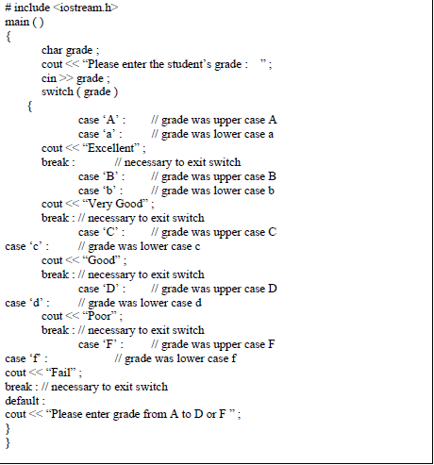

Slide 60
Sample Program
Let’s consider a problem. In a company, there are deductions from the salary of the employees for a fund. The deductions rules are as follows:
If salary is less than 10,000 then no deduction
If salary is more than 10,000 and less than 20,000 then deduct Rs. 1,000 as fund
If salary is equal to or more than 20,000 then deduct 7 % of the salary for fund
Take salary input from user and after appropriate deduction show the net payable amount.

Slide 61
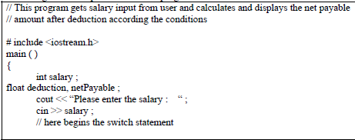
Solutionn

Slide 62
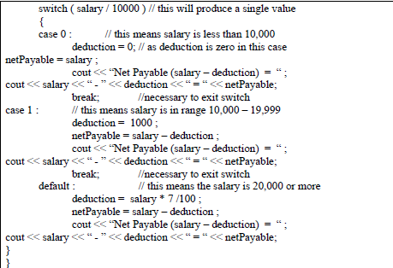

Slide 63
What have we done till now …
Sequential Statements
Decisions
if , if else , switch
Loops
while , do while , for

Slide 64
Structured Programming
Sequences
Decisions
Loops

