Slide 1
PERIPHERAL JOINT MOBILIZATION TECHNIQUES
Dr. M.Jaffar PT DPT (NCS,KMU)
MSNMPT*(RIU)

Slide 10
Glenohumeral Joint

Slide 11
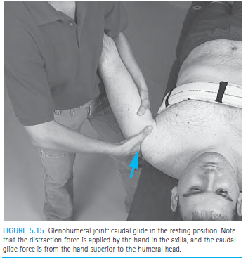
Glenohumeral Caudal Glide, Resting Position
Indications
To increase abduction (sustained grade III); to reposition
the humeral head if superiorly positioned.

Slide 13
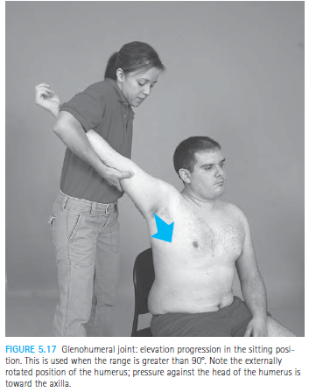
Glenohumeral Elevation Progression
Indication
To increase elevation
beyond 90 deg
of abduction.

Slide 14
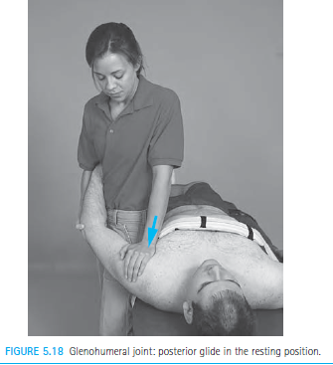
Glenohumeral Posterior Glide, Resting Position
Indications
To increase flexion;
To increase internal rotation.

Slide 15
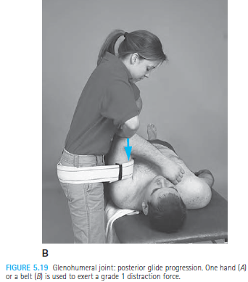
Glenohumeral Posterior Glide Progression

Slide 16
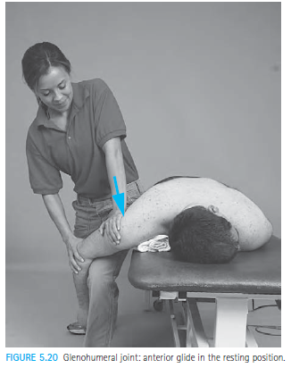
Glenohumeral Anterior Glide, Resting Position
Indications
To increase extension;
to increase ext rotation.

Slide 17
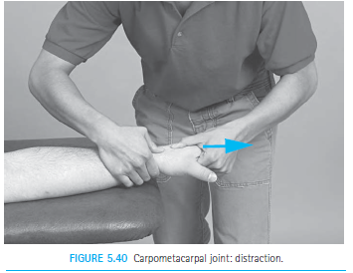
Carpometacarpal Distraction
Indication
To increase mobility of the hand.

Slide 18
Metacarpo phalangeal joint

Slide 19
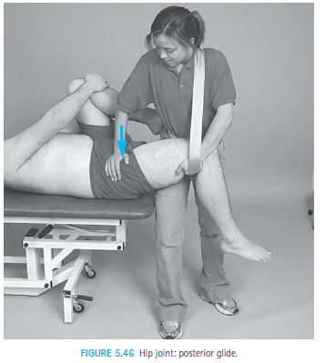
Hip Posterior Glide
Indications
To increase flexion
and Internal rotation

Slide 20
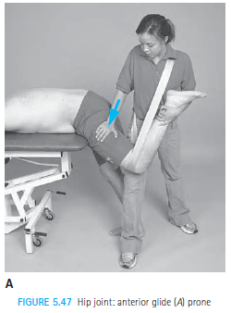
Hip Anterior Glide
Indications
To increase extension
and Ext rotation

Slide 21
Alternate positions

Slide 22
Distal Tibiofibular Articulation

