Slide 1
Principles of Electronic Communication Systems
Third Edition
Louis E. Frenzel
Engr. Latif Jan

Slide 2
Chapter 13
Fiber Optic-Communication

Slide 3
Topics Covered in Chapter 13
13-1: Optical Principles
13-2: Optical Communication Systems
13-3: Fiber-Optic Cables
13-4: Optical Transmitters and Receivers
13-5: Wavelength-Division Multiplexing
13-6: Passive Optical Networks

Slide 4
13-3: Fiber-Optic Cables
A fiber-optic cable is thin glass or plastic cable that acts as a light “pipe.”
Fiber cables have a circular cross section with a diameter of only a fraction of an inch.
A light source is placed at the end of the fiber, and light passes through it and exits at the other end of the cable.
Light propagates through the fiber based upon the laws of optics.

Slide 5
13-3: Fiber-Optic Cables
Fiber-Optic Cable Construction
Fiber-optic cables come in a variety of sizes, shapes, and types.
The portion of a fiber-optic cable that carries the light is made from either glass, sometimes called silica, or plastic.
Plastic fiber-optic cables are less expensive and more flexible than glass, but the optical characteristics of glass are superior.
The glass or plastic optical fiber is contained within an outer cladding.

Slide 6
13-3: Fiber-Optic Cables
Fiber-Optic Cable Construction
The fiber, which is called the core, is usually surrounded by a protective cladding.
In addition to protecting the fiber core from nicks and scratches, the cladding gives strength.
Plastic-clad silica (PCS) cable is a glass core with a plastic cladding.
Over the cladding is usually a plastic jacket similar to the outer insulation on an electrical cable.
Fiber-optic cables are also available in flat ribbon form.

Slide 7
13-3: Fiber-Optic Cables
Figure 13-12: Basic construction of a fiber-optic cable.

Slide 8
13-3: Fiber-Optic Cables
Figure 13-13: Typical layers in a fiber-optic cable.

Slide 9
13-3: Fiber-Optic Cables
Types of Fiber-Optic Cables
There are two ways of classifying fiber-optic cables.
The first method is by the index of refraction, which varies across the cross section of the cable.
The second method of classification is by mode, which refers to the various paths the light rays can take in passing through the fiber.

Slide 10
13-3: Fiber-Optic Cables
Types of Fiber-Optic Cables
The two ways to define the index of refraction variation across a cable are the step index and the graded index.
Step index refers to the fact that there is a sharply defined step in the index of refraction where the fiber core and cladding interface.
With the graded index cable, the index of refraction of the core is not constant. It varies smoothly and continuously over the diameter of the core.

Slide 11
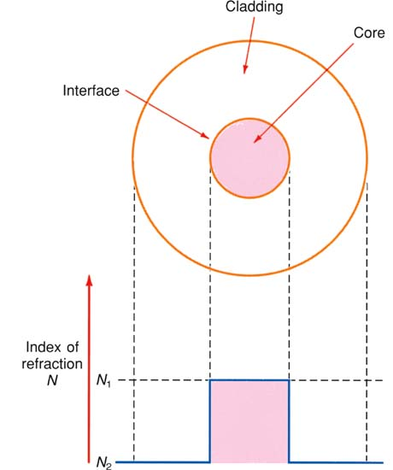
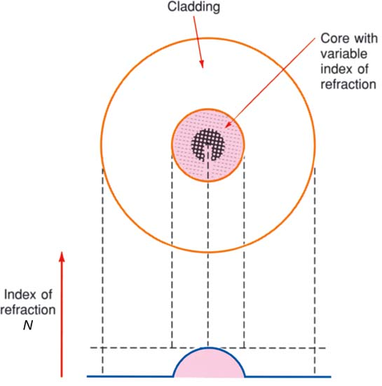
13-3: Fiber-Optic Cables
Figure 13-15: A step index cable cross
section.
Figure 13-16: Graded index cable cross section.

Slide 12
13-3: Fiber-Optic Cables
Types of Fiber-Optic Cables: Cable Mode
Mode refers to the number of paths for light rays in the cable.
There are two classifications: single mode and multimode.
In single mode, light follows a single path through the core.
In multimode, the light takes many paths.

Slide 13
13-3: Fiber-Optic Cables
Types of Fiber-Optic Cables
In practice, there are three commonly used types of fiber-optic cable:
Multimode step index
Single-mode step index
Multimode graded index

Slide 14
13-3: Fiber-Optic Cables
Types of Fiber-Optic Cables: Multimode Step Index Cable
The multimode step index fiber cable is probably the most common and widely used type.
It is the easiest to make and therefore the least expensive.
It is widely used for short to medium distances at relatively low pulse frequencies.
The main advantage of a multimode stepped index fiber is its large size.

Slide 15
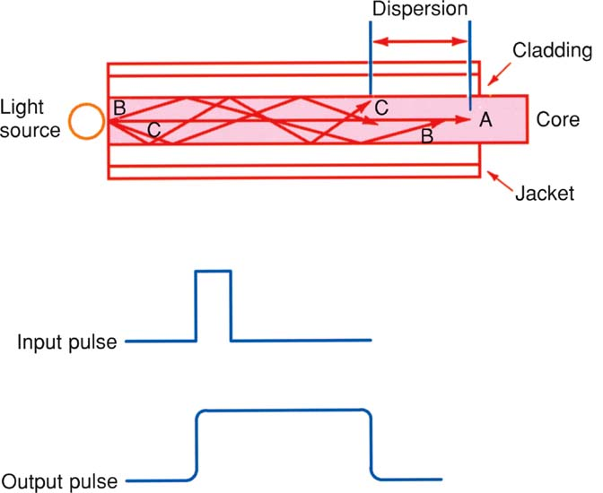
13-3: Fiber-Optic Cables
Figure 13-17: A multimode step index cable.

Slide 16
13-3: Fiber-Optic Cables
Types of Fiber-Optic Cables: Single-Mode Step Index Cable
A single-mode or monomode step index fiber cable eliminates modal dispersion by making the core so small that the total number of modes or paths through the core is minimized.
Typical core sizes are 2 to 15 μm.
The pulse repetition rate can be high and the maximum amount of information can be carried in this type cable.
They are preferred for long-distance transmission and maximum information content.

Slide 17
13-3: Fiber-Optic Cables
Types of Fiber-Optic Cables: Single-Mode Step Index Cable
This type of cable is extremely small, difficult to make, and therefore very expensive.
It is also more difficult to handle.
Splicing and making interconnections are more difficult.
For proper operation, an expensive, super-intense light source such as a laser must be used.

Slide 18
13-3: Fiber-Optic Cables
Figure 13-19: Single-mode step index cable.

Slide 19
13-3: Fiber-Optic Cables
Types of Fiber-Optic Cables: Multimode Graded Index Cable
Multimode graded index fiber cables have several modes, or paths, of transmission through the cable, but they are much more orderly and predictable.
These cables can be used at very high pulse rates and a considerable amount of information can be carried.
This type of cable is much wider in diameter, with core sizes in the 50- to 100-μm range.
It is easier to splice and interconnect, and cheaper, less intense light sources can be used.

Slide 20
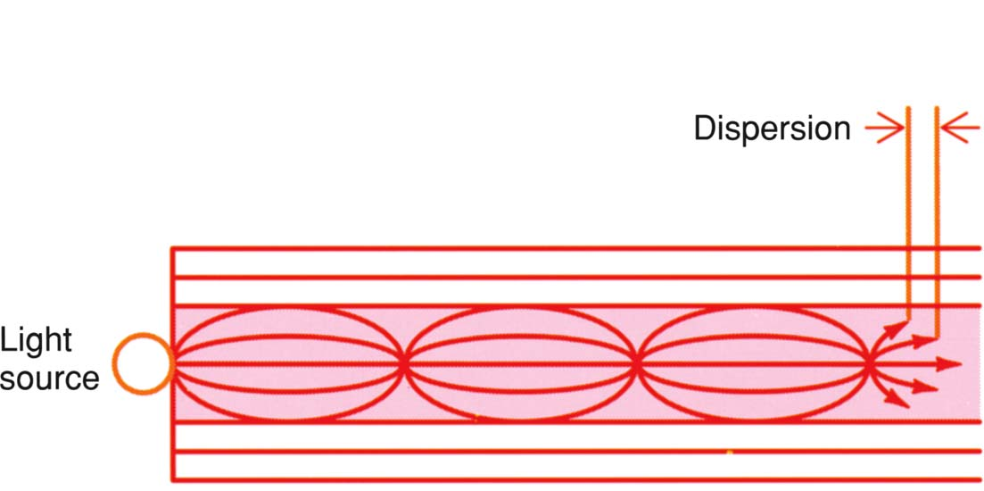
13-3: Fiber-Optic Cables
Figure 13-20: A multimode graded index cable.

Slide 21
13-3: Fiber-Optic Cables
Fiber-Optic Cable Specifications
The most important specifications of a fiber-optic cable are:
Size
Attenuation
Bandwidth

Slide 22
13-3: Fiber-Optic Cables
Fiber-Optic Cable Specifications: Cable Size
Fiber-optic cable comes in a variety of sizes and configurations.
Size is normally specified as the diameter of the core, and cladding is given in micrometers (μm).
Cables come in two common varieties, simplex and duplex.
Simplex cable is a single-fiber core cable.
In a common duplex cable, two cables are combined within a single outer cladding.

Slide 23
13-3: Fiber-Optic Cables
Fiber-Optic Cable Specifications: Attenuation
The most important specification of a fiber-optic cable is its attenuation.
Attenuation refers to the loss of light energy as the light pulse travels from one end of the cable to the other.
Absorption refers to how light energy is converted to heat in the core material because of the impurity of the glass or plastic.
Scattering refers to the light lost due to light waves entering at the wrong angle and being lost in the cladding because of refraction.

Slide 24
13-3: Fiber-Optic Cables
Fiber-Optic Cable Specifications: Bandwidth
The bandwidth of a fiber-optic cable determines the maximum speed of the data pulses the cable can handle.
The bandwidth is normally stated in terms of megahertz-kilometers (MHz-km).
A common 62.5/125-μm cable has a bandwidth in the 100- to 300-MHz∙km range.
As the length of the cable is increased, the bandwidth decreases in proportion.

Slide 25
13-3: Fiber-Optic Cables
Fiber-Optic Cable Specifications: Frequency Range
Most fiber-optic cable operates over a relatively wide light frequency range, although it is normally optimized for a narrow range of light frequencies.
The most commonly used light frequencies are 850, 1310, and 1550 nm.

Slide 26
13-3: Fiber-Optic Cables
Connectors and Splicing
When long fiber-optic cables are needed, two or more cables can be spliced together.
A variety of connectors are available that provide a convenient way to splice cables and attach them to transmitters, receivers, and repeaters.

Slide 27
13-3: Fiber-Optic Cables
Connectors and Splicing
Connectors are special mechanical assemblies that allow fiber-optic cables to be connected to one another.
Most fiber-optic connectors either snap or twist together or screw together with threaded ends.
Connectors ensure precise alignment of the cables to ensure maximum light transfer between cables.
Dozens of different kinds of connectors are available for different applications. The two most common connector designations are ST (bayonet connectors) and SMA.

Slide 28
13-3: Fiber-Optic Cables
Connectors and Splicing
Splicing fiber-optic cable means permanently attaching the end of one cable to another.
This is usually done without a connector.
The first step is to cut the cable, called cleaving the cable, so that it is perfectly square on the end.
The two cables to be spliced are then permanently bonded together by heating them instantaneously to high temperatures so that they fuse or melt together.
Special tools and machines must be used in cleaving and splicing to ensure clean cuts and perfect alignment.

Slide 29
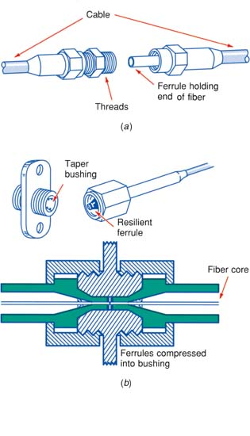
13-3: Fiber-Optic Cables
Figure 13-26: Details of a fiber cable connector.

Slide 30
13-4: Optical Transmitters and Receivers
In an optical communication system, transmission begins with the transmitter, which consists of a carrier generator and a modulator.
The carrier is a light beam that is modulated by turning it on and off with digital pulses.
The basic transmitter is essentially a light source.
The receiver is a light or photodetector that converts the received light back into an electrical signal.

Slide 31
13-4: Optical Transmitters and Receivers
Light Sources
Conventional light sources such as incandescent lamps cannot be used in fiber-optic systems because they are too slow.
The two most commonly used light sources are light-emitting diodes (LEDs) and semiconductor lasers.
A light-emitting diode is a PN-junction semiconductor device that emits light when forward-biased.
Semiconductor lasers emit coherent monochromatic light.

Slide 32
13-4: Optical Transmitters and Receivers
Light Transmitters: LED Transmitter
An LED light transmitter consists of the LED and its associated driving circuitry.
The binary data pulses are applied to a logic gate which operates a transistor switch that turns the LED off and on.
Most LEDs are capable of generating power levels up to approximately several thousand microwatts.
LED transmitters are good for only short distances.

Slide 33
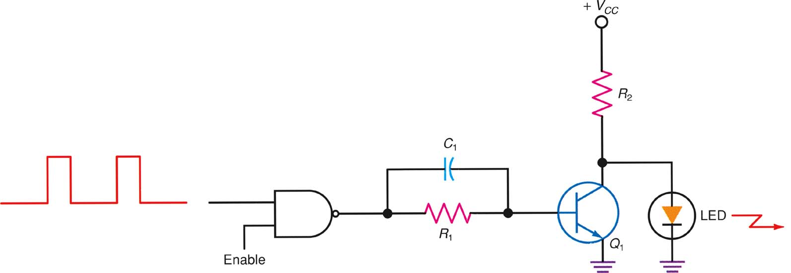
13-4: Optical Transmitters and Receivers
Figure 13-30: Optical transmitter circuit using an LED.

Slide 34
13-4: Optical Transmitters and Receivers
Light Transmitters: Laser Transmitter
Most of the circuitry is contained in a single IC.
A multiplexer either passes the input data directly to the laser driver transistors or selects data that is clocked via a flip-flop and an external differential clock signal.
Enable/disable signals turn the laser off or on.
The laser diode connects to the driver by several resistors and a capacitor that set the current and switching response.
Most laser packages also contain a photodiode that monitors the laser light output and provides feedback to the APC circuit.

Slide 35
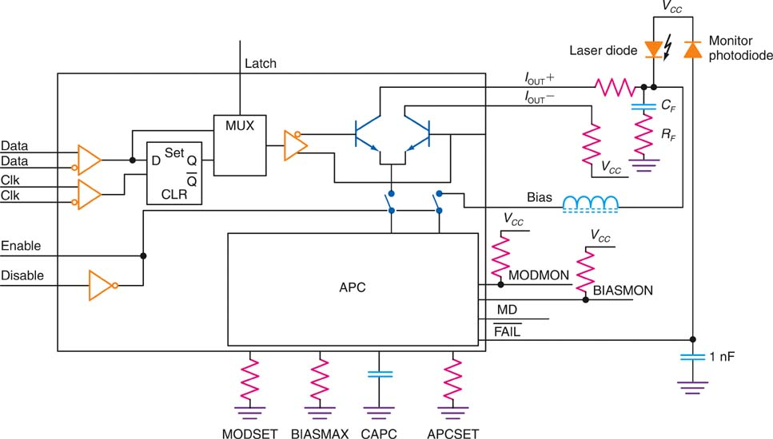
13-4: Optical Transmitters and Receivers
Figure 13-31: A typical laser driver circuit. (Courtesy Vitesse Semiconductor Corp.)

Slide 36
13-4: Optical Transmitters and Receivers
Light Detectors
The receiver part of the optical communication system consists of a detector that senses the light pulses and converts them into an electrical signal.
This signal is amplified and shaped into the original serial digital data.
The most critical component is the light sensor.
The most widely used light sensor is a photodiode. It is a silicon PN-junction diode that is sensitive to light.

Slide 37
13-4: Optical Transmitters and Receivers
Light Detectors
The phototransistor amplifies the small leakage current into a larger, more useful output.
PIN diodes are more sensitive than the PN-junction photodiode.
The avalanche photodiode (APD) is widely used and is the fastest and most sensitive photodiode, but it is expensive and its circuitry is complex.

Slide 38
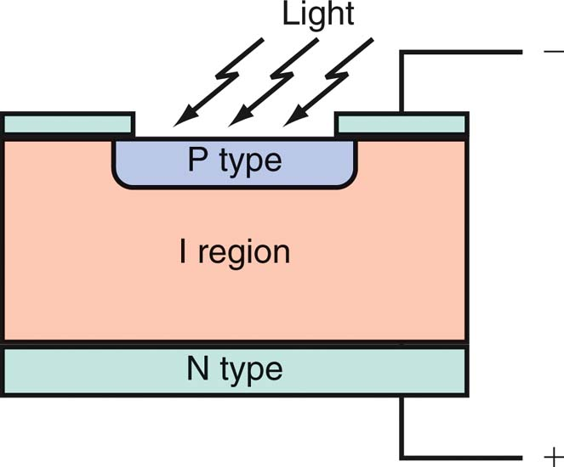
13-4: Optical Transmitters and Receivers
Figure 13-35: Structure of a PIN photodiode.

Slide 39
13-4: Optical Transmitters and Receivers
A typical light receiver circuit is an IC using an external PIN or APD photodiode. It can operate at rates to 3.125 Gbps.
Optical transceivers or transponders are assemblies called optical modules into which both the light transmitter and light receiver are packaged to form a single module.
These modules form the interface between the optical transmission medium and the electrical interface to the computer or other networking equipment.

Slide 40
13-4: Optical Transmitters and Receivers
Power Budget
A power budget, sometimes called a flux budget, is an accounting of all the attenuation and gains in a fiber-optic system.
There are numerous sources of losses in a fiber-optic cable system:
Cable losses
Connections between cable and light source and photodetector.
Connectors
Splices
Cable bends

Slide 41
13-4: Optical Transmitters and Receivers
Power Budget
To calculate the power budget:
First, calculate all the losses; add all the decibel loss factors.
Also add a 4-dB contingency factor.
Calculate the power gain needed to overcome the loss:
dB = 10 log P_{t} / P_{r}
where P_{t} is the transmitted power and P_{r} is the received power.

Slide 42
13-4: Optical Transmitters and Receivers
Power Budget: Regeneration and Amplification
There are several ways to overcome the attenuation experienced by a signal as it travels over fiber-optic cable.
Use newer types of cable that inherently have lower losses and fewer dispersion effects.

Slide 43
13-4: Optical Transmitters and Receivers
Power Budget: Regeneration and Amplification
Use regeneration.
Regeneration is the process of converting the weak optical signal to its electrical equivalent, then amplifying and reshaping it electronically, and retransmitting it on another laser.
This process is generally known as optical-electrical- optical (OEO) conversion.
Use an optical amplifier (the best option).
Optical amplifiers boost signal level without OEO conversion.

Slide 44
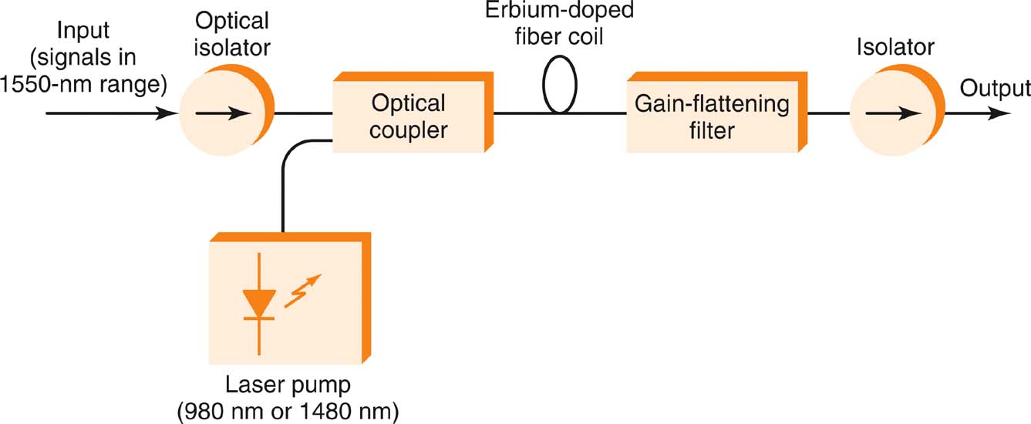
13-4: Optical Transmitters and Receivers
Figure 13-39: An erbium-doped fiber amplifier.

Slide 45
13-5: Wavelength-Division Multiplexing
Data is most easily multiplexed on fiber-optic cable by using time-division multiplexing (TDM).
Developments in optical components make it possible to use frequency-division multiplexing (FDM) on fiber-optic cable (called wavelength-division multiplexing, or WDM), which permits multiple channels of data to operate over the cable’s light-wave bandwidth.
WDM has been widely used in radio, TV, and telephone systems.

Slide 46
13-5: Wavelength-Division Multiplexing
The first coarse WDM (CWDM) systems used two channels operating on 1310 and 1550 nm. Later, four channels of data were multiplexed.
Dense wavelength-division multiplexing (DWDM) refers to the use of 8, 16, 32, 64, or more data channels on a single fiber.
Arrayed waveguide grating (AWG) is an array of optical waveguides of different lengths made with silica on a silicon chip. It can be used for both multiplexing and demultiplexing.

Slide 47
13-6: Passive Optical Networks
The primary applications for fiber-optic networks are in wide-area networks such as long-distance telephone service and the Internet backbone.
As speeds have increased and prices have declined, fiber-optic technology has been adopted into MANs, storage-area networks (SANs), and LANs.

Slide 48
13-6: Passive Optical Networks
A newer and growing fiber-optic system is the passive optical network (PON), a type of MAN technology.
This technology is also referred to as fiber to the home (FTTH). Similar terms are fiber to the premises or fiber to the curb, designated as FTTP or FTTC.

Slide 49
13-6: Passive Optical Networks
The PON Concept
Most optical networking uses active components to perform optical-to-electrical and electrical-to-optical (OEO) conversions during transmission and reception. This is an expensive and problematic structure.
One solution to this problem is to use a passive optical network.
The term passive implies no OEO repeaters, amplifiers, or any other device that uses power.

Slide 50
13-6: Passive Optical Networks
The PON Concept
In a PON, the transmitter sends the signal out over the network cable, and a receiver at the destination picks it up.
There are no intervening repeaters or amplifiers. Only passive optical devices such as splitters and combiners are used.
By using low-attenuation fiber-optic cable, powerful lasers, and sensitive receivers, it is possible to achieve distances of up to about 20 km without intervening active equipment.

Slide 51
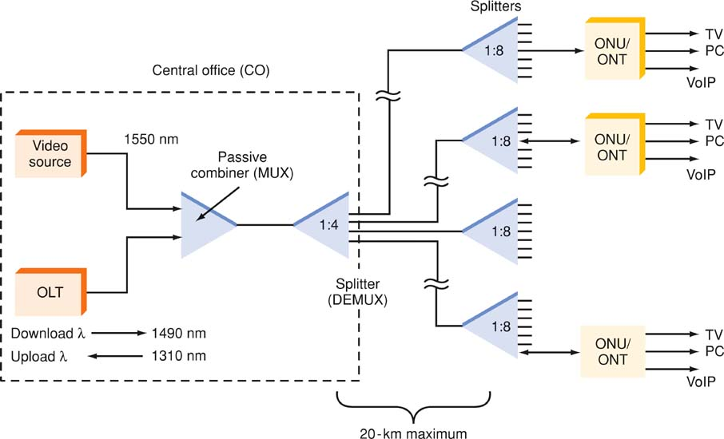
13-6: Passive Optical Networks
Figure 13-42: A passive optical network (PON) used as a high-speed Internet connection and for TV distribution in fiber to the home systems.

