Slide 1
Object Oriented Software Engineering
Analysis – Part 1
May 5th, 2020
10th Week

Slide 2
Analysis
Analysis results in a model of the system that aims to be correct, complete, consistent, and unambiguous.
Developers formalize the requirements specification produced during requirements elicitation and examine in more detail boundary conditions and exceptional cases.
Developers validate, correct and clarify the requirements specification if any errors or ambiguities are found.
The client and the user are usually involved in this activity when the requirements specification must be changed and when additional information must be gathered.

Slide 3
Analysis
In object-oriented analysis, developers build a model describing the application domain.
For example, the analysis model of a watch describes how the watch represents time: Does the watch know about leap years? Does it know about the day of the week? Does it know about the phases of the moon? The analysis model is then extended to describe how the actors and the system interact to manipulate the application domain model: How does the watch owner reset the time? How does the watch owner reset the day of the week?
Developers use the analysis model, together with nonfunctional requirements, to prepare for the architecture of the system developed during high-level design

Slide 4
What Do You See?

Slide 5
If the drawing in the previous figure had been a requirements specification, which models should you have constructed?
Specifications, like multi-stable images, contain ambiguities caused by the inaccuracies inherent to natural language and by the assumptions of the specification authors. For example, a quantity specified without a unit is ambiguous (e.g., the “Feet or Miles?”), a time without time zone is ambiguous (e.g., scheduling a phone call between different countries).
Formalization helps identify areas of ambiguity as well as inconsistencies and omissions in a requirements specification.
Once developers identify problems with the specification, they address them by eliciting more information from the users and the client.
Requirements elicitation and analysis are iterative and incremental activities that occur concurrently.

Slide 6
We Model the System … But Why Model?
We use models
To abstract away from details in the reality, so we can draw complicated conclusions in the reality with simple steps in the model
To get insights into the past or presence
To make predictions about the future

Slide 7
Overview of Analysis
Analysis focuses on producing a model of the system, called the analysis model, which is correct, complete, consistent, and verifiable.
Analysis is different from requirements elicitation in that developers focus on structuring and formalizing the requirements elicited from users.
This formalization leads to new insights and the discovery of errors in the requirements.
There is a natural tendency for users and developers to postpone difficult decisions until later in the project, this difficulty may be caused by the lack of domain knowledge, lack of technological knowledge, or simply because of disagreements among users and developers. These decisions are made in Analysis phase to resolve all issues.

Slide 8
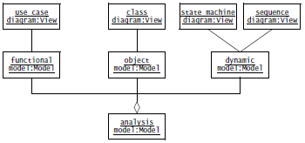
Overview of Analysis
The analysis model is composed of three individual models:
The functional model, represented by use cases and scenarios
The analysis object model, represented by class and object diagrams
The dynamic model, represented by state machine and sequence diagrams

Slide 9
Analysis Concepts
Here we describe the main analysis concepts used in Analysis Phase.
Analysis Object Models and Dynamic Models
Entity, Boundary, and Control Objects
Generalization and Specialization

Slide 10
Analysis Object Models and Dynamic Models
The analysis model represents the system under development from the user’s point of view. The analysis object model is a part of the analysis model and focuses on the individual concepts that are manipulated by the system, their properties and their relationships. The analysis object model, depicted with UML class diagrams, includes classes, attributes, and operations. The analysis object model is a visual dictionary of the main concepts visible to the user.
The dynamic model focuses on the behaviour of the system. The dynamic model is depicted with sequence diagrams and with state machines. Sequence diagrams represent the interactions among a set of objects during a single use case. State machines represent the behaviour of a single object (or a group of very tightly coupled objects). The dynamic model serves to assign responsibilities to individual classes and, in the process, to identify new classes, associations, and attributes to be added to the analysis object model.

Slide 11
Entity, Boundary, and Control Objects
The analysis object model consists of entity, boundary, and control objects .
Entity objects represent the persistent information tracked by the system.
Boundary objects represent the interactions between the actors and the system.
Control objects are in charge of realizing use cases.

Slide 12
Generalization and Specialization
Generalization is the modelling activity that identifies abstract concepts from lower-level ones. For example, assume we are reverse-engineering an emergency management system and discover screens for managing traffic accidents and fires. Noticing common features among these three concepts, we create an abstract concept called Emergency to describe the common (and general) features of traffic accidents and fires.
Specialization is the activity that identifies more specific concepts from a high-level one. For example, assume that we are building an emergency management system from scratch and that we are discussing its functionality with the client.

Slide 13
Analysis Activities: From Use Cases to Objects
Analysis activities include:
Identifying Entity Objects
Identifying Boundary Objects
Identifying Control Objects
Mapping Use Cases to Objects with Sequence Diagrams
Modeling Interactions among Objects with CRC Cards
Identifying Associations
Identifying Aggregates
Identifying Attributes
Modeling State-Dependent Behavior of Individual Objects
Modeling Inheritance Relationships
Reviewing the Analysis Model

Slide 14
Identifying Entity Objects
Participating objects form the basis of the analysis model. Developers name and briefly describe the objects, their attributes, and their responsibilities as they are identified. Uniquely naming objects promotes a standard terminology. For entity objects we recommend always to start with the names used by end users and application domain specialists. Describing objects, even briefly, allows developers to clarify the concepts they use and avoid misunderstandings (e.g., using one object for two different but related concepts). Developers should document attributes and responsibilities.

Slide 15
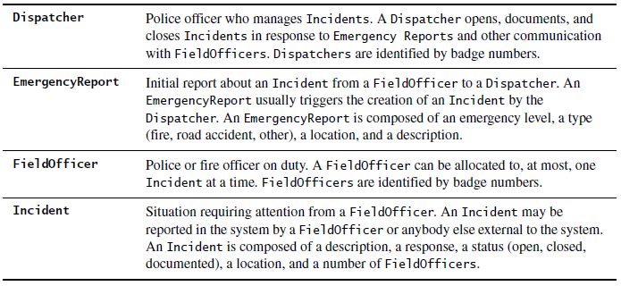
Identifying Entity Objects

Slide 16
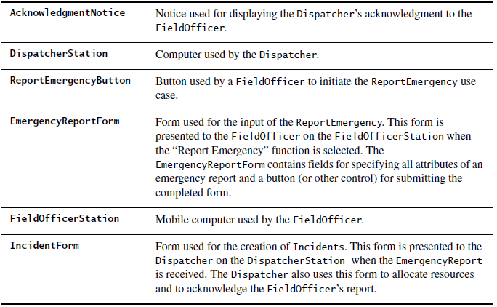
Identifying Boundary Objects
Boundary objects represent the system interface with the actors. In each use case, each actor interacts with at least one boundary object. The boundary object collects the information from the actor and translates it into a form that can be used by both entity and control objects.

Slide 17
Identifying Control Objects
Control objects are responsible for coordinating boundary and entity objects. Control objects usually do not have a concrete counterpart in the real world. Often a close relationship exists between a use case and a control object; a control object is usually created at the beginning of a use case and ceases to exist at its end. It is responsible for collecting information from the boundary objects and dispatching it to entity objects. For example, control objects describe the behavior associated with the sequencing of forms, undo and history queues, and dispatching information in a distributed system.

Slide 18
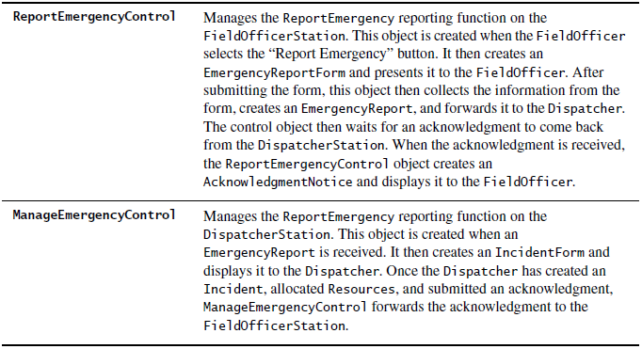
Identifying Control Objects

Slide 19
To Be Continued After Midterms …

Slide 20
Mapping Use Cases to Objects with Sequence Diagrams
A sequence diagram ties use cases with objects. It shows how the behavior of a use case (or scenario) is distributed among its participating objects.
By constructing sequence diagrams, we not only model the order of the interaction among the objects, we also distribute the behavior of the use case. That is, we assign responsibilities to each object in the form of a set of operations. These operations can be shared by any use case in which a given object participates. Note that the definition of an object that is shared across two or more use cases should be identical; that is, if an operation appears in more than one sequence diagram, its behavior should be the same.

Slide 21
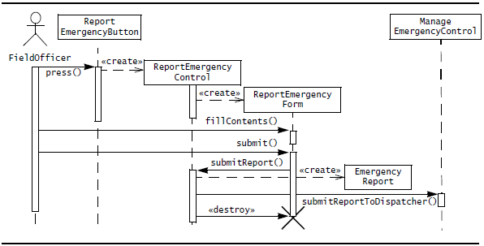
Mapping Use Cases to Objects with Sequence Diagrams

Slide 22
Modeling Interactions among Objects with CRC Cards
An alternative for identifying interactions among objects are CRC cards. CRC cards (CRC stands for class, responsibilities, and collaborators) were initially introduced as a tool for teaching object-oriented concepts to novices and to experienced developers unfamiliar with object-orientation.
Each class is represented with an index card (called the CRC card). The name of the class is depicted on the top, its responsibilities in the left column, and the names of the classes it needs to accomplish its responsibilities are depicted in the right column.

Slide 23
Identifying Associations
An association shows a relationship between two or more classes. For example, a FieldOfficer writes an EmergencyReport.
Identifying associations has two advantages. First, it clarifies the analysis model by making relationships between objects explicit (e.g., an EmergencyReport can be created by a FieldOfficer or a Dispatcher). Second, it enables the developer to discover boundary cases associated with links. Boundary cases are exceptions that must be clarified in the model. For example, it is intuitive to assume that most EmergencyReports are written by one FieldOfficer. However, should the system support EmergencyReports written by more than one? Should the system allow for anonymous EmergencyReports? Those questions should be investigated during analysis by discussing them with the client or with end users.

Slide 24
Identifying Associations
Associations have several properties:
A name to describe the association between the two classes (e.g., Writes in Figure). Association names are optional and need not be unique globally.
A role at each end, identifying the function of each class with respect to the associations (e.g., author is the role played by FieldOfficer in the Writes association).
A multiplicity at each end, identifying the possible number of instances (e.g., * indicates a FieldOfficer may write zero or more EmergencyReports, whereas 1 indicates that each EmergencyReport has exactly one FieldOfficer as author).

Slide 25
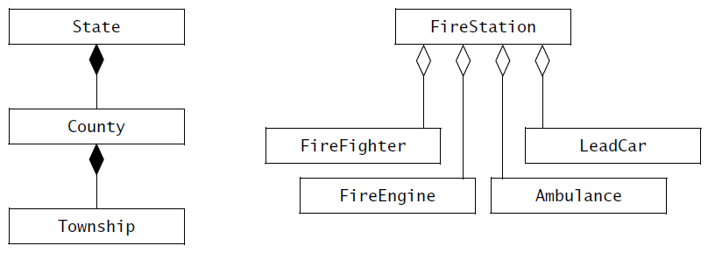
Identifying Aggregates
Aggregations are special types of associations denoting a whole–part relationship. E.g., a FireStation consists of a number of FireFighters, FireEngines, Ambulances, and a LeadCar. A State is composed of a number of Counties that are, in turn, composed of a number of Townships. An aggregation is shown as a association with a diamond on the side of the whole part.

Slide 26
Identifying Aggregates
There are two types of aggregation, composition and shared.
A solid diamond denotes composition. A composition aggregation indicates that the existence of the parts depends on the whole. For example, a County is always part of exactly one State, a Township is always part of a County. As political boundaries do not change often, a Township will not be part of or shared with another County (at least, in the life time of the emergency response system).
A hollow diamond denotes a shared aggregation relationship, indicating the whole and the part can exist independently. For example, although a FireEngine is part of at most one FireStation at the time, it can be reassigned to a different FireStation during its life time.

Slide 27
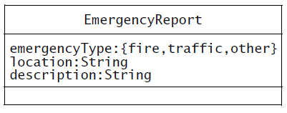
Identifying Attributes
Attributes are properties of individual objects. For example, an EmergencyReport has an emergency type, a location, and a description property. These are entered by a FieldOfficer when she reports an emergency and are subsequently tracked by the system.
When identifying properties of objects, only the attributes relevant to the system should be considered. For example, each FieldOfficer has a social security number that is not relevant to the emergency information system. Instead, FieldOfficers are identified by badge number, which is represented by the badgeNumber property.

Slide 28
Reviewing the Analysis Model
The analysis model is built incrementally and iteratively.
The analysis model is seldom correct or even complete on the first pass. Several iterations with the client and the user are necessary before the analysis model converges toward a correct specification usable by the developers for design and implementation. For example, an omission discovered during analysis will lead to adding or extending a use case in the requirements specification, which may lead to eliciting more information from the user.
The following questions should be asked to ensure that the model is correct:
Is the glossary of entity objects understandable by the user?
Do abstract classes correspond to user-level concepts?
Are all descriptions in accordance with the users’ definitions?
Do all entity and boundary objects have meaningful noun phrases as names?
Do all use cases and control objects have meaningful verb phrases as names?
Are all error cases described and handled?

Slide 29
Reviewing the Analysis Model
The following questions should be asked to ensure that the model is complete:
For each object: Is it needed by any use case? In which use case is it created? modified? destroyed? Can it be accessed from a boundary object?
For each attribute: When is it set? What is its type? Should it be a qualifier?
For each association: When is it traversed? Why was the specific multiplicity chosen?
Can associations with one-to-many and many-to-many multiplicities be qualified?
For each control object: Does it have the necessary associations to access the object participating in its corresponding use case?
The following questions should be asked to ensure that the model is consistent:
Are there multiple classes or use cases with the same name?
Do entities (e.g., use cases, classes, attributes) with similar names denote similar concepts?
Are there objects with similar attributes and associations that are not in the same generalization hierarchy?
The following questions should be asked to ensure that the system described by the analysis model is realistic:
Are there any novel features in the system? Were any studies or prototypes built to ensure their feasibility?
Can the performance and reliability requirements be met? Were these requirements verified by any prototypes running on the selected hardware?

Slide 30
Managing Analysis
The primary challenge in managing the requirements in such a project is to maintain consistency while using so many resources. In the end, the requirements analysis document should describe a single coherent system understandable to a single person.
The Analysis Management consists the following activities:
Documenting Analysis
Assigning Responsibilities
Communicating about Analysis
Iterating over the Analysis Model
Client Sign-Off

