Slide 1
Requirement Elicitation
Sanaa Jeehan
April 7th, 2020
8th Week

Slide 2
Requirement Elicitation
Requirement: A feature that the system must have or a constraint that must be satisfied to be accepted by the client.
Requirements engineering aims at defining the requirements of the system under construction. It Includes two main activities:
Requirement Elicitation: Gives specification of the system that the client understands
Analysis: which results in an analysis model that the developers can unambiguously interpret.
Requirements elicitation is the more challenging of the two because it requires the collaboration of several groups of participants with different backgrounds.

Slide 3
Requirement Elicitation
Developers elicit requirements by observing and interviewing users. Developers first represent the user’s current work processes as as-is scenarios, then develop visionary scenarios describing the functionality to be provided by the future system. The client and users validate the system description by reviewing the scenarios and by testing small prototypes provided by the developers. As the definition of the system matures and stabilizes, developers and the client agree on a requirements specification in the form of functional requirements, non-functional requirements, use cases, and scenarios.
Requirement Elicitation is all about communication among Clients, Developers and Users.

Slide 4
Overview of Requirements Elicitation
Focuses on describing the purpose of the system.
The client, the developers, and the users identify a problem area and define a system that addresses the problem. Such a definition is called a requirements specification and serves as a contract between the client and the developers.
This specification is further structured and formalized in Analysis Phase to produce Analysis Model.
Both requirements specification and analysis model represent the same information. They differ only in the language and notation they use; the requirements specification is written in natural language, whereas the analysis model is usually expressed in a formal or semiformal notation.
Requirement Specification supports communication with Clients and Users whereas analysis model supports the communication among developers.

Slide 5
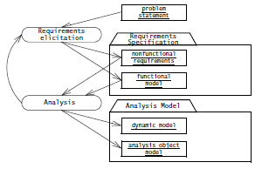
Product of Requirement Elicitation and Analysis

Slide 6
Overview of Requirements Elicitation
Requirements elicitation includes the following activities:
Identifying actors.
Identifying scenarios
Identifying use cases
Refining use cases
Identifying relationships Among Actors and Use Cases
Identifying Initial Analysis Objects
Identifying non-functional requirements
Requirements elicitation and analysis focus only on the user’s view of the system. For example, the system functionality, the interaction between the user and the system, the errors that the system can detect and handle, and the environmental conditions in which the system functions are part of the requirements.
Lets describe each one of the above listed in detail.

Slide 7
Consider an Example
FRIEND is a distributed information system for accident management. It includes many actors, such as FieldOfficer, who represents the police and fire officers who are responding to an incident, and Dispatcher, the police officer responsible for answering 911 calls and dispatching resources to an incident. FRIEND supports both actors by keeping track of incidents, resources, and task plans. It also has access to multiple databases, such as a hazardous materials database and emergency operations procedures. The FieldOfficer and the Dispatcher actors interact through different interfaces: FieldOfficers access FRIEND through a mobile personal assistant, Dispatchers access FRIEND through a workstation

Slide 8
Identifying Actors
Actors represent external entities that interact with the system. An actor can be human or an external system.

Slide 9
Identifying Scenarios
A scenario is “a narrative description of what people do and experience as they try to make use of computer systems and applications”.
A scenario is a concrete, focused, informal description of a single feature of the system from the viewpoint of a single actor.
It may have any of the following types:
As-is scenarios describe a current situation. During reengineering, for example, the current system is understood by observing users and describing their actions as scenarios. These scenarios can then be validated for correctness and accuracy with the users.
Visionary scenarios describe a future system. Visionary scenarios are used both as a point in the modelling space by developers as they refine their ideas of the future system and as a communication medium to elicit requirements from users. Visionary scenarios can be viewed as an inexpensive prototype.

Slide 10
Identifying Scenarios
Evaluation scenarios describe user tasks against which the system is to be evaluated. The collaborative development of evaluation scenarios by users and developers also improves the definition of the functionality tested by these scenarios.
Training scenarios are tutorials used for introducing new users to the system. These are step-by-step instructions designed to hand-hold the user through common tasks.

Slide 11
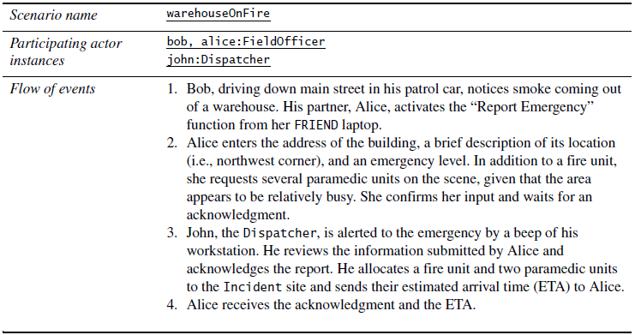
Example: Scenario

