Slide 1
Design Patterns
Lecture 6

Slide 2
Contents…
Traditional way of solving design problems
What are Design Patterns?
Benefits
Singleton Pattern
Example in Java
Decorator Pattern
Example in Java

Slide 3
Why we need Design Patterns
Design Objectives
Good Design (the “ilities”)
High readability and maintainability
High extensibility
High testability
High reusability

Slide 4
What is a design pattern
Well tested design solutions to common design problems in software world
A guideline for flexible code design
It is not a library, module or a package
It is a higher level than a library

Slide 5
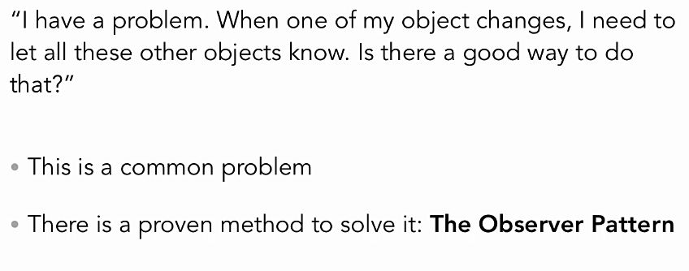
An example

Slide 6
Where did Design pattern come from
Invented by the “gang of four”
Erich Gamma, Richard Helm, Ralph Johnson and John Vlissides
Design Patterns—Elements of Reusable Object-Oriented Software (Addison-Wesley, 1995)
Twenty three original patterns
In this lecture:
Singleton
Decorator

Slide 7
Using Design Patterns
Built from years of software development experience
reduces errors
Saves time
Ultimate in reuse
We are not reusing code, we are reusing experience

Slide 8
Three Types of Patterns
Creational patterns:
Deal with initializing and configuring classes and objects
Structural patterns:
Deal with decoupling interface and implementation of classes and objects
Behavioral patterns:
Deal with dynamic interactions among societies of classes and objects
How they distribute responsibility

Slide 9
Creational Patterns
Abstract Factory
Builder
Factory Method
Prototype
Singleton
Behavioral Patterns
Chain of Responsibility
Command
Interpreter
Iterator
Mediator
Memento
Observer
State
Strategy
Template Method
Visitor
Structural Patterns
Adapter
Bridge
Composite
Decorator
Proxy

Slide 10
Singleton Pattern

Slide 11
Singleton Pattern
Ensures a class has only one instance and provides a global access point to that instance
Connection
Logging facilities
Preferences objects
Device, printer, and graphics drivers

Slide 12
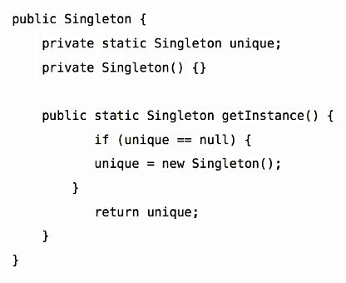
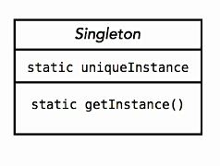

Slide 13
Decorator Pattern

Slide 14
Decorator Pattern
Attaches additional responsibilities to an object dynamically.
Provides a flexible alternative to sub-classing for extending behavior.

Slide 16
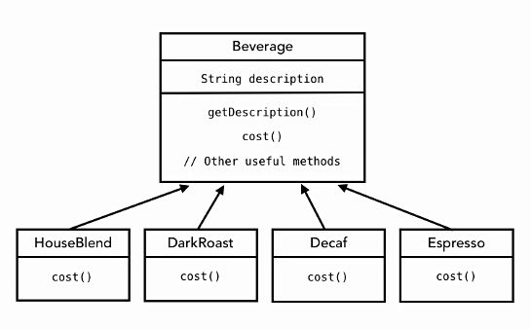

Slide 17
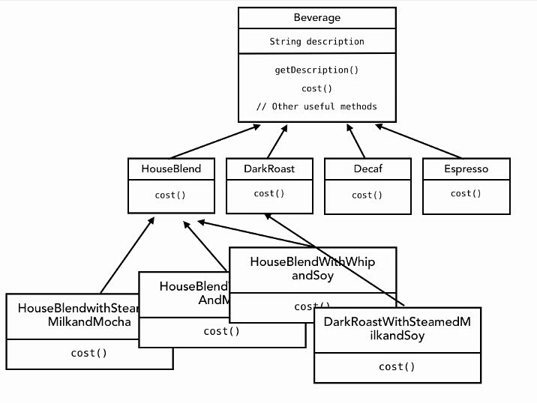

Slide 18
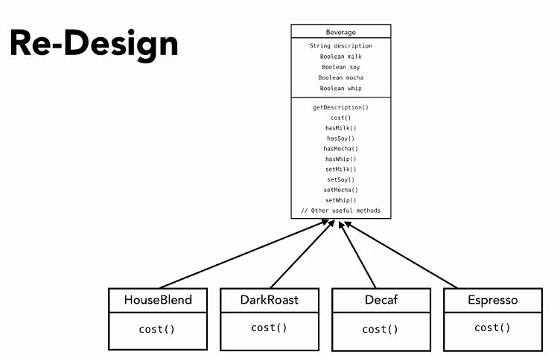

Slide 19
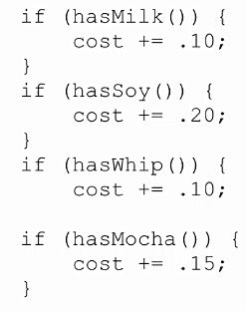

Slide 20
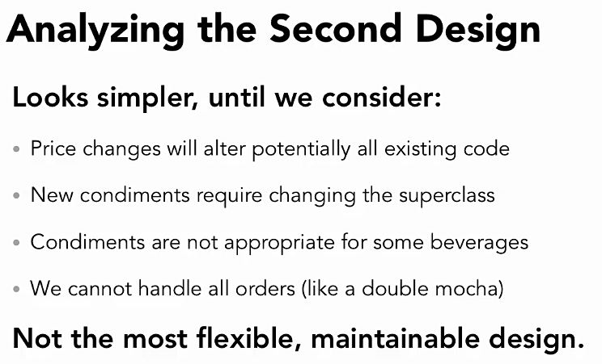

Slide 21
Design Principle…
Classes should be open for extension but closed for modification called the Open-Closed Principle.

Slide 22
Composition over Inheritance
We know inheritance is powerful but it can lead to inflexible design.
We can use Composition instead of inheritance. Composition gives us flexible design.
It allows us to make dynamic runtime decisions.

Slide 24
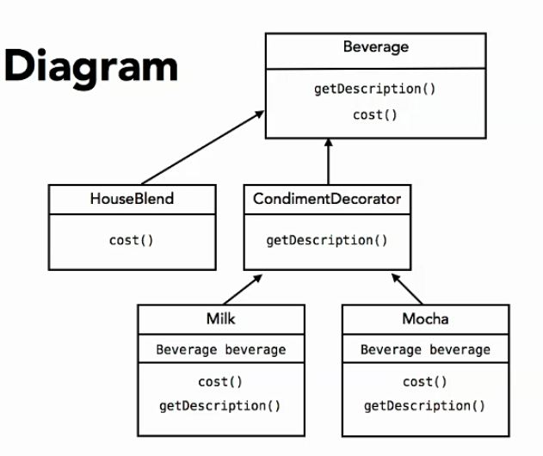
Class Diagram

Slide 26
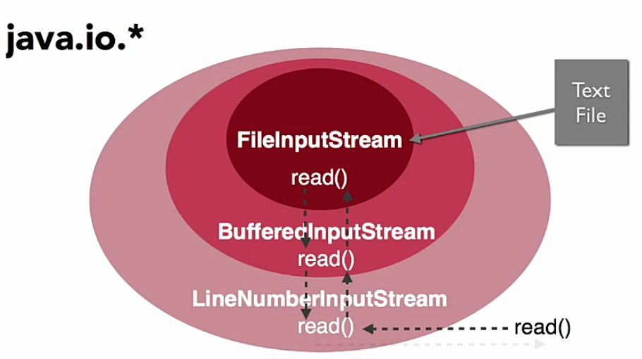

Slide 27
Any Question…?

