Slide 1
Functional Modeling

Slide 2
Functional Modeling
Functional Modeling is used to describe:
Business processes
Interaction of the system with the environment
Activity Diagram
Use Case Diagram

Slide 3
Business Process Models
Describe the different activities that, when combined together, support a business process.
Business processes typically cut across functional departments.
from an object-oriented perspective, they cut across multiple objects.
If used properly, they are a very powerful tool for communicating the analyst’s current understanding of the requirements with the user.

Slide 4
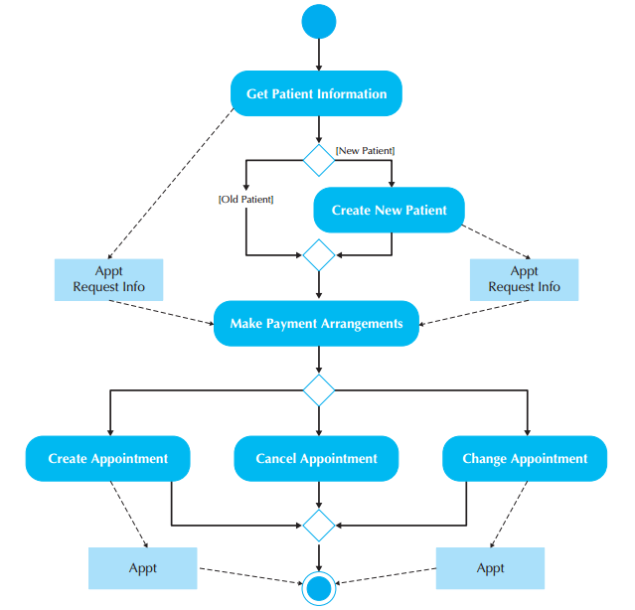
Activity Diagrams
Can be used to model any type of process
It shows how the process operates.
They illustrate:
Activities that are performed
How object move among them
Can be used for modeling both:
As-is systems
To-be systems
Model the behavior in a business process independent of objects.

Slide 5
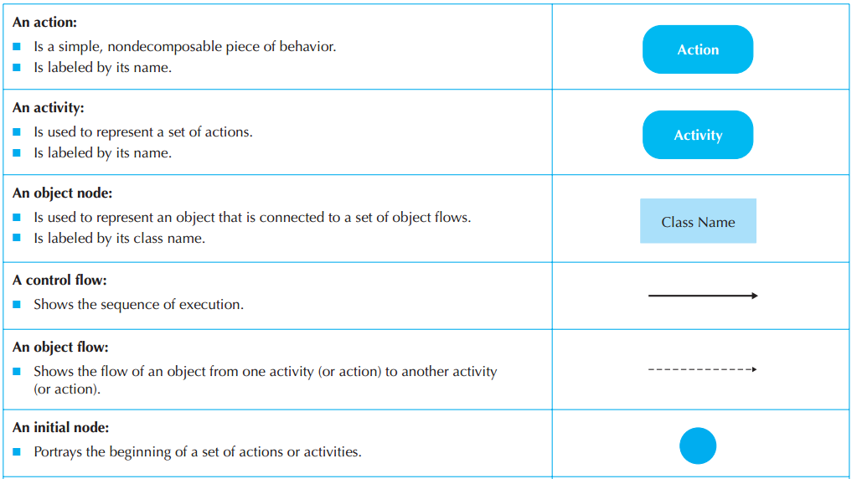

Slide 6
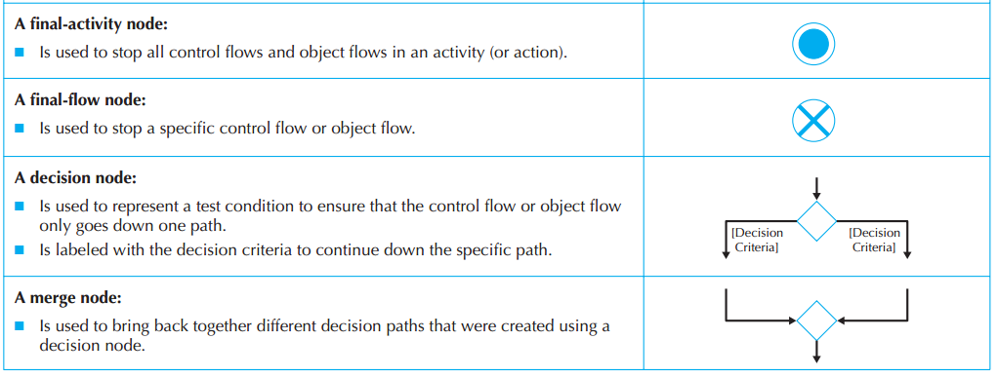

Slide 7
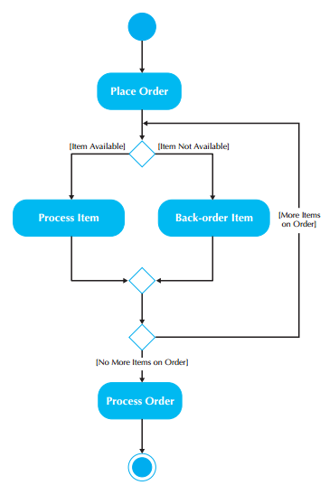

Slide 8
Actions and Activities
Actions and activities are performed for some specific business reason.
Actions and activities can represent manual or computerized behavior.
They should have a name that begins with a verb and ends with a noun (e.g., Make Appointment or Make Payment Arrangements).
Names should be short.
In most cases, each activity is associated with a use case.

Slide 9
Object Nodes
Actions and Activities typically modify or transform Objects.
Object Nodes model these objects in an activity diagram.
The name of the class of the object is written inside the rectangle.

Slide 10
Control Flows
Control flows model the paths of execution through a business process.
A control flow is portrayed as a solid line with an arrowhead on it showing the direction of flow.
Control flows can be attached only to actions or activities.

Slide 11
Object Flows
Object flows model the flow of objects through a business process.
Because activities and actions modify or transform objects, object flows are necessary to show the actual objects that flow into and out of the actions or activities.
An object flow is depicted as a dashed line with an arrowhead on it showing the direction of flow.

Slide 12
Control Nodes
7 control nodes: initial, final-activity, final-flow, decision, merge, fork, and join.
An initial node portrays the beginning of a set of actions or activities.
A final-activity node is used to stop the process being modeled.
A final-flow node is similar to a final-activity node, except that it stops a specific path of execution through the business process but allows the other concurrent or parallel paths to continue.
The decision and merge nodes support modeling the decision structure of a business process.
A guard condition represents the value of the test for that particular path to be executed.
The fork and join nodes allow parallel and concurrent processes to be modeled.

Slide 13
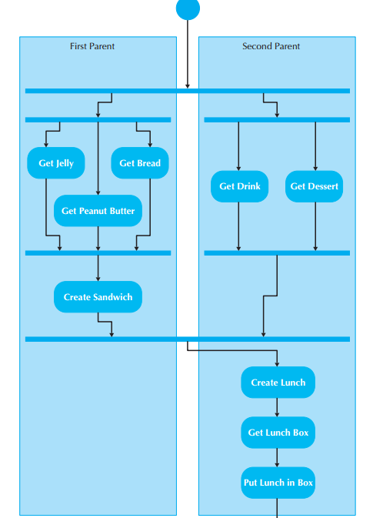
Swimlanes
There are times when it helps to break up an activity diagram in such a way that it can be used to assign responsibility to objects or individuals who would actually perform the activity.
Swimlanes allows to model this phenomena.

Slide 14
Guidelines for creating Activity Diagrams
Scope the activity
Give the diagram a title
Identify actions, control flows and object flows
Identify decisions
Identify parallelism in the process
Draw the diagram

Slide 15
Any Question?

Slide 16
Now your turn!!!
Create an Activity Diagram of any process in your FYP.

