Slide 1
Object Oriented System Analysis and Design
Lecture 1

Slide 2
Outline
What is SDLC
The fundamental four phases model
System development methodologies
Object-oriented System Analysis and Design
Rational Unified Process

Slide 3
SDLC
Systems Development Life Cycle (SDLC) is the process of understanding how an information system (IS) can support business needs by
designing a system,
building it, and
delivering it to users.
System Analyst is the key person who designs an information system
The objective is to create a useful system not a wonderful system
Notes:
System Analyst
analyzes the business situation,
Identifies business opportunities
Designs information system

Slide 4
SDLC
Four fundamental phases:
planning,
analysis,
design, and
implementation.
It is a process of gradual refinement.
Many times, SDLC phases proceed in logical order
While, it can be executed in incrementally, iteratively, etc
Notes:
Buildng an information system is somehow similar to building a house
Starts with a basic idea, then some drawing are made, then blueprints are created and final house is built
Each phase is itself composed of a series of steps, which rely upon techniques that produce deliverables

Slide 5
Planning Phase
Answers why and how an IS should be built.
The Planning phase is composed of two planning steps.
Project Initiation
Project Management
Notes:
This phase is the fundamental Process of
understanding why an IS should be built. and
How the project team will go about building the IS.

Slide 6
Planning Steps
During project initiation, the system’s business value to the organization is identified
Results in System Request followed by feasibility study and then
Approval from the approval committee
After approval It is followed by project management activities
During project management, the project manager creates a work plan, staffs the project, and puts techniques in place to help the project team control and direct the project through the entire SDLC.
Notes:
System Request comes from outside the IS area
SR is a brief summary of the business need and how the new system will generate value
The person who generates SR is project sponsor.
IS department and project sponsor work together to carry out feasibility study
■ Technical feasibility (Can we build it?)
■ Economic feasibility (Will it provide business value?)
■ Organizational feasibility (If we build it, will it be used?)
The system request and feasibility analysis is presented to approval committee which decides whether the project should be proceeded
Once it is approved, it goes to project manager and project managements starts
Creating workplan, staffing, provision of tools, applying techniques

Slide 7
Analysis Phase
The analysis phase answers the questions of
who will use the system,
what the system will do, and
where and when it will be used.
During this phase the project team:
investigates any current system(s),
identifies improvement opportunities, and
develops a concept for the new system.

Slide 8
Analysis Steps
Analysis strategy: This is developed to guide the projects team’s efforts. Analysis of the current system (called the as-is system) and ways to design new system (called the to-be system).
Requirements gathering: (e.g., through interviews or questionnaires). The analysis of this information leads to the development of a concept for a new system. This concept is used to build a set of analysis models which describe how the business will operate if the new system is developed.
System proposal: The proposal is presented to the project sponsor and other key individuals who decide whether the project should continue to move forward.
Notes:
System Proposal is a combination of:
Analyses
System concepts and Models

Slide 9
Deliverables
The system proposal is the initial deliverable that describes what business requirements the new system should meet.
The deliverable from this phase is both an analysis and a high-level initial design for the new system.
Notes:
System proposal is the first step in the design of new system, some experts argue that this phase should be named as analysis and initial design

Slide 10
Design Phase
In this phases it is decided how the system will operate, in terms of:
hardware, software, and network infrastructure;
the user interface, forms, and reports that will be used; and
the specific programs, databases, and files that will be needed.
It has four steps
Design Strategy
Architecture Design
Database and File Specification
Program Design

Slide 11
Design Steps
Design Strategy: This clarifies whether the system will be developed by the company or outside the company.
Architecture Design: This describes the hardware, software, and network infrastructure that will be used.
Database and File Specifications: These documents define what and where the data will be stored.
Program Design: Defines what programs need to be written and what they will do.
The collection of all these deliverables (architecture design, interface design, etc) is called system specification.
System specification is handed to the programing team for implementation.
Notes:
Architecture design will need the system to add or change the infrastructure.
Interface design specifies how the user will navigate through the system.
The collection of all these deliverables (architecture design, interface design, etc) is called system specification.
System specification is handed to the programing team for implementation.

Slide 12
Before moving on to Implementation
The feasibility analysis and project plan are reexamined and revised.
The project sponsor and approval committee decide whether to terminate the project or continue.

Slide 13
Implementation Phase
During this phase, the system is either developed or purchased (in the case of packaged software).
This phase is usually the longest and most expensive part of the process.
This phase has three steps.
System Construction
Installation
Support Plan

Slide 14
Implementation Steps
System Construction:
The system is built and
tested to make sure it performs as designed.
Installation: Prepare to support the installed system.
Cutover approach: the new system immediately replaces the old system
Parallel conversion approach: both old and new system operate for a month or two to make sure that the new system is free from bugs
Phased conversion approach: the system is installed in one part of the organization.
Support Plan:
This plan usually includes a formal or informal post-implementation review as well as a systematic way for identifying major and minor changes needed for the system.
Notes:
Installation approaches:
Cutover: the new system immediately replaces the old system
Parallel: both old and new system operate for a month or two to make sure that the new system is free from bugs
Phased: the system is installed in one part of the organization.

Slide 15
It is not simple
A 1996 survey by the Standish Group found that 42 percent of all corporate IS projects were abandoned before completion.
A similar study done in 1996 by the General Accounting Office found 53 percent of all U.S. government IS projects were abandoned.
Unfortunately, many of the systems that aren’t abandoned are delivered to the users significantly late, cost far more than planned, and have fewer features than originally planned.

Slide 16
Software Development Methodologies
A methodology is a formalized approach to implementing the SDLC.
Can be categorized based on:
Whether they focus on business process or data or both
Sequencing of the SDLC phases & amount of time and effort devoted to each phase
Notes:
A Methodology defines a list of steps and deliverable that will be produced.

Slide 17
System Development Methodologies
Structured Design
Waterfall
Parallel
Rapid Application Development (RAD)
Phased
Prototyping
Throw-away prototyping
Agile Development
Extreme Programing

Slide 18
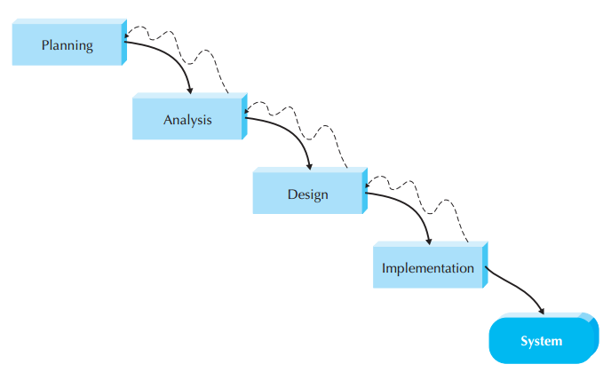
Waterfall Model
Notes:
The analyst and users proceed from one phase to another in sequence.
Deliverables are very long (often hundreds of pages).
Deliverable are presented to project sponsors before moving to another phase.
Advantages:
System requirements are identified long before programing begins
It minimizes changes to requirements as project proceeds
Disadvantages:
Design must be completely specified before programing begins
Lengthy deliverables are overlooked
The users are rarely prepared for the new system.
Missing any requirement means a lot of rework at the end.
There is a long time gape between the production of system proposal in analysis phase and delivery of the system.
A lot of rework is required at the end as the business environment has changed after the analysis is done.

Slide 19
Waterfall Model
The analyst and users proceed from one phase to another in sequence.
Deliverables are very long (often hundreds of pages).
Deliverable are presented to project sponsors before moving to another phase.
Advantages:
System requirements are identified long before programing begins
It minimizes changes to requirements as project proceeds
Disadvantages:
Design must be completely specified before programing begins
Lengthy deliverables are overlooked
The users are rarely prepared for the new system.
Missing any requirement means a lot of rework at the end.
There is a long time gape between the production of system proposal in analysis phase and delivery of the system.
A lot of rework is required at the end as the business environment has changed after the analysis is done.

Slide 20
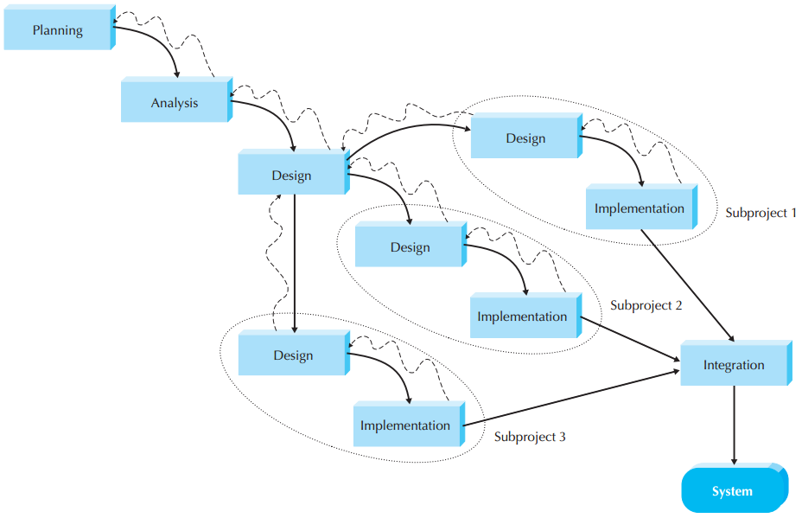
Parallel Model
Notes:
It addresses the problem of long delays in delivery caused by waterfall model
Instead of doing design and implementation in sequence,
It performs a general design for the whole system and then
Divides the project into subprojects
AT the end the subprojects are integrated
Advantages:
Shorter delivery time
Less rework at the end because there will be small changes in the business environment during development
Disadvantages:
Sometimes the subprojects are not independent, may take more time in integration
Lengthy deliverables are overlooked
The users are rarely prepared for the new system.
Missing any requirement means a lot of rework at the end.

Slide 21
Parallel Model
It addresses the problem of long delays in delivery caused by waterfall model
Instead of doing design and implementation in sequence,
It performs a general design for the whole system and then
Divides the project into subprojects
AT the end the subprojects are integrated
Advantages:
Shorter delivery time
Less rework at the end because there will be small changes in the business environment during development
Disadvantages:
Sometimes the subprojects are not independent, may take more time in integration
Lengthy deliverables are overlooked
The users are rarely prepared for the new system.
Missing any requirement means a lot of rework at the end.

Slide 22
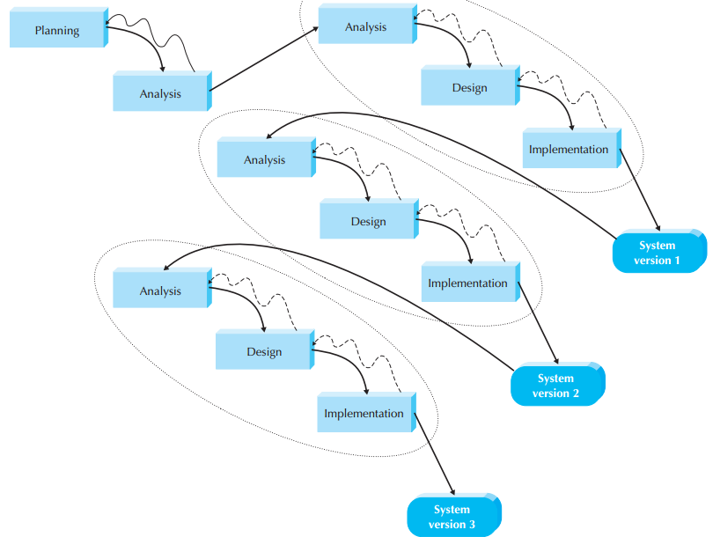
Phased Approach (RAD)
Notes:
Breaks the system into a series of versions which are developed sequentially.
Analysis phase identifies the overall system concepts.
Requirements prioritization occurs for different versions.
Previous versions are experienced by the user and the problems are tackled in the next version.
Advantages:
A useful system is quickly available for user to experience and test.
Additional requirements can be identified when user uses the system.
Disadvantages:
Finding the most important requirements is critical to ensure user satisfaction.

Slide 23
Phased Approach (RAD)
Breaks the system into a series of versions which are developed sequentially.
Analysis phase identifies the overall system concepts.
Requirements prioritization occurs for different versions.
Previous versions are experienced by the user and the problems are tackled in the next version.
Advantages:
A useful system is quickly available for user to experience and test.
Additional requirements can be identified when user uses the system.
Disadvantages:
Finding the most important requirements is critical to ensure user satisfaction.

Slide 24
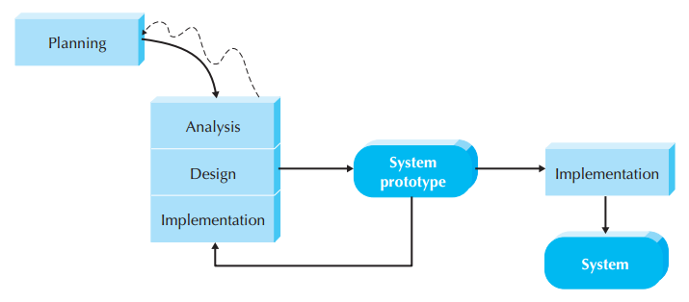
Prototyping
Notes:
Prototyping performs the Analysis, design, and implementation phases concurrently and repeated until whole system is implemented.
After a basic analysis and design, a system prototype is built.
This prototype is shown to the user and project sponsor for comments.
These comments are used to create second prototype adding some new features.
After enough functionality is added to the prototype, it is installed and used in organization.
Refinement occurs until this is accepted as new system.
Advantages:
Quick provision of a system
Quick refinement of requirements.
User satisfaction as user can see the progress of development team
Disadvantages:
It is very challenging to conduct careful, methodical analysis in such a fast-paced releases.
Often significant changes are made to the prototype, making initial design decisions poor.

Slide 25
Prototyping
Prototyping performs the Analysis, design, and implementation phases concurrently and repeated until whole system is implemented.
After a basic analysis and design, a system prototype is built.
This prototype is shown to the user and project sponsor for comments.
These comments are used to create second prototype adding some new features.
After enough functionality is added to the prototype, it is installed and used in organization.
Refinement occurs until this is accepted as new system.
Advantages:
Quick provision of a system
Quick refinement of requirements.
User satisfaction as user can see the progress of development team
Disadvantages:
It is very challenging to conduct careful, methodical analysis in such a fast-paced releases.
Often significant changes are made to the prototype, making initial design decisions poor.

Slide 26
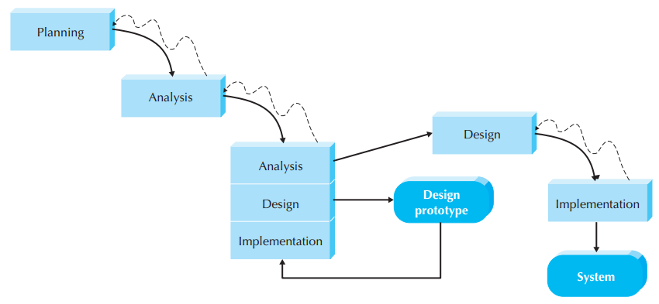
Throw-away Prototyping
Notes:
Have a relatively thorough analysis phase that is used to:
Gather information
Develop ideas for the system
Critical requirements where clarity is needed are prototyped separated and analyzed. After resolving all critical issues, the process proceeds to Design and implementation of the final product.
Advantages:
Confirms that important issues are addressed
More stable and reliable systems
Disadvantages:
Takes longer to deliver the final product compared to prototyping model

Slide 27
Throw-away Prototyping
Have a relatively thorough analysis phase that is used to:
Gather information
Develop ideas for the system
Critical requirements where clarity is needed are prototyped separated and analyzed. After resolving all critical issues, the process proceeds to Design and implementation of the final product.
Advantages:
Confirms that important issues are addressed
More stable and reliable systems
Disadvantages:
Takes longer to deliver the final product compared to prototyping model

Slide 28
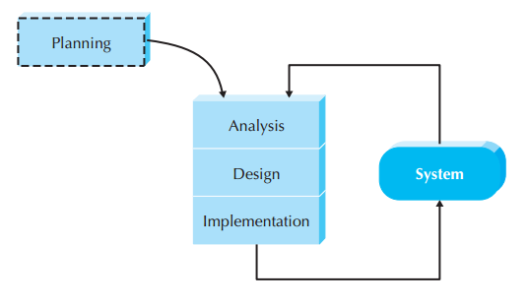
eXtreme Programing
Notes:
User stories
Coded in small, simple modules and tested.
Users should be available to clear problems as they arise.
Coding standards are followed to minimize confusion and increase understandability.
XP is founded on four core values:
Communication (rapid feedback to user)
Simplicity (KISS principle)
Feedback (embrace change)
Courage (quality-first)
After a superficial planning process, projects perform analysis, design, and implementation phases iteratively.
Testing and efficient coding practices are core to XP.
XP relies heavily on refactoring.
Advantages:
Very effective in case of changing requirements.
Disadvantages:
Requires a great deal of discipline to keep focus
Not good for large project with large teams
Since no documentation, therefore it is very hard to maintain large systems built with XP

Slide 29
eXtreme Programing
User stories
Coded in small, simple modules and tested.
Users should be available to clear problems as they arise.
Coding standards are followed to minimize confusion and increase understandability.
XP is founded on four core values:
Communication (rapid feedback to user)
Simplicity (KISS principle)
Feedback (embrace change)
Courage (quality-first)
After a superficial planning process, projects perform analysis, design, and implementation phases iteratively.
Testing and efficient coding practices are core to XP.
XP relies heavily on refactoring.
Advantages:
Very effective in case of changing requirements.
Disadvantages:
Requires a great deal of discipline to keep focus
Not good for large project with large teams
Since no documentation, therefore it is very hard to maintain large systems built with XP

Slide 30
Selection Criteria
Notes:
Unfamiliar Technology:
Throwaway is excellent because it encourages to design prototypes for areas with high risks.
Prototyping is poor because it takes months to explore the capability of new technology as prototypes in the start only scratch the surface
Phased is good because it allows to investigate the technology in some depth before design is complete
Complex Systems:
Throwaway is excellent because it requires careful and detailed analysis and design
Waterfall and parallel are good but they take time to deliver the product to the user
In phased since users are able to use the product early, less attention is paid to the analysis of the complete problem domain
System Reliability:
Throwaway is excellent because it requires careful and detailed analysis and design
Prototyping is poor because it lack careful analysis

Slide 31
Assignment
Suppose you are an analyst for the Roanoke Software Consulting Company (RSCC), a large consulting firm with offices around the world. The company wants to build a new knowledge management system that can identify and track the expertise of individual consultants anywhere in the world based on their education and the various consulting projects on which they have worked. Assume that this is a new idea that has never before been attempted in RSCC or elsewhere. RSCC has an international network, but the offices in each country may use somewhat different hardware and software. RSCC management wants the system up and running within a year.
Question
1. What type of methodology would you recommend RSCC use? Why?
Submission allowed till next class

Slide 32
OO vs Traditional Methodologies
The main difference is in problem decomposition
Traditional Techniques
Process Centric or Data Centric
OO approaches use RAD technique
Focuses rather on objects that contains both data and processes
Notes:
OOSAD can use any of the traditional methodologies like waterfall, parallel, phased, prototyping, etc.
However, OO approaches are well suited for phased development RAD.
The main difference between OO and traditional ………

Slide 33
Object oriented approach
Use case driven
use cases are the primary modeling tools defining the behavior of the system.
E.g. placing an order, searching for information, etc.
Architecture centric
Views (Functional, structural, and behavioral)
The functional, or external, view describes the behavior of the system from the perspective of the user.
The structural, or static, view describes the system in terms of attributes, methods, classes, and relationships.
The behavioral, or dynamic, view describes the behavior of the system in terms of messages passed among objects and state changes within an object.
Iterative and incremental
Continuous testing and refinement

Slide 34
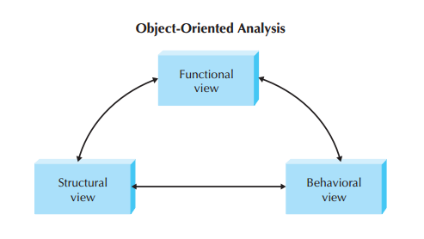
Notes:
These views are interrelated. No single view can demonstrate the whole system.

Slide 35
Benefits of OOSAD
Dividing complex systems into modules
Easy to handle
Easy to share among the team members
Easy to communicate with the users
Reusability of modules

Slide 36
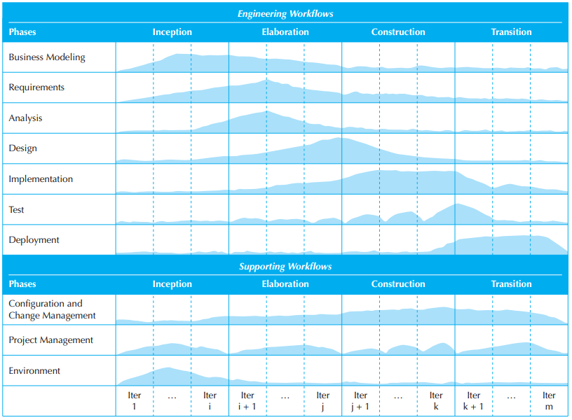
Rational Unified Process
RUP is a specific methodology that specify when and how to use various UML techniques for OOAD.
Four phases
Inception
Elaboration
Construction
Transition
Workflows
Business modeling, requirements, analysis, design, etc

Slide 37
Inception
Similar to planning in traditional SDLC
Business case is made for the system:
Feasibility study
Technical Feasibility: Do we have the technical capability to build it?
Economic Feasibility: If we build it, will it provide business value?
Organizational Feasibility: If we build it, will it be used by the organization?
Throw-away prototyping is commonly used
Primary deliverable is Vision Document
Vision Document:
Scope of the project
Primary requirements with constraints
Initial project plan
Feasibility of the project
Risks associated with the project

Slide 38
Elaboration
Analysis and design workflows are the primary focus
Deals with
Gathering requirements
Building UML structural and behavioral models
Deliverables:
UML structural and behavioral diagrams
An evolutionary prototype of the system
Developers are involved in all workflows except the deployment
Notes:
Elaboration phase continues with developing the vision document:
Finalizing the business case
Revising the risk assessment
Completing a project plan in sufficient details so that stakeholders agree on constructing the system
It involves:
Requirements gathering
Building uml models (structural and behavioral)
Detailing how the problem domain model fits in the evolving system architecture

Slide 39
Construction
Primarily concerned with the implementation workflow
Focuses heavily on programming the system
Requirements analysis is also done as missing requirements are uncovered
Analysis and design models are completed
Deliverables:
An implementation of the system that can be released for Beta testing
Notes:
Workflows involved:
Implementation (primary)
requirements and
Analysis & Design
Deployment (At last iteration)
Configuration and Change Mgt.
No roll back if no configuration and change mgt. is properly done.

Slide 40
Transition
Primary focus on testing and deployment workflows
Beta testing
Due to testing
Some minimal redesign and coding might be necessary
Deliverable:
The actual executable system
User manuals
Plan for upgradation
Notes:
Activities:
Beta testing
Fine tuning the design and implementation
User training
Deployment in actual environment

Slide 41
Rational Unified Process

Slide 42
UML
Is a standard set of diagramming techniques that provide a graphical representation rich enough to model any systems development project from analysis through implementation.
In November 1997, the Object Management Group (OMG) formally accepted UML as the standard for all object developers.
Version 2.0 of the UML defines a set of fourteen diagramming techniques used to model a system.

Slide 43
Any Questions?

