Slide 1
Equation Reducible
To
Homogeneous Form

Slide 2
Definition:
The differential equation
$\frac{dy}{dx}= \frac{a_{1}x+ b_{1}y+c }{a_{2}x+ b_{2}y+c}$
Is not homogeneous.
But it can be reduced to a homogeneous form as illustrated below.

Slide 3
Case : 2
If $\frac{a_{1}}{a_{2}}=\frac{b_{1}}{b_{2}}$
Then put
$$V = a_{1}x+b_{1}y$$
Differentiate w.r.t x
And the given equation will reduce to a separable equation
in the variable $v$ and $x$.

Slide 4
Question: Solve the differential equation.

Slide 5
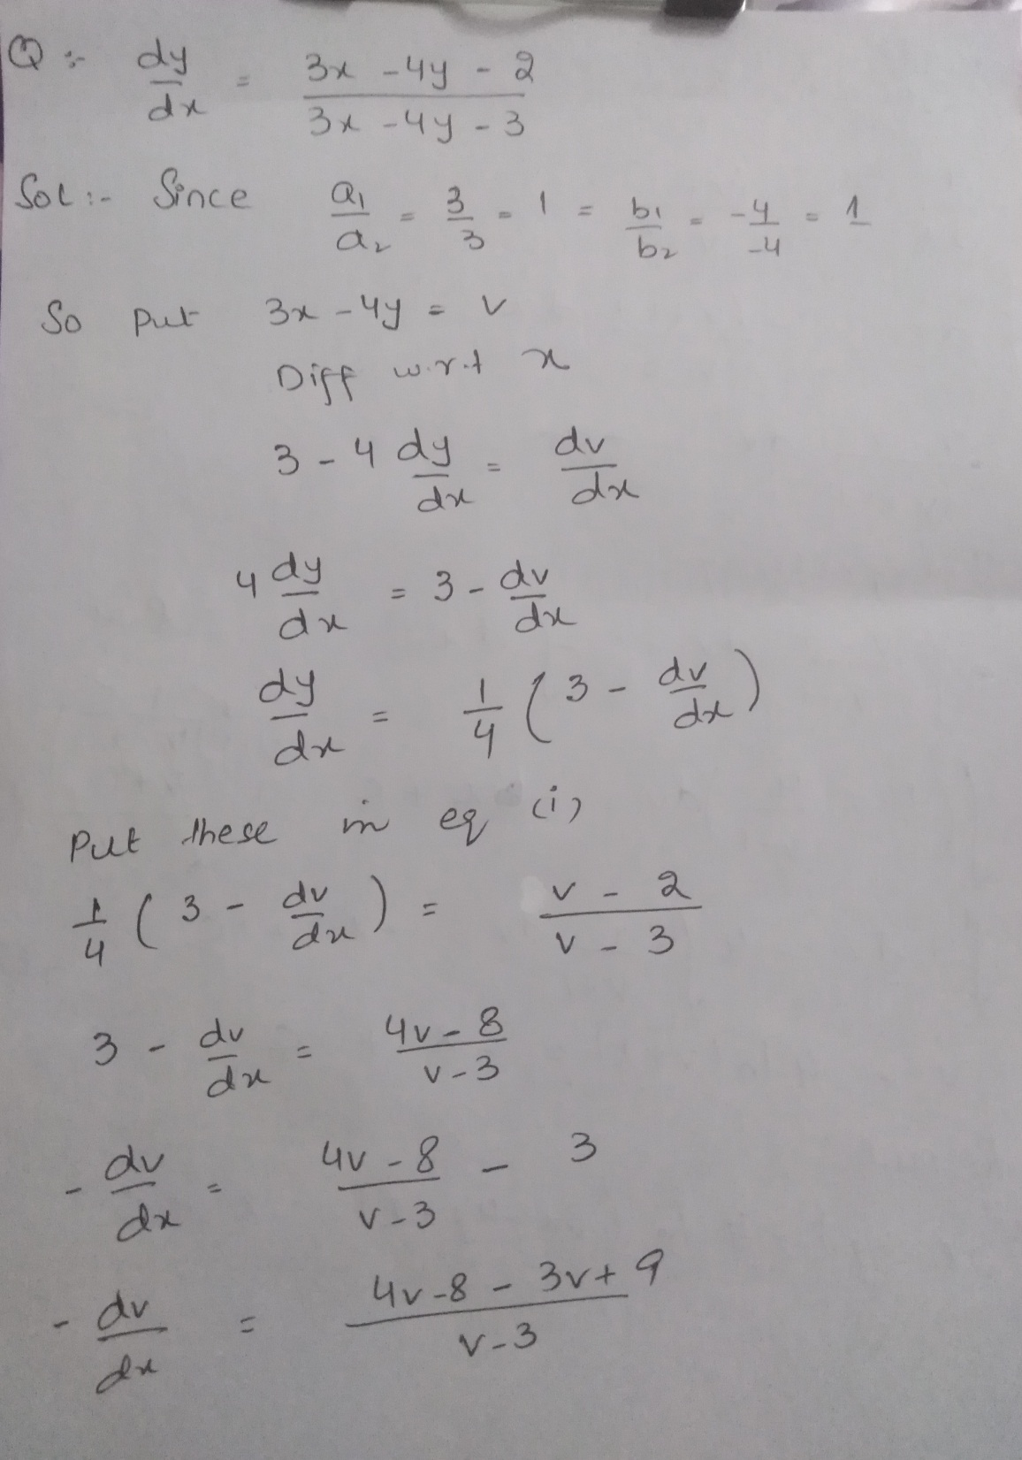

Slide 6
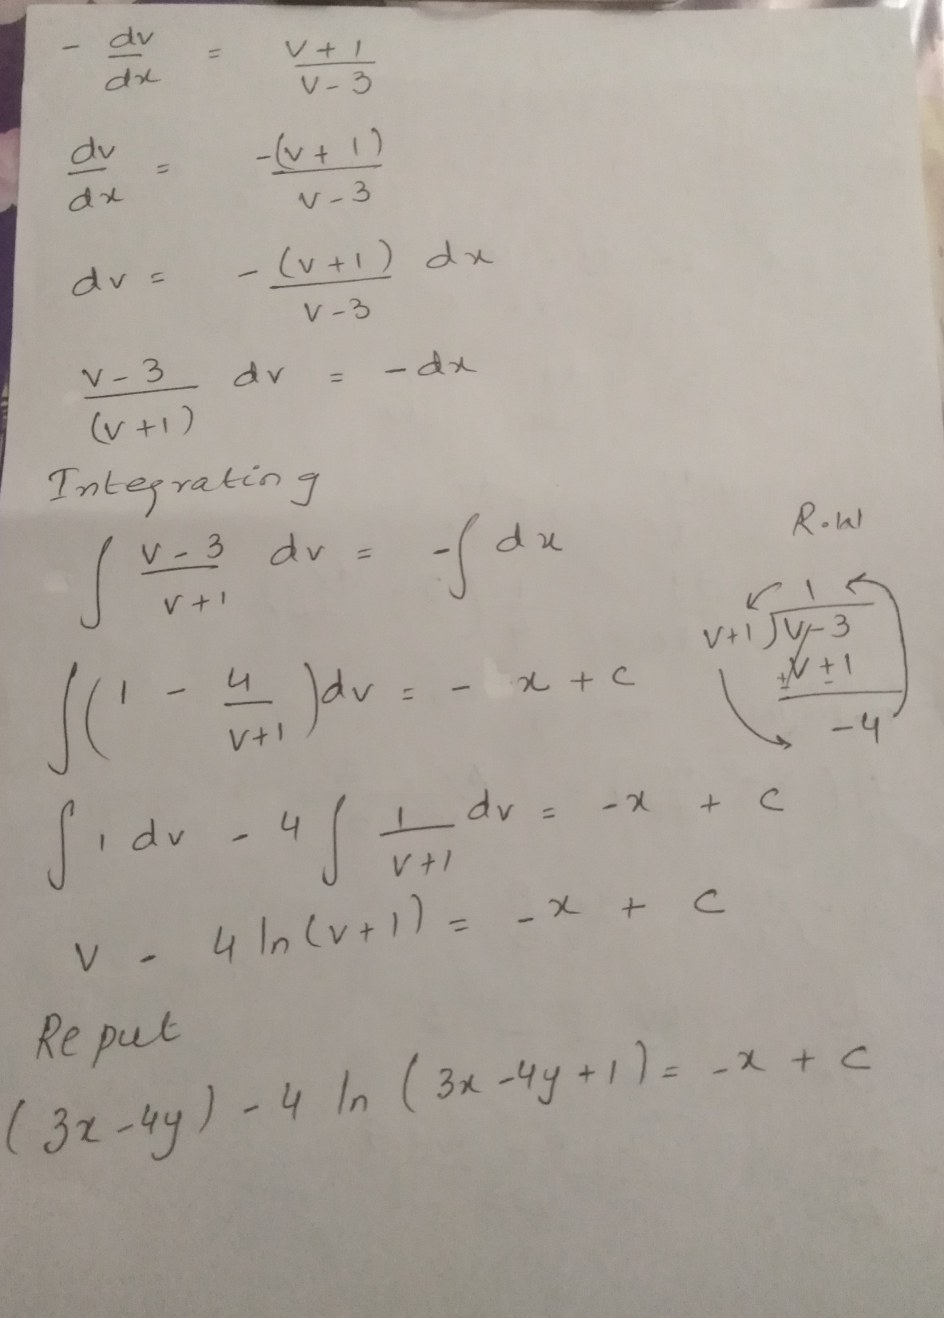

Slide 7
Practice Question

Slide 8
