Slide 1
Network Crashing

Slide 2
Project Management with Certain Time Estimates
Summary of steps:
Determine activities that need to be accomplished
Determine precedence relationships and completion times
Construct network diagram
Determine the critical path
Determine early start and late start schedules

Slide 3
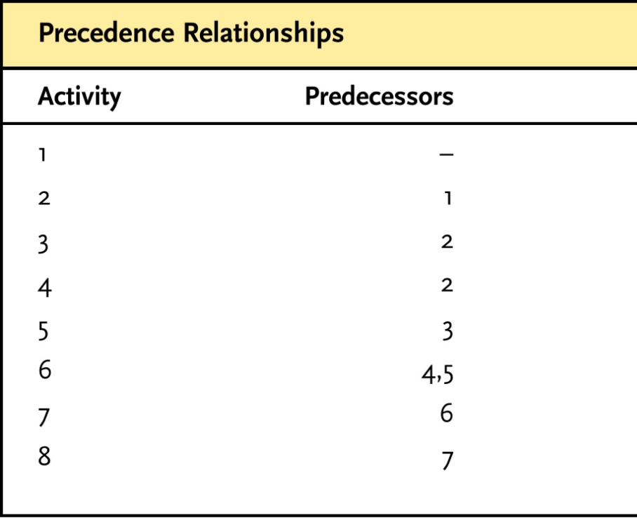
Project Management: Scheduling Projects with Certain Time Estimates
Create Network Diagram
Based on order of precedence among activities

Slide 4
Calculation of the Critical Path
Network approach helps calculate project duration
A “path” is a sequence of activities that begins at the start of the project and goes to the end of the project
1,2,3,5,6,7,8
1,2,4,6,7,8
The “critical path” is the path that takes the longest to complete
and thus determines the minimum duration of the project
3
5
1
2
6
7
8
4

Slide 5
Calculation of the Critical Path

Slide 6
Calculation of the Critical Path
Critical Path
The path that takes the longest to complete
2 weeks
3 weeks
3
5
4 weeks
10 weeks
16 weeks
4 weeks
1 week
1
2
6
7
8
4 weeks
4

Slide 7
Calculation of the Critical Path
Critical Path
The path that takes the longest to complete
2 weeks
3 weeks
3
5
4 weeks
10 weeks
16 weeks
4 weeks
1 week
1
2
6
7
8
4 weeks
4
C.P. = 40 weeks

Slide 8
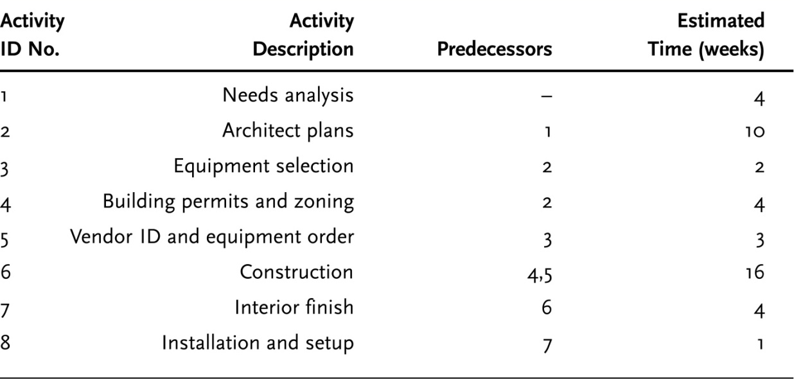
Calculation of the Critical Path
It is possible for multiple Critical Paths to exist
New information suggests that Activity 4 will take 5 weeks instead of 4
5
X
2 weeks
3 weeks
3
5
4 weeks
10 weeks
16 weeks
4 weeks
1 week
1
2
6
7
8
4 weeks
4

Slide 9
Calculation of the Critical Path
It is possible for multiple Critical Paths to exist
New information suggests that Activity 4 will take 5 weeks instead of 4
5
X
2 weeks
3 weeks
3
5
4 weeks
10 weeks
16 weeks
4 weeks
1 week
1
2
6
7
8
5 weeks
4
C.P. = 40 weeks

Slide 10
Calculation of the Critical Path
Critical Path may also shift if non-critical activity is lengthened or Critical Path activity is shortened
Another update indicates it will actually take 6 weeks for Activity 4
6
X
2 weeks
3 weeks
3
5
4 weeks
10 weeks
16 weeks
4 weeks
1 week
1
2
6
7
8
4 weeks
4

Slide 11
Calculation of the Critical Path
Critical Path may also shift if non-critical activity is lengthened or Critical Path activity is shortened
Another update indicates it will actually take 6 weeks for Activity 4
6
X
2 weeks
3 weeks
3
5
4 weeks
10 weeks
16 weeks
4 weeks
1 week
1
2
6
7
8
6 weeks
4
C.P. = 41 weeks

Slide 12
Determining Slack
Slack - The amount of time an activity on a non-critical path can be delayed without affecting the duration of the project (i.e., without putting it on the critical path)
Uses four calculated values
Early start - Earliest an activity can start (based on prerequisites)
Early finish - Earliest it can finish (based on prerequisites & duration)
Late start - Latest an activity can start and not delay the project
Late finish - Latest an activity can finish and not delay the project

Slide 13
Calculating Early Start (ES) and Early Finish (EF)
Move from left to right in network
ES for 1st activity usually zero
EF equals ES plus activity duration
ES is latest of the EF times of an activity’s predecessors
THIS IS CALLED THE FORWARD PASS

Slide 14
Calculating Late Start (LS) and Late Finish (LF)
Move from right to left in network
LF for last activity equals EF for last activity
Or target date if different
LS equals LF minus activity duration
LF is earliest of the LS times of an activity’s followers
THIS IS CALLED THE BACKWARD PASS

Slide 15
Calculating Slack
Computed by either:
Late Start - Early Start
or
Late Finish - Early Finish
Slack - The amount of time an activity on a non-critical path can be delayed without affecting the duration of the project (i.e., putting it on the critical path)
Activities that have zero slack are, by definition, on the critical path

Slide 16
Project Scheduling with Uncertain Time Estimates
Summary of steps:
Determine activities that need to be accomplished
Determine precedence relationships and completion times
Construct network diagram
Determine the critical path
Determine early start and late start schedules
Calculate the variances for the activity times
Calculate the probability of completing by the desired due date

Slide 17
Project Scheduling with Time Uncertainty
Take three time estimates
Optimistic - What is the (realistic) fastest we can get an activity done?
Pessimistic - What is the (realistic) worst case scenario for delay?
Most likely - What is our “most likely” estimate?

Slide 18
Project Scheduling with Time Uncertainty
Calculate the “expected time” for the activity
Where:
T_{e} = Expected Time
o = Optimistic estimate
m = Most likely estimate
p = Worst-case (pessimistic) estimate

Slide 19
Project Scheduling with Time Uncertainty
Activity #1
weeks
Activity #2
weeks
Activity #3
weeks

Slide 20
Using Variation in Time Estimates to Assess Duration Probabilities
How do we interpret this estimate???
Probability theory (“central limit theorem”) dictates that we assume that finish times across entire project are distributed “normally”
Probabilistically: 50% chance we will
finish faster, 50% chance
we will finish slower
2.17 weeks
3 weeks
3
5
4 weeks
10 weeks
16.17 weeks
4.17 weeks
1.17 weeks
1
2
6
7
8
4.17 weeks
4
C.P. = 40.68 weeks

Slide 21
Using Variation in Time Estimates to Access Duration Probabilities
Note that this is σ, not σ² ,
We have to take the square root of the
“variance” to get the standard deviation
Where:
Z = Number of standard deviations D is from T_{e}
T_{e} = Expected Time
D = Project duration I am thinking about

Slide 22
Using Variation in Time Estimates to Access Duration Probabilities
We recognize that there is variation around our estimates
We are estimating “most likely” or “expected” not “exact”
Commonly assume a “Beta” distribution
Another asymmetric distribution (because duration is never less than zero)
Calculating variance of the activity’s duration estimate:

Slide 23
Using Variation in Time Estimates to Access Duration Probabilities
Activity #1
weeks
Activity #2
weeks
Activity #3
weeks

Slide 24
Using Variation in Time Estimates to Assess Duration Probabilities
Calculate Critical Path using T_{e}
Accumulate the variances of the individual activities
Apply formula to estimate project duration probabilities
Where:
Z = Number of standard deviations D is from T_{e}
T_{e} = Expected Time
D = Activity duration I am thinking about

Slide 25
Using Variation in Time Estimates to Assess Duration Probabilities

Slide 26
Using Variation in Time Estimates to Assess Duration Probabilities
What is the probability of finishing in 39 weeks or less?
2.17 weeks
3 weeks
3
5
4 weeks
10 weeks
16.17 weeks
4.17 weeks
1.17 weeks
1
2
6
7
8
4.17 weeks
4

Slide 27
Using Variation in Time Estimates to Assess Duration Probabilities
Exhibit 8.22: Expected Values and Variances of Time Estimates
What is the probability of finishing in 39 weeks or less?
Critical Path = 40.68 weeks
Sum of Variances = 2.56 weeks
2.17 weeks
3 weeks
3
5
4 weeks
10 weeks
16.17 weeks
4.17 weeks
1.17 weeks
1
2
6
7
8
4.17 weeks
4

Slide 28
Using Variation in Time Estimates to Assess Duration Probabilities
Where:
Z = Number of standard deviations D is from T_{e}
T_{e} = Expected Time
D = Activity duration I am thinking about
Standard deviation difference between “most likely” and desired duration
1.6 = the square root of 2.56!!!
So, I look up the cumulative probability [G(z)] of the activity being completed before -1.05 standard deviations from the “most likely” estimate…
… and find out I have a 85.314% chance of finishing within 39 weeks!! FROM APPENDIX A PAGE A3

Slide 29
Using Variation in Time Estimates to Access Duration Probabilities
So, what if I want to be 90 percent sure that I hit the project duration that I tell my boss I will (or she will fire me)?
Reconfigure “Z” equation to solve for D
Pick the value of “Z” that corresponds to the level of certainty I want (90% = +1.30)
Solve
Find probability under G(z) in Appendix B and translate to number of standard deviations
weeks!!!
What if I can stand to be only 80% sure??

Slide 30
Crashing Projects
A methodical approach to reducing project duration
Focus on the time of activities on the critical path
Looking for greatest improvement with least cost
Additional labor, machinery
Overtime and temporary employees
Premiums paid to outside contractors for early delivery
Steps
Create network
Identify critical path
Identify costs of reducing each activity on path
Reduce most cost effective activity
Look for critical path changes
Beware of multiple critical paths
Crash next activity

Slide 31
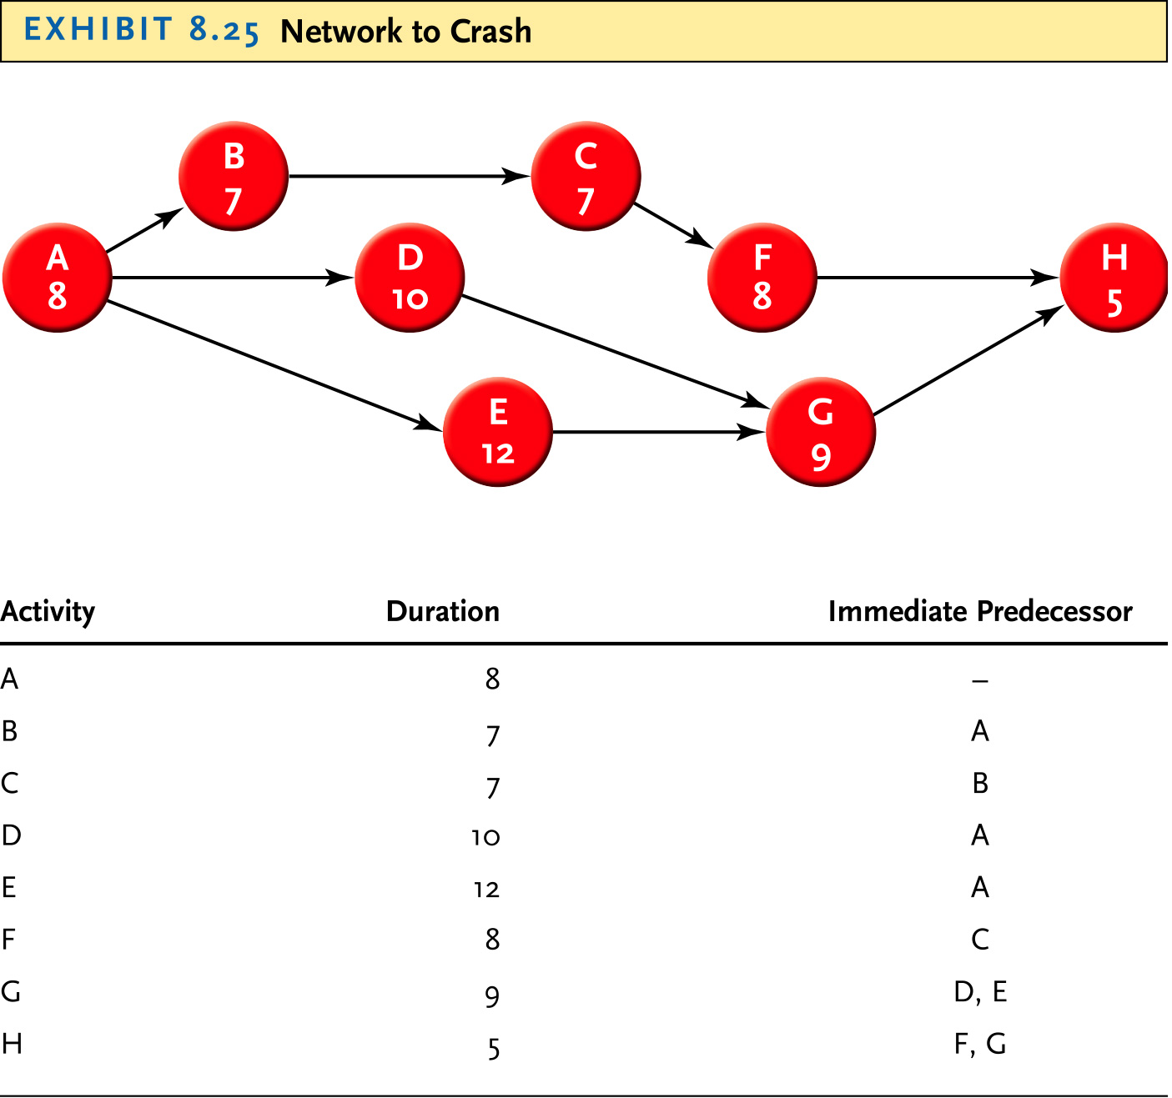
Crashing Projects: Create the Network

Slide 32
Crashing Projects: Identify the Critical Path
B
7
C
7
A
8
D
10
F
8
H
5
E
12
G
9
A-B-C-F-H
Critical Path = 35 days

Slide 33
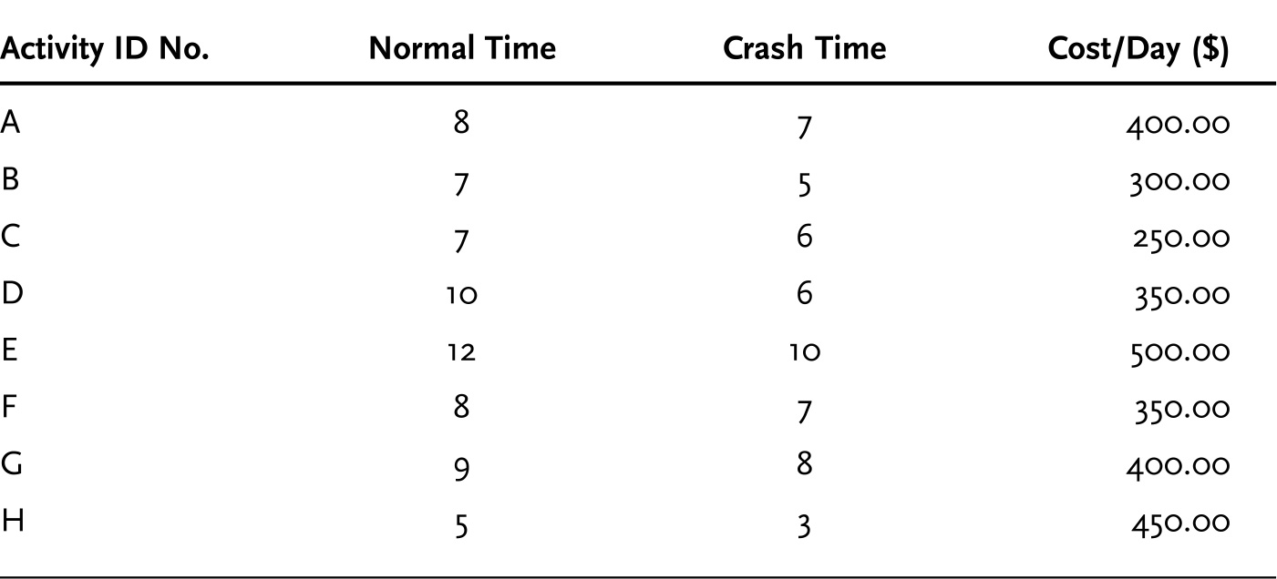
Crashing Projects: Identify Costs of Crashing Each Activity

Slide 34
Crashing Projects: Reduce Most Cost Effective Activity
6
B
7
C
7
X
A
8
D
10
F
8
H
5
E
12
G
9

Slide 35
Crashing Projects: Look for Critical Path Changes
6
B
7
C
7
X
A
8
D
10
F
8
H
5
E
12
G
9
Old Critical Path Completion = 35 days
Activity C Crashed by 1 day project completion = 34 days
Did that effect the critical path?

Slide 36
Crashing Projects: Look for Critical Path Changes
6
B
7
C
7
X
A
8
D
10
F
8
H
5
E
12
G
9
Multiple Critical Paths Appear!!!
Critical Path = 34 days

Slide 37
Crashing Projects: Crash Next Activity
Exhibit 8.25: Crash Time and Costs
Both C.P.
Path 1 Only
Path 2 Only

Slide 38
Crashing Projects: Summary
Exhibit 8.26: Crashing Summary
Solution

Slide 39
Caveats
Time estimates are frequently wrong
Early finishes are absorbed
Cushions get wasted
Resources aren’t always available when needed

