Slide 1
Cloud Computing
Module 61

Slide 2
SaaS: Issues and Concerns
The NIST has identified few issues and concerns about SaaS.
Most of these issues are due to network dependency of SaaS.

Slide 3
SaaS: Issues and Concerns
Browser based risks and remedies: Since the SaaS is accessed through browser installed on consumers’ device, the inherent vulnerabilities of the web browsers do have impact over SaaS security.

Slide 4
SaaS: Issues and Concerns
Although the browsers apply encryption upon network traffic, yet various network attacks such as brute force and man in the middle attacks are possible upon the SaaS data.
The resources leased by a consumer can be hijacked by malicious users due to poor implementation of cryptographic features of browsers.

Slide 5
SaaS: Issues and Concerns
If the consumer’s browser is already infected with a security threat (due to a visit to malicious website) then later, the same browser is used for SaaS access, then the SaaS data might get compromised.

Slide 6
SaaS: Issues and Concerns
If a single consumer accesses multiple SaaS services using browser instances, then the data of these SaaS instances may get mixed up.

Slide 7
SaaS: Issues and Concerns
A few suggestions by NIST:
Use different browsers to access each different SaaS.
Do not use the same web browser for web surfing and SaaS access.
Use a VM to access the SaaS.

Slide 8
SaaS: Issues and Concerns
Network dependence: SaaS application depends upon reliable and continuously available network.
The reliability of a public network (Internet) can not be guaranteed as compared to dedicated and protected communication links of private SaaS applications.

Slide 9
SaaS: Issues and Concerns
Lack of portability between SaaS clouds:, It may not be trivial to import export data among different SaaS applications deployed over different clouds due to customized development and deployment of SaaS applications and data formats.

Slide 10
SaaS: Issues and Concerns
Isolation vs. Efficiency (Security vs. Cost Tradeoffs): The SaaS provider has to make a trade-off decision as to deploy separate IT-resources (such as VMs) for each client or concurrently server multiple clients through a single deployment of SaaS application.

Slide 11
Cloud Computing
Module 62

Slide 12
NIST Recommendations for SaaS
Data protection: The consumer should analyze the data protection, configuration, database transaction processing technologies of SaaS provider. Compare them with the confidentiality, integrity, availability and compliance requirement of the consumer.

Slide 13
NIST Recommendations for SaaS
Client device/application protection: The consumer’s client device (browser running over a computer) should be protected to control the exposure to attacks.

Slide 14
NIST Recommendations for SaaS
Encryption: Strong encryption algorithm with key of required strength should be used for each web session as well as for data.

Slide 15
NIST Recommendations for SaaS
Secure data deletion: The data deletion through consumer’s request should be reliably done.
end

Slide 16
Cloud Computing
Module 63

Slide 17
PaaS Overview
According to NIST, PaaS provides a toolkit for conveniently developing, deploying and administering application software which can support a large number of users, process large volumes of data and can be accessed over Internet.

Slide 18
PaaS Overview
What does PaaS clouds really provide: a set of software building blocks, a set of development tools (languages and compilers) and supporting environments for run-time of applications developed over PaaS.

Slide 19
PaaS Overview
PaaS clouds also provide tools to deploy the developed applications.
Additionally, the PaaS clouds provide processing, storage and networking resources.

Slide 20
PaaS Overview
PaaS consumers:
Application developers
Application testers
Application deployers
Application administrators
Application end users (SaaS users)
The consumers are charged according to tools and IT-resources usage.

Slide 21
PaaS Overview
PaaS Software stack: The cloud provider fully controls the hardware and OS layers.
Hardware
Application
Middleware
Operating System

Slide 22
PaaS Overview
PaaS Provider/ Consumer Scope of Control: The provider has administrative control of middleware.
Hardware
Application
Middleware
Operating System

Slide 23
PaaS Overview
The provider has no control over application layer.
Hardware
Application
Middleware
Operating System

Slide 24
PaaS Overview
Remember that the application developed by using PaaS is deployed as SaaS and the PaaS consumer has full administrative control over that SaaS.
The provider however controls the runtime-environment which is necessary for PaaS application.

Slide 25
PaaS Overview
PaaS billing: Usually based on:
Number of consumers
kind of consumers (e.g., developers vs. application end users)
Storage, processing, or network resources consumed by the platform
Requests serviced
The time the platform is in use.

Slide 26
PaaS Overview
SaaS billing: Based on
Number of users
Time in use
Per-execution, per-record-processed
Network bandwidth consumed
Quantity/duration of data stored
end

Slide 27
Cloud Computing
Module 64

Slide 28
PaaS Examples
We are going to discuss a few examples of PaaS.

Slide 29
PaaS Examples
Google App Engine (GAE): Allows the users to create and host web based (Java, Python & Go) applications running over the infrastructure and services provided by Google.
GAE is a free service until the application grows to a significant size.

Slide 30
PaaS Examples
Force.com as a PaaS: This is a service of Salesforce.com (a SaaS provider). It offers four different programming environments for nonprogrammers, programmers and software vendors.

Slide 31
PaaS Examples
Nonprogrammers can create finance, HR etc. applications and websites without coding by using drag drop of controls.

Slide 32
PaaS Examples
Programmers can develop Java applications and deploy them as SaaS.
The software vendors can distribute and update their applications over cloud by using Force.com.

Slide 33
PaaS Examples
LongJump as a PaaS: Supports the entire cycle of software development from requirement gathering to application release and support. It is free of cost.

Slide 34
PaaS Examples
Openshift as a PaaS: It is a PaaS offering from Red Hat which is also the distributor for Red Hat Linux. Openshift PaaS provides the primary development tools for cloud based solutions written in PHP, Python and Ruby.

Slide 35
PaaS Examples
Openshift also provides development tools for Linux-based solutions written in C programming language.

Slide 36
PaaS Examples
Windows Azure and SQL Azure as a PaaS: Provided by Microsoft as a paid service. The users can develop applications in .Net as well as Java, PHP and Ruby.
SQL Azure provides database solutions for application developed and running inside Windows Azure.
end

Slide 37
Cloud Computing
Module 65

Slide 38
Benefits and Disadvantages of PaaS Solutions
Benefits:
Lower total cost of ownership in terms of hardware and software investment.
Lower administrative overhead of system development.
No requirement of software upgrades of tools.
Faster application development and deployment.

Slide 39
Benefits and Disadvantages of PaaS Solutions
Scalable resources available for the applications. The user pays only for the resources used.

Slide 40
Benefits and Disadvantages of PaaS Solutions
Disadvantages:
The inherent problem of data placed offsite raises the security concerns.
The integration of PaaS applications with on-site legacy solutions is not trivial.
The PaaS provider has to be trusted for data and application security.

Slide 41
Benefits and Disadvantages of PaaS Solutions
The issues of SaaS are also the issues of PaaS such as browser based risks, network dependence and isolation vs efficiency.
Portability of PaaS applications across different providers may not be possible sue to incompatibility in coding structures (hash, queue, file etc.).
end

Slide 42
Cloud Computing
Module 66

Slide 43
PaaS Recommendations
Generic interfaces: The consumer should make sure that the interfaces for hash tables, queues and files etc. are generic so that there will be less issues of portability (among PaaS providers) and interoperability (of applications) in future.

Slide 44
PaaS Recommendations
Standard language and tools: Choose a PaaS provider which offers standardized language and tools unless it is absolutely unavoidable to use the proprietary languages and tools.

Slide 45
PaaS Recommendations
Data access: The provider with the standardized data access protocol (such as SQL) should be preferred.

Slide 46
PaaS Recommendations
Data protection: The confidentiality, compliance, integrity and availability needs of the organization should be compared with the data protection mechanisms of the provider.

Slide 47
PaaS Recommendations
Application framework: The PaaS providers which offer the features in application development framework for eliminating security vulnerabilities of the application should be chosen.

Slide 48
PaaS Recommendations
Component testing: The software libraries provided by the PaaS provider should be aiming at providing proper functionality and performance.

Slide 49
PaaS Recommendations
Security and secure data deletion: Ensure that the PaaS applications can be configured to run in a secure manner (e.g., using cryptography during communication) and that a reliable mechanism for data deletion is provided by the PaaS provider.
end

Slide 50
Cloud Computing
Module 67

Slide 51
IaaS Overview
As an alternative to PaaS, some consumers may prefer to use IaaS in order to have management control over the IT resources.
The IaaS provider makes available the computing resources in the form of VMs.
The consumer has the duty of installing OS and software.

Slide 52
IaaS Overview
The provider also provides stable network access, network components such as firewalls, and data storage.

Slide 53
PaaS Overview
IaaS Provider/Consumer Scope of Control: The provider has no control over top three layers.
Hardware
Application
Middleware
Operating System
Hypervisor

Slide 54
PaaS Overview
IaaS Provider/Consumer Scope of Control: The provider has admin control over hypervisor and total control over hardware layer.

Slide 55
PaaS Overview
IaaS Provider/Consumer Scope of Control: The consumer has total control over top three layers.
Hardware
Application
Middleware
Operating System
Hypervisor

Slide 56
PaaS Overview
IaaS Provider/Consumer Scope of Control: The consumer can request the provider to deliver a VM from hypervisor layer.
The consumer has no control over hardware layer.

Slide 57
IaaS Overview
Customer billing:
Per CPU hour
Data GB stored per hour
Network bandwidth consumed, network infrastructure used (e.g., IP addresses) per hour
Value-added services used (e.g., monitoring, automatic scaling).
end

Slide 58
Cloud Computing
Module 68

Slide 59
IaaS Operational Overview
The operational infrastructure of IaaS will be discussed.

Slide 60
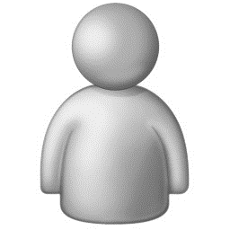
IaaS Operational Overview
Network
Legend
DOS – Data Object Storage
PLS – Persistent Local Storage
WAN
LAN
Cloud Manager
DOS
Queries, Cmds
Queries, Cmds
reports
reports
PLS
Cluster Manager
Cluster Manager
PLS
Queries, Cmds
Queries, Cmds
reports
reports
CM1
…
Computer Manager (CMj )
CMn
CM1
…
Computer Manager (CMj )
…
CMn
…
hypervisor
hypervisor
VM1
VM2
…
VMn
VM1
VM2
…
VMn

Slide 61
Cloud Computing
Module 68

Slide 62
IaaS Benefits
Saving in upfront cost: As in SaaS and PaaS. Although the responsibility of installing OS and software is of the consumer.

Slide 63
IaaS Benefits
Full administrative control over VM:
Start, shut down, pause
Installation of OS and applications
Accessing VM through network services of VM through a network protocol such as Secure Shell.

Slide 64
IaaS Benefits
Flexible and scalable renting: The VMs can be rented in any volume desired by the consumer. The rental for each VM can be on usage (of raw resources such as CPU, memory, bandwidth, storage, firewall, database etc.) basis.

Slide 65
IaaS Benefits
Portability and interoperability with legacy applications: Since the consumer has full control over the VM to install OS and other applications, the legacy applications (which are usually installed on consumer owned server/s) can be configured to run with or ported to the VM.
end

Slide 66
Cloud Computing
Module 70

Slide 67
IaaS Issues and Concerns
Network dependence
Browser based risks
As discussed for SaaS and PaaS.

Slide 68
IaaS Issues and Concerns
Compatibility with legacy software vulnerabilities: Since the consumer is allowed to install the legacy applications on VMs rented through IaaS, this exposes the VMs to the vulnerabilities in those legacy software.

Slide 69
IaaS Issues and Concerns
Implementation challenges exist for VM isolation: In order to prevent the VMs from eavesdropping other VMs mounted over same server, the isolation features of hypervisor are utilized. But these features may not withstand a sophisticated attacks.

Slide 70
IaaS Issues and Concerns
Dynamic network configuration for VM traffic isolation: A dynamic network path is provided from VM to consumer when a VM is rented. The provider has to isolate VM consumers from accessing the network traffic of other consumers.

Slide 71
IaaS Issues and Concerns
Data erase practices: When a VM is no longer rented by a consumer, the virtual drive of that VM must be erased/overwritten multiple times to eliminate any chance of residual data access by the next consumer of that VM.

Slide 72
IaaS Issues and Concerns
NIST recommendations for IaaS: The provider should implement data and network traffic isolation for the VM consumers. The features of data security as well as secure deletion of residual data of VM consumer.
end

Slide 73
Cloud Computing
Module 71

Slide 74
Identity as a Service (IDaaS)
Today within most companies, the users may have to log in to several applications servers (on premises and/or cloud) to perform daily tasks. Some of these systems may be cloud based.
The user has to remember multiple logins and passwords.

Slide 75
Identity as a Service (IDaaS)
When a user leaves a company, the related logins and passwords must be deleted.
The identity management is a complex task and therefore provided as a service for cloud consumers.
For example single sign on (SSO).

Slide 76
Identity as a Service (IDaaS)
Single sign on (SSO) software is installed over authentication server.
Before connecting to application servers, the user connects with the authentication server to obtain a secure ticket.

Slide 77
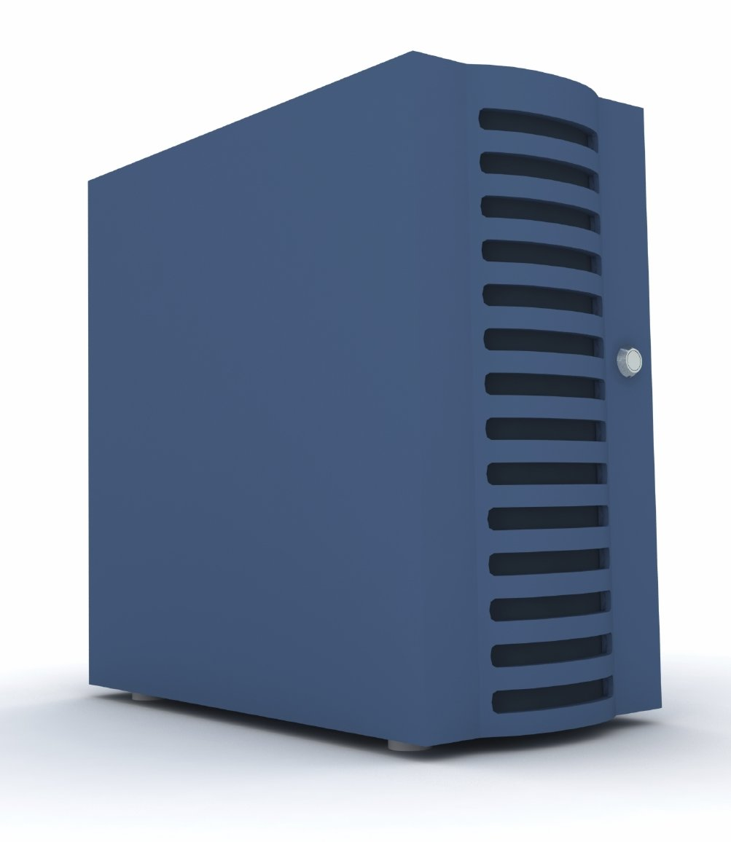
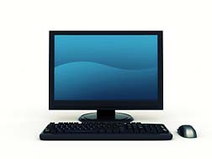
Identity as a Service (IDaaS)
3. Ticket
User
HR server
Payroll server
4. Ticket
2. Ticket
1. Username and password
5. Security credentials
Training server
Authentication server

Slide 78
Identity as a Service (IDaaS)
The authentication server maintains the user login security credentials required by application servers.
When the user leaves the company, only the user’s login on authentication server is needed to be disabled to block the user’s access to all the application servers.

Slide 79
Identity as a Service (IDaaS)
There are a few examples of IDaaS providers for on-premises and cloud applications such as Ping IDaaS and PasswordBank IDaaS.
end

