Slide 1
Components of Android Application (Detail)

Slide 2
Basic Component
Activities
Services
Broadcast Receivers
Content Providers

Slide 3
Activity

Slide 4
Functions in Activity
OnCreate()
This is the first callback and called when the activity is first created
OnStart()
This callback is called when the activity becomes visible to the user
OnResume()
This is called when the user starts interacting with the application
OnPause()
The paused activity does not receive user input and cannot execute any code and called when the current activity is being paused and the previous activity is being resumed.

Slide 5
Functions in Activity cont.
OnStop()
This callback is called when the activity is no longer visible
OnDestroy()
This callback is called before the activity is destroyed by the system
OnRestart()
This callback is called when the activity restarts after stopping it

Slide 6
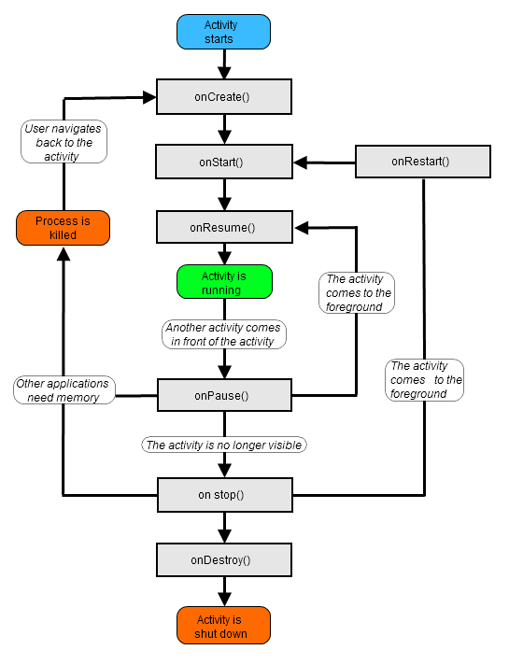

Slide 7
package com.example.helloworld;
import android.os.Bundle;
import android.app.Activity;
import android.util.Log; public class MainActivity extends Activity
{
String msg = "Android : "; /** Called when the activity is first created. */
@Override public void onCreate(Bundle savedInstanceState)
{
super.onCreate(savedInstanceState);
setContentView(R.layout.activity_main);
Log.d(msg, "The onCreate() event");
} /** Called when the activity is about to become visible. */
@Override protected void onStart()
{
super.onStart();
Log.d(msg, "The onStart() event");
} /** Called when the activity has become visible. */
@Override protected void onResume()
{
super.onResume();
Log.d(msg, "The onResume() event");
} /** Called when another activity is taking focus. */
@Override protected void onPause()
{
super.onPause();
Log.d(msg, "The onPause() event");
} /** Called when the activity is no longer visible. */
@Override protected void onStop()
{
super.onStop();
Log.d(msg, "The onStop() event");
} /** Called just before the activity is destroyed. */
@Override public void onDestroy()
{
super.onDestroy();
Log.d(msg, "The onDestroy() event");
}
}

Slide 8
Registering an Activity in Manifest
<?xml version="1.0" encoding="utf-8"?>
<manifest xmlns:android="http://schemas.android.com/apk/res/android"
package="com.example.tutorialspoint7.myapplication">
<application android:allowBackup="true"
android:icon="@mipmap/ic_launcher"
android:label="@string/app_name"
android:supportsRtl="true"
android:theme="@style/AppTheme">
<activity android:name=".MainActivity">
<intent-filter>
<action android:name="android.intent.action.MAIN" />
<category android:name="android.intent.category.LAUNCHER" />
</intent-filter>
</activity>
</application>
</manifest>

Slide 9
Service

Slide 10
Types of Service
Service is created by one of the two methods:
Started
A service is started when an application component, such as an activity, starts it by calling startService(). Once started, a service can run in the background indefinitely, even if the component that started it is destroyed
Bound
A service is bound when an application component binds to it by calling bindService(). A bound service offers a client-server interface that allows components to interact with the service, send requests, get results, and even do so across processes with interprocess communication (IPC).

Slide 11
Functions in Service
onStart()
The system calls this method when another component, such as an activity, requests that the service be started, by calling startService(). If you implement this method, it is your responsibility to stop the service when its work is done, by calling stopSelf() or stopService() methods.
onBind()
The system calls this method when another component wants to bind with the service by calling bindService(). If you implement this method, you must provide an interface that clients use to communicate with the service, by returning an IBinder object. You must always implement this method, but if you don't want to allow binding, then you should return null.

Slide 12
Functions in Service cont.
onUnbind()
The system calls this method when all clients have disconnected from a particular interface published by the service.
onRebind()
The system calls this method when new clients have connected to the service, after it had previously been notified that all had disconnected in its onUnbind(Intent).
onCreate()
The system calls this method when the service is first created using onStartCommand() or onBind(). This call is required to perform one-time set-up.
onDestroy()
The system calls this method when the service is no longer used and is being destroyed. Your service should implement this to clean up any resources such as threads, registered listeners, receivers, etc.

Slide 13
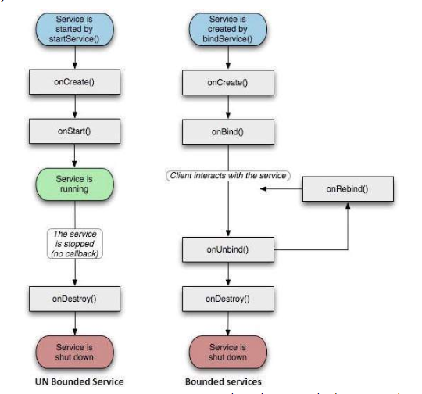

Slide 14
package com.example.tutorialspoint7.myapplication;
import android.app.Service;
import android.content.Intent;
import android.os.IBinder;
import android.support.annotation.Nullable;
import android.widget.Toast;
/** * Created by TutorialsPoint7 on 8/23/2016. */
public class MyService extends Service
{
@Nullable @Override public IBinder onBind(Intent intent)
{
return null;
}
@Override public int onStartCommand(Intent intent, int flags, int startId)
{
// Let it continue running until it is stopped.
Toast.makeText(this, "Service Started",
Toast.LENGTH_LONG).show();
return START_STICKY;
}
@Override public void onDestroy()
{
super.onDestroy();
Toast.makeText(this, "Service Destroyed",
Toast.LENGTH_LONG).show();
}
}

Slide 15
Registering an Service in Manifest
<?xml version="1.0" encoding="utf-8"?>
<manifest xmlns:android="http://schemas.android.com/apk/res/android"
package="com.example.tutorialspoint7.myapplication">
<application android:allowBackup="true"
android:icon="@mipmap/ic_launcher"
android:label="@string/app_name"
android:supportsRtl="true"
android:theme="@style/AppTheme">
<activity android:name=".MainActivity">
<intent-filter>
<action android:name="android.intent.action.MAIN" />
<category android:name="android.intent.category.LAUNCHER" />
</intent-filter>
</activity>
<service android:name=".MyService" />
</application>
</manifest>

Slide 16
Broadcast Receiver

Slide 17
Broadcast Receiver Steps
Creating Broadcast Receiver
A broadcast receiver is implemented as a subclass of BroadcastReceiverclass and overriding the onReceive() method where each message is received as a Intent object parameter.
public class MyReceiver extends BroadcastReceiver {
@Override public void onReceive(Context context, Intent intent)
{
Toast.makeText(context, "Intent Detected.",
Toast.LENGTH_LONG).show();
} }

Slide 18
Registering Broadcast receiver
An application listens for specific broadcast intents by registering a broadcast receiver in AndroidManifest.xml file. Consider we are going to register MyReceiver for system generated event ACTION_BOOT_COMPLETED which is fired by the system once the Android system has completed the boot process.
<application
android:icon="@drawable/ic_launcher"
android:label="@string/app_name"
android:theme="@style/AppTheme" >
<receiver android:name="MyReceiver">
<intent-filter>
<action android:name="android.intent.action.BOOT_COMPLETED">
</action>
</intent-filter>
</receiver>
</application>

Slide 19
System Generated Broadcast Receiver
There are several types system generated messages
android.intent.action.BATTERY_CHANGED
android.intent.action.BATTERY_LOW
android.intent.action.BATTERY_OKAY
android.intent.action.BUG_REPORT
android.intent.action.CALL
android.intent.action.CALL_BUTTON
android.intent.action.DATE_CHANGED

Slide 20
Costum made Intents
package com.example.tutorialspoint7.myapplication;
import android.app.Activity;
import android.content.Intent;
import android.os.Bundle;
import android.view.View;
public class MainActivity extends Activity
{
/** Called when the activity is first created. */
@Override public void onCreate(Bundle savedInstanceState)
{
super.onCreate(savedInstanceState);
setContentView(R.layout.activity_main);
}
// broadcast a custom intent.
public void broadcastIntent(View view)
{
Intent intent = new Intent();
intent.setAction("com.tutorialspoint.CUSTOM_INTENT");
sendBroadcast(intent);
}
}
In order to generate your own intent:
Override broadcastIntent() in main java file
This costume intent is then sent to broadcast

Slide 21
Content Provider

Slide 22
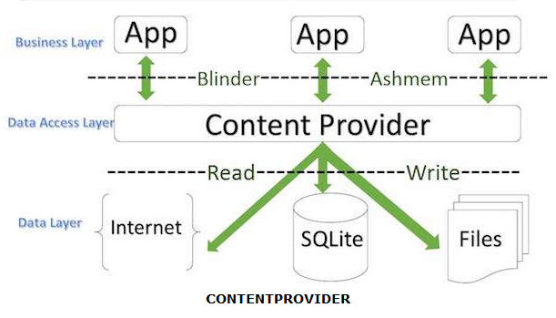
Mechanism of Content Provider

Slide 23
Content URI
Content URIs
To query a content provider, you specify the query string in the form of a URI which has following format
<prefix>://<authority>/<data_type>/<id>

Slide 24
Content URI cont.
Prefix
This is always set to content
Authority
This specifies the name of the content provider, for example contacts, browser etc. For third-party content providers, this could be the fully qualified name, such as com.tutorialspoint.statusprovider
Data type
This indicates the type of data that this particular provider provides. For example, if you are getting all the contacts from the Contacts content provider, then the data path would be people and URI would look like thiscontent://contacts/people
ID
This specifies the specific record requested. For example, if you are looking for contact number 5 in the Contacts content provider then URI would look like this content://contacts/people/5.

