Slide 1
Management
Management is the act of getting people together to accomplish desired goals and objectives using available resources efficiently and effectively.
.

Slide 2
Management can be defined as the process of administering and controlling the affairs of the organization, irrespective of its nature, type, structure and size. It is an act of creating and maintaining such a business environment wherein the members of the organization can work together, and achieve business objectives efficiently and effectively

Slide 3
Nature of Management
Management acts as a guide to a group of people working in the organization and coordinating their efforts, towards the attainment of the common objective.
In other words, it is concerned with optimally using 5M’s, i.e. men, machine, material, money and methods and, this is possible only when there proper direction, coordination and integration of the processes and activities, to achieve the desired results.

Slide 4
Different type of Management Styles
Traditional Management
There is a hierarchy of employees, low level management, mid-level management, and senior management. In traditional management systems, the manager sets out expectations for the employees who need to meet goals, but the manager receives the reward of meeting those goals.
Team Management
In a team management arrangement the manager is a guiding hand to help the members of the team work together to solve problems but doesn’t dictate policy and the entire team receives the reward of meeting those goals.
Servant Management
With this approach, the manager helps supply resources the employees need to meet company goals. In servant leadership, the organization recognizes employees as experts in their field and work to help them work efficiently.

Slide 5
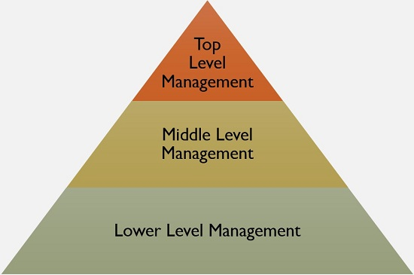
Levels of Management
Top-Level Management: This is the highest level in the organizational hierarchy, which includes Board of Directors and Chief Executives. They are responsible for defining the objectives, formulating plans, strategies and policies.
Middle-Level Management: It is the second and most important level in the corporate ladder, as it creates a link between the top and lower level management. It includes departmental and division heads and managers who are responsible for implementing and controlling plans and strategies which are formulated by the top executives.
Lower Level Management: Also called functional or operational level management. It includes first line managers, foreman, supervisors. As lower level management directly interacts with the workers, it plays a crucial role in the organization because it helps in reducing wastage and idle time of the workers, improving quality and quantity of output.

Slide 6
The Need for Management
Management is needed in order to coordinate the activities of a business and make sure all employees are working together toward the accomplishment of the organization’s goals
Management is needed in order to perform certain functions

Slide 7
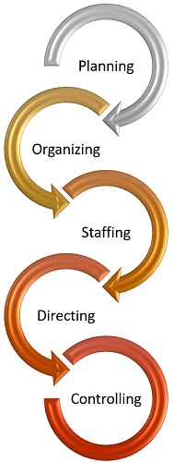
Functions of Management

Slide 8
Planning: It is the first and foremost function of management, i.e. to decide beforehand what is to be done in future. It encompasses formulating policies, establishing targets, scheduling actions and so forth.
Organizing: Once the plans are formulated, the next step is to organize the activities and resources, as in identifying the tasks, classifying them, assigning duties to subordinates and allocating the resources.
Staffing: It involves hiring personnel for carrying out various activities of the organization. It is to ensure that right person is appointed to the right job.
Directing: It is the task of the manager to guide, supervise, lead and motivate the subordinates, to ensure that they work in right direction, so far as the objectives of the organization are concerned.
Controlling: The controlling function of management involves a number of steps to be taken to make sure that the performance of the employees is as per the plans. It involves establishing performance standards and comparing them with the actual performance. In case of any variations, necessary steps are to be taken for its correction.

