Slide 1
Main Memory
Chapter 3 (Lec-03)

Slide 2
Main Memory
Main memory consists of several small storage areas called locations or cells.
Each memory location has a unique number assigned to it called address.
Instructions and data of a program reside mainly in this area when CPU is executing the program.

Slide 3
Types of Main Memory
Random Access Memory (RAM)
Read Only Memory (ROM)
Random Access Memory (RAM)
Volatile in nature
In case of power interruption all the data in RAM is lost.
RAM can only store data as long as computer is ON.

Slide 4
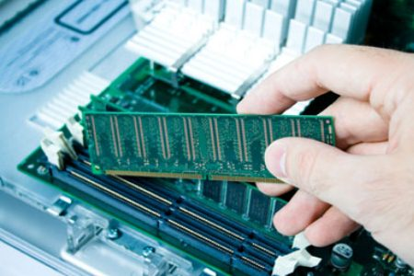
Types of Main Memory
RAM CHIP

Slide 5
Types of Main Memory
RAM chips are of two types
Dynamic RAM
Static RAM
Dynamic RAM
Uses an external circuitry to periodically “regenerate” or refresh storage charge to retain the stored data.
Static RAM
Does not need any special regenerator circuit to retain the stored data.
Faster, costlier and consumes more power.

Slide 6
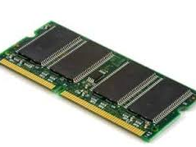
Types Of RAM- Dynamic Ram

Slide 7
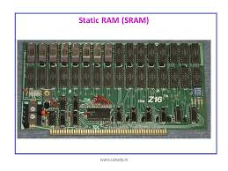
Types Of RAM--Static RAM

Slide 8
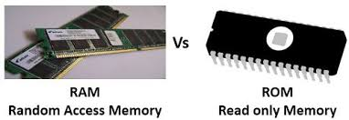
Read Only Memory(ROM)
data is stored permanently
Usual program can’t alter this data.
The process of permanently storing data in ROM chip is called “Burning in of data”.
ROM chip does not lose its data in case of power off or interruption.
There are two types of read only memory.
Manufactured programme
User programmed

Slide 9
Read Only Memory
Manufactured programme
data is burnt in by the manufacturer of the electronic equipment in which it is used.
User programmed
A user can load and store “read-only” programs and data.
It is possible for a user to “customise” a system by converting his/her programs to programmable Read Only Memory (PROM) because a user can program it.
Once a user programs a PROM chip it becomes a ROM.

