Slide 1
Mineral Trioxide Aggregate

Slide 2
Introduction
Quest for newer material are never ending especially in the field of dental science. Various material have been formulated, tested and standard to obtain maximum benefit for good clinical performance

Slide 3
One such new material is Mineral Trioxide Aggregate (MTA), which was introduced by Dr.Mahmoud Torabinejad at Loma Linda University, California, US and the first literature about the material appeared in 1993

Slide 4
History

Slide 5
Properties of MTA
PH
initial pH of 10.2 which rises to 12.5 (similar to calcium hydroxide) following setting The high pH is theorized to be responsible for the antimicrobial action and biological activity of the material

Slide 6
Working time 5minutes
Setting time 3-4hours(old one) 20minutes
Solubility MTA displays low or nearly no solubility, which is attributable to addition of the bismuth oxide

Slide 7
Compressive strength
The compressive strength of set MTA is about 70 mpa
Biocompatible
good Sealing Ability (resist Micro leakage)
Usually a thickness of 3 mm to 5 mm is sufficient to provide a good seal.

Slide 8
Retentive strength : MTA is not suitable as luting agent
Marginal adaptation is better than intermediate Restorative Material (IRM)
Ethoxy Benzoic Acid (super EBA)
amalgam and GIC

Slide 9
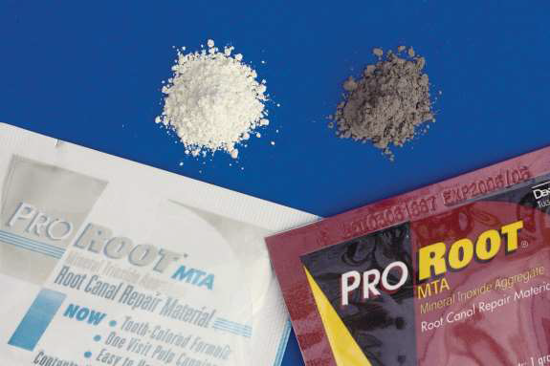
Types of MTA
White MTA
Grey MTA

Slide 10
MTA was introduced as grey but because of the discoloration problem ,white MTA was developed in 2002

Slide 11
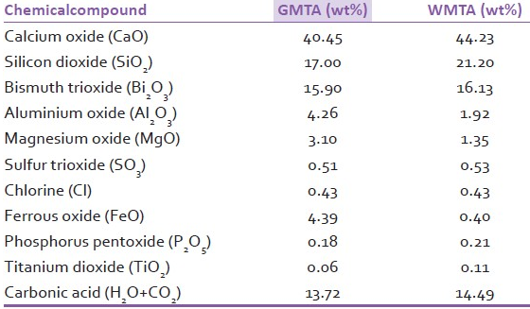
Chemical compositions of GMTA and WMTA

Slide 13
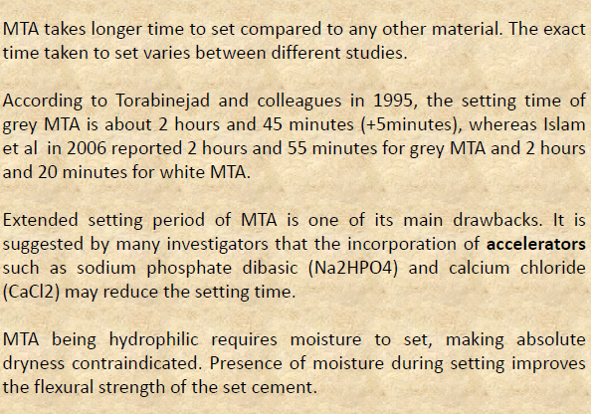

Slide 15
Advantages of MTA
versatile application
biocompatible
excellent sealing ability
set in the presence of Moisture
MTA has the capacity to induce bone, dentin, and cementum formation and regeneration of periapical tissues (periodontal ligament)
Least cytotoxic compared with other materials .

Slide 16
Disadvantages of MTA
technique sensitive require operator experience

