Slide 1
Machine Learning
Lecture-01
Dr. Fazal-e-Malik
Assistant Professor , Computer Science Department,
Iqra National University, Peshawar.
Phone: 0346-9138373
Email: fazal_i_malik@yahoo.com

Slide 2
Outline
What today’s AI Can Do?
Traditional AI
AI Development Statistical Techniques
Need of Machine Learning
What is machine learning (ML)?
How Machine Learning (ML) is performed?
What is the difference between AI and Machine Learning?
History and relationships to other fields

Slide 3
What today’s AI (Artificial Intelligence) Can Do?
When you tag a face in a Facebook photo, it is AI that is running behind the scenes and identifying faces in a picture.
Face tagging is now all over in several applications that display pictures with human faces.
Why just human faces? There are several applications that detect objects such as cats, dogs, bottles, cars, etc.
We have autonomous cars running on our roads that detect objects in real time to steer the car.
When you travel, you use Google Directions to learn the real-time traffic situations and follow the best path suggested by Google at that point of time. This is yet another implementation of object detection technique in real time.
Let us consider the example of Google Translate application that we typically use while visiting foreign countries. Google’s online translator app on your mobile helps you communicate with the local people speaking a language that is foreign to you.
There are several applications of AI that we use practically today. In fact, each one of us use AI in many parts of our lives, even without our knowledge.
Today’s AI can perform extremely complex jobs with a great accuracy and speed. Let us discuss an example of complex task to understand what capabilities are expected in an AI application that you would be developing today for your clients.

Slide 4
Example - What today’s AI Can Do?
We all use Google Directions during our trip anywhere in the city for a daily commute or even for inter-city travels. Google Directions application suggests the fastest path to our destination at that time instance.
When we follow this path, we have observed that Google is almost 100% right in its suggestions and we save our valuable time on the trip.
You can imagine the complexity involved in developing this kind of application considering that there are multiple paths to your destination and the application has to judge the traffic situation in every possible path to give you a travel time estimate for each such path.
Besides, consider the fact that Google Directions covers the entire globe. Undoubtedly, lots of AI and Machine Learning techniques are in-use under the covers of such applications.
This continuous demand for the development of such applications, increases the demand for IT professionals with AI skills.

Slide 5
Traditional AI
AI began in the 1950's when the computing power was a fraction of what it is today.
AI started out with the predictions made by the machine in a fashion a statistician does predictions using his calculator.
Thus, the initial entire AI development was based mainly on statistical techniques.

Slide 6
AI Development Statistical Techniques
The development of today’s AI applications started with using the age-old traditional statistical techniques. Straight-line interpolation has been used in schools to predict a future value.
There are several other such statistical techniques which are successfully applied in developing so-called AI programs. “so-called” because the AI programs that we have today are much more complex and use techniques far beyond the statistical techniques used by the early AI programs.
Some of the examples of statistical techniques that are used for developing AI applications in those days and are still in practice are listed here −
Regression
Classification
Clustering
Probability Theories
Decision Trees
These statistical techniques can be used for developing AI applications based on limited data due to some limitations while for huge data more advanced methods such as deep learning are developed to solve many complex problems.

Slide 7
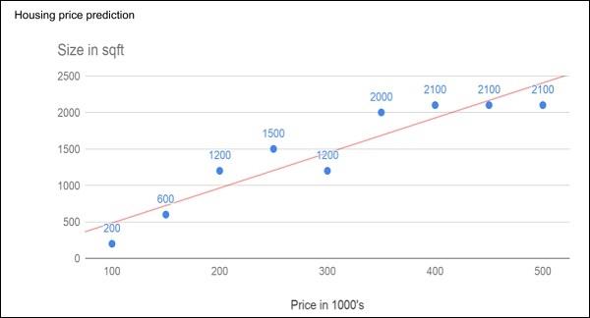
Need of Machine Learning
Consider the following figure that shows a plot of house prices versus its size in sq. ft.
A best-fit line shows our predictions for any other house given its size after having various data points on the XY.
Feed the known data to the machine and ask it to find the best fit line. Once the best fit line is found by the machine, you will test its suitability by feeding in a known house size, i.e. the Y-value in the above curve.
The machine will now return the estimated X-value, i.e. the expected price of the house. The diagram can be extrapolated to find out the price of a house which is 3000 sq. ft. or even larger. This is called regression in statistics.
Particularly, this kind of regression is called linear regression as the relationship between X & Y data points is linear.

Slide 8
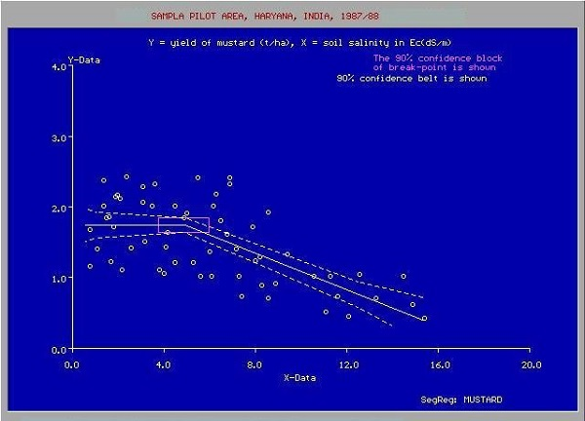
Need of Machine Learning
In many cases, the relationship between the X & Y data points may not be a straight line, and it may be a curve with a complex equation. Your task would be now to find out the best fitting curve which can be extrapolated to predict the future values. One such application plot is shown in the given figure.
The statistical optimization techniques will be used to find out the equation for the best fit curve here. And this is what exactly Machine Learning is about.
The known optimization techniques can be used to find the best solution to the problem.

Slide 9
What is machine learning (ML)?
Machine Learning (ML)is enabling computers to tackle tasks that have, until now, only been carried out by people.
ML is an application of artificial intelligence (AI) that provides systems the ability to automatically learn and improve from experience without being explicitly programmed.
ML is the process of teaching a computer system how to make accurate predictions when fed data.
Those predictions could be answering
whether a piece of fruit in a photo is a banana or an apple, spotting people crossing the road in front of a self-driving car,
whether the use of the word book in a sentence relates to a paperback or a hotel reservation,
whether an email is spam, or recognizing speech accurately enough to generate captions for a YouTube video.
From driving cars to translating speech, machine learning is using the capabilities of artificial intelligence - helping software make sense of the disordered and unpredictable real world.
The key difference from traditional computer software is that a human developer hasn't written code that instructs the system how to tell the difference between the banana and the apple.
ML algorithms build a mathematical model based on sample data, known as "training data", in order to make predictions or decisions without being explicitly programmed to do so.

Slide 10
How Machine Learning (ML) is performed?
ML involves computers discovering how they can perform tasks without being explicitly programmed to do so.
It involves computers learning from data provided so that they carry out certain tasks.
For simple tasks assigned to computers, it is possible to program algorithms telling the machine how to execute all steps required to solve the problem at hand; on the computer's part, no learning is needed.
For more advanced tasks, it can be challenging for a human to manually create the needed algorithms.
In practice, it can turn out to be more effective to help the machine to develop its own algorithm, rather than having human programmers specify every needed step.
ML employs various approaches to teach computers to accomplish tasks where no fully satisfactory algorithm is available.
In cases where vast numbers of potential answers exist, one approach is to label some of the correct answers as valid. This can then be used as training data for the computer to improve the algorithm(s) it uses to determine correct answers.
For example, to train a system for the task of digital character recognition, the MNIST dataset of handwritten digits has often been used.

Slide 11
What is the difference between AI and Machine Learning?
Machine learning may have enjoyed huge success of late, but it is just one method for achieving artificial intelligence.
At the birth of the field of AI in the 1950s, AI was defined as any machine capable of performing a task that would typically require human intelligence.
AI systems will generally demonstrate at least some of the following characters:
planning,
learning,
reasoning,
problem solving,
knowledge representation,
perception,
motion,
Manipulation
social intelligence and creativity.
Along with machine learning, there are various other approaches used to build AI systems, including
evolutionary computation, where algorithms undergo random mutations and combinations between generations in an attempt to "evolve" optimal solutions,
expert systems, where computers are programmed with rules that allow them to simulate the behavior of a human expert in a specific domain, for example an autopilot system flying a plane.

Slide 12
History and relationships to other fields
In 1959 , the term machine learning was invented by Arthur Samuel, an American IBMer and pioneer in the field of computer gaming and artificial intelligence.
In 1960s, Nilsson’s book on machine learning research was dealing mostly with machine learning for pattern classification.
In 1970s, Interest in pattern recognition was continued and described by Duda and Hart in 1973.
In 1981 a report was given on using teaching strategies so that a neural network learns to recognize 40 characters (26 letters, 10 digits, and 4 special symbols) from a computer terminal.
Tom M. Mitchell provided a more formal definition of the algorithms studied in the machine learning field: "A computer program is said to learn from experience E with respect to some class of tasks T and performance measure P if its performance at tasks in T, as measured by P, improves with experience E.“
This follows Alan Turing's proposal in his paper "Computing Machinery and Intelligence", in which the question "Can machines think?" is replaced with the question "Can machines do what we (as thinking entities) can do?

