Slide 1
Concrete Technology Lecture 9 Concrete Mix Design ACI-211

Slide 2
Introduction
The required properties of hardened concrete are specified by the designer of structure and the properties of fresh concrete are by the type of construction and by the technique and placing and transportation.
In this chapter we will briefly summarize those important factors which are taken into account in the process of mix design. Specifications lay down limiting values of range of properties that need to be specified.

Slide 3
American Concrete Institute Method of Mix Design
Mix design can be defined as the process of selecting suitable ingredients of concrete and determining their relative proportions with the object of producing concrete of certain minimum strength and durability as economically as possible.
The purpose of designing from the above definition is two folds
The first object is to achieve the stipulated minimum strength and durability.
The second object is to make the concrete in the most economical manner.

Slide 4
American Concrete Institute Method of Mix Design
Data to be collected:
Sieve analysis of coarse and fine aggregate for determination do fineness modulus.
Unit weight of coarse aggregate by dry rodded method.
Bulk specific gravities and absorptions of aggregates. Aggregates are assumed in saturated surface dry condition.
Mixing water requirements of concrete developed from experience and available aggregates.
Absorption characteristics of coarse aggregate and fine aggregate.
Relationship between strength and water cement ratio.
Specific gravity of Portland cement or other cementations material used.

Slide 5
American Concrete Institute Method of Mix Design
Procedure:
Choice of slump.
Choice of maximum size of aggregate.
Estimation of mixing water and air content.
Selection of water-cement or water-cementitious material ratio.
Calculation of cement content.
Estimation of coarse aggregate content.
Estimation of fine aggregate content.
Adjustments for aggregate absorption.
Trial batch adjustment.

Slide 6
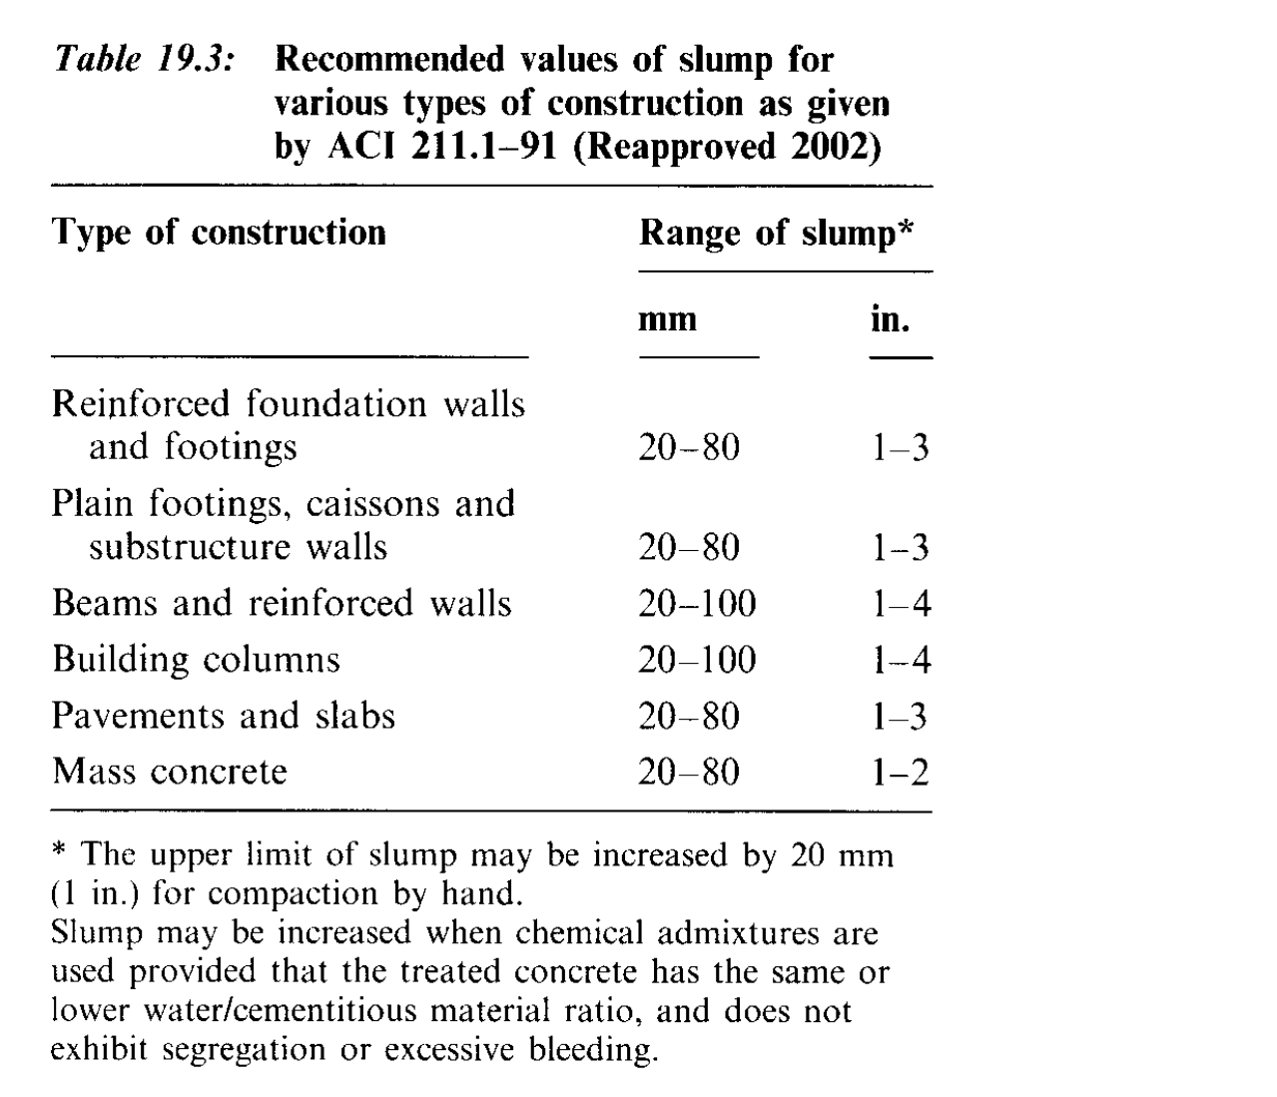
1. Choice of slump

Slide 7
2. Choice of maximum size of aggregate
Large nominal maximum sizes of well graded aggregates have less voids than smaller sizes. Hence, concretes with the larger-sized aggregates require less mortar per unit volume of concrete. Generally, the nominal maximum size of aggregate should be the largest that is economically available and consistent with dimensions of the structure.
In no event should the nominal maximum size exceed
one-fifth of the narrowest dimension between sides of forms
One-third the depth of slabs.
Three-fourths of the minimum clear spacing between individual reinforcing bars.

Slide 8
3. Estimation of mixing water and air content
The quantity of water per unit volume of concrete required to produce a given slump is dependent on
The nominal maximum size of aggregate.
Particle shape and grading of the aggregates;
the concrete temperature;
the amount of entrained air
Use of chemical admixtures.

Slide 9
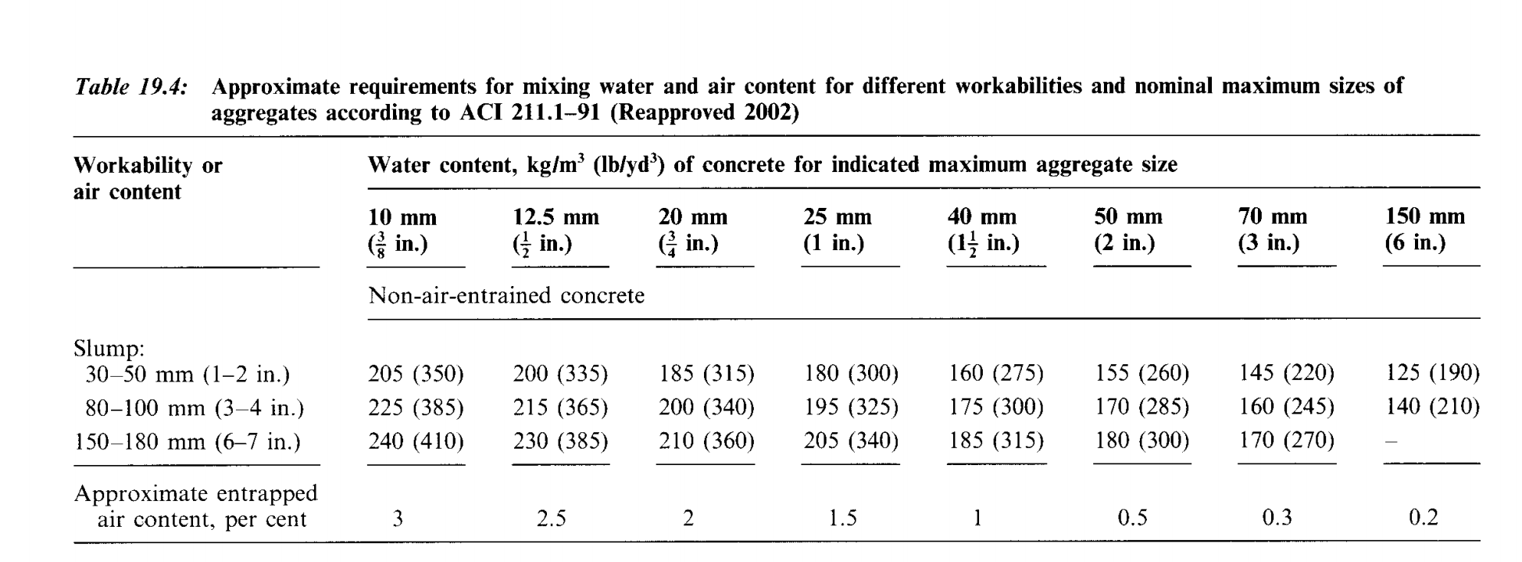

Slide 10
4. Selection of Water-Cement Ratio
The required W/C is determined by strength as well as durability requirements.
Approximate and relatively conservative values of strength for a given W/C ratio containing Type 1cement can be taken from table.

Slide 11
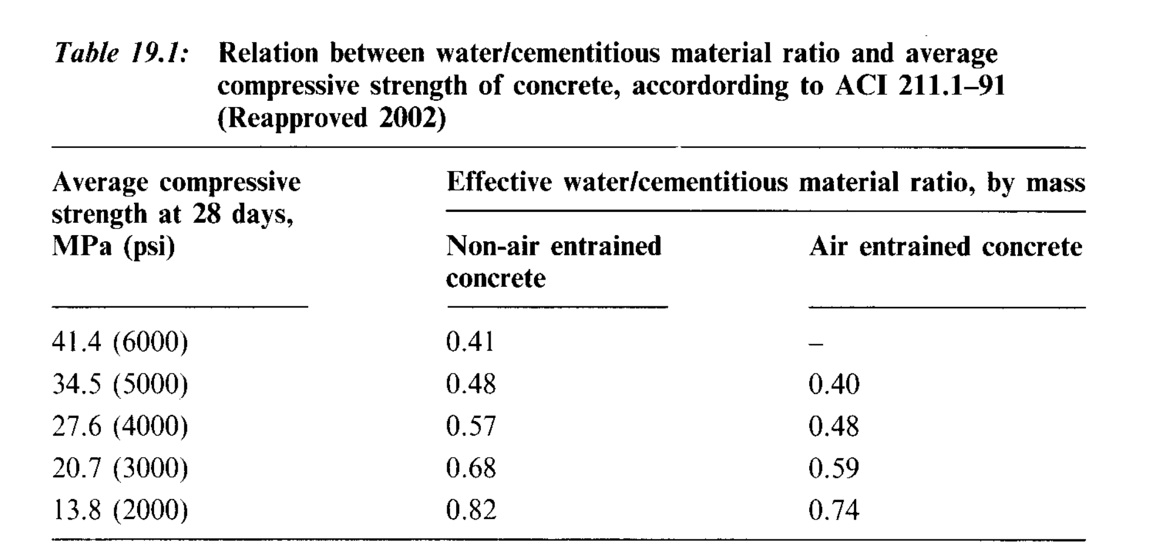

Slide 12
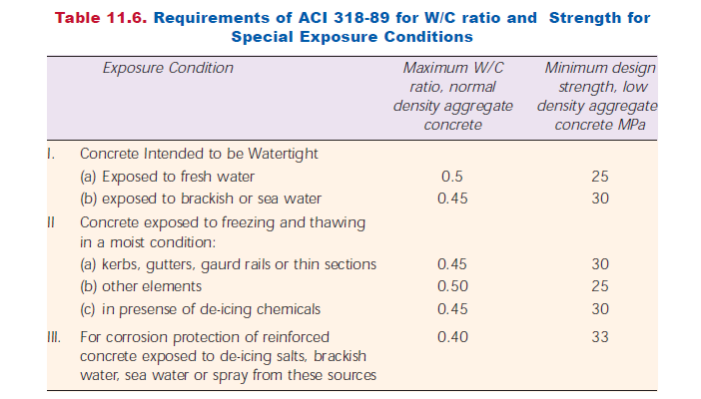

Slide 13
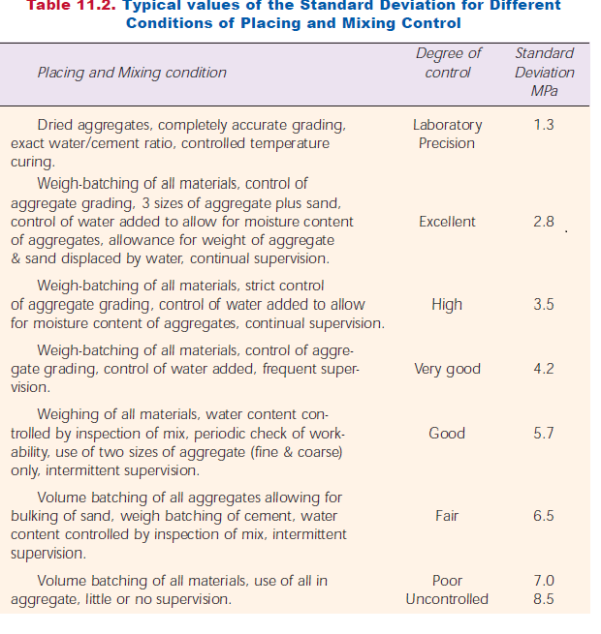

Slide 14
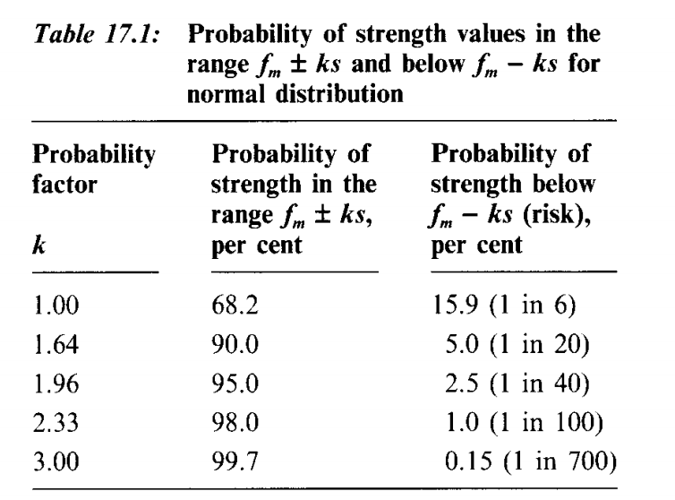

Slide 15
5. Calculation of cement content
The amount of cement per unit volume of concrete is fixed by the determination made in Step 3 and step 4.
The require cement content C$=\frac{Mixing Water content (Step 3)}{\frac{W}{C} (step 4)}$

Slide 16
6. Estimation of Coarse aggregate for cement
Appropriate values for this aggregate volume are given in Table 6.3.6. The volume of CA is in ft³
For equal workability, the volume of coarse aggregate in a unit volume of concrete is dependent only on its nominal maximum size and the fineness modulus of the fine aggregate.

Slide 17
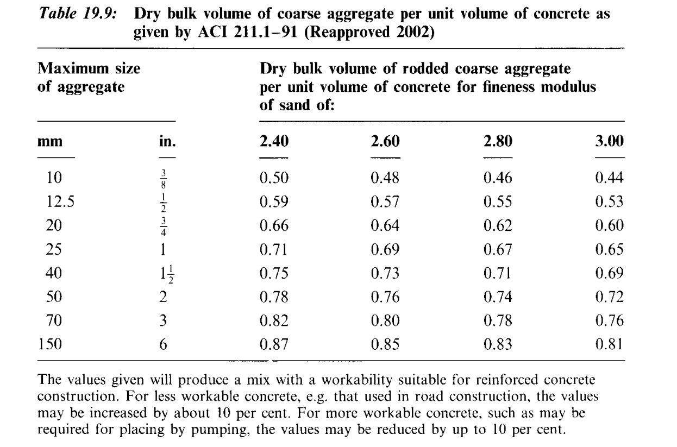

Slide 18
7. Estimation of Fine Aggregate Content.
At completion of Step 6, all ingredients of the concrete have been estimated except the fine aggregate. Its quantity is determined by difference.
Either of two procedures may be employed:
the weight method
or the absolute volume method
Both these methods have been used in the example problem.

Slide 19
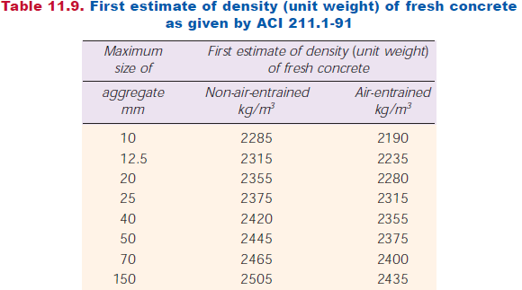

Slide 20
American Concrete Institute Method of Mix Design
Example :
Design a concrete mix for construction of an elevated water tank. The specified design strength of concrete is 30 Mpa at 28 days measured on a standard cylinder. Standard deviation can be taken as 4 Mpa. The specific gravity of FA and CA are 2.65 and 2.7 respectively. The dry rodded bulk density of CA is 1600 kg/m³ and fineness modulus of FA is 2.80. Ordinary Portland Cement type 1 will be used. A slump of 50mm is necessary. CA is found to be absorptive to the extent of 1% and free surface moisture in sand is found to be 2%. Assume any essential data.

Slide 21
American Concrete Institute Method of Mix Design
Preparing the Mix design
Assuming 5 percent of results are allowed to fall below specified design strength.
$$fm=fmin+k.s$$
Where fm= mean compressive strength, fmin= Minimum compressive strength or specified design strength, s=standard deviation, k= Himsworth constant
fm= 30 + 1.64 *4
= 36.56 MPa
Standard deviation S = 4 from the question
We took The value of Factor K from Himsworth Constant (´Table 17.1). There is 5% result falling below specified design strength.

Slide 22
American Concrete Institute Method of Mix Design
In case Standard deviation is not given, approximate equations specified by ACI can also be used.
In case s is available, the larger value of following equations can be used
$fm=fmin+1.34s$
and, when fmin≤35Mpa
Mpa; $fm=fmin+2.33s−3.5$
Psi; $fm=fmin+2.33s−500$
or, when fmin≥35MPa
MPa; $fm=0.9fm+2.33s$
Average Strength (MPa) | Range (Mpa)
fm = fmin + 6.9 | fmin<20.7
fm = fmin + 8.3 | 20.7<fmin<34.5
fm = fmin + 10.9 | fmin>34.5

Slide 23
American Concrete Institute Method of Mix Design
Since OPC is used, from Table 19.1, the estimated w/c ratio is 0.48
This water cement ratio from strength point of view is to be checked against maximum w/c ratio given in table 11.6 and minimum of the two is to be adopted.
From table 19.4, for a slump of 50mm, 20 mm maximum size of aggregate, for non-air entrained concrete
the mixing water content is 185 kg/m³ of concrete. Also the approximate entrapped air content is 2%
The required cement content = 185/0.48 = 385.41kg/m³ (wt of cement)

Slide 24
American Concrete Institute Method of Mix Design
From table 19.9, for 20mm coarse aggregate, for fineness modulus of 2.80, the dry rodded bulk volume of C.A is 0.62 per unit volume of concrete.
Therefore, the weight of C.A = 0.62 * 1600
= 992 kg/m³
Note: 1600 is not a constant value, so how do we get the Value 1600
Weight of Coarse aggregate (A)= weight of container and coarse aggregate - weight of Container (Kg)
Volume of Container (B) = (π/4D²* L) (Cm³)
Bulk Density = A/B = C (g/cm³)
= C (Kg/m³)

Slide 25
American Concrete Institute Method of Mix Design
From table 11.9, the first estimate of density of fresh concrete for 20 mm maximum size of aggregate and for non-air-entrained concrete is =2355kg/m³
The weight of all known ingredients of concrete
Weight of Water = 185 kg/m³
weight of Cement = 394 kg/m³
Weight of CA = 992 kg/m³
Weight of FA = 2355 – (185+394+992)
= 784 kg/m³
Alternatively the weight of F.A can also be found out by absolute volume method which is more correct

Slide 26
American Concrete Institute Method of Mix Design
Tabulate the absolute volume of all the known ingredients
Item number | Ingredients | Weight kg/m³ | Absolute volume cm³
1 | Cement | 394/3.15 *10³ | 125 *10³
2 | Water | 185/1* 10³ | 185 *10³
3 | Coarse aggregate | 992/2.7 *10³ | 367 *10³
4 | Air | 2/100 * 10⁶ | 20 *10³
3.15 is cement specific gravity, 1 is water specific gravity , 2.7 is specific gravity given in the question

Slide 27
American Concrete Institute Method of Mix Design
Total absolute volume = 697 *10³ cm³
Therefore absolute volume of FA
= (1000 - 697) * 10³
= 303*10³
Weight of FA = 303*2.65
= 803 kg/m³
Adopt FA = 803 kg/m³

Slide 28
American Concrete Institute Method of Mix Design
Estimated quantities of material per cubic meter of concrete are
Cement = 394kg
F.A = 803kg
C.A = 992kg
Water = 185kg
Density of fresh concrete = 2374kg/m³
First estimate of density of
fresh concrete = 2355 for 20mm aggregate (11.9)

Slide 29
American Concrete Institute Method of Mix Design
Proportions
Cement | Fine aggregate | Coarse aggregate | water
394 | 803 | 992 | 185
394/394 | 803/394 | 992/394 | 185/394
1 | 2.04 | 2.52 | 0.47
Weight of material for one Bag mix in Kg = 50
50 | 50 * 2.04 | 50*2.52 | 50 * 0.47
1 | 102 | 126 | 23.5
The above quantities are on the basis that both FA and CA are in saturated and surface Dry condition (SSD Condition)

Slide 30
American Concrete Institute Method of Mix Design
The proportions are required to be adjusted for the field conditions. FA has a surface moisture of 2 percent
Total free surface moisture in FA = 2/100 *803 = 16.06 kg/m³
Weight of FA in field condition = 803 + 16.06 = 819 kg/m³
C.A absorbs 1% water
Quantity of water absorbed by CA = 1/100*992 = 9.92 kg/m³
Weight of CA in Field Condition = 992 – 9.92
= 982.08 kg/m³ say 982.0 kg/m³

Slide 31
American Concrete Institute Method of Mix Design
Now with regard to water, 16.06 kg of water is contributed by FA and 9.92 kg of water is absorbed by CA
Therefore 16.06 – 9.92 = 6.14 kg
6.14 extra water is contributed by aggregates. This quantity of water is deducted from total water
i.e., 185.00 – 6.14 = 178.86 kg/m³.
say 179 kg/m³.

Slide 32
American Concrete Institute Method of Mix Design
Quantities of materials to be used in field duly corrected for free surface moisture in FA and absorption characteristics of CA
Cement = 394 kg/m³
F.A = 819 kg/m³
C.A = 982 kg/m³
Water = 179 kg/m³
Field density of fresh concrete = 2374 kg/m³.

Slide 33
THE END

