Slide 2
Intro: Engr. Saleha Durrani B.Sc. Electrical Engineering from UET Pesh. Masters in Communications from UET Pesh.

Slide 3
Subject: Electronics II Lecture # 9.

Slide 4
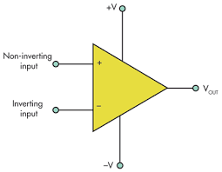
5.Input Impedance
Two basic ways of specifying the input impedance are
1. Differential input impedance
2. Common mode input impedance

Slide 5
Input Impedance
1. Differential input impedance:
It is the total resistance between inverting and non inverting inputs.
It is measured by determining the change in bias current for a given change in differential input voltage.
2. Common mode input impedance:
It is the resistance between each input & ground.
While it is measured by determining the change in bias current for a given change in common mode input voltage

Slide 7
6.Input Offset Current
“It is the difference of the input bias currents, expressed as an absolute value”.
Formula:
Ios=I I1-I2 I

Slide 8
7. Output Impedance Zout
“It is the resistance viewed from the output terminal of the op-amp.”

Slide 9
9. Slew Rate
The maximum rate of change of the output voltage in response to a step input voltage is the slew rate of an op-amp

Slide 10
Negative Feedback
“Negative feedback is the process whereby a portion of the output voltage of an amplifier is returned to the input with a phase angle that opposes ( or subtracts from) the input signal”
Inverting (-) input effectively makes the feedback signal 180’ out of phase with the input signal.

Slide 11
Op-Amps with negative Feedback.

Slide 12
Magic Rules of Op-amps
Rule #1:
No Current flows in or out of the inputs.
Rule# 2:
The Op-amps tries to keep the inputs, the same voltage ( This rule does not apply on the open loop configuration of op-amps)

Slide 13
1.Op-amp as Buffer

Slide 14
2. Op-amp as Non Inverting Amplifier

Slide 15
3.Op-amp as Inverting Amplifier
Formula:
Av= -RF/ R1

Slide 16
Op-amp Input & Output Signals

Slide 17
Input & output signals of Inverting and Non Inverting Amplifier.

Slide 18
1.Comparators
“Op-amp are often used as comparators to compare the amplitude of one voltage with another”.
“In Comparator, op-amp is used in open loop configuration with the input voltage on one input and a reference voltage on the other.”
The op-amp voltage comparator compares the magnitudes of two voltage inputs and determines which is the largest of the two.

Slide 19
Types of Comparators
1. Zero Level Detector
2. Non-zero Level Detector

Slide 20
1. Zero Level Detector
One application of op-amp used to determine when the input voltage exceeds a certain level is called Zero level detector.
In this Inverting Input……………….Grounded
Non inverting input……………….Input signal voltage
It can also be used as squaring circuit.

Slide 21
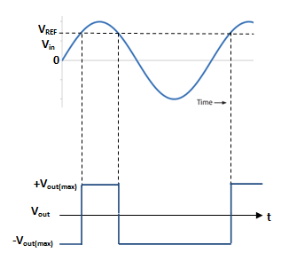
Zero Level Detector
Vout
Vin

Slide 24
2. Non Zero Level Detectors
a. Battery Reference
b. Voltage-Divider Reference
c. Zener Diode sets Reference Voltage

Slide 25
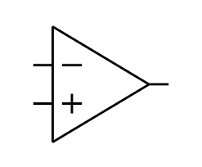
a. Battery Reference of Non-zero Level Detector
25
Vout
VREF
Vin

Slide 26
Non-zero Level Detector (Battery Reference)
Zero level detector is modified to detect positive and negative voltages by connecting fixed reference voltage source to the inverting input and Input signal voltage to the non inverting input.

Slide 27
b. Voltage-Divider Reference
Formula:
VREF= [ R2 ] x (+V)
R1 + R2
b) Voltage divider reference
a) Battery Reference

Slide 28
c. Zener Diode sets Reference Voltage

Slide 29
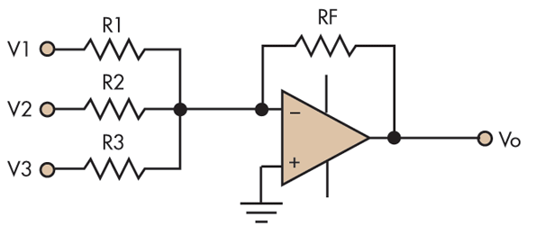
Summing Amplifiers
“Summing amplifier is a type of operational amplifier circuit which can be used to sum signals. The sum of the input signal is amplified by a certain factor and made available at the output.”
Any number of input signal can be summed using an opamp. The circuit shown below is a three input summing amplifier in the inverting mode

Slide 30
.“ Summing amplifier is an application of inverting op-amp configuration that has two or more inputs and its output voltage is proportional to the negative of the algebraic sum of its input voltages.”

Slide 31
Important Concepts
1. Infinite input impedance
2. Virtual ground

Slide 32
Derivation of Vout Formula
According to KVL:
IT= I1 + I2…………………….eq.1
According to Ohm’s Law output voltage will be:
Vout= - IT Rf………………….eq.2
Reason (for negative sign): Summing amplifier is an inverting amplifier.
Putting values of eq.1 in eq.2
Vout=-(I1+I2) x Rf…………...eq.3

Slide 33
According to Ohm’s Law V=IR
VIN1=I1 R1
Therefore
I1=VIN/R1
I2=VIN/R2
I3=VIN/R3
Put these values in eq.3

Slide 34
Vout=-[ VIN1/R1+ VIN2/R2+VIN3/R3] RF………..eq.4
If the three resistors are equal R1=R2=R3=Rf=R
Vout=-[ VIN1/R+ VIN2/R+VIN3/R] R
Vout=-[VIN1+ VIN2+VIN3]……………eq.5
Vout=-[VIN1+ VIN2+VIN3……….VINn]

Slide 35
Summing Amplifier with gain greater than unity
When Rf is greater than input resisters the amplifier has a gain of Rf/R, where R is the value of each equal value input resistor.
Vout= -(Rf/R)* [Vin1+ Vin2+……….VinN]

Slide 36
Problem # 13.6
Determine output voltage for summing amplifier.Vin1=0.2V, Vin2=0.5V, R1=R2=1k ohms, Rf=10k Ohms.

Slide 37
DATA:
Given:
Vin1=0.2V
Vin2=0.5V
R1=R2= 1k Ohms
Rf= 10k Ohms
Required:
Vout=?

Slide 38
Solution:
Formula: Vout= -( Rf/R) * (Vin1+ Vin2)
=-(10k/1k)* (0.2+0.5)
= -7V Answer
……………………………………………………………………………………………….

Slide 39
Assignment
Question # 1.
Briefly explain Class A, B & C amplifiers.
Question # 2.
Draw the tree diagram of various Input Modes of Operational Amplifiers (with definitions)

Slide 40
Quiz
Q1. Draw the buffer circuit
Q2. Write the “Majic Rules of Op-Amps.”
Q3. What are the two basic ways of specifying
the input impedance with circuit diagram.

