Slide 1
Analog to Digital Conversion
Lecture 9
Signals & Systems

Slide 2
Introduction
Most of the signals directly encountered in science and engineering are continuous.
Analog-to-Digital Conversion (ADC) is the process that allow digital computers to interact with these everyday signals.

Slide 3
Introduction
Digital information is different from its continuous counterpart in two important respects:
It is sampled, and it is quantized.
Both of these restrict how much information a digital signal can contain.

Slide 4
The Sampling Theorem

Slide 5
Proper Sampling
The definition of proper sampling is quite simple. Suppose you sample a continuous signal in some manner.
If you can exactly reconstruct the analog signal from the samples, you must have done the sampling properly.
Even if the sampled data appears confusing or incomplete, the key information has been captured if you can reverse the process.

Slide 6
Proper Sampling
A continuous signal is sampled properly if the samples contain all the information needed to recreate the original waveform.

Slide 7
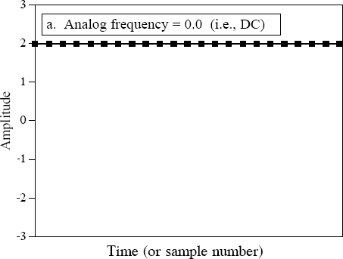
Example
The continious line represents the analog signal entering the ADC, while the square markers are the digital signal leaving the ADC
The analog signal is a constant DC value, a cosine wave of zero frequency
All of the information needed to reconstruct the analog signal is contained in the digital data. This is proper sampling.

Slide 8
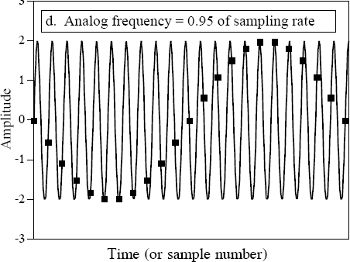
Example (continued)
Do these samples properly represent the data? No, they don't!
The samples represent a different sine wave from the one contained in the analog signal.
This phenomenon of sinusoids changing frequency during sampling is called aliasing

Slide 9
The Sampling Theorem
For instance, a sampling rate of 200 samples/second requires the analog signal to be composed of frequencies below 100 cycles/second.
If frequencies above this limit are present in the signal, they will be aliased to frequencies between 0 and 100 cycles/second.

Slide 10
The Sampling Theorem
Frequently this is called the Shannon sampling theorem, or the Nyquist sampling theorem.
The sampling theorem indicates that a continuous signal can be properly sampled, only if it does not contain frequency components above one-half of the sampling rate.

Slide 11
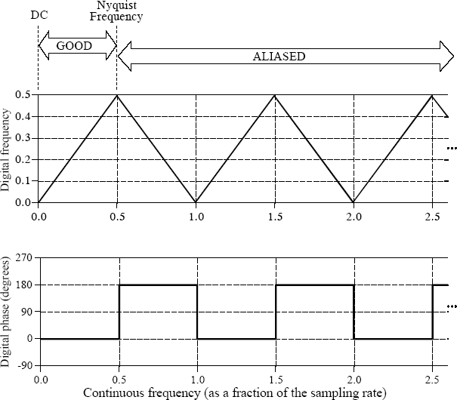
The Sampling Theorem
The figure shows how frequencies are changed during aliasing.
The key point to remember is that a digital signal cannot contain frequencies above one-half the sampling rate (i.e., the Nyquist frequency rate.

Slide 12
The Sampling Theorem
The last Figure shows the conversion of analog frequency into digital frequency during sampling.
Continuous signals with a frequency less than one-half of the sampling rate are directly converted into the corresponding digital frequency.
Above one-half of the sampling rate, aliasing takes place, resulting in the frequency being misrepresented in the digital data.
Aliasing always changes a higher frequency into a lower
frequency between 0 and 0.5.
In addition, aliasing may also change the phase of the signal by 180 degrees.

Slide 13
The Sampling Theorem
Sampling has generated new frequencies. Is this proper sampling?
The answer is yes, because the sampling signal can be transformed back into the original signal by eliminating all frequencies above ½fs.

Slide 14
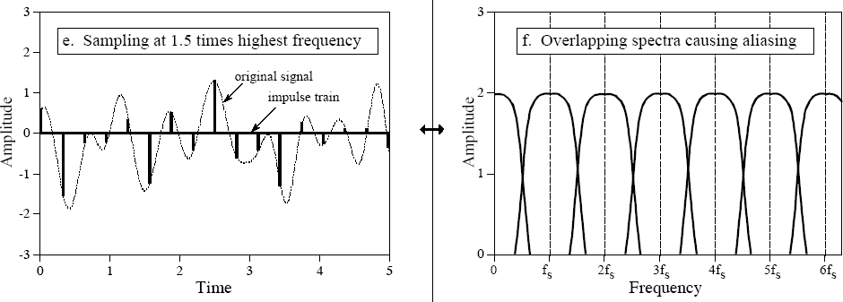
The Sampling Theorem
Example of improper sampling, resulting from too low of sampling rate
The analog signal still contains frequencies up to 3.3 kHz, but the sampling rate has been lowered to 5 kHz.

Slide 15
The Sampling Theorem
Since there is no way to separate the overlapping frequencies, information is lost, and the original cannot be reconstructed.
signal
This overlap occurs when the analog signal contains frequencies greater than one-half the sampling rate, that is, we have proven the sampling theorem.

Slide 16
Quantization

Slide 17
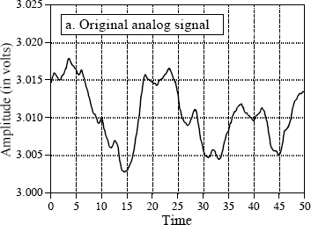
Example
The next figure is an analog signal to be digitized.
This signal is a voltage that varies over time.
We will assume that the voltage can vary from 0 to 4.095 volts that will be produced by a 12-bit digitizer.

Slide 18
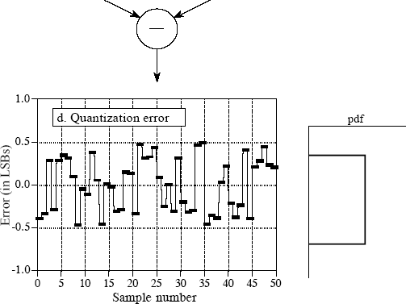
Quantization
Sampled analog signal
Digitized signal
In most cases, quantization results in nothing more than the addition of a specific amount of random noise to the signal.

Slide 19
Quantization
Digitizing this same signal would produce virtually no increase in the noise, and nothing would be lost due to quantization.
When faced with the decision of how many bits are needed in a system, ask two questions:
(1)How much noise is already present in the analog signal? (1)How much noise can be tolerated in the digital signal?

