Slide 1
Lecture 9
Instructor: Engr. Syed Ashraf Ali

Slide 8
Plotting in MATLAB
MATLAB has extensive plotting capabilities
Basic function is plot to plot one vector vs. another vector (vectors must have same length)
plot(x, y)
Can also simply plot one vector vs. its index
plot(x)
Repeat three arguments to plot multiple vectors
Different pairs of x and y data can have different sizes!
plot(x1, y1, x2, y2, x3, y3)

Slide 9
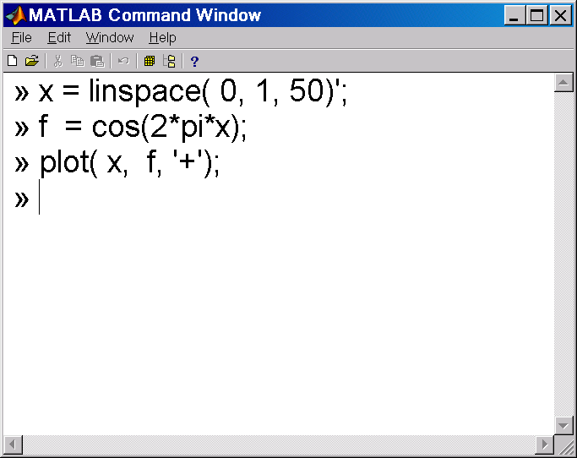
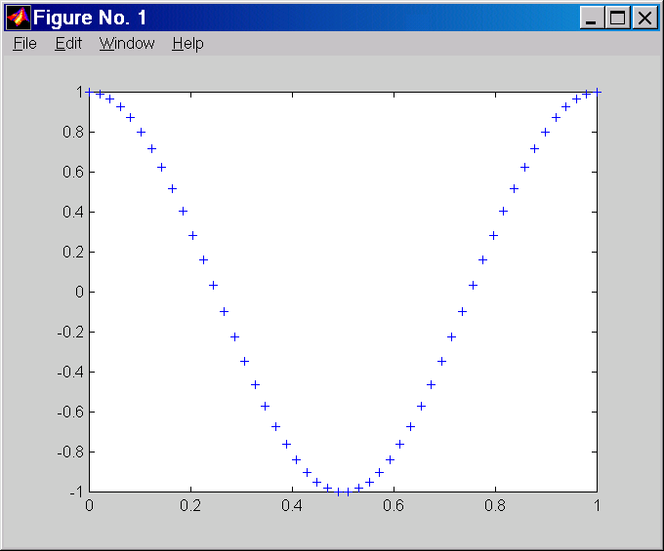
Building and plotting a function of a vector
create a vector x, with 50 equally spaced entries from 0 to 1.0.
create a vector f, with entries of cosine evaluated at entries of 2*pi*x.
plot f as a function of x, using + symbols
Figure created by matlab

Slide 10
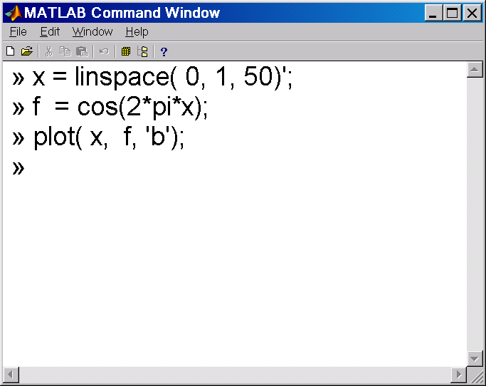
Building and plotting a function of a vector
create a vector x, with 50 equally spaced entries from 0 to 1.0
create a vector f, with entries of cos evaluated at entries of x.
plot f as a function of x, using a blue line.
Figure created by matlab

Slide 11
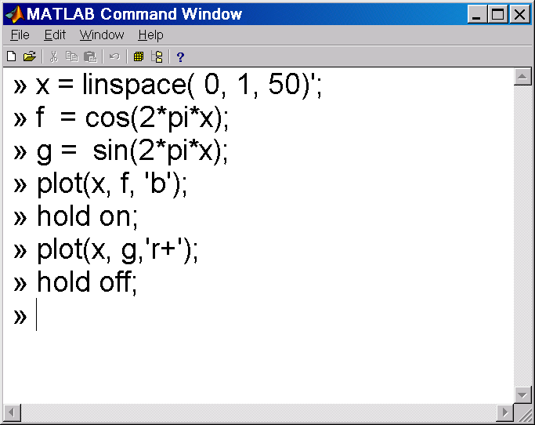
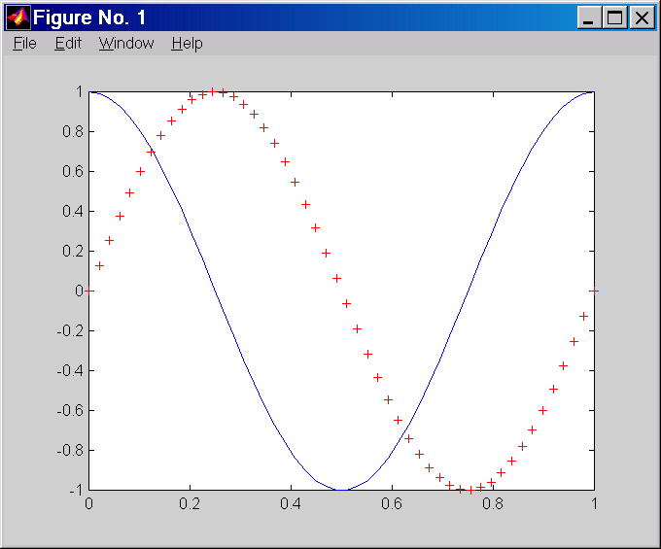
Building and plotting two functions of a vector
create a vector x, with 50 entries from 0.0 to 1.0.
create a vector f, with cos(2*pi*x).
create a vector g with entries sin(2*pi*x).
plot f as a function of x, using a blue line.
on same graph plot g as a function of x, using red + symbols.

Slide 13
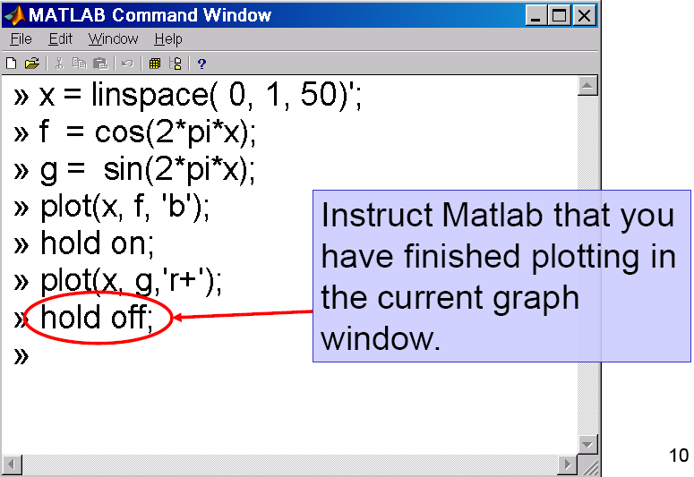

Slide 14
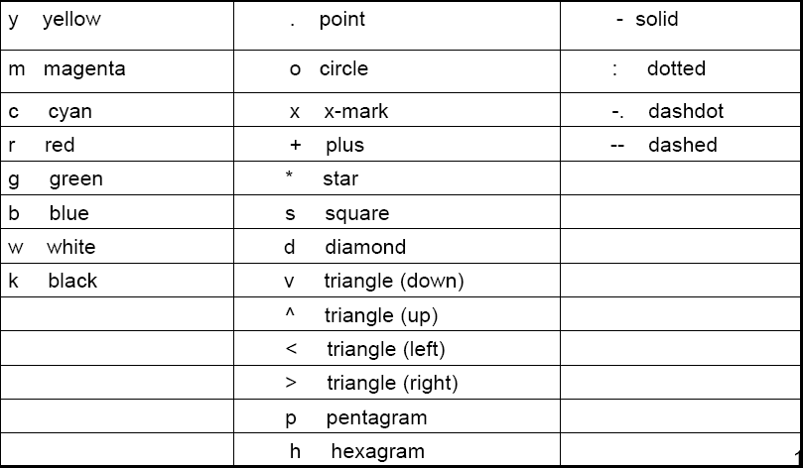
Quick Reference For Plot (Taken from Matlab: > help plot)
Various line types, plot symbols and colors may be obtained with PLOT(X,Y,S) where S is a character string made from one element from any or all the following 3 colunms:

Slide 15
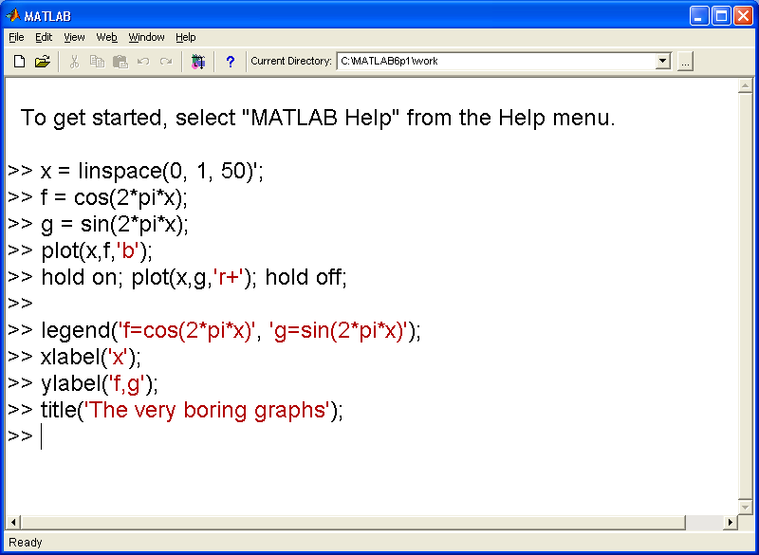
Adding a Title, Labeling Axes and Legends
we have made a cool graph but it isn’t much use to anybody else unless you label everything in sight!
The following functions will modify the current figure: title, xlabel, ylabel, legend.

Slide 16
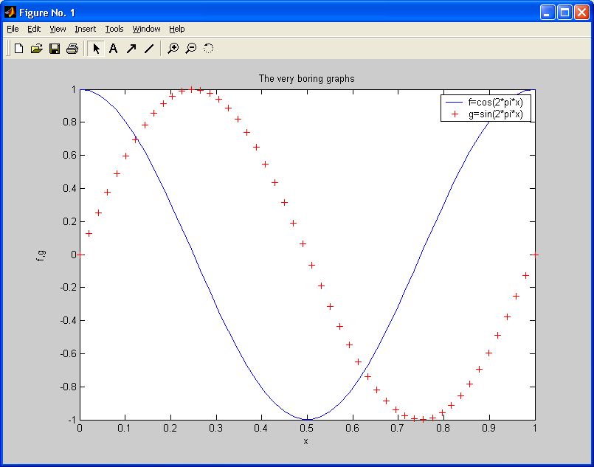
Set up the legend box with descriptions of each curve:
>> legend('f=cos(2*pi*x)', 'g=sin(2*pi*x)');
Label the axis
>> xlabel('x');
Label the y-axis
>> ylabel('f,g');
Give the graph a title
>> title('The very boring graphs');

Slide 17
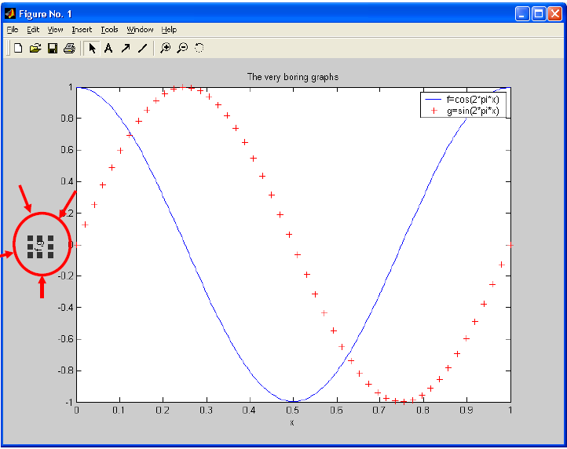
Modifying the Figure Properties
It is easy to change the font,
In the figure window click on the text object you wish to change.

Slide 18
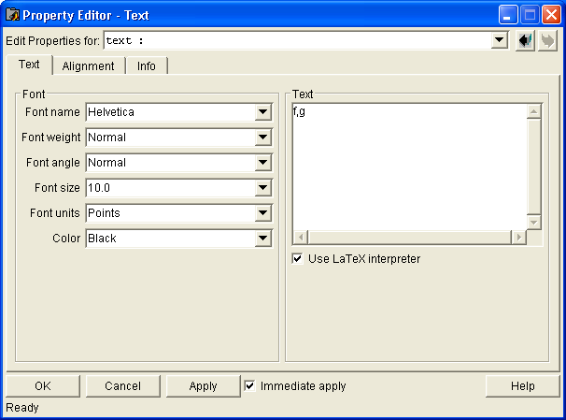
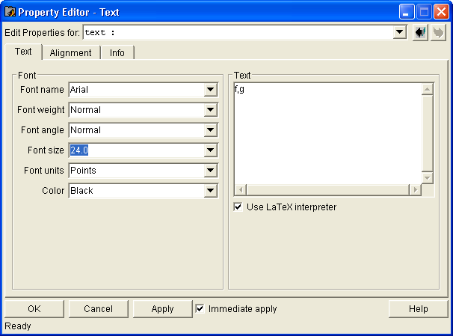
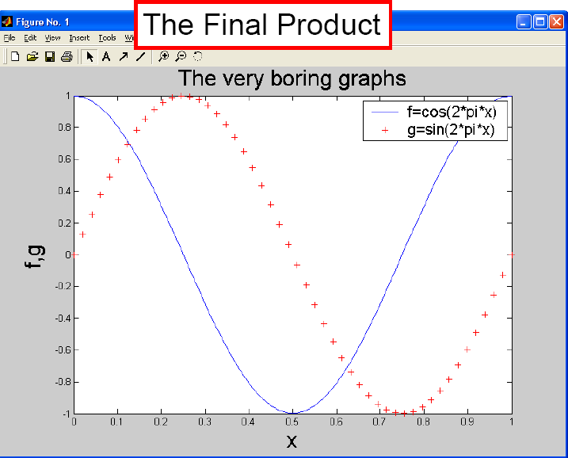
Click on “Edit/Current Object Properties”.
I prefer a larger Arial font.

Slide 19
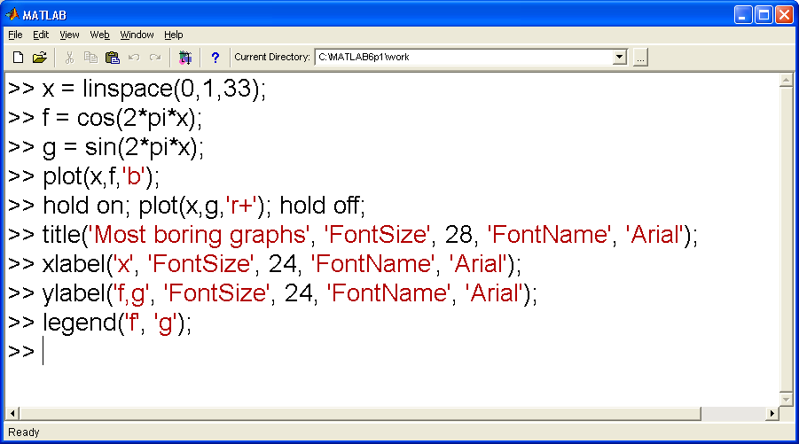
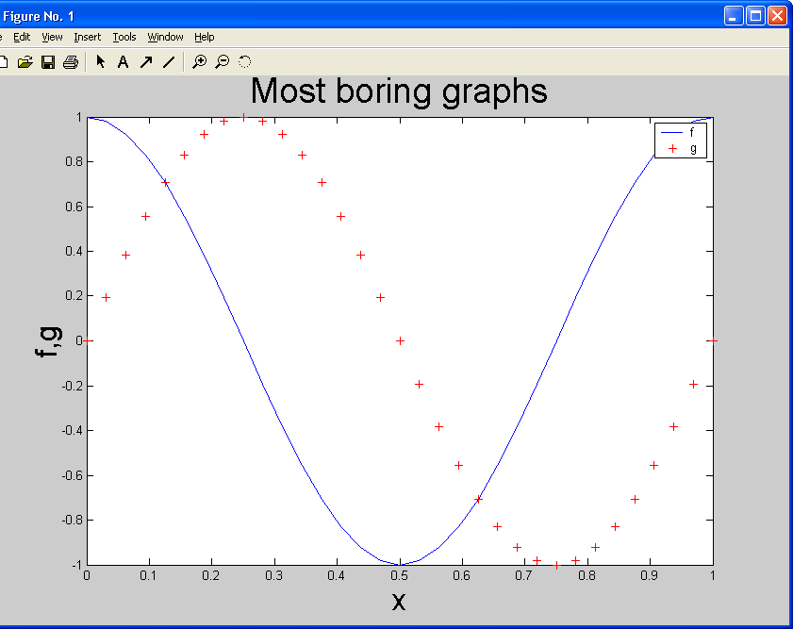
Alternative Ways To Change Fonts..

Slide 20
Individual Exercise
Create two curves on the same graph:
F = 1/(1+x^2)
G = exp(x^3)
Plot the points at 33 points equally spaced between 0 and 1.
Use black *’s for F and green o’s for G.
Label the horizontal and vertical axes.
Create a title (including your name).
Create a legend.

Slide 21
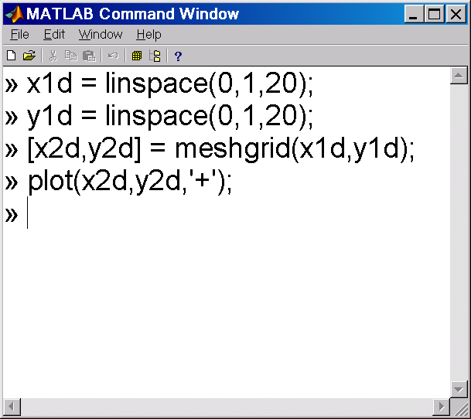
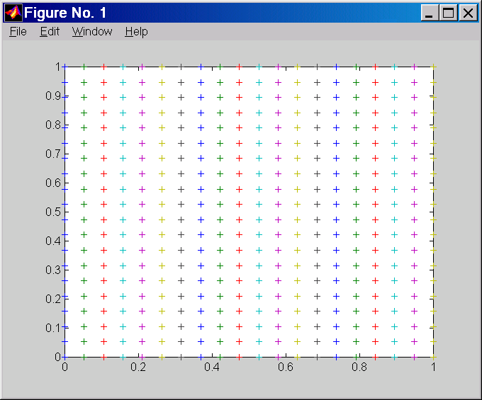
Plotting Two-dimensional Data
create two vectors x1dand y1d, with 20 entries from 0.0 to 1.0.
create matrices of values using the x1d and y1d to distribute points in the unit square with 20 points in the x and y directions.
plot results in a graph.

Slide 22
Where are we going with this
We can evaluate a function at the two dimensional points (x2d,y2d).
We can plot contours of this function where: a contour is a curve in the domain of the function where the value of the function is constant.

Slide 23
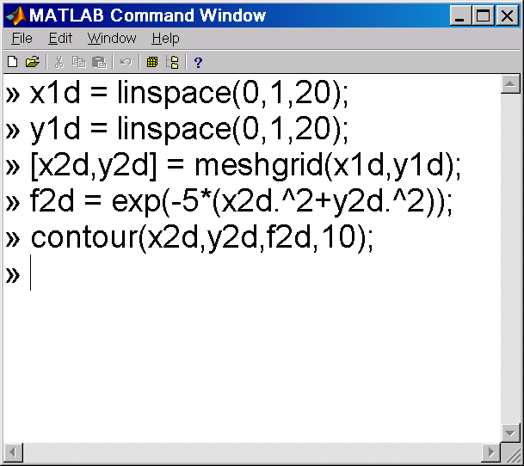
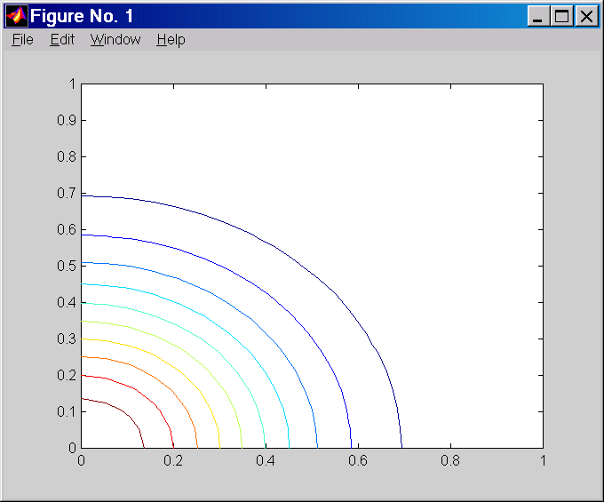
plotting contours of a two-dimensional function

Slide 24
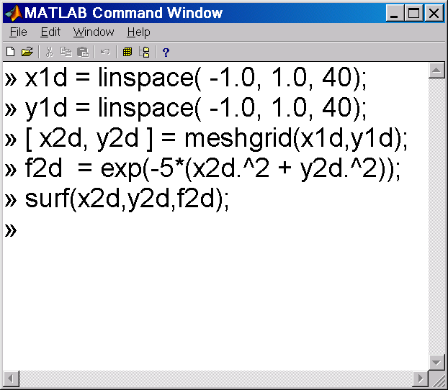
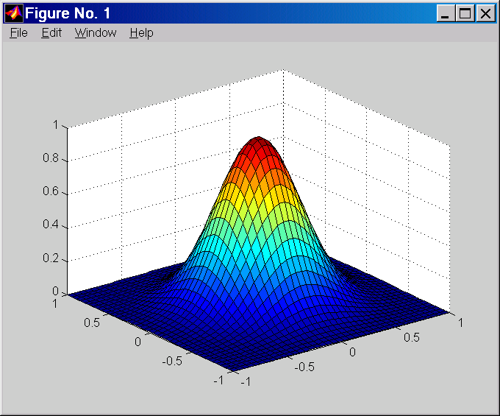
plotting two-dimensional function as a surface

Slide 25
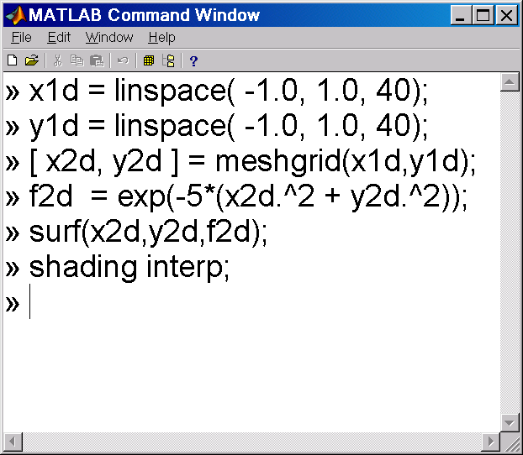
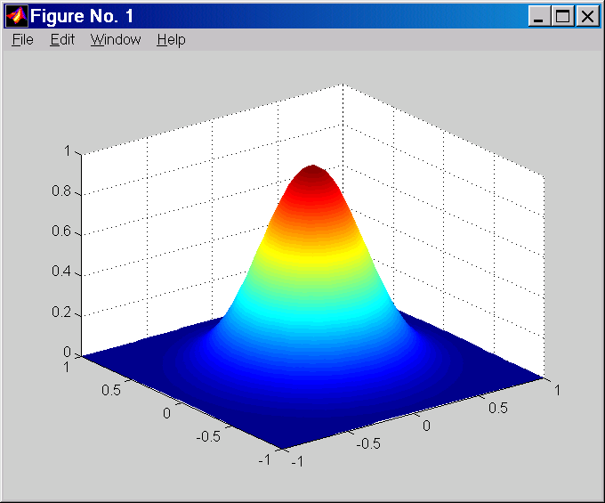
plotting two-dimensional function as a smooth surface

Slide 26
Plotting in MATLAB
>> x1 = 0:1:2*pi;
>> y1 = sin(x1);
>> x2 = 0:0.01:2*pi;
>> y2 = sin(x2);
>> plot(x1,y1,x2,y2)
Matlab will automatically change the colors of the lines if plotted with one plot command!

Slide 27
Plotting in MATLAB
The line style, marker symbol, and color of the plot is specified by the LineSpec
LineSpec is specified for each line after the y data and is optional
To see all options in Matlab: doc LineSpec
Common formatting:
Lines: '-' solid, '--'dashed, ':'dotted, '.-'dash-dot
Markers: '+'plus, 'o'circle, '.'point, 's'square, 'd'diamond, 'x'cross
Colors: 'r‘ red, 'g‘ green, 'b‘ blue, 'k‘ black, 'y‘ yellow, 'c'cyan, 'm'magenta

Slide 28
Plot in MATLAB
>> plot(x1,y1,'ks',x2,y2,'r--')

Slide 29
Plotting in MATLAB
Other commands allow you to modify the plot
Annotation: title, x label, y label, z label
Grid: grid on, grid off, grid minor
Axes: axis([xmin xmax ymin ymax]), axis keyword(doc axis for full keyword list)
Legend: legend('Line 1','Line 2','Location','Position')
Another way to plot multiple lines is with the hold command
hold on
plot(x1,y1)
plot(x2,y2)
hold off
Unless a new figure is created using figure(), any plotting function will overwrite the current plot

Slide 30
Plotting in MATLAB
>> plot (x1,y1,'sk',x2,y2,'r--')
>> legend ('7 Data Points','629 Data Points', 'Location', 'NorthEast')
>> title ('Some Sine Curves!')
>> xlabel ('x')
>> ylabel ('sin(x)')
>> grid on
>> axis tight

Slide 31
Plotting in MATLAB
Subplot function in Matlab:
subplot(m,n,p)
Functionality
Breaks the figure into an m(rows) by n(cols) grid and places the plot in location p(counts across rows first)
Plot can span across multiple locations by setting pas a vector→subplot(2, 3, [2 5])
Set the subplot location with subplot command, then use normal plotting commands (plot, hist, surf, etc.)
Title Over ALL Subplots
Use command suptitle('Title Text')
Suptitle must be LAST command of entire subplot

Slide 32
Plotting in MATLAB
Other plotting functions in Matlab:
Log scales: semilogx, semilogy, loglog
Two y-axes scales: plotyy
3D line plots: plot3
Surface and mesh plots: surf, surfc, mesh, meshc, waterfall, ribbon, trisurf, trimesh
Histograms: hist, histc, area, pareto
Bar plots: bar, bar3, barh, bar3h
Pie charts: pie, pie3, rose
Discrete data: stem, stem3, stairs, scatter, scatter3, spy, plotmatrix
Polar plots: polar, rose, compass
Contour plots: contour, contourf, contourc, contour3, contourslice
Vector fields: feather, quiver, quiver3, compass, streamslice, streamline

