Slide 1
Introduction to Computing
Muhammad Waqas

Slide 2
Monitors
The picture that appears on your monitor comes from the graphics card in your computer.
And the job of the graphics card is to render the picture suitable for the monitor.
A wired output runs from the graphics card to the monitor.

Slide 3
Both the graphics card and monitor use the same set of specifications, so that they can happily talk to each other.
The standards are set out by VESA, which defines things like how monitors identify themselves to the computer.

Slide 4
Monitors
CRT Monitors
LCD Monitors

Slide 5
CRT Monitors
CRT stands for Cathode Ray Tube
CRTs receive their picture through an analogue cable
That signal is decoded by the display controller, which handles the internal components of the monitor.

Slide 6
CRTs have a distinctive funnel shape.
At the very back of a monitor is an electron gun.
The electron gun fires electrons towards the front through a vacuum which exists in the tube of the monitor.
The gun can also be referred to as a cathode - hence the electrons fired forward are called Cathode Rays

Slide 7
These rays correspond to the red, green and blue channels of the display and video card.
At the neck of the funnel-shaped monitor is an anode, which is magnetized according to instructions from the display controller.

Slide 8
As electrons pass the anode, they are shunted or pulled in one direction or the other depending on how magnetic the anode is at that time.
This moves the electrons towards the correct part of the screen.

Slide 9
The electrons pass through a mesh, and this mesh defines the individual pixels and resolution on the screen.
Electrons that pass through the mesh then hit the phosphor coating which is on the inside of the glass screen.
When the particles hit the phosphor, they immediately light up - causing the light to shine through the front of the monitor, thus making up the picture on the screen.
There are three differently colored phosphorus for each pixel (known as phosphor triads), and depending on which phosphor the electron hits, that's which color the pixel will light up.

Slide 10
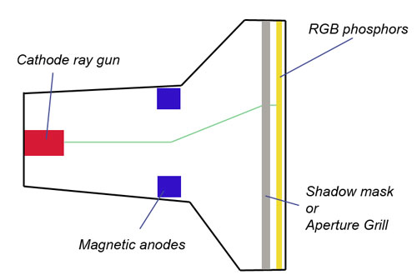

Slide 11
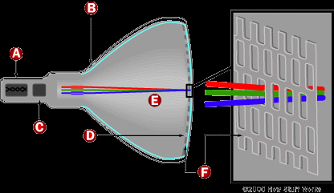

Slide 12
Different monitors differ in quality, and this is often dependent on the technology and components used internally.
Some CRT monitors use a single electron gun at the rear of the monitor to produce the electrons that will become the red, green and blue electron rays.
However, higher quality monitors have an individual gun for each, which can increase picture quality.

Slide 13
The metal used for the mesh at the front of the monitor will also affect quality.
Electrons also produce ions because of imperfections in the vacuum, and these electrons are destructive to image quality if they hit the phosphor.
Consequently, meshes are made of relatively thick metal to prevent phosphor damage.

Slide 14
However, in better quality monitors, a thinner, yet tougher metal alloy is used for the mesh.
Because it's thinner, it means more light can get through, making for increased brightness and higher contrast.

Slide 15
Dot pitch and resolution
Each pixel on the CRT screen is defined by lighting up combinations of the red, blue and green phosphors that make up the pixel.
With a varying strength of electron gun operating on each phosphor, different colors are produced - with red, blue and green all fired on maximum strength, that means bright white is produced.

Slide 16
Dot pitch is measured on most monitors as the distance, diagonally, between two phosphors of the same color.
However, some manufacturers quote dot pitch on monitors as the horizontal distance between phosphors, which can make them appear better specified, on paper, than perhaps they are.

Slide 17
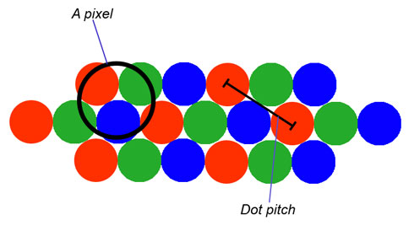

Slide 18
In general, the lower the dot pitch, the better the sharpness of the image.

