Slide 1
Concrete Technology Lecture 8
Hardened Concrete

Slide 2
Contents
1. Strength
2. Deformation under load
3. Deformation independent of load
4. Permeability
5. Durability

Slide 3
1. Strength
Strength of concrete is defined as the max stress it can resist or the maximum stress it can carry. Strength of concrete is the resistance to rupture.
The tensile strength of concrete is 8 to 10 times lower than compressive strength. The tests usually used to measure tensile strength of concrete are Flexural tension (Modulus of Rupture) and Split cylinder test (Indirect test). Usually split cylinder test gives a lower value than Flexural tension test.
The compressive test is the main test performed on concrete specimen. The compressive strength generally gives us the idea about other properties of concrete as well, such is Elasticity, Permeability, Durability, Fatigue strength, impact strength etc.
Concrete cylinders are usually used to measure the compressive strength. These cylinders are 6in. In diameter and 12in. In length. The 28days strength of these cylinders is determined using UTM. Sometimes Concrete cubes are also used to measure compressive strength. The compressive strength of concrete cubes is more.

Slide 4
1. Strength
Fatigue Strength:
They are of two types i.e. static fatigue and fatigue.
The failure under cyclic repeated loading is known as fatigue (type 2). It is a time dependent phenomenon and failure occurs if the magnitude of repeated stress is larger that a threshold value.
The fatigue strength (S) decreases as the number of cycles (N) increases. The minimum value of S below which failure does not occur is known as endurance level. For steel S=0.5xstrength. Concrete does not have a minimum endurance level.
As the compressive strength of concrete increases with age, fatigue strength also increase.

Slide 5
COMPRESSION TEST
FLEXURAL TENSILE TEST

Slide 6
Strength of concrete increase with age
W8

Slide 7
W8

Slide 8
1. Strength
Factors Influencing the strength of concrete:
1. Influence of the constituent materials. a) Cement
Fineness of cement increase strength.
Chemical composition.
Type of cement ( RHPC, SRPC, LHPC).
b) Water
Water cement ratio (w/c) required for hydration process.
The lower w/c, the greater is the compressive strength and vice versa because the strength of concrete depends upon strength of cement paste.
Instead of W/C, Gel space ratio can be more accurate representation of strength. Gel/space is the volume of hydrated cement to the sum of volume of hydrated cement and capillary pores.

Slide 10
1. Strength
Factors Influencing the strength of concrete:
(c) Aggregate:
Bond strength between aggregate influence by surface texture, shape and cleanliness.
The compressive strength of concrete tends to increase with the decrease in the size of coarse aggregate. This due to the facts that smaller size aggregates provide larger surface area for bonding with the mortar matrix. Also, larger size aggregate introduce heterogeneity in concrete which is undesirable. Moreover, a weaker transition zone is expected due to internal bleeding.
Aggregate surface roughness has a considerable affect on bond strength (greater the roughness, higher is the bond strength) due to improvement in mechanical interlocking.
The strength of transition zone also depends upon the W/C.

Slide 11
1. Strength
Factors Influencing the strength of concrete:
d) Admixture
➢Effect of particular admixture (eg. accelerator, retarder, plasticizer etc.) depend on the precise nature of the admixtures themselves.

Slide 12
1. Strength
Factors Influencing the strength of concrete:
2. Degree of compaction:
➢Proper compaction increase strength.
➢When the concrete compacts, it has a very low porosity, thus result in a very high strength.
➢The increase in the strength of concrete is probably influenced by the volume of voids in concrete i.e. entrapped air, capillary pores, gel pores or entrained air.

Slide 13
1. Strength
Factors Influencing the strength of concrete:
3. Influence of curing:
➢Curing is used for promoting the hydration of cement and consists of a control of temperature and moisture movement from and into the concrete.
➢The longer period of curing, the greater its
final strength.
Early-age: ages less than 7days
Later-age: ages exceeding 28days.

Slide 14
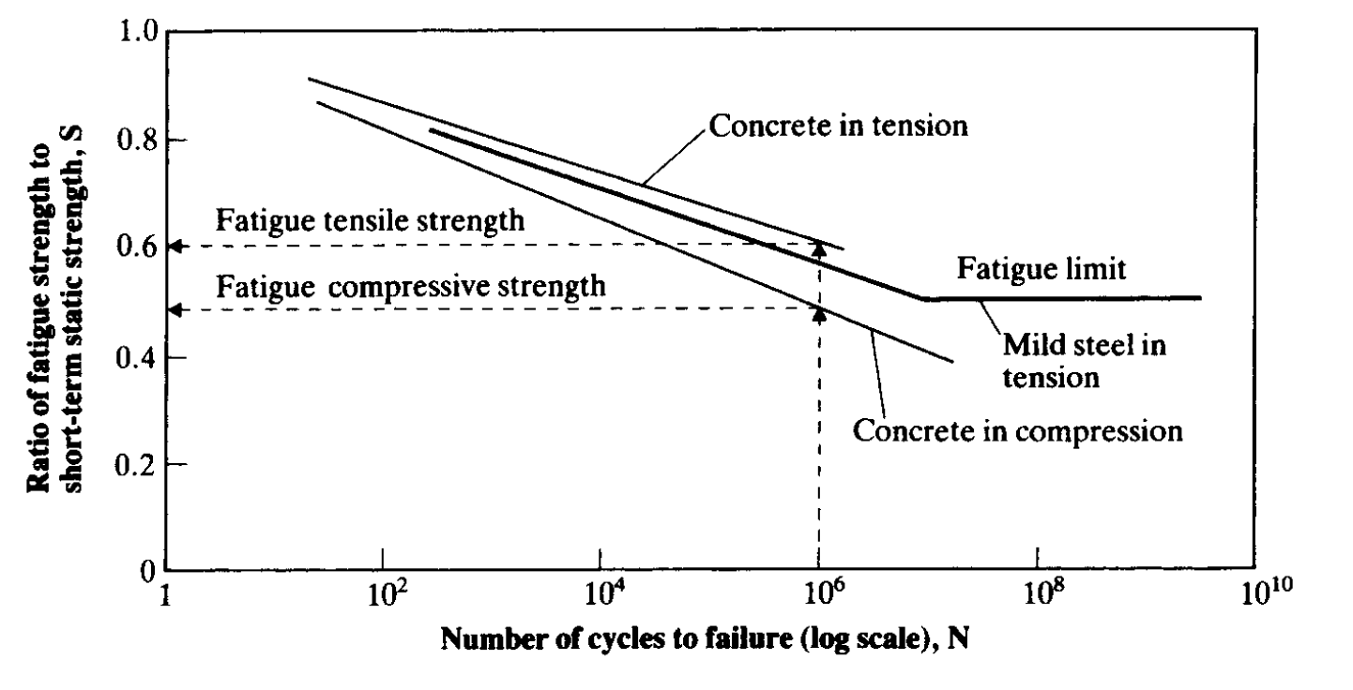
1. Strength
Typical relation between the fatigue strength and no. of cycles for mild steel and concrete.

Slide 15
1. Strength
Impact strength:
Impact strength is important in case piles are driven in ground. Or in case impact load is expected to be exerted on a structure.
Impact strength depends upon coarse aggregate quality and the storage condition of aggregate (moist or dry). Angular and rough result in concrete with higher impact strength. Additionally, Aggregate with lower E has better impact strength.
Dry stored aggregate gives higher impact strength.

Slide 17
1. Strength
Resistance to Abrasion:
Sliding and scraping of concrete surface can cause attrition, and in hydraulic structures, action of water can cause erosion of concrete. Damage of concrete due to abrasion depends upon cause of wear.
Light weight concrete is unsuitable for surface exposed to wear.
For improving wear resistance, delayed finishing is recommended. Moreover, prolonged moist curing is essential.
Bond to reinforcement:
Strength of bond depends upon the friction between steel and concrete.
The bond strength increase with increase in compressive strength of concrete.
Deformed (ribbed) bars should be used to increase friction between reinforcement and concrete.

Slide 18
2. Deformation under load
It is a stress strain relationship under normal loading and under sustained loading.
Under normal loading: the first effect of applying a load to concrete is to produce an elastic deformation i.e. as the load increases deformation increases.
The relationship between stress and strain is known as modulus of Elasticity. The relationship between Modulus of elasticity and compressive strength can be given by Ec=5000$\sqrt{fc^{′}}$ (Ec and fc’ in N/mm²)
Modulus of elasticity of concrete also depends upon the aggregate. Ec for light weight aggregate is about 40% to 80% to that of normal aggregate.

Slide 19
Stress Strain Relationship of Concrete

Slide 20
2. Deformation under load
Creep:
The increase in strain of concrete with in passage of time under sustained stress is known as creep.
All materials exhibit the phenomenon of creep, but in concrete its considerably more.
The deformation of material under design stress is termed elastic and the subsequent increase in deformation under sustained design stress in creep.
If a loaded concrete specimen is retrained in such a way that strain over time remains constant, creep will manifest itself in the form of progressive decrease in stress over time. This is term as relaxation.
Creep is not a completely reversible phenomenon.

Slide 21
2. Deformation under load
Factors affecting Creep:
Stiffer the aggregate lower the creep. More the content of aggregate per unit volume of concrete, lower the creep.
Decrease in W/C causes decrease in creep. In other words strength and creep and inversely proportional.
Creep is smaller when concrete is cured at high temperature because strength is higher than when cured and loaded at high temperature.
Creep also depends upon the applied stress. The relationship is directly proportional.
Creep also depends on the type of cement. High alumina cement experiences less creep as compared to Ordinary Portland Cement.

Slide 22
2. Deformation under load
Magnitude of Creep:
Creep beyond 20 years is insignificant.
About 25% creep occurs in first 2 weeks. 50% creep occurs I first 3 month and 75% creep occurs within a year.
Effects of creep:
Creep causes deflection of reinforced concrete members and sometimes causes bucking of slender columns.
In mass concrete, creep can causes cracks.
Loss of pre-stress in pre-stressed concrete.
In Statically indeterminate structures the creep may relieve (by relaxation) the stress concentration induced by shrinkage, temperature changes etc.

Slide 23
Creep

Slide 24
Strain Relaxation

Slide 25
3. Deformation independent of Load
Shrinkage and Swelling:
Shrinkage is caused by evaporation of water, or by hydration of cement, and also by carbonation. This results in reduction of volume i.e. volumetric strain and is measure in mm/mm.
The volumetric contraction of cement is called plastic shrinkage and results in 1% reduction per unit volume of cement paste. This results in tensile stress on surface of concrete, inducing cracks.
Plastic shrinkage increases with increase in temperature. Similarly, plastic shrinkage increases with increase in evaporation. Plastic shrinkage also increases with increase of cement content in mix.
If there is continuous supply of water during hydration, the concrete expands due absorption of water by cement gel. This process is known as swelling. Swelling is more prominent in light weight aggregate.

Slide 26
3. Deformation independent of Load
Shrinkage and Swelling:
Withdrawal of water from hardened concrete causes drying shrinkage.
A part of drying shrinkage is reversible through moisture movement (40 to 70%)

Slide 27
Plastic cracking (Plastic Shrinkage Cracking) is cracking that occurs in the surface of the fresh concrete soon after it is placed and while it is still plastic.
W8

Slide 28
3. Deformation independent of Load
Magnitude of Shrinkage:
14 to 34% of 20 year drying shrinkage occurs in 2 weeks. 40 to 80% of 20 yr drying shrinkage occurs in 3 months and 65 to 85 % of 20 yr drying shrinkage occurs within a year.
Factors affecting Shrinkage:
The presence of aggregate restrains the amount of shrinkage caused in cement paste e.g. increase in aggregate from 71 to 74% reduces shrinkage by 20%.
Light weight aggregate exhibits higher shrinkage than light weight aggregate.
Higher W/C results in higher shrinkage.

Slide 29
3. Deformation independent of loading
Factors affecting shrinkage:
Aggregate -Concrete with higher aggregate content exhibits smaller shrinkage.
Water-cement ratio - The higher the W/C ratio is, the higher the shrinkage. As W/C increases, paste strength and stiffness decrease; and as water content increases, shrinkage potential increases.
Member size - Shrinkage decrease with an increase in the volume of the concrete member. However, the duration of shrinkage is longer for larger members since more time is needed for shrinkage effects to reach the interior regions.
Medium ambient conditions - The rate of shrinkage is lower at higher values of relative humidity. Shrinkage becomes stabilized at low temperatures.
Admixtures - Effect varies from admixture to admixture. Any material which substantially changes the pore structure of the paste will affect the shrinkage characteristics of the concrete. In general, as pore refinement is enhanced, shrinkage is increased.

Slide 30
4. Permeability
Concrete has a tendency to be porous due to the presence of voids formed during or after placing. Permeability is ease with which liquids or gases can travel through the concrete. Permeability to water is important with regards to water tightness of liquid retaining structures. Permeability to air is important consideration in structures such as sewerage tanks, pressure vessels in nuclear reactors etc.
Penetration by substance may adversely affect durability e.g. Ca(OH)₂ leaches out.
➢ Ingress of air and moisture resulting in corrosion.
To produce concrete of low permeability, full compaction & proper curing is essential
Low permeability is important in increasing resistant to frost action and chemical attack and in protecting embedded steel against corrosion.
➢ The permeability of cement paste varies with the age of concrete or with hydration.
With age, the permeability decreases because gel gradually fill the original water filled space.
➢ For the same w/c ratio, the permeability of paste with coarser cement particles is higher than those with finer cement.
➢ In general, the higher the strength of cement paste, the lower will the permeability.

Slide 31
4. Permeability
Factors affection Permeability:
W/C Ratio. Low W/C results in higher permeability.
Curing. Interruption in curing results in increased permeability.
Method of compaction
Workability
Soundness & porosity of the aggregate
Age (permeability decrease with age)
Grading of aggregate. Well graded aggregate results in decreases permeability
Type of structure

Slide 32
5. Durability
Defined as its resistance to deterioration processes that may occur as a result of interaction with its environment (external) or between the constituent materials or their reaction with contaminants present (internal).
The deterioration process may be physical i.e. frost action, mechanical i.e. abrasion, or chemical attacks like sulphate attack, sea water, alkali aggregate reactions etc.
The absence of durability maybe caused either by the environment to which the concrete is exposed i.e. external or internal causes.

Slide 33
5. Durability
Steps to Improve Durability:
Good workmanship,reduced porosity
The use of aluminous sulphate resisting cement, Portland blast furnace or Portland pozzolana cement.
Sufficient cover over reinforcement.
Use of low water cement ratio.

Slide 34
5. Durability
Sulphate attack:
Concrete attacked by sulphates has a characteristic whitish appearance, damage usually starts at the edges and corners, followed by abrasion and spalling of concrete.
Sulphate attack causes formation of Calcium sulphate (ettrengite) and calcium sulphoaluminate (gypsum) causing expansion and disruption of hardened concrete.
Sulphates of Na, K, Mg and Ca are usually present in soil and ground water. Among these, Magnesium Sulphate is considered more dangerous.
To counter sulphate attack dense concrete of low permeability must be used. Moreover, cement with low content of C3A is also useful (Type V).
Efflorescence is an indication of high permeability. The leached out Ca(OH)2 from within the concrete reacts with CO2 to form CaCO3.

Slide 35
5. Durability
Attack by sea water:
In addition to sulphates present in sea water, chlorides are also present. The presences of chlorides prevents expansion of concrete unlike sulphate attack, but increase porosity of concrete over time, resulting decrease in strength.
Expansion of concrete above high level of water due to crystallization of percolated salts can occur which can be prevented by making concrete impermeable. Concrete subjected to alternate wetting and drying is severely attacked, while concrete that is constantly wet is least affected.
Concrete exposed to sea water should have W/C below 0.45, it should have low permeability, it should be well compacted with good workmanship, especially in the construction joints.

Slide 36
5. Durability
Acid attack:
No Portland Cement is resistant to acid attack. In damp conditions SO2 and CO2 from atmosphere form acid and attack concrete by dissolving it and removing a part. This form of attack is also being experiences in chimneys of industries etc.
Attack occurs at a PH value of less than 6.5, while PH less than 4.5 is severe.
Although alkaline in nature, domestic sewage cause deterioration of concrete, especially at high temperatures.
Alkali Aggregate reaction:
Concrete can be damaged by reaction between active silica constituents of aggregate and alkalis (N2O and K2O) in cement. The gel formed attacks water, causing expansion and eventually disruption and cracking of concrete.
Fine particles lead to expansion within 4 to 8 weeks while larges aggregate particles can expand after some years. It is usually the damage at late occurrences, even 5 years, that is a source of worry and uncertainly.
These reaction usually take place at the exterior of concrete.
Reducing porosity can reduce alkali aggregate reactions.
Materials like slag and fly ash don’t contribute to alkali aggregate reactions. Therefore, partial replacement of cement with pozzolans can be of advantage.

Slide 37
THE END

