Slide 1
Lecture 8
Instructor: Engr. Syed Ashraf Ali

Slide 2
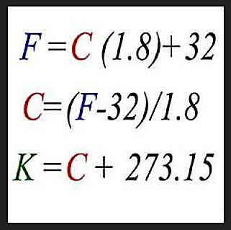
Thermal energy: Total energy of the particles in a material.
Heat: is the thermal energy that flows from something of a higher temperature to something of a lower temperature.
Temperature: measure of the average kinetic energy of the particles in a sample of matter.
Temperature scales: The temperature scales most widely used today are the Fahrenheit, Celsius and Kelvin Scales.
Temperature Conversion Formulas;
Fahrenheit to Celsius,
Celsius to Fahrenheit,
Kelvin to Celsius.

Slide 3
Conversion of Temperature
0 °C = 32 °F = 273 K.
100 °C = 212 °F = 373 K.
-40 °C = -40 °F = 233 K.
°C = (°F – 32) * 5/9.
°F = (°C) * 9/5 + 32.
K = °C + 273.
1 °C change in temp. = 1.8 °F change in temp.
= 1 K change in temp.

Slide 4
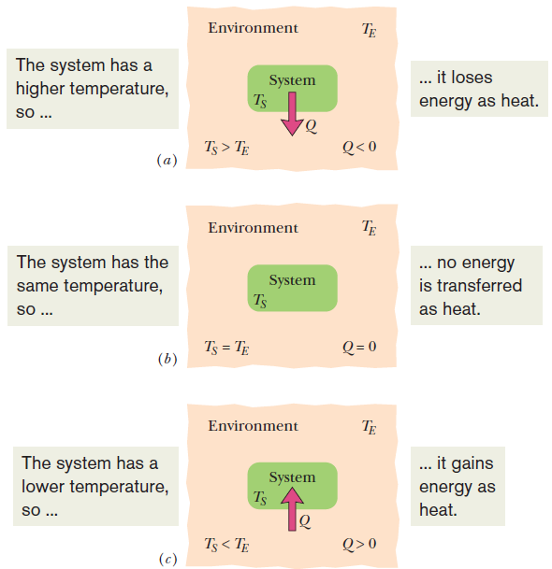
Heat
Heat is the energy transferred between a system and its environment because of a temperature difference that exists between them.
  Figure shows that if the temperature of a system exceeds that of its environment as in (a),heat Q is lost by the system to the environment until thermal equilibrium (b) is established.(c) If the temperature of the system is below that of the environment, heat is absorbed by the system until thermal equilibrium is established.

Slide 5
Heat
Unit:
  The calorie (cal) is defined as the amount of heat that would raise the temperature of 1 g of water from 14.5°C to 15.5°C.
  In the British system, the corresponding unit of heat was the British thermal unit (Btu), defined as the amount of heat that would raise the temperature of 1 pound of water from 63°F to 64°F.
  The SI unit for heat is the joule.
  The calorie is now defined to be 4.1868 J.
  1 cal =3.968 x10⁻³ Btu = 4.1868 J.

Slide 6

Heat Capacity
  The heat capacity C of an object is the proportionality constant between the heat Q that the object absorbs or loses and the resulting temperature change ΔT of the object.
  in which T_{i} and T_{f} are the initial and final temperatures of the object.
Heat capacity C has the unit of energy per degree or energy per kelvin.

Slide 7


Specific Heat Capacity
The specific heat, c, is the heat capacity per unit mass.
It refers not to an object but to a unit mass of the material of which the object is made.
When specific heats are expressed in units of moles (rather than a mass unit), they are called molar specific heats.
It is important to distinguish the heat transfer is done with constant volume or constant pressure.
The specific heat is different for different processes, particular for gases.

Slide 8
Example
How much heat is needed to raise the temperature of 25.6 grams of water from 20.0 C to 50.0 C?
Solution:
        Q = m c ∆T.
        Q = (25.6g)(4.18J/g.cº)(30.0cº).
        Q = 3210 J.
What is the final temperature of 27.0 grams of water, initially at 0cº, after it absorbs 700.0 J of energy?
Solution:
        Q = m c ∆T.
        Answer =6.20 cº.

Slide 9
Example
A 32.0 g silver spoon cools from 60cº to 20cº. What is the change in thermal energy?
Solution:
      m = 32.0g = 0.0320 kg
      C = 235 J/(kg.K) –from table of values for silver
      T_{initial} =60cº=60+273=333K
      T_{final} =20cº=20+273=293K
      Q = (m)(∆T)(C)
      = (0.0320 kg)(-40.0K)(235J/kg .K)
      = -301 J
      The spoon loses 301 J of thermal energy as it cools.

Slide 10
Example
A 75.0 g piece of lead (specific heat = 0.130 J/gºC),initially at 435ºC, is set into 125.0 g of water, initially at 23.0ºC. What is the final temperature of the mixture?
Solution;
Q_{water} = –Q_{Pb}
m_{water} C_{water} ∆T_{water}
–(m_{Pb} C_{Pb} ∆T_{Pb} )
=
125 (4.18) (T_{f} – 23) =
–75 (0.13) (T_{f} – 435)
522.5 T_{f} – 12017.5 =
–9.75 T_{f} + 4241.25
+9.75 T_{f}
+12017.5
+9.75 T_{f}
+12017.5
532.25 T_{f}
=
16258.75
T_{f} = 30.5ºC

Slide 11
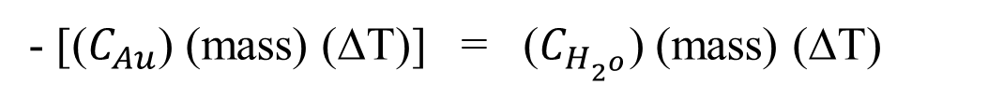

Example
A 97.0 g sample of gold at 785ºC is dropped into 323 g of water, which has an initial temperature of 15.0ºC. If gold has a specific heat of 0.129 J/gºC, what is the final temperature of the mixture? Assume that the gold experiences no change in state of matter.
Solution;
${−Lose}_{heat}$=${Gain}_{heat}$
- [($C_{Au}$) (mass) (∆T)] = ($C_{H_{2^{o}}}$) (mass) (∆T)
- [(0.129 J/gºC) (97 g) (T_{f} - 785ºC)] = (4.184 J/gºC) (323 g) (T_{f} - 15ºC)]
- [(12.5) (T_{f} - 785ºC)] = (1.35 x 10³) (T_{f} - 15ºC)]
-12.5 T_{f} + 9.82 x 10³ = 1.35 x 10³ T_{f} - 2.02 x 10⁴
3 x 10⁴ = 1.36 x 10³ T_{f}
T_{f} = 22.1ºC

Slide 12

Heat of Transformation
The amount of energy per unit mass that must be transferred as heat when a sample completely undergoes a phase change is called the heat of transformation L (or latent heat). When a sample of mass m completely undergoes a phase change, the total energy transferred is:
    When the phase change is between solid to liquid, the heat of transformation is called the heat of fusion L_{F.}
    When the phase change is between liquid to gas, the heat of transformation is called the heat of vaporization L_{V.}
    sublimation: transition from solid directly to gas phases.

Slide 13
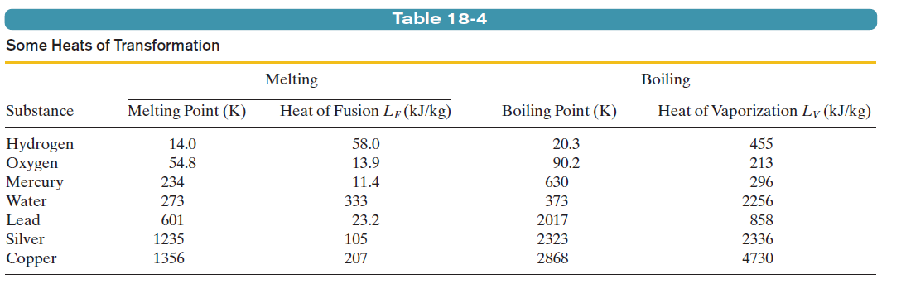
Heat of Transformation

Slide 14
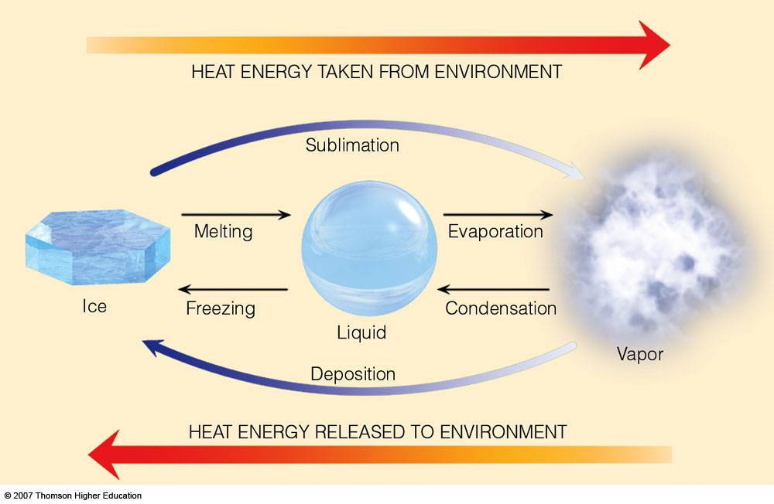
Heat of Transformation

Slide 15
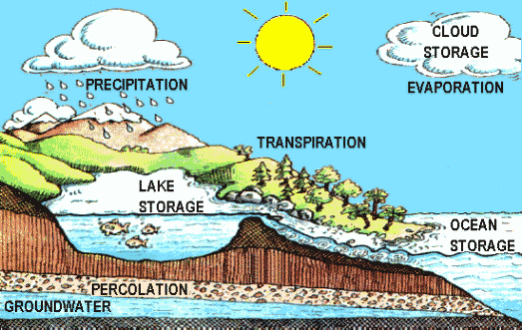

Slide 16
Specific Latent Heat
The amount of heat required to change the state of 1kg of a substance without changing its temperature.
    Energy Transfer = Δml.
    Enthalpy supplied = mass * specific enthalpy.
The units of l are Jkg⁻¹
Remembering that you must be using the correct Latent Heat for the transformation taking place.

Slide 17
Heat Transfer
Heat is the form of energy that can be transferred from one system to another as a result of temperature difference.
A thermodynamics analysis is concerned with the amount of heat transfer as a system undergoes a process from one equilibrium state to another.
The science that deals with the determination of the rates of such energy transfers is the heat transfer.
The transfer of energy as heat is always from the higher-temperature medium to the lower-temperature one and heat transfer stops when the two mediums reach at the same temperature.
Heat can be transferred in three different modes: conduction, convection, and radiation.
All modes of heat transfer require the existence of a temperature
difference, and all modes are from the high-temperature medium to a
lower-temperature one.

Slide 18
CONDUCTION
Conduction is the transfer of energy from the more energetic particles of a substance to the adjacent less energetic ones as a result of interactions between the particles.
Conduction can take place in solids.
In solids, it is due to the combination of vibrations of the molecules in a lattice and the energy transport by free electrons.

Slide 19
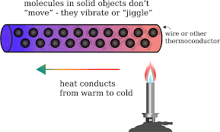
CONDUCTION
When you heat a metal strip at one end, the heat travels to the other end.
As the metal is heated, the particles vibrate. These vibrations pass thermal energy along the metal causing it to heat up.
This is called Conduction.

Slide 20
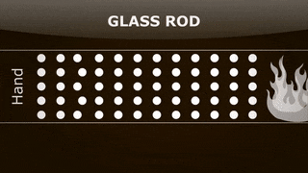
CONDUCTION

Slide 21
CONDUCTION
The rate of heat conduction through a medium depends on the geometry of the medium, its thickness and the material of the medium as well as the temperature difference across the medium.
We know that wrapping a hot water tank with glass wool (an insulating material) reduces the rate of heat loss from the tank. The thicker the insulation, the smaller the heat loss.
We also know that a hot water tank loses heat at a higher rate when the temperature of the room housing the tank is lowered. Further, the larger the tank, the larger the surface area and thus the rate of heat loss.

Slide 22
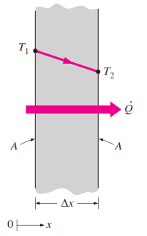

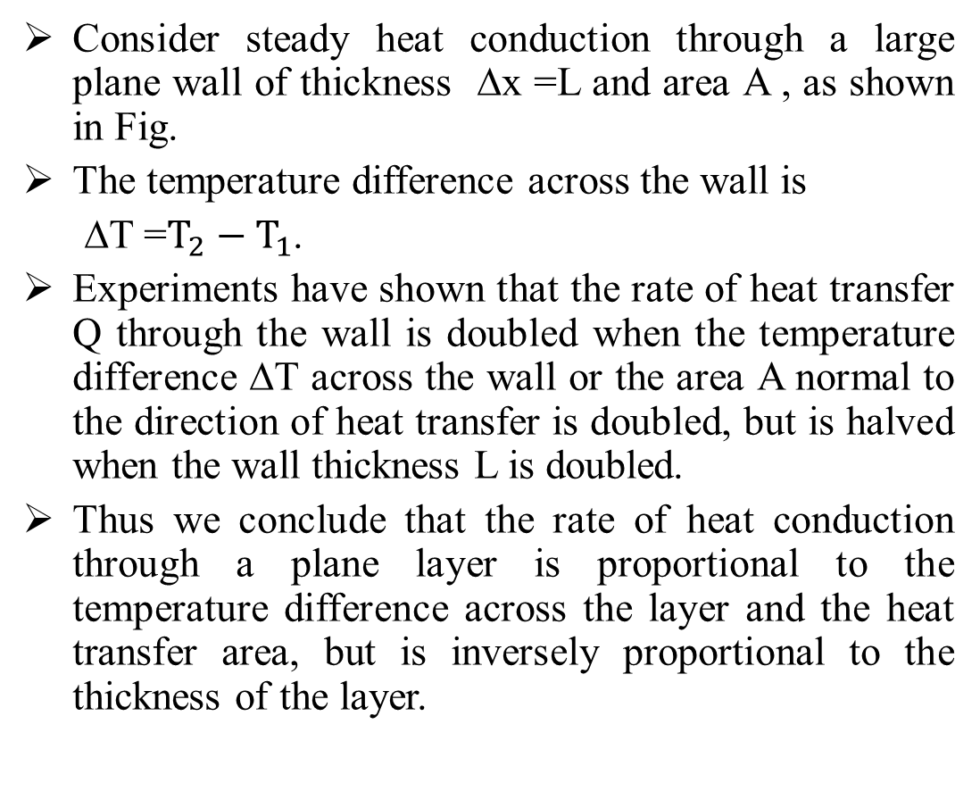
CONDUCTION
Consider steady heat conduction through a large plane wall of thickness ∆x =L and area A , as shown in Fig.
The temperature difference across the wall is
∆T =$T_{2}−T_{1}$.
Experiments have shown that the rate of heat transfer Q through the wall is doubled when the temperature difference ∆T across the wall or the area A normal to the direction of heat transfer is doubled, but is halved when the wall thickness L is doubled.
Thus we conclude that the rate of heat conduction through a plane layer is proportional to the temperature difference across the layer and the heat transfer area, but is inversely proportional to the thickness of the layer.

Slide 23

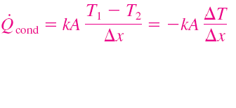
CONDUCTION
Heat flow rate increases with area and temperature drop.
In solids, it is due to the combination of vibrations of the molecules in a lattice and the energy transport by free electrons.
The rate of heat conduction through a plane layer is proportional to the temperature difference across the layer and the heat transfer area, but is inversely proportional to the thickness of the layer.

Slide 24
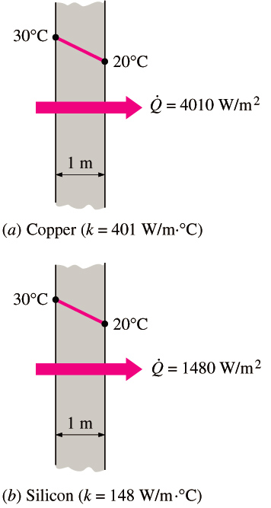
CONDUCTION
Fourier’s law of heat conduction
Thermal conductivity, k: A measure of the ability of a material to conduct heat.
Temperature gradient dT/dx: The slope of the temperature curve on a T-x diagram.
Heat is conducted in the direction of decreasing temperature, and the temperature gradient becomes negative when temperature decreases with increasing x. The negative sign in the equation ensures that heat transfer in the positive x direction is a positive quantity.
The rate of heat conduction through a solid is directly proportional to its thermal conductivity

Slide 25
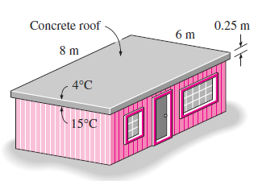
Example
The roof of an electrically heated home is 6 m long, 8 m wide,
and 0.25 m thick, and is made of a flat layer of concrete whose
thermal conductivity is k 0.8 W/m · °C . The temperatures of the
inner and the outer surfaces of the roof one night are measured
to be 25°C and 0°C, respectively, for a period of 10 hours.
Determine:
    the rate of heat loss through the roof that night and
    the cost of that heat loss to the home owner if the cost of electricity is $0.2/kWh.

Slide 26
Example
Solution;
Noting that heat transfer through the roof is by conduction and the area of the roof is;
A= 6 m×8 m=48 m².
The steady rate of heat transfer through the roof is determined
to be;
Q·=kA(T₁-T₂)/L= (0.8)(48 )(25-0)/0.25= 3840 W= 3.84 kW
The amount of heat lost through the roof during a 10-hour period and its cost are determined from;
Q = Q·.∆t =(3.84 kW)(10 h) = 38.4 kWh
Cost/day = (Amount of energy)(Unit cost of energy)
= (38.4 kWh)($0.2/kWh) =$7.68
Cost/month = (cost/day)×(30day/month)= $7.68×30=$230.4

Slide 27
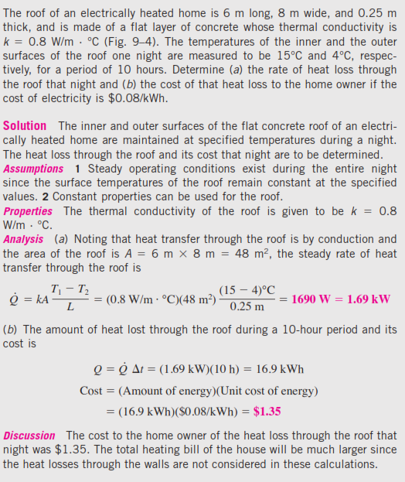
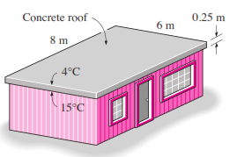
Example

Slide 28
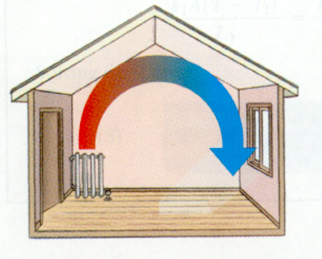
Convection
The process that transfers energy by the movement of large numbers of particles in the same direction within a liquid or gas.
Natural convection relies on the buoyancy effect alone to move the fluid.
Forced convection drastically increases the fluid movement by using a fan or pump.

Slide 29
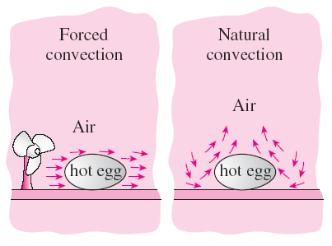
Convection
Forced convection: If the fluid is forced to flow over the surface by external means such as a fan, pump, or the wind.
Natural (or free) convection: If the fluid motion is caused by buoyancy forces that are induced by density differences due to the variation of temperature in the fluid.
The cooling of a boiled egg by forced and natural convection.

Slide 30
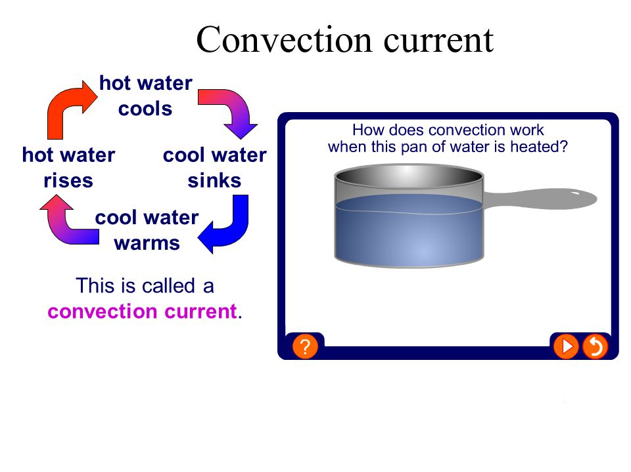

Slide 31
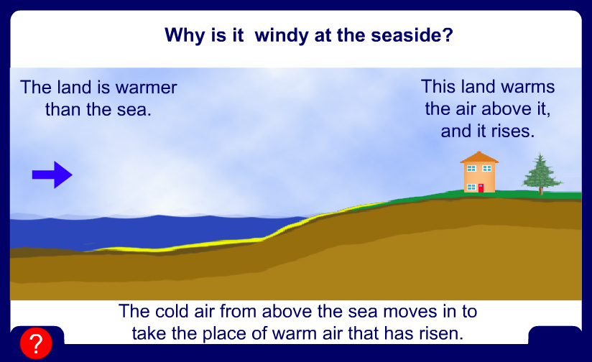
Why is it windy at the seaside?

Slide 32
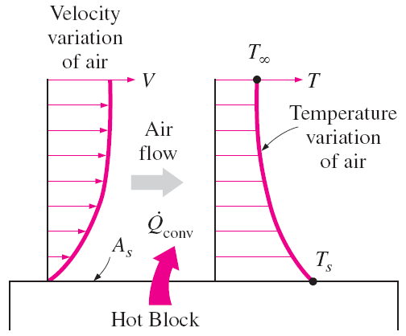
Convection
Convection: The mode of energy transfer between a solid surface and the adjacent liquid or gas that is in motion, and it involves the combined effects of conduction and fluid motion.
The faster the fluid motion, the greater the convection heat transfer.
In the absence of any bulk fluid motion, heat transfer between a solid surface and the adjacent fluid is by pure conduction.
Heat transfer from a hot surface to air by convection.

Slide 33

Convection
Newton’s law of cooling
h convection heat transfer coefficient, W/m² · °C
A_{s} the surface area through which convection heat transfer takes place
T_{s} the surface temperature
T∞ the temperature of the fluid sufficiently far from the surface.
The convection heat transfer coefficient h is not a property of the fluid but it is an experimentally determined parameter whose value depends on all the variables influencing convection such as;
    the surface geometry
    the nature of fluid motion
    the properties of the fluid
    the bulk fluid velocity

Slide 34
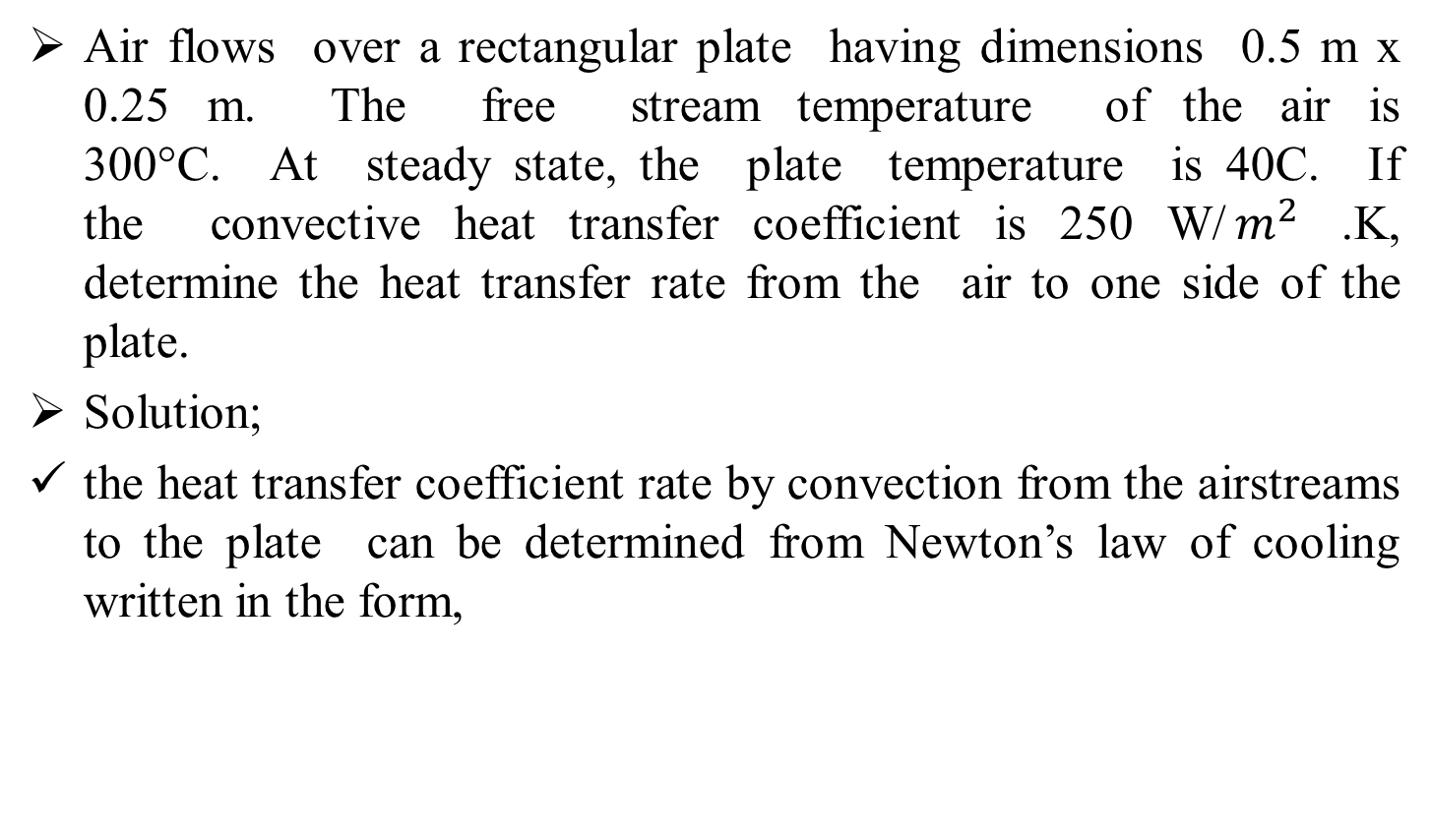
Example
Air flows over a rectangular plate having dimensions 0.5 m x 0.25 m. The free stream temperature of the air is 300°C. At steady state, the plate temperature is 40C. If the convective heat transfer coefficient is 250 W/$m^{2}$ .K, determine the heat transfer rate from the air to one side of the plate.
Solution;
the heat transfer coefficient rate by convection from the airstreams to the plate can be determined from Newton’s law of cooling written in the form,

Slide 35
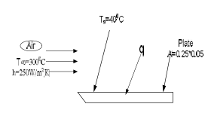

Example
where A is the area of the plate. Substituting numerical values,
Q=250 W / $m^{2}$.K * (0 .25 * 0 .50 )$m^{2}$(300 -40 ) C◦
Q=8125 W

Slide 36
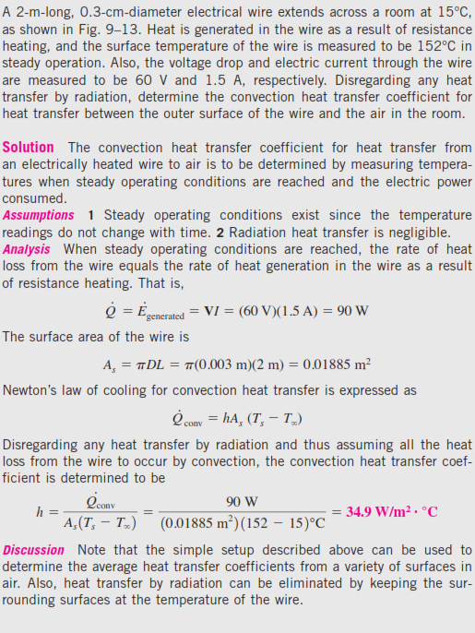

Example

Slide 37

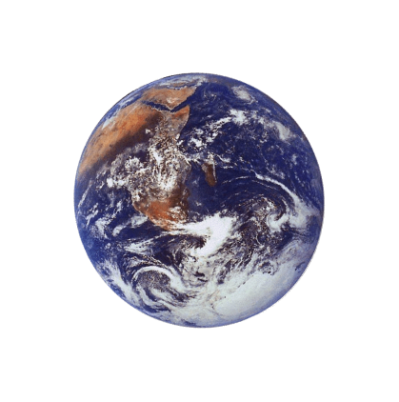
The third method of heat transfer
How does heat energy get from the Sun to the Earth?
There are no particles between the Sun and the Earth so it CANNOT travel by conduction or by convection.
RADIATION
?

Slide 38
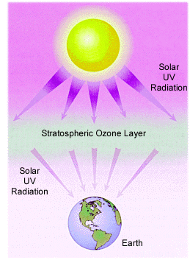
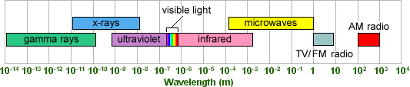
Radiation
The energy that travels by electromagnetic waves (visible light, microwaves, and infrared light).
Radiation from the sun strikes the atoms in your body and transfers energy.

Slide 39
Radiation
Thermal radiation is emission of energy as electromagnetic waves.
Intensity depends on body temperature and surface characteristics.
Important mode of heat transfer at high temperatures, e.g. combustion.
Can also be important in natural convection problems.
Radiation properties can be strong functions of chemical composition, especially CO₂, H₂O.
Radiation heat exchange is difficult solve (except for simple configurations). We must rely on computational methods.

Slide 40
RADIATION
Radiation: The energy emitted by matter in the form of electromagnetic waves (or photons) as a result of the changes in the electronic configurations of the atoms or molecules.
Unlike conduction and convection, the transfer of heat by radiation does not require the presence of an intervening medium.
In fact, heat transfer by radiation is fastest (at the speed of light) and it suffers no attenuation in a vacuum. This is how the energy of the sun reaches the earth.
In heat transfer studies we are interested in thermal radiation, which is the form of radiation emitted by bodies because of their temperature.
All bodies at a temperature above absolute zero emit thermal radiation.
Radiation is a volumetric phenomenon, and all solids, liquids, and gases emit, absorb, or transmit radiation to varying degrees.
However, radiation is usually considered to be a surface phenomenon for solids.

Slide 41
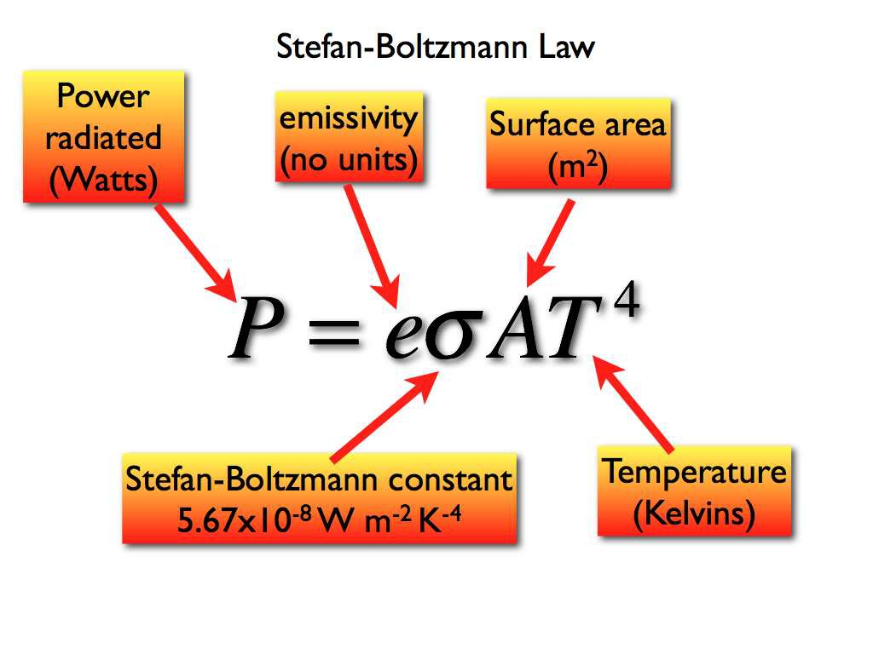
Radiation

Slide 42
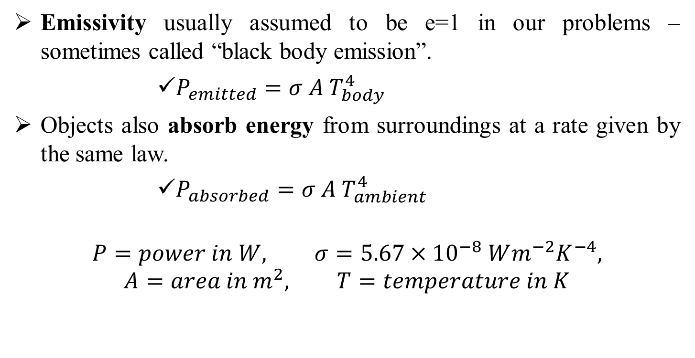
Radiation
Emissivity usually assumed to be e=1 in our problems – sometimes called “black body emission”.
        $P_{emitted}=σ A{ T}_{body}^{4}$
Objects also absorb energy from surroundings at a rate given by the same law.
        $P_{absorbed}=σ A{ T}_{ambient}^{4}$
$$P=power in W, σ=5.67×{10}^{−8} Wm^{−2}K^{−4},$$
$$A=area in m^{2}, T=temperature in K$$

Slide 43
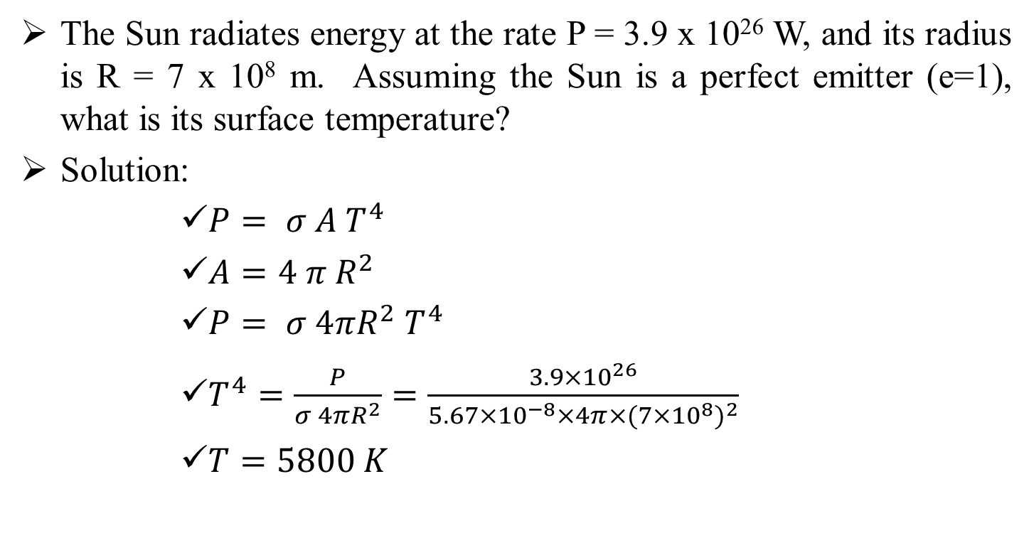
Example
The Sun radiates energy at the rate P = 3.9 x 10²⁶ W, and its radius is R = 7 x 10⁸ m. Assuming the Sun is a perfect emitter (e=1), what is its surface temperature?
Solution:
      $P= σ A T^{4}$
      $A=4 π R^{2}$
      $P= σ 4πR^{2} T^{4}$
      $T^{4}=\frac{P}{σ 4πR^{2}}=\frac{3.9×{10}^{26}}{5.67×{10}^{−8}×4π×{(7×{10}^{8})}^{2}}$
      $T=5800 K$

Slide 44
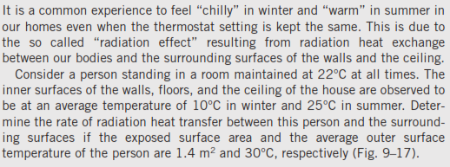
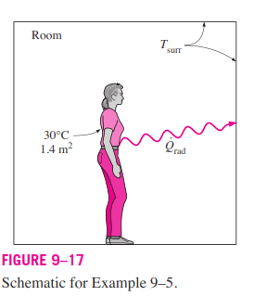
Example

Slide 45
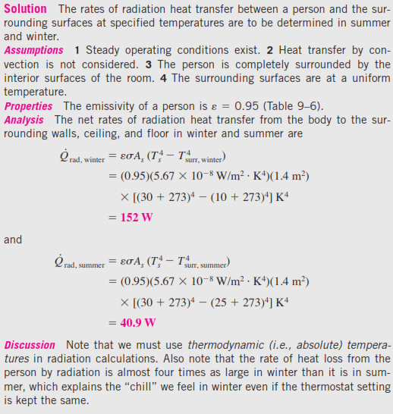
Example

Slide 46
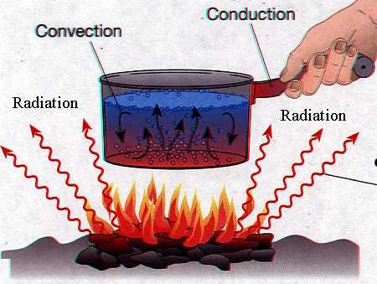
Conduction, Convection & Radiation

Slide 47
Conduction | Convection | Radiation
Energy transferred by direct contact Energy flows directly from warmer to cooler objects Continues until object temperatures are equal | Occurs in gases and liquids Movement of large number of particles in same direction Cycle occurs while temperature differences exist | Energy transferred by electromagnetic waves (visible light, microwaves, infrared) All objects radiate energy Can transfer energy through empty space

Slide 48
Heat transfer optimization
We have the following relations for heat transfer:
  Conduction:
  Convection:
  Radiation:
As a result, when equipment designers want to improve heat transfer rates, they focus on:
  Increasing the area A, e.g. by using profiled pipes and ribbed surfaces.
  Increasing ΔT (which is not always controllable).
  For conduction, increasing k_{f} /d.
  Increase h by not relying on natural convection, but introducing forced convection.
  Increase h_{r}, by using “black” surfaces.

Slide 49
Surface characteristics
(W/m²)
(incident energy flux)
(reflected)
(absorbed)
translucent slab
(transmitted)
absorptance
transmittance
reflectance

Slide 50
Black body radiation
A “black body”:
  Is a model of a perfect radiator.
  Absorbs all energy that reaches it; reflects nothing.
  Therefore
The energy emitted by a black body is the theoretical maximum:
This is Stefan-Boltzmann law; δ is the Stefan-Boltzmann constant (5.6697E-8 W/m²K⁴).
The wavelength at which the maximum amount of radiation occurs is given by Wien’s law:
Typical wavelengths are λ_{max} = 10 μm (far infrared) at room temperature and λ_{max} = 0.5 μm (green) at 6000K.

Slide 51
Real bodies
Real bodies will emit less radiation than a black body:
    Here ε is the emissivity, which is a number between 0 and 1. Such a body would be called “gray” because the emissivity is the average over the spectrum.
Example: radiation from a small body to its surroundings.
  Both the body and its surroundings emit thermal radiation.
  The net heat transfer will be from the hotter to the colder.
The net heat transfer is then:
For small ΔT the term (T_{w}⁴-T∞⁴) can be
approximated as and
with h_{r} as an effective
radiation heat transfer coefficient.

