Slide 1
TRIANGULATION AND TRILATERATION
Engr. Abdul Farhan

Slide 2
Introduction
To prevent accumulation of error it is necessary to provide number of control points all over the area, this is done by control survey.
The determination of the precise position of a number of stations, usually spread over a large area, is referred to as control surveying.
Control surveys can be horizontal or vertical.
The objective of horizontal control surveys is to establish a network of control stations whose position is specified in terms of latitude and longitude, whereas the objective of vertical control survey is to provide the elevations of fixed benchmarks with respect to the mean sea level datum.

Slide 3
Introduction
Methods of horizontal control survey are 1:Traverse 2:Triangulation 3:Trilateration and combination of these methods can be used.

Slide 4
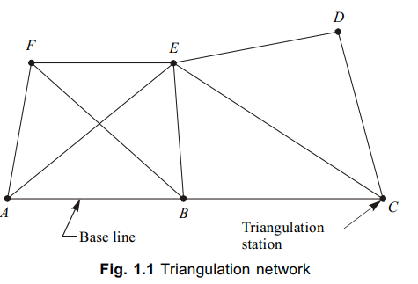
Triangulation
Triangulation consists of a number of interconnected triangles in which the length of only one base line and the angles of the triangles are measured very precisely which are used to calculate the coordinates of vertices.
The lines of a triangulation system form a network that ties together all the triangulation stations at the vertices of the triangles.

Slide 5
TRIAGULATION (Cont’d)
NOTE: RED = BASE LINE

Slide 6
Principle of triangulation
If all the three angles and the length of one side of a triangle are known, then by trigonometry the lengths of the remaining sides of the triangle can be calculated.
Again, if the coordinates of any vertex of the triangle and azimuth of any side are also known, then coordinates of the remaining vertices may be computed
Bridge site survey By Triangulation Method
Er. Pramesh Hada, Assistant Professor, nec

Slide 7
Uses of Triangulation
For establishment of accurate control points for plane and geodetic survey of large areas
For establishment of accurate control points for photogrammetric survey of large areas
To assist in determination of the size and shape of the earth
To determine the accurate location for setting out of engineering works such as piers and abutments for long-span bridge.

Slide 8
Advantages of Triangulation
More redundancies or checks are available (i.e. more than one route can be followed to compute the length of a line.)
There is little tendency for the system to sway or bend (i.e. azimuths can be easily and accurately carried or established throughout system).
Outstanding landmarks such as steeples, water tanks, etc can be located by establishing directions from different stations

Slide 9
Classification of Triangulations
The basis of the classification of triangulation figures is the accuracy with which the length and azimuth of a line of the triangulation are determined.
On the basis of quality , accuracy & purpose, triangulations are classified as:
Primary or First order Triangulation
Secondary or Second order Triangulation
Tertiary or Third order Triangulation Primary or First order Triangulation:
Is the highest grade of triangulation system.
To determine the shape & size of earth surface or to provide precise planimetric control points to which subsidiary triangulations may be connected.
Stations of first order triangulation are generally selected 16 to 150 Km apart.
Every possible precaution is taken in making linear, angular and astronomical observations, and also in their computation.

Slide 10
2. Secondary or Second order Triangulation:
The secondary triangulation consists of a number of points fixed within the framework of primary triangulation.
To provide control points closer together than those of primary.
Secondary is classified, If primary doesnot attain standard of accuracy.
The stations are fixed at close intervals so that the sizes of the triangles formed are smaller than the primary triangulation. (length = 8-65km)
3. Tertiary or Third order Triangulation:
Employed to provide control points between stations of primary & second order series.
The third order triangulation consists of a number of points fixed within the framework of secondary triangulation, and forms the immediate control for detailed engineering and other surveys.
The sizes of the triangles are small and instrument with moderate precision may be used.
For topogaphical details, tertiary triangulations forms immediate control points. (length = 1.5 -10km)
•

Slide 11
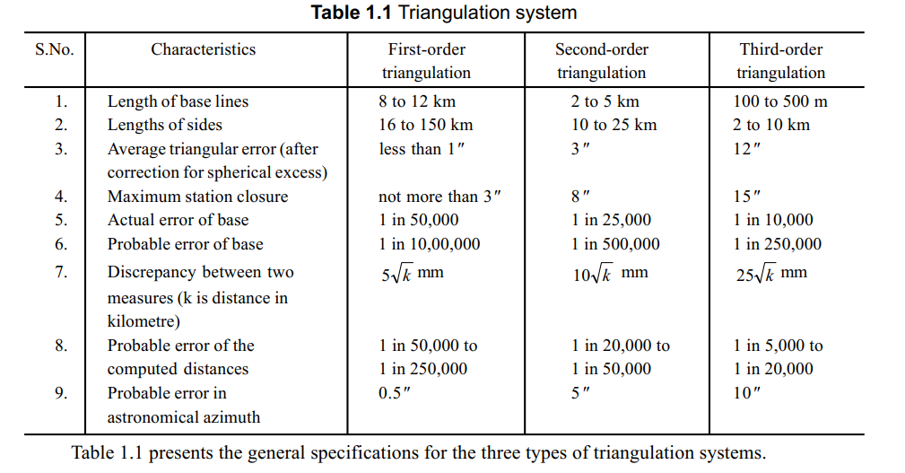

Slide 12
Layout of Triangulation
The arrangement of the triangles of a series is known as the layout of triangulation.
A series of triangulation may consists of:
Single chain of triangles
- narrow strip is cover
Double chain of triangles
-- cover large area
Centred Figures
--cover area and give satisfactory result in flat area.-Progress slow
Quadrilaterals
--best for hilly areas.-accurate

Slide 13
Satellite Stations
To secure well-conditioned triangles or to have good visibility, objects such as chimneys, flat poles, towers, lighthouse, etc. are selected as triangulation stations.
Such stations can be sighted from other stations but it is not possible to occupy the station directly below such excellent targets for making the observations by setting up the instrument over the station point.
Also, signals are frequently blown out of position, and angles read on them have to be corrected to the true position of the triangulation station. Thus, there are two types of problems:
When the instrument is not set up over the true station
When the target is out of position.

Slide 14
In Fig. 1.39, A, B, and C are the three triangulation stations.
It is not possible to place instrument at C.
To solve this problem another station S, in the vicinity of C, is selected where the instrument can be set up, and from where all the three stations are visible for making the angle observations.
Such station is known as satellite station.
As the observations from C are not possible, the observations form S are made on A, B, and, C from A and B on C.
From the observations made, the required angle ACB is calculated. This is known as reduction to centre.

Slide 15
Criteria for selection of triangulation stations
Triangulation stations should be intervisible. For this purpose the station points should be on the highest ground such as hill tops, house tops, etc.
Stations should be easily accessible with instruments.
Station should form well-conditioned triangles.
Stations should be at commanding positions so as to serve as control for subsidiary triangulation, and for possible extension of the main triangulation scheme.
Stations should be useful for providing intersected points and also for detail survey.
Stations should be selected such that the cost of clearing and cutting, and building towers, is minimum.

Slide 16
Field work of Triangulation Survey
Field work of triangulation involves the following steps:
Reconnaissance
Erection of signals
Measurement of the base lines
Measurement of horizontal angles
Astronomical observations
Computations

Slide 17
Reconnaissance
Examination of terrain to be surveyed.
Selection of suitable sites for measurement of base lines.
Selection of suitable positions for triangulation stations.
Determination of intervisibility of triangulation stations.
Selection of conspicuous well-defined natural points to be used as intersected points.
Collection of miscellaneous information regarding:
(a) Access to various triangulation stations
(b) Transport facilities
(c) Availability of food, water, etc.
(d) Availability of labour
(e) Camping ground.

Slide 18
Erection of signals and towers
A signal is a device erected to define the exact position of a triangulation station so that it can be observed from other stations whereas a tower is a structure over a station to support the instrument and the observer, and is provided when the station or the signal, or both are to be elevated.
A signal should fulfil the following requirements : (i) It should be conspicuous and clearly visible against any background. (ii) It should be capable of being accurately centered over the station mark. (iii) It should be suitable for accurate bisection from other stations.

Slide 19
MEASUREMENT OF BASE LINE
The accuracy of an entire triangulation system depends on that attained in the measurement of the base line and, therefore, the measurement of base line forms the most important part of the triangulation operations.
The length of the base line depends upon the grade of the triangulation.

Slide 20
Selection of Site for Baseline
The following points should be taken into consideration while selecting the site for a base line.
The site should be fairly level or gently undulating. If the ground is sloping, the slope should be uniform and gentle.
The site should be free from obstructions throughout the length of the base line.
The site should be such that a minimum length of the base line as specified, is available

Slide 21
Equipment for base line measurement
Generally the following types of base measuring equipments are used :
Standardised tapes : These are used for measuring short bases in plain grounds.
Tacheometric base measurements : It is used in undulating grounds for small bases
Electronic distance measurement: such as TotalStation

Slide 22
MEASUREMENT OF HORIZONTAL ANGLES
The instruments used for triangulation surveys, require great degree of precision. Horizontal angles are generally measured with an optical or electronic theodolite in primary and secondary triangulation. For tertiary triangulation generally transit or Engineer’s transit having least count of 20" is used.

Slide 23
ASTRONOMICAL OBSERVATIONS
To determine the azimuth of the initial side, intermediate sides, and the last side of the triangulation net, astronomical observations are made.

Slide 24
Computations
Sine Rule is used to calculate sides of the triangles.
Latitude and Departures are calculated by
Latitude =Lcosθ
Departure=Lsinθ
Where L=length of the a side of the triangle
Θ= Azimuth

Slide 25
Trilateration (Length Measured all sides- angles computed by Cosine rule)
Method in which the lengths of all sides of chain of triangles, polygons, or quadril aterals (or any combination of them) are measured with an electronic instrument orothers; the angles then may be compu ted from these field measurements.
Uses in the construction of a chain or ne twork of interconnected triangles in
a given area and the measurement of
all three sides of each triangle.
Angles of the triangles and the coordinates of their vertices are determined by trigonometric computations.
In contrast to triangulation, it does not involve the measurement of angles in a field.
Trilateration has the same purpose as triangulation.

Slide 26
Trilateration Network

Slide 27
Trilateration and its Principles
Trilateration is
a highly accurate and precise method of establishing and
expanding horizontal control.
Method of
control survey in which a network of triangles is used as in
triangulation system.
All the three sides of each triangle are measured in the field with the distance measuring instruments(EDMs, tapes, other apparatus).
Horizontal angles are not measured in the field.
Angles in a trilateration system are computed indirectly from the lengths of the sides of triangle by cosine formula.
Few horizontal angles are also sometimes measured to provide a check on computed angles.
Trilateration is
adjusted after the computation of the angles and then
coordinates of the stations are determined.
Vertical angles are also measured where elevations have not been established.

Slide 29
END OF LECTURE

