Slide 1
ENGINEERING SURVEYING LECTURE 6 Theodolite Traversing

Slide 2
Introduction
The theodolite is an intricate instrument used mainly for accurate measurement of horizontal and vertical angle up to 10” or 20”, depending upon the least count of the instrument. Because of its various uses, the theodolite is sometimes known as “Universal Instrument”.

Slide 3
Theodolite Types
Theodolites may be of two types
(i) Transit Theodolite
(ii) Non-Transit
In the transit theodolite, the telescope, the telescope can be revolved through a complete revolution about its horizontal axis in a vertical plane.
In the non transit theodolite, the telescope, cannot be revolved through a complete revolution in the vertical plane.

Slide 4
Transit Theodolite & Non-Transit

Slide 5
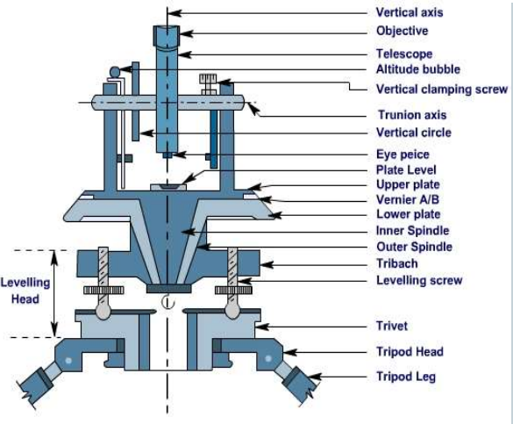

Slide 6
Theodolite Traversing
In theodolite traversing, the field work consisting of
(1)reconnaissance,
(ii) selection, marking, and referencing of stations, (iii) running of survey lines,
(iv) picking up of the detail, and (v) booking of field notes
is much the same as for compass traversing. For linear measurements, the steel tape is generally used.

Slide 7
Theodolite Traversing
The methods by which the relative directions of the lines of a traverse may be determined are : (I) By the measurement of angles between successive lines, (II) By the direct observation of bearings of the lines. The former is generally used for long traverses, or where high precision is required, while the latter is used for short traverses where great precision is not required, and for topographical survey

Slide 8
Theodolite Traversing
In the first method the angles between successive lines are measured, and the bearing of the initial line observed. The bearings of the remaining lines are then calculated from the observed bearing and the measured angles. The angles measured at the different stations may be (1) included angles, (2) direct angles or angles to the right, and (3) deflection angles.

Slide 9
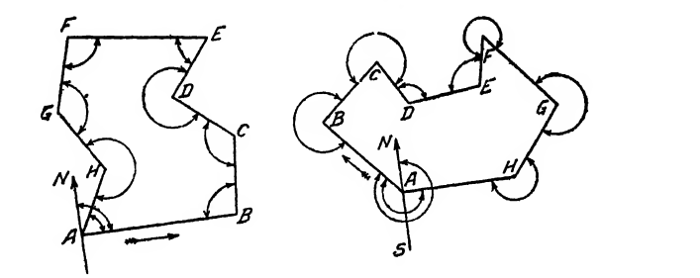
Traversing by the Method of Included Angles
This method is chiefly used in land surveying. Where great accuracy is required, it is invariably used as the angles can be measured by the method of repetition to any desired degree of precision. In this method the bearing of the initial line, angles of a traverse are measured. .

Slide 10
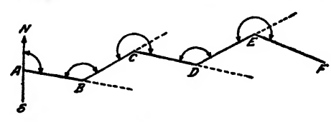
By Direct angles or angles to the right
Angles measured clockwise from the preceding line to the following one are called direct angles, or angles to the right as in the below figure. This method is mostly used for open traverse .

Slide 11
By Deflection angles
This method is mostly used for open traverse A deflection angle is the angle which a survey line makes with the prolongation of the preceding line and is equal to the difference between the included angle and 180 °. Deflection angles may have any value between 0° and 180°, never exceeding 180° .

Slide 12
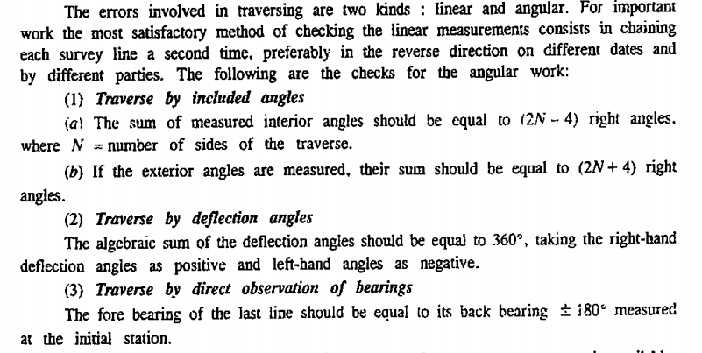
Checks in Closed Traverse
Checks in Open Traverse (Assignment)

Slide 13
Traverse Computations
The theodolite is not plotted according to interior angles or bearings. It is plotted by computing the latitude and departure of the point and then finding the independent coordinates of the point.
The latitude of a line is the distance measured parallel to the North-South line and the departure of a line measured parallel to the East-West line.
The latitude and departure of lines are also expressed in the following ways

Slide 14
Computation of Latitude and Departure
Northing= Latitude towards north= + L
Southing= Latitude towards South= -L
Easting= Departure towards East= + D
Westing= Departure towards West= -D
Conversion of WCB to RB
WCB | RB | Quadrant
0 to 90 ⁰ | RB=WCB | NE
90 ⁰ and 180 ⁰ | RB= 180 – WCB | SE
180 ⁰ and 270 ⁰ | RB= WCB- 180 ⁰ | SW
270 ⁰ and 360 ⁰ | RB= 360 ⁰ – WCB | NW

Slide 15
Computation of Latitude and Departure
Line | Length (L) | Reduced Bearing (Ө) | Latitude (LCOS Ө) | Departure (L Sin Ө)
AB | L | NӨE | + L cos Ө | + L sin Ө
BC | L | SӨE | -L cos Ө | + Lsin Ө
CD | L | SӨW | -L cos Ө | -L sin Ө
DA | L | NӨW | + Lcos Ө | -L sin Ө
N
B
Ө
Latitude= (L Cos Ө)
W
E
Departure= (L Sin Ө)
S
A

Slide 16
Computation of Latitude and Departure
Line | Length | Reduced Bearing | Consecutive Coordinates
 | (L) | (Ө) | Northing (+) | Southing (-) | Easting (+) | Westing (-)
AB | L | NӨE | L cosӨ |  | L sin Ө
BC | L | SӨE |  | Lcos Ө | Lsin Ө
CD | L | SӨW |  | Lcos Ө |  | Lsin Ө
DA | L | NӨW | L cosӨ |  |  | Lsin Ө
Check for Closed Traverse
Sum of Northing= Sum of Southing
Sum of Easting= Sum of Westing

Slide 17
Computation of Latitude and Departure
Consecutive Coordinates
The latitude and departure of a point calculated with reference to the preceding point are called consecutive coordinates.
Independent Coordinates
The coordinates of any point with respect to a common origin are said to be the independent coordinates of that point. The origin may be a station of the survey or a point entirely outside the traverse.

Slide 18
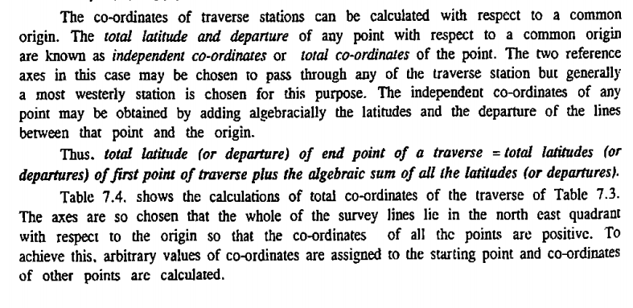
Independent Coordinates

Slide 19
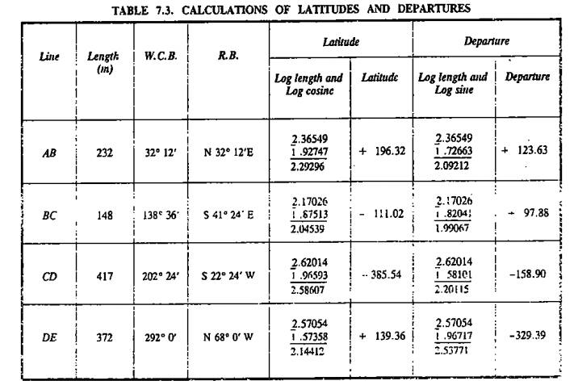
Independent Coordinates

Slide 20
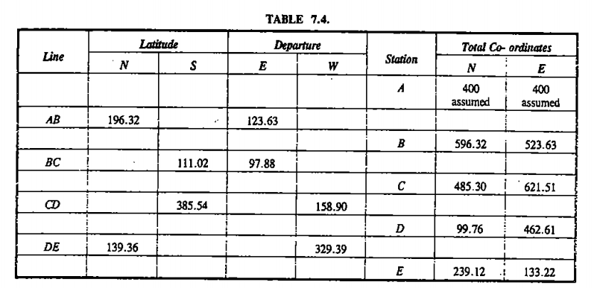
Independent Coordinates

Slide 21
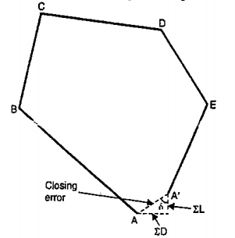
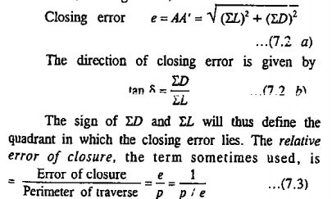
Closing Error
In any closed traverse the algebraic sum of the latitudes should equal zero, and the algebraic sum of the departures should equal zero, provided the work is correct. In other words, the sum of the north latitudes (Northings) should be equal to the sum of south latitudes (Southings), and the sum of the east departures (Eastings) should be equal to the sum of the west departures (Westings). But owing to errors in the field measurements of angles and distances, the traverse, if plotted according to the field measurements, will not close on paper, i. e. the end point of the traverse will not coincide exactly with the starting point. The distance by which the end point of a survey falls short to coincide with the starting point, i. e. the length of the line joining the beginning of the first line to the ending of the last line is called closing error or error of closure.

Slide 22
Balancing the Traverse
The term Balancing is generally used to refer to the operation of applying corrections to the traverse such that the algebraic sum of latitudes and that of departures become equal to zero. The following methods are used for
1: Bowditch Method
2: Transit Method
3: Graphical Method
4:Axis Method

Slide 23
Bowditch Method
By this rule, the total error (in latitude or departure) is distributed in proportion to the length of the traverse legs. This is the most common method of traverse adjustment. This rule is used to balance the traverse when the angular and linear measurements are equally precise.
Correction to latitude of any side
• = Length of that Side x Total Error in latitude Perimeter of Traverse
Correction to departure of any side
Length of that Side x Total Error in departure Perimeter of Traverse

Slide 24
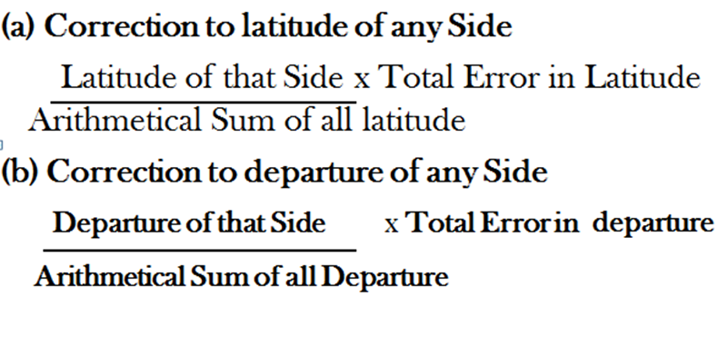
Transit Rule
This rule is used when angular measurements are more precise than linear measurements

Slide 25
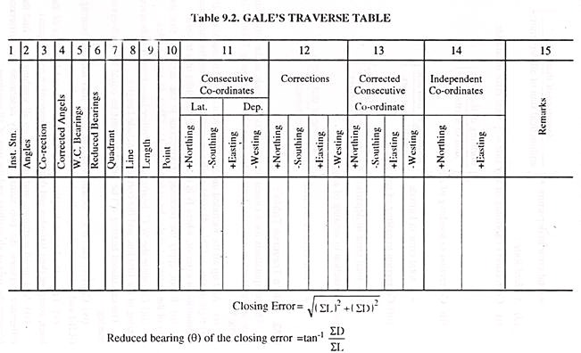
Gale’s Traverse Table
Traverse Computations are done in a tabular form called Gale’s Traverse Table

Slide 26
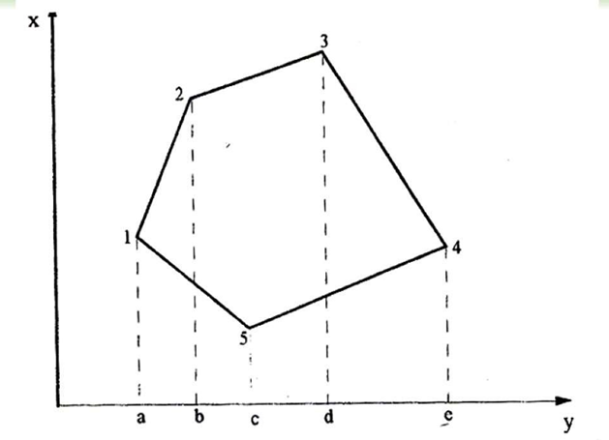
Area Calculation of Traverse from Independent Coordinates

Slide 28
Assignment 1: Checks on open traverse 2: Graphical and Axis Rule of Balancing of Traverse

