Slide 1
Lecture 6
Instructor: Engr. Syed Ashraf Ali

Slide 2
Introduction to Computing
Using computers to solve (engineering) problems of our interest is called Computing. In this process, we develop computational tools that help us do our jobs better and faster.
Computing is different from Computer Science. Computer Scientists try to design the Computer itself and develop programming languages that we, as programmers, can use for our own engineering applications.

Slide 3
Types of Computing
On-site Data Analysis and response systems in real-life applications:
Structural Health Monitoring and Control
Water quality management
Earthquake Engineering
Direct simulation of physical phenomena (Scientific Computing)
Analysis & design of systems such as buildings, bridges, machines etc.
Verify &Validate current and future theories of physics-Simulate stuff we cannot measure or observe-subatomic particles, core of stars, even origin of the universe!!

Slide 5
MATLAB
Mat lab is a program for doing numerical computations, originally designed for solving linear algebra type problems.
MATLAB = MATrix LABoratory
Matlab is an interpreter
Code does not need to be compiled
Can make a little slower than compiled code
Can be linked to C / C++, JAVA, SQL, etc.
Can do much more than just math!
Wide variety of toolboxes and functions available

Slide 6
MATLAB
MATLAB is a high-level programming language.
This means (informally) it is closer to English.
Very low level
(machine language)
Low level
(Assembly language)
High level
(Matlab language)
01010010101010
01010101010101
10101001010100
101010011111001
….
BCC A7
LDA B2
AND A1
CMP A # HEXERR
JMP CTRL
….
if student_marks < =88
disp(‘A’grade)
else
disp(‘B’grade)
…

Slide 7
MATLAB
If MATLAB can process and visualize data, why ever use FORTRAN, C, or some other language?
MATLAB is an interpreted language
It is not a compiled language
Therefore identical code executes more slowly, sometimes MUCH more slowly in MATLAB
MATLAB has more memory overhead than equivalent FORTRAN or C programs
MATLAB may be unsafe for some critical systems

Slide 8
MATLAB
Main Features:
Simple programming rules
Extended accuracy
Continuity among integer, real and complex values
Comprehensive mathematical library
Extensive graphics tools
Linkages with other languages
Transportability across environment
MATLAB scripts will work on PC, UNIX, Mac

Slide 12
MATLAB (R2012a) Environment
Working Path
Where you are
Working Path
Where you are
Command Window
Where the magic happens
Current Folder
Contents of
working directory
Command History
Past Commands

Slide 13
MATLAB(R2013a) Environment

Slide 14
Why MATLAB
Because it simplifies the analysis of mathematical models
It frees you from coding in high-level languages (saves a lot of time - with some computational speed penalties)
Provides an extensible programming/visualization environment
Provides professional looking graphs

Slide 15
Starting MATLAB
Once MATLAB is running the GUI (Graphical User Interface) will appear
Default Window appearance (you can change this)

Slide 16
This is the command prompt
>>
Command Window
Main window in MATLAB
Commands entered here

Slide 17
MATLAB GUI
Current Folder Window:
Displays contents of the current working directory
MATLAB Search Path
Path that MATLAB uses to search for script and function files
Default path contains all built in MATLAB functions
Can modify path through MATLAB function or going under File>Set Path
MATLAB will ask to modify path if running a program from a folder not in path

Slide 18
MATLAB GUI
Workspace Window:
Shows all currently defined variables
Array dimensions
Min, max values
Good debugging tool
Command History:
Shows all past commands
Can copy and past commands into command window
Double click will execute command

Slide 19
MATLAB GUI
Other windows include editor window, figure window, variable editor, help, etc
Will discuss editor and figure window in upcoming weeks, get to help window in a little bit

Slide 20
MATLAB GUI
Desktop Menus
File Menu
New
Create new MATLAB program file (m-file)
Open existing m-file
Import data
Set Path
Print files
Open recent m-files

Slide 21
MATLAB GUI
Edit Menu
Copy, cut, paste
Find and replace phrases
Clear command history, workspace
Desktop Menu
Change appearance of desktop
Select windows to display

Slide 22
MATLAB is Case Sensitive
Matlab cares about how you use case
Mistakes can be a huge source of frustration
So Fish FISH fish are three completely different things to Matlab

Slide 23
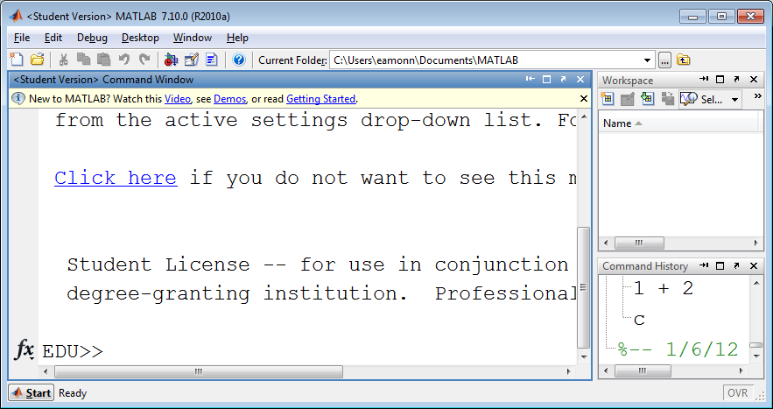
Starting MATLAB…
Nothing in my workspace yet
Command prompt is ready

Slide 24
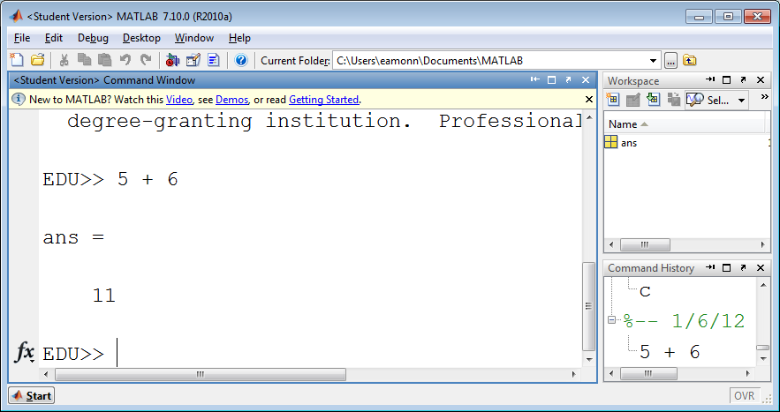
Using Matlab as a simple calculator, let us add 5 and 6
Something is in my workspace now
Matlab computed the answer to 5 + 6, and called it ‘ans’
Here is my history

Slide 25
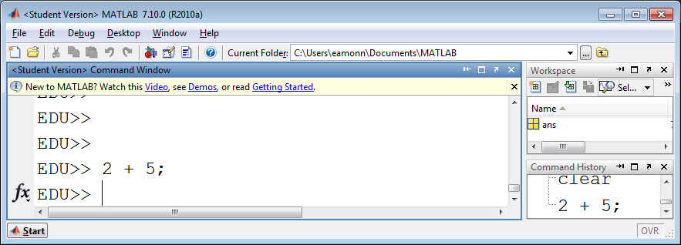
Using The Semicolon To Suppress Echoing
;
If we use the semicolon is this way, Matlab still adds the numbers, and still puts the answer into ‘ans’, but it does not show the answer
show the answer
echo the answer
display the answer

Slide 26
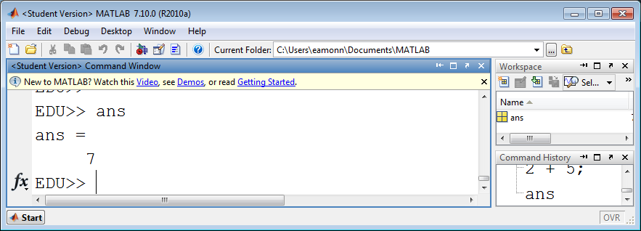
Using The Semicolon To Suppress Echoing
;
We can examine the contents of ans at any time, simply by typing its name.

Slide 27
Examples
What is sum of the first 5 natural numbers?
What is the student to faculty ratio at INU if We have 20,74 students, and 42 faculty.
What is the area of the blue square?
What is Eamonn’s BMI? He is 1.87m tall and 99.79 kg in weight.
11

Slide 28
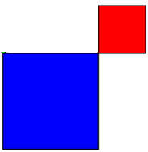
Examples
What is Eamonn’s BMI, using imperial units?He is 74 inches tall and 220 lbs in weight.
What is the total area of the two squares?
It is 5 * 5 + 11 * 11 But the order matters….
Left to right…
Right to left …
Multiplication first…
5
5 * 5 + 11 * 11
25 + 11 * 11
36 * 11
396
5 * 5 + 11 * 11
5 * 5 + 121
5 * 126
630
5 * 5 + 11 * 11
5 * 5 + 121
25 + 126
151
11
Wrong!
Wrong!
Right!

Slide 29
Precedence: Order of Operations
An expression inside parentheses is evaluated on its own before being used by operands outside the parentheses
Parentheses
Exponentiation
Multiplication and division have equal precedence
Addition and subtraction have equal precedence
Evaluation occurs from left to right
When in doubt, use parentheses
MATLAB will help match parentheses for you
The acronym PEMDAS is common. It stands for Parentheses,
Exponents, Multiplication, Division, Addition, Subtraction.

Slide 30
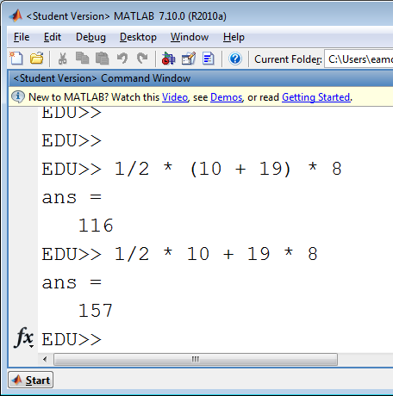
Area of a Trapezoid
10
What is my area?
8
19
Wrong!
= ½(a+b) × h
In the wrong example Matlab did…
1/2 * 10 + 19 * 8
5 + 19 * 8
5 + 152
157

