Slide 1
Building Drawings
Civil Engineering Drawings & Graphics
Set of Working Drawings
Ar. Alina Babar
alina@inu.edu.pk
Civil Engineering Department
Iqra National University

Slide 2
Introduction
A building or construction project requires a complete set of specialised drawings. These drawings, called a project set, are used by the local planning department and building control, as well as by builders, joiners, plumbers, electricians and water, gas and telephone engineers.
The buildings are designed by an architect with a team of technicians and surveyors to help plan and produce the drawings.
Drawings for new buildings require approval from the building control department and the planning department before construction work can begin. The building control department checks that the quality of design and construction meet the standards/ byelaws. The planning department assesses whether or not the style and proportions of the proposed building are appropriate for the location.

Slide 3
What do working drawings include?
Depending upon the purpose they serve, construction/ working drawings include:
Architectural Drawings: Architectural drawing can be termed as the mother drawing for all the other drawings used for construction
Structural Drawings
Electrical Drawings
Plumbing Drawings
Finishing/ Detail Drawings
Other Drawings:
Mechanical drawings
Civil drawings
Traditionally, working drawings consist of two-dimensional orthogonal projections of the building or component they are describing, such as plans, sections and elevations

Slide 4
Main Parts of Drawing Set

Slide 5
Title Sheet

Slide 9
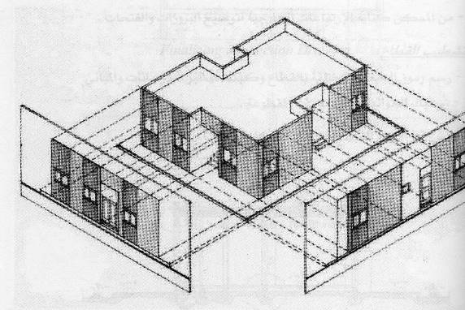
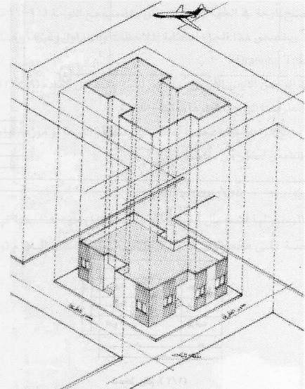
Location Plan
ARCHITECTURAL DRAWINGS
Site plan
Floor Plans
Elevations
Sections

Slide 10
Location Plan
It identifies the location of the proposed new building within its surroundings. It also helps the builder to plan the layout of a new building scheme and is required by the local government planning department which decided whether or not to approve the project.
Neighbouring buildings and their boundaries are shown, as are roads, street names and fields.
The scale of the drawing depends on the size of the whole building scheme but is normally 1:1250
All building projects come under local authority control

Slide 11
Site Plan
A site plan (also known as a block plan) is a view looking down at a building from above, illustrating the site boundary and the outline of the new building which are highlighted in the location plan.
Paths, roads and neighbouring plots are also shown. This type of plan enables the builder to mark out the site, lay drainage pipes and build manholes.
It provides information about the site’s topography, utilities, site work etc.
The importance of site plan:
It illustrates the existing natural features such as trees and also existing built features
The building outline, including the roof
The main dimensions of the house and site
Drainage pipes and manholes which run from the bathroom and kitchen to the main drain under the road
The position and orientation of the house on the site/ plot
Contour lines which show the slope of the land
The scale of a site plan: It depends on the size of the building. For houses and small buildings a 1:200 scale is used

Slide 12
Floor Plan
A floor plan is a drawing of the rooms and spaces in a building with a view looking downward from above
It is a type of sectional view of the building with a horizontal plane cut through a building from above 5 Feet to show:
The arrangement of rooms
The horizontal dimensions between the walls to specify room sizes and wall lengths.
The thickness & construction of vertical walls & columns that define these spaces
The positions of windows and doors
Details like sinks, kitchen counters, water heaters, furnaces, etc.
Floor plans are used by builders, plumbers, electricians and joiners to help plan the construction work and to cost the building materials.
The scale of a floor plan depends on the size of the building but for most domestic buildings a sale of 1:50 is used
Floor plan includes dimensions of each room & the exact positions of doors & windows

Slide 13
Floor Plans
The importance of Plans:
Define the spaces & its functional relationship.
Illustrates places of openings (doors- windows).
Finishing.
Entrance (main- secondary)
Utilities (stairs, elevators, baths, stores)
Structural system:
R.C, steel, bearing walls
Columns, beams
Thickness of walls (exterior & interior)
Measurement and cost (quantity survey)

Slide 14
Components in Floor Plan
There are 4 components of floor plans
Column to column dimensions
Door, window and other dimensions
Room Tags
Furniture Layout
These components are individually shown on the same floor plan and then printed on separate sheets of a drawing set for easy communication
All of these components can be merged in one plan and can be printed on a single sheet rather than on multiple sheets e.g. One plan having dimensions, room tags and furniture layout all together depending on the clarity and size of sheets and complexity of the project
In order for the client to easily understand and read these drawings all the above mentioned plans are printed separately

Slide 16
Elevations
Elevations are orthographic projections of a building OR
It is view of a building’s exterior perpendicular to the principle vertical surfaces.
Elevations are required by the local planning department to assess whether the style and proportions of the proposed building are appropriate for the location. Builders also need a picture of what the house will look like from the outside.
The importance of Building Elevations:
Exterior finishing
Openings
Size, shape , materials of exterior surfaces
Size proportion
Heights of the building
Measurements

Slide 18
Section
It is a vertical pane cut through a building where you can see through the walls into the house or building
Or It is a drawing of interior & exterior partitions and roofs and ground floor in addition of interior elevations seen beyond the plane of cut.
The importance of Building Sections:
Illustrate building construction
Technical details
Types of slab (solid slab, hollow block, flat slab)
Building material (block, stone, concrete)
Height of the building and levels.
Details and finishing
Measurements

Slide 20
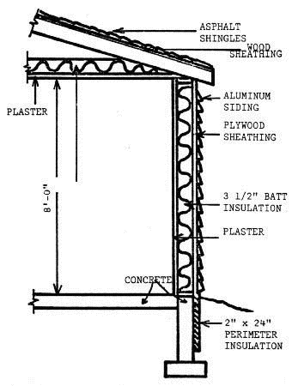
A cross-section showing a slice through the wall gives builders, joiners and roofers a great deal of information about how the house should be built,
Sections can be shown through any part of the building and normally a scale of 1:20 is used. The local building control department needs sectional views and floor plans to assess the quality of construction design.
Sectional Detail

