Slide 1
Lecture 5
Instructor: Engr. Syed Ashraf Ali

Slide 2
Introduction
Energy can be obtained from the other form with the help of
converters.
Converters that are used to continuously translate electrical input to mechanical output or vice versa are called electric machines.
The process of translation is known as electromechanical energy
conversion.

Slide 3
Electrical machines
An electrical machine is the device that converts energy in two categories;
  Generators which convert mechanical energy into electrical energy,
  Motors which convert electrical energy into mechanical energy.

Slide 4
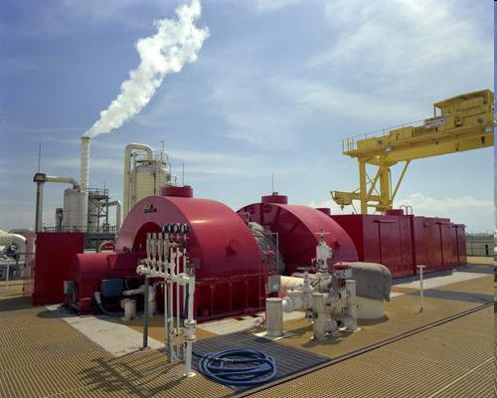
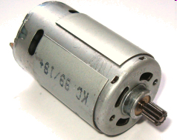
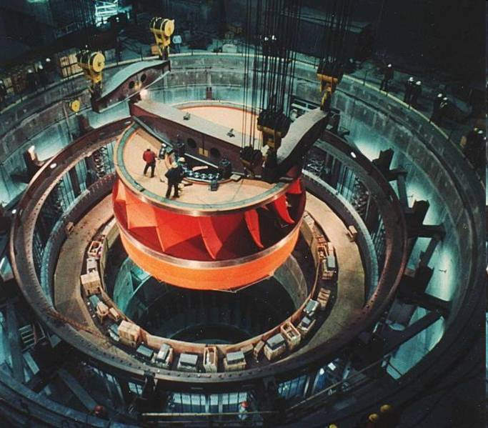
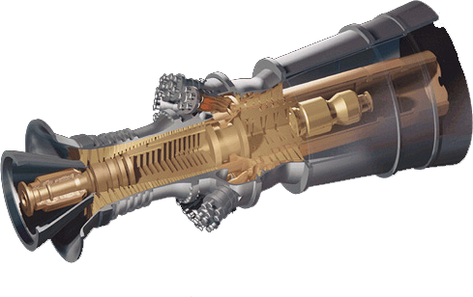
Motors and Generators
Small DC Motor
Image courtesy of DOE / NREL
Geothermal Generator
Generator in a Hydro Plant
Electric Turbine Generator
Notes:
The hydro plant generator is an image from the Grand Coulee dam.
This geothermal plant is located in southeastern California.
The electric turbine is the type that might be powered by burning natural gas.

Slide 5
Classification of Motors
Electric Motors
Alternating Current (AC) Motors
Direct Current (DC) Motors
Synchronous
Induction
Separately Excited
Self Excited
Single-Phase
Three-Phase
Series
Compound
Shunt

Slide 6
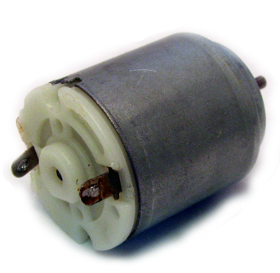
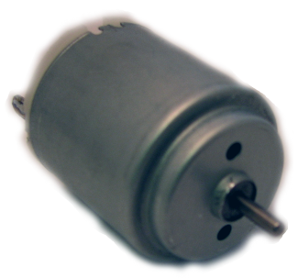
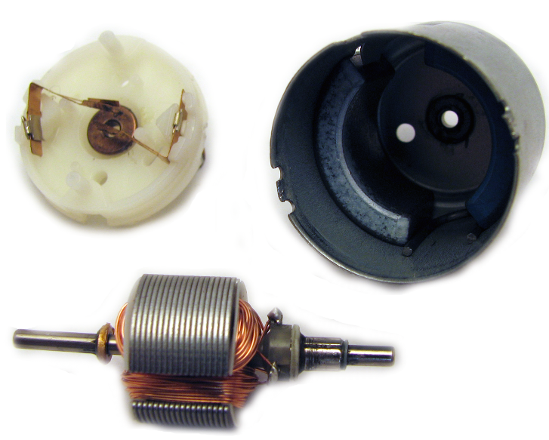
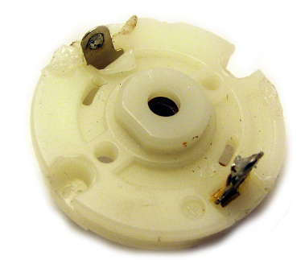
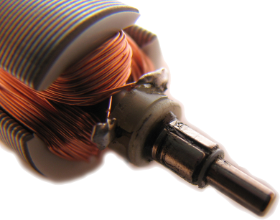
Parts of a Small DC Motor
Brushes
Wire
Connections
Permanent
Magnets
Armature
Commutator

Slide 7
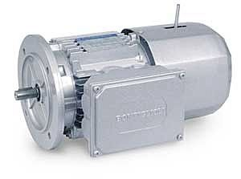
DC Motor
Field pole;
  North pole and south pole.
  Receive electricity to form
  magnetic field.
Armature;
  Cylinder between the poles.
  Electromagnet when current goes through
  Linked to drive shaft to drive the load.
Commutator;
  Overturns current direction in armature.
  .

Slide 8
DC Motor
Speed control without impact power supply quality;
  Changing armature voltage.
  Changing field current.
Restricted use;
  Few low/medium speed applications.
  Clean, non-hazardous areas.
Expensive compared to AC motor.

Slide 9
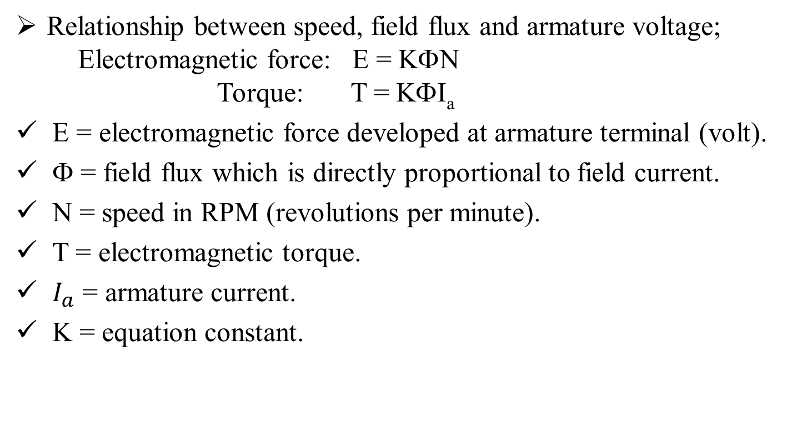
DC Motors
Relationship between speed, field flux and armature voltage;
Electromagnetic force: E = KΦN
Torque: T = KΦI_{a}
E = electromagnetic force developed at armature terminal (volt).
Φ = field flux which is directly proportional to field current.
N = speed in RPM (revolutions per minute).
T = electromagnetic torque.
$I_{a}$ = armature current.
K = equation constant.

Slide 10
AC Motors
Electrical current reverses direction.
Two parts;
  Stator: stationary electrical component.
  Rotor: rotates the motor shaft.
Speed difficult to control.
Two types;
  Synchronous motor.
  Induction motor.

Slide 11
Asynchronous motor / induction motor;
    Motors whose field current is supplied by magnetic induction (transformer action) into their field windings.
Synchronous motor;
    Motors whose field current is supplied by a separate dc power source.
Note;
    Induction motor has the same physical stator as a synchronous motor with a different rotor construction.
    The fields circuit of most synchronous and induction motor are located on their rotors.

Slide 12
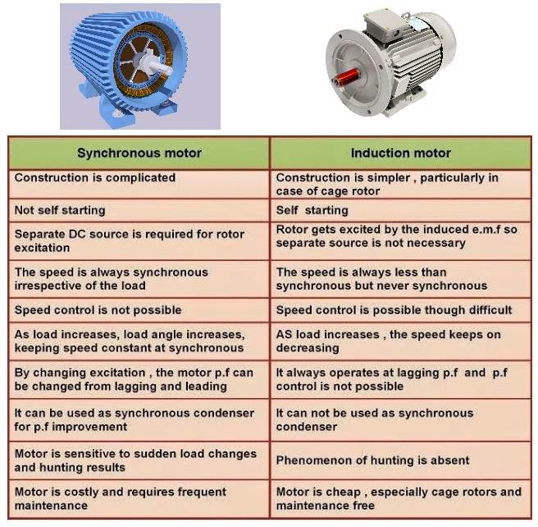

Slide 13
Synchronous Motor
Constant speed fixed by system frequency.
Low starting torque: suited for low load applications.
Can improve power factor: suited for high electricity use systems.
Synchronous speed (Ns);
Ns = 120 f / P
F = supply frequency
P = number of poles

Slide 14
Example 1
Calculate the synchronous speed of a 3-phase induction motor having 20 poles when it is connected to a 50 Hz source.
Knowing quantities;
Source frequency = 50 Hz, number of poles = 20
120 f
Synchronous speed n_{s} =
p
120 x 50
=
20
n_{s} =
300 r/min

Slide 15
Induction Motors
Induction motors are the motor frequently encountered in industry.
Simple, low-priced and easy to maintain.
It run essentially constant speed from zero to full-load.
The speed is frequency-dependent and consequently these motors are not easily adapted to speed control.
Induction machines is called induction because the rotor voltage (which produces the rotor current and the rotor magnetic field) is induced in the rotor winding rather than physically connected by wires.

Slide 16
Induction Motor Construction

Slide 17
Slip and Slip Speed
The slip s of an induction motor is the difference between the
synchronous speed and the rotor speed, expressed as a percent
(per unit) of synchronous speed.
The per-unit slip is given by the equation;
n_{s} - n_{r}
S = slip
n_{s} = synchronous speed [r/min]
n_{r} = rotor speed [r/min]
S =
n_{s}

Slide 18
Voltage and frequency induced in the rotor
The voltage and frequency induced in the rotor both depend
on the slip.
They are given by the following equation;
f₂ = s f
E₂ = s E_{oc} (approx.)
f₂= frequency of the voltage and current in the rotor [Hz].
f = frequency of the source connected to the stator [Hz].
s= slip.
E₂= voltage induced in the rotor at the slip s.
E_{oc}= open-circuit voltage induced in the rotor when at rest [V].

Slide 19
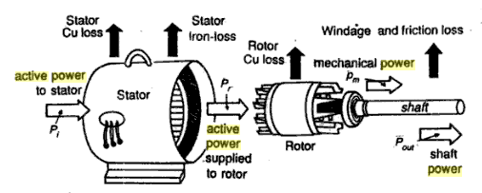
Active Power in a Induction Motor
P_{output}
Efficiency (η) =
P_{input}

Slide 20
Example 2
A 0.5 hp, 6-pole induction motor is excited by a 3-phase, 60 Hz
source. If the full-load is 1140 r/min, calculate the slip.

Slide 21
Knowing quantities;
Source frequency = 60 Hz, number of poles = 6
Full load/rotor speed = 1140 r/min
Synchronous speed n_{s} =
120 f
p
120 x 60
=
6
n_{s} =
1200 r/min

Slide 22
Slip speed: n_{s} – n = 1200 – 1140 = 60 r/min
Slip: s = (n_{s} - n) / n_{s}
= 60/1200
= 0.05 or 5%

Slide 23
Induction Motor
Most common motors in industry.
Advantages;
  Simple design,
  Inexpensive,
  Easy to maintain,
  Direct connection to AC power source.

Slide 24
Induction motor
Components;
    Rotor;
      conducting bars in parallel slots.
      Wound rotor: 3-phase, double-layer, distributed winding.
    Stator;
      Stampings with slots to carry 3-phase windings.
      Wound for definite number of poles.

Slide 25
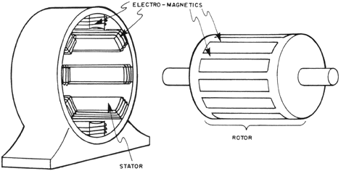
Induction Motor
How induction motors starts;
  Electricity supplied to stator,
  Magnetic field generated that moves around rotor,
  Current induced in rotor,
  Rotor produces second magnetic field that opposes stator magnetic field,
  Rotor begins to rotate.
Electromagnetics
Rotor
Stator

Slide 26
Induction Motor
Single-phase induction motor;
  One stator winding,
  Single-phase power supply,
  Require device to start motor,
  Household appliances: fans, washing machines, dryers.

Slide 27
Induction Motor
Three-phase induction motor;
  Three-phase supply produces magnetic field,
  wound rotor,
  Self-starting,
  High power capabilities,
  High Power applications: pumps, compressors, conveyor belts, grinders.
  70% of motors in industry.

Slide 28
Main Constructional Features
Body or magnetic frame or yoke,
Pole core and pole shoes,
Field or exciting coils ,
Armature core,
Armature winding,
Commutator,
Brushes,
End housings,
Bearings,
Shaft.

Slide 29
MAIN CONSTRUCTIONAL FEATURES
Brush
Bearing
Body / Yoke
Pulley
End Housing
Shaft
Armature
Commutator
Field Core
Brush
holder
Field Winding

Slide 30
MAIN CONSTRUCTIONAL FEATURES
YOKE
ARMATURE
+
SHAFT
FIELD POLE
& COIL
BRUSH
-
COMMUTATOR

Slide 31
MAIN CONSTRUCTIONAL FEATURES
Magnetic frame or Yoke;
The outer cylindrical frame to which main poles and inter poles are fixed and by means of which the machine is fixed to the foundation is called YOKE.

Slide 32
It serves two purposes;
  It provides mechanical protection to
  the inner parts of the machines,
  It provides a low reluctance path for the magnetic flux.
The yoke is made of cast iron for smaller machines and cast steel or Fabricated rolled steel for larger machines.

Slide 33
Pole core and pole shoes;
The pole core and pole shoes are fixed to the yoke by Screws.
They serves the following purpose;
    They support the field or exciting coils,
    They distribute the magnetic flux on the armature periphery more uniformly,
POLE CORE

Slide 34
The pole shoes have larger
X-section, so, the reluctance of
the magnetic path is reduced,
The pole core and pole shoes are made of Laminated steel assembled by Riveting together under hydraulic
Pressure.

Slide 35
Field or exciting coils;
Field coils or exciting coils are used to magnetize the pole core.
Enameled copper wire is used for the construction of these coils.
When direct current is passed through these coils/winding, it sets up the magnetic field which magnetize the pole core to the reqd. flux.

Slide 36
Armature core;
Armature is a rotating part of the DC machine, reversal of flux takes place, so hysteresis losses are produced.
To minimize this loss, silicon steel is used for the construction.
The rotating armature cuts the main magnetic field , therefore an e.m.f is induced in the armature core.
This e.m.f circulates currents in the core which results in current loss in it.
The armature core is laminated to reduce the current loss.
Armature core serves the following purposes;
  It houses the conductors in the slots,
  It provides an easy path for magnetic flux.

Slide 37
Armature winding;
The no. of conductors in form of coils placed in the slots of the armature and suitably inter connected are called
winding.
This is the armature winding where conversion of power takes place i.e. in case of generator ,
mechanical power is converted into
electrical power and in case of a
motor,
ARMATURE WINDING
Electrical power is converted into mechanical
power.

Slide 38
Depending upon the types of inter connection of coils, the winding can be classified into two types;
  Lap Winding,
  Wave Winding.
  Lap Winding,
    The conductors/coils are connected in such a way that no. of parallel paths are equal to no. of poles.
    If machine has ‘P’ no. of poles and ‘Z’ no. of conductors, then there will be ‘P’ no. of parallel paths and each path will have ‘Z/P’ no of conductors in series. Also the no. of brushes are equal to no. of parallel paths. Out of which half of the brushes will be positive and remaining will be negative.

Slide 39
Wave Winding;
    The conductors are so connected that they are divided into two parallel paths only , irrespective of the no. of poles. If machines has ‘Z’ no. of conductors, there will be only two parallel paths and each will be having ‘Z/2’ no. of conductors connected in series with only two brushes.

Slide 40
Commutator;
It is the most important part of a DC machine and serves the following purpose;
  It connects the rotating armature conductors
to the stationary external circuit through the
brushes,
  It converts altering current induced in the armature conductors into unidirectional current in the external load circuit in generating action and it converts alternating torque into unidirectional-

Slide 41
torque produced in the armature in motoring action.
The commutator is of cylindrical shape and is made of wedge shaped hard drawn copper segments.
The segments are insulated from each other by a thin sheet of mica.
The segments are held together by means of two V-shaped rings that fit into the V-grooves cut into the segments.
Each armature coil is connected to the commutator segment through riser.

Slide 42
Commutator;
COPPER SEGMENT
RISER
MICA INSULATION
END RING
ADJUSTING NUT
SHAFT
METAL SLEEVE

Slide 43
Brushes;
Brushes are made of high grade carbon.
They form the connecting link between armature winding and the external circuit.
The brushes are held in particular position around the commutator by brush holders.

Slide 44
End housings;
They are attached to the ends of main frame and support bearing.
The front housing supports the bearing and the brush assembly whereas rear housing supports the bearing only.
END HOUSING

Slide 45
Bearings;
The function of the bearing is to reduce friction between the rotating and stationary parts of the machines.
These are fitted in the end housings.
Generally, high carbon steel is used for the construction of the bearings.

Slide 46
Shaft;
The function of shaft is to transfer mechanical power to the machine or from the machine.
Shaft is made of mild steel with maximum breaking strength.
All the rotating parts like armature core, commutator, cooling fan etc are keyed to the shaft.
SHAFT

