Slide 1
Lecture 5
Product Life-Cycle Stages

Slide 2
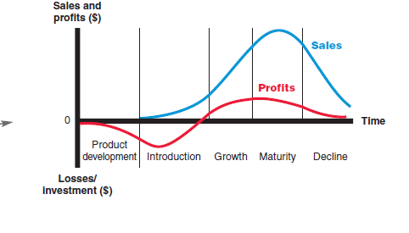
Product Life-Cycle Stages

Slide 3
After launching the new product, management wants that product to enjoy a long and happy life. Although it does not expect that product to sell forever, the company wants to earn a decent profit to cover all the effort and risk that went into launching it.
1. Product development begins when the company finds and develops a new-product idea.
During product development, sales are zero, and the company’s investment costs mount.
2. Introduction is a period of slow sales growth as the product is introduced in the market.
Profits are nonexistent in this stage because of the heavy expenses of product introduction.
3. Growth is a period of rapid market acceptance and increasing profits.
4. Maturity is a period of slowdown in sales growth because the product has achieved acceptance by most potential buyers.
Profits level off or decline because of increased marketing outlays to defend the product against competition.
5. Decline is the period when sales fall off and profits drop.

Slide 4
The Promotion Mix
The five major promotion tools are defined as follows:
• Advertising: Any paid form of non-personal presentation and promotion of ideas, goods, or services by an identified sponsor. Advertising includes broadcast, print, Internet, outdoor, and other forms.
• Sales promotion: Short-term incentives to encourage the purchase or sale of a product or service. Sales promotion includes discounts, coupons, displays, and demonstrations.
• Personal selling: Personal presentation by the firm’s sales force for the purpose of making sales and building customer relationships. Personal selling includes sales presentations, trade shows, and incentive programs.
• Public relations: Building good relations with the company’s various publics by obtaining favorable publicity, building up a good corporate image, and handling or heading off unfavorable rumors, stories, and events. Public relations (PR) includes press releases, sponsorships, special events, and Web pages.
• Direct marketing: Direct connections with carefully targeted individual consumers to both obtain an immediate response and cultivate lasting customer relationships. Direct marketing includes catalogs, telephone marketing, kiosks, the Internet, mobile marketing, and more.

