Slide 1
Lecture 4
Instructor: Engr. Syed Ashraf Ali

Slide 2
Program
A Precise sequence of steps to solve a particular problem.
Precise=exact,
Sequence= what should be first, what should be second, and so on..
And there should be any problem to solve.

Slide 3
Programming Language
A vocabulary and set of grammatical rules for instructing a Computer to perform specific tasks.
Each language has a unique set of keywords (words that it understands) and a special syntax for organizing program instructions.

Slide 4
Programming Languages
Low level languages;
Computer language consisting of mnemonics that directly correspond to machine language instructions.
High Level Languages;
Basically symbolic languages that use English words and/or mathematical symbols rather than mnemonic codes.

Slide 5
Programming Languages
Low Level Languages;
Very close to machine language,
Concentrate on machine architecture.
High Level Languages;
Machine-independent programming language,
Concentrate on the logic of problem.

Slide 6
Programming Languages
Low Level Language;
Machine language,
Assembly language.
High Level Language;
C,
C++,
Java.

Slide 7
LOW vs. HIGH Level Languages
Differences in terms of;
Understand,
Ease of writing,
Running speed,
Writing format.

Slide 8
Understandable
Low Level Language;
Mnemonic, binary, hexadecimal.
High Level Language;
Simple English and mathematics symbols.

Slide 9
Understandable
Adds two numbers and stores the result
Low Level Language;
.model small, C
.586
.data
mov eax,5
mov ebx,10
add eax,ebx
end

Slide 10
Understandable
Adds two numbers and stores the result
High Level Language;
int main()
{
//assign to the variable result the value of 5 + 10
int result = 5 + 10;
return 0;
}

Slide 11
Ease of Writing
Low Level Language;
Designed for the ease of the computer running the language,
Difficult for user to read and write.
High Level Language;
Designed for the ease of the person writing the language,
Using language that user can understand, English.

Slide 12
Running Speed
Low Level Language;
Faster,
No need to compile,
More efficient.
High Level Language;
Need compiler or interpreter,
Translate into machine code,
Lower speed execution.

Slide 13
Compiler and Interpreter
Computer programs are compiled or interpreted.
Languages like Assembly Language, C, C++ were almost always compiled into machine code.
Languages like Basic and JavaScript were usually interpreted.

Slide 14
Compiler
A compiler is a program that translates user readable source code into computer executable machine code.
To do this successfully the human readable code must comply with the syntax rules of whichever programming language it is written in.
The compiler is only a program and cannot fix your programs for you. If you make a mistake, you have to correct the syntax or it won't compile.
What happens When You Compile Code;
A compiler's complexity depends on the syntax of the language and how much abstraction that programming language provides.

Slide 15
Compiling
To write a program takes these steps;
Edit the Program,
Compile the program into Machine code files,
Link the Machine code files into a run able program,
Run the Program With some languages.

Slide 16
Interpreting
The steps to run a program via an interpreter are;
Edit the Program,
Run the Program,
This is a far faster process and it helps beginner programmers edit and test their code quicker than using a compiler,
The disadvantage is that interpreted programs run much slower than compiled programs,
As much as 5-10 times slower as every line of code has to be re-read, then re-processed.

Slide 17
Java and C
Both of these languages are semi-compiled.
They generate an intermediate code that is optimized for interpretation.
This intermediate language is independent of the underlying hardware and this makes it easier to port programs written in either to other processors, so long as an interpreter has been written for that hardware.
Java when compiled produces byte code that is interpreted at runtime by a Java.

Slide 18
Running Speed (Example)
Low Level Language;
00110100 00100000 00111101 00100000 00110010 00101011 00110010
High Level Language;
4 = 2+2

Slide 19
Writing Format
Low Level Language;
Set of instructions for processor.
High Level Language;
Grammar rules.

Slide 20
Algorithms & Flowcharts
Algorithm;
A detailed description of the exact methods used for solving a particular problem.
Pseudo code;
Is an artificial and informal language that helps programmers to develop algorithms,
Pseudo code is very similar to everyday English.
Flowchart;
A schematic representation of a sequence of operations, as in a manufacturing process or computer program.

Slide 21
Algorithms & Flowcharts

Slide 22
Algorithms & Flowcharts
Write an algorithm and draw a flowchart that will read the two sides of a rectangle and calculate its area.
Pseudo code;
Input the width (W) and Length (L) of a rectangle,
Calculate the area (A) by multiplying L with W,
Print A.

Slide 23
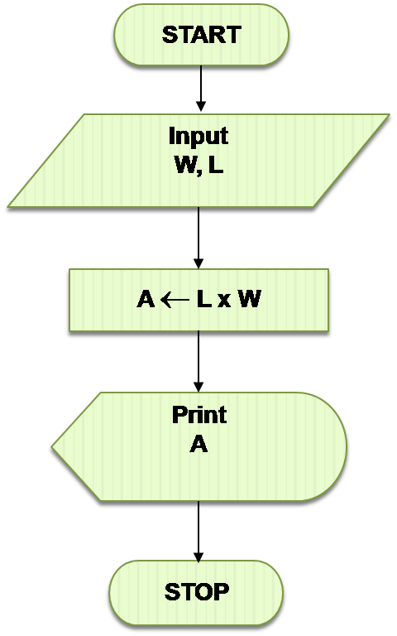
Algorithms & Flowcharts
Algorithm;
Step 1: Input W,L,
Step 2: A ← L x W,
Step 3: Print A.

Slide 24
Algorithms & Flowcharts
Write an algorithm that reads two values, determines the largest value and prints the largest value with an identifying message.
Algorithm;
Step 1: Input VALUE1, VALUE2
Step 2: if (VALUE1 > VALUE2) then
MAX ← VALUE1
else
MAX ← VALUE2
Step 3: Print “The largest value is”, MAX

Slide 25
Algorithms & Flowcharts
Pseudo code;
Input Variable 1 and Variable 2,
Check if Variable 1 > Variable 2,
Store Variable 1 in another variable ‘Max’.
Else
Store Variable 2 in another variable ‘Max’,
Print Max.

Slide 26
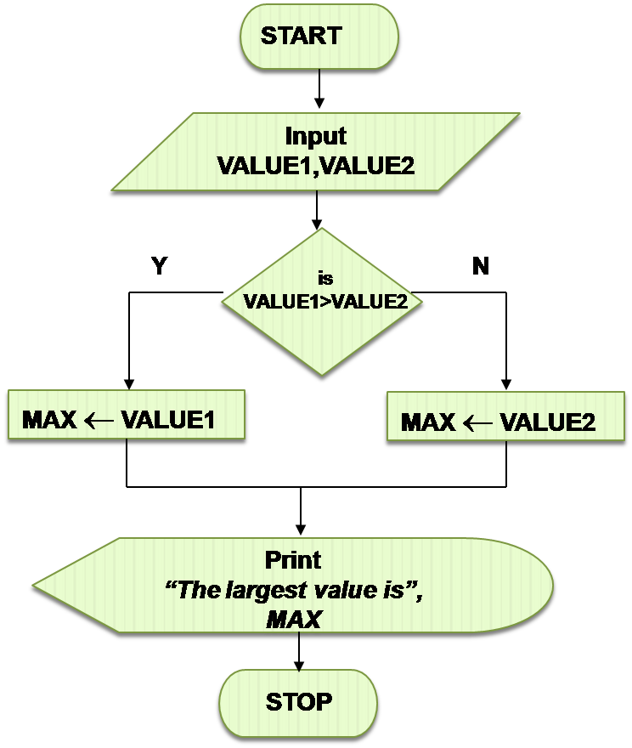
Algorithms & Flowcharts

