Slide 1
Lecture 4
Services Marketing

Slide 2
Services have grown dramatically in recent years. Services now account for close to 80 percent of the U.S. gross domestic product (GDP). And the service industry is growing.
It is estimated that nearly four out of five jobs in the United States will be in service industries.
Services are growing even faster in the world economy, making up 64 percent of the gross world product.
Service industries vary greatly. Governments offer services through courts, employment services, hospitals, military services, police and fire departments, the postal service, and schools.
Private not-for-profit organizations offer services through museums, charities, churches, colleges, foundations, and hospitals.
Alarge number of business organizations offer services— airlines, banks, hotels, insurance companies, consulting firms, medical and legal practices, entertainment and telecommunications companies, real-estate firms, retailers, and others

Slide 3
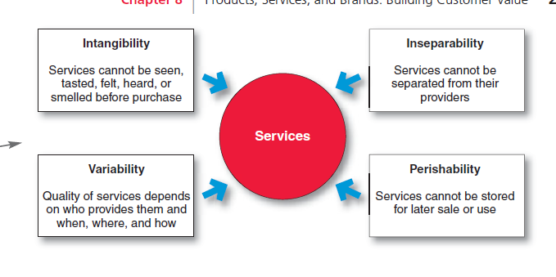
The Nature and Characteristics of a Service

Slide 4
Service intangibility
It means that services cannot be seen, tasted, felt, heard, or smelled before they are bought.
For example, people undergoing cosmetic surgery cannot see the result before the purchase.
Airline passengers have nothing but a ticket and a promise that they and their luggage will arrive safely at the intended destination, hopefully at the same time.
To reduce uncertainty, buyers look for “signals” of service quality.

Slide 5
They draw conclusions about quality from the place, people, price, equipment, and communications that they can see.
Physical goods are produced, then stored, later sold, and still later consumed.
In contrast, services are first sold and then produced and consumed at the same time.
In services marketing, the service provider is the product.

Slide 6
2) Service inseparability
It means that services cannot be separated from their providers, whether the providers are people or machines.
If a service employee provides the service, then the employee becomes a part of the service.
Because the customer is also present as the service is produced, provider-customer interaction is a special feature of services marketing.
Both the provider and the customer affect the service outcome.

Slide 7
Service variability
It means that the quality of services depends on who provides them as well as when, where, and how they are provided.
For example, some hotels—say, Marriott—have reputations for providing better service than others.
Still, within a given Marriott hotel, one registration-counter employee may be cheerful and efficient, whereas another standing just a few feet away may be unpleasant and slow.
Even the quality of a single Marriott employee’s service varies according to his or her energy and frame of mind at the time of each customer encounter

Slide 8
4 Service perishability
It means that services cannot be stored for later sale or use. Some doctors charge patients for missed appointments because the service value existed only at that point and disappeared when the patient did not show up.
The perishability of services is not a problem when demand is steady.
However, when demand fluctuates, service firms often have difficult problems.
Thus, service firms often design strategies for producing a better match between demand and supply.
Hotels and resorts charge lower prices in the off-season to attract more guests.
And restaurants hire part-time employees to serve during peak periods

Slide 9
The Service Profit Chain
In a service business, the customer and the front-line service employee interact to create the service.
Effective interaction, in turn, depends on the skills of front-line service employees and on the support processes backing these employees.
Thus, successful service companies focus their attention on both their customers and their employees.
They understand the service profit chain, which links service firm profits with employee and customer satisfaction.
This chain consists of five links:
1) Internal service quality: superior employee selection and training, a quality work environment, and strong support for those dealing with customers, which results in . .

Slide 10
2) Satisfied and productive service employees: more satisfied, loyal, and hardworking employees, which results in .
3) Greater service value: more effective and efficient customer value creation and service delivery, which results in . . .
4) Satisfied and loyal customers: satisfied customers who remain loyal, repeat purchase, and refer other customers, which results in . . .
5) Healthy service profits and growth: superior service firm performance

