Slide 1
Lecture 4
Airport engineering

Slide 2
Airport Engineering
Airport Engineering encompasses the planning, design, and construction of terminals, runways, and navigation aids to provide for passenger and freight service.
Airport engineers design and construct airports. They must account for the impacts and demands of aircraft in their design of airport facilities.
These engineers must use the analysis of predominant wind direction to determine runway orientation, determine the size of runway border and safety areas, different wing tip to wing tip clearances for all gates and must designate the clear zones in the entire port.

Slide 3
What is an AIRPORT?
An airport is a facility where passengers connect from ground transportation to air transportation.
It is a location where aircraft such as airplanes, helicopters take off and land.
Aircraft may also be stored or maintained at an airport.
An airport should have runway for takeoffs and landings, buildings such as hangars and terminal buildings.

Slide 4
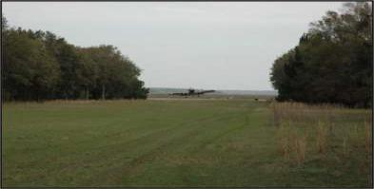
AIRFIELD
Airfield is an area where an aircraft can land and take off, which may or may not be equipped with any navigational aids or markings.
Many grass strips are also designated as airfields.

Slide 5
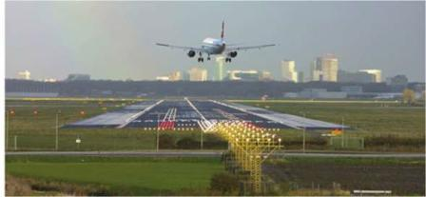
What are Aerodromes?
A defined area on land or water (including any buildings, installations and equipment) intended to be used either wholly or in part for the arrival, departure and surface movement of aircraft.

Slide 6
Aircraft Characteristics
The size;
– Span of wings: This decides the width of taxiway, size of aprons and hangers.
– Height: This decides the height of hanger gate and miscellaneous installations inside the hanger.
– Wheel base: This decides minimum taxiway radius.
– Tail width: Required for size of parking and apron.
Minimum turning radius: To determine the radii at the ends of the taxiways and to ascertain the position on the loading apron.

Slide 7
Aircraft Characteristics
Take-off and landing distances: A number of factors such as altitude of the airport, gradient of runway, direction and intensity of wind, temperature and the manner of landing and take-off which influence the take-off and landing distances.
Tyre pressure and contact area: It governs the thickness of the pavement.

Slide 8
Factors affecting selection of site for Airport:
Availability of adequate area
Accessibility
Topography, soil condition and drainage
Availability of construction materials
Cost of development
Cost of maintenance
Traffic volume and type of traffic
Cross-wind component
Proximity of airways
Safety factors
Revenues

Slide 9
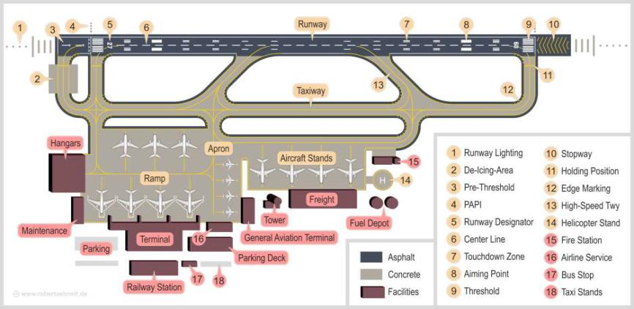
Typical Layout of an Airport

Slide 10
Important Components of An Airport Layout
1. Runway
2. Terminal Building
3. Apron
4. Taxiway
5. Aircraft Stand
6. Hangar
7. Control Tower
8. Parking

Slide 11
1. Runways
A runway is the area where an aircraft lands or takes off. It can be grass, or packed dirt, or a hard surface such as asphalt or concrete. Runways have special markings on them to help a pilot in the air to tell that it is a runway (and not a road) and to help them when they are landing or taking off. Runway markings are white.
Most runways have numbers on the end. The number is the runway's compass direction. (For example, runway numbered 36 would be pointing north or 360 degrees). Some airports have more than one runway going in the same direction, so they add letters to the end of the number R for right, C for center, and L for left.

Slide 12
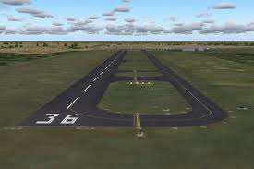
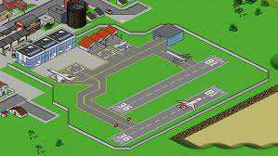
1. Runways

Slide 13
2. Terminal Buildings
Also known as airport terminal, these buildings are the spaces where passengers board or alight from flights. These buildings house all the necessary facilities for passengers to check-in their luggage, clear the customs and have lounges to wait before disembarking. The terminals can house cafes, lounges and bars to serve as waiting areas for passengers.
Ticket counters, luggage check-in or transfer, security checks and customs are the basics of all airport terminals. Large airports can have more than one terminal that are connected to one another through link ways such as walkways, sky-bridges or trams. Smaller airports usually have only one terminal that houses all the required facilities.

Slide 14
3. Aprons
Aircraft aprons are the areas where the aircraft park. Aprons are also sometimes called ramps.
They vary in size, from areas that may hold five or ten small planes, to the very large areas that the major airports have.

Slide 15
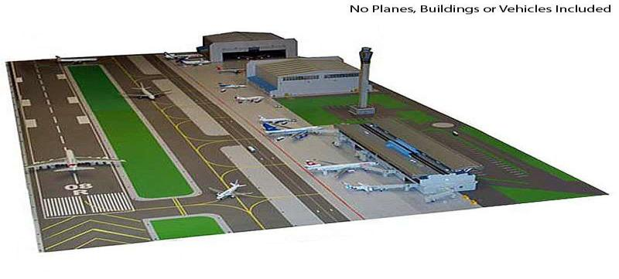
3. Aprons

Slide 16
4. Taxiway
A taxiway is a path on an airport connecting runways with ramps, hangars, terminals and other facilities.
They mostly have hard surface such as asphalt or concrete, although smaller airports sometimes use gravel or grass.

Slide 17
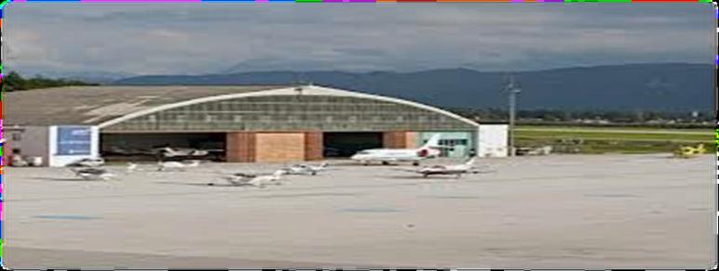
5. Aircraft Stand
A portion of an apron designated as a taxiway and intended to provide access to aircraft stands only.

Slide 18
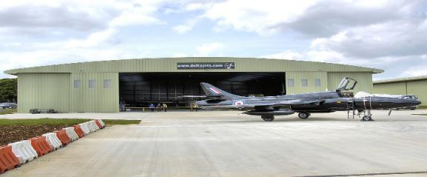
6. hangar
A hangar is a closed building structure to hold aircraft or spacecraft. Hangars are built of metal, wood, or concrete.
Hangars are used for protection from the weather, direct sunlight and for maintenance, repair, manufacture, assembly and storage of aircraft.

Slide 19
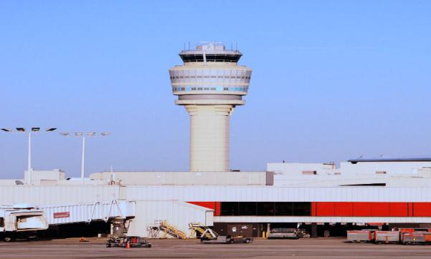
7. Control Tower
A tower at an airfield from which air traffic is controlled by radio and observed physically and by radar.

Slide 20
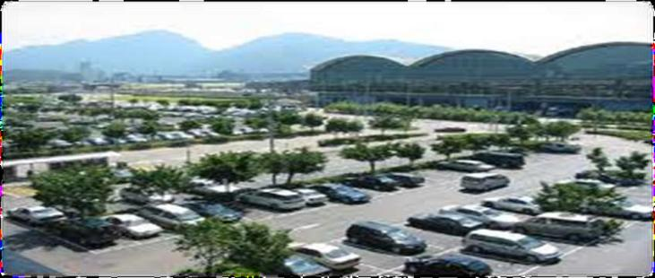
8. Parking
Parking is a specific area of airport at which vehicles park.

Slide 21
Runway Orientation & Design
Runway is defined as the “Rectangular area on an aerodrome used for landing and take off “
Runway orientation is important in airport planning
Current practice is to layout a runway in the direction of prevailing wind.

Slide 22
IMPORTANCE OF RUNWAY LAYOUT
Determination of runway is a critical task
It is very important for safe take offs and approaches
The width and sloping of runway also play a role in safe approaches . It can be illustrated by the figure

Slide 23
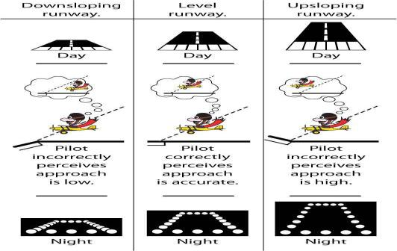
IMPORTANCE OF RUNWAY LAYOUT

Slide 24
RUNWAY NUMBERS
Runways are numbered according the magnetic compass direction they are oriented to.
Consists of two numbers one at each end of runway
Preceding that number are eight stripes.
Runway numbers are not given in degrees, rather in shorthand format e.g. a runway with a marking of 14 is actually 140 degrees
For simplicity FAA rounds off the precise headings to nearest tens.

Slide 25
RUNWAY CONFIGURATION
FAA includes over 20 runway layouts
Amongst them there are 4 basic runway patterns :
1. SINGLE RUNWAY
2. INTERSECTING RUNWAY
3. PARALLEL RUNWAY
4. OPEN-V RUNWAY

Slide 26
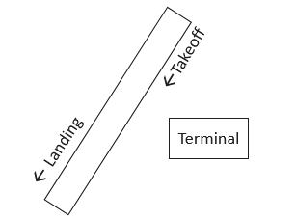
1. SINGLE RUNWAY
Single runways consist of one lone runway that accommodates both takeoffs and landings.
The configuration is often seen in small regional airports that do not have heavy amounts of air traffic. Single runways can handle up to 100 flights per hour in ideal conditions, both inbound and outbound.

Slide 27
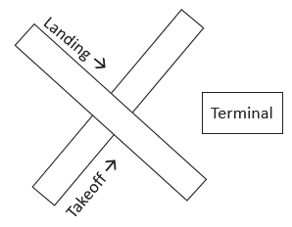
2. Intersecting runway
Intersecting runways consist of two or more runways that cross paths and share ground with one another.
These runways are often used in locations with strong winds and/or limited expansion space. When wind speeds are not favorable for arriving and departing aircraft, one of the intersecting runways will go unused.

Slide 28
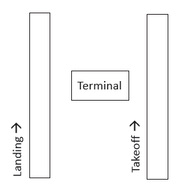
3. Parallel runway
Parallel runways are defined as those in which more than one runway is present and situated at the same angle. A basic parallel runway configuration can be seen in figure. The capacity of parallel runways depends on the number of runways in parallel and the spacing between them.

Slide 29
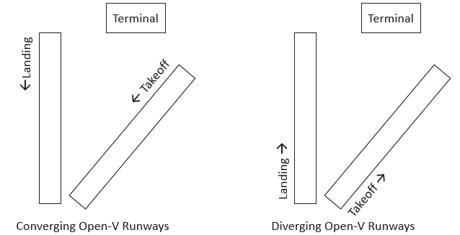
4. OPEN-V RUNWAY
Open-V runways are those that are oriented in different directions that do not Intersect.
If wind speeds were strong enough in one direction, the runway unfavorable to the prevailing wind would be inoperable. The remaining runway would act as if were at a single runway airport.

Slide 30
RUNWAY LIGHTING
These lights are used to assist pilot in to identify the runway
GREEN THRESHOLD LIGHTS : Line the runway edge
RED LIGHTS : Mark the end of runway
BLUE LIGHTS : Run alongside taxiways
While runways have YELLOW or WHITE lights marking their edges

