Slide 1
Lecture 3
Instructor: Engr. Syed Ashraf Ali

Slide 2
Capacitor
The capacitor is a component which has the ability or “capacity” to store energy in the form of an electrical charge producing a potential difference across its plates.
capacitor consists of two parallel conductive (metal) plates which are not connected or touching each other, but are electrically separated either by air or by some form of a good insulating material such as waxed paper, plastic or some form of a liquid gel as used in electrolytic capacitors.
The insulating layer between a capacitors plates is commonly called the Dielectric.

Slide 3
Capacitance
Each capacitor is built to have a specific amount of capacitance.
The capacitance of a capacitor tells how much charge it can store.
More capacitance means more capacity to store charge.
The standard unit of capacitance is called the farad, which is abbreviated as F.

Slide 4
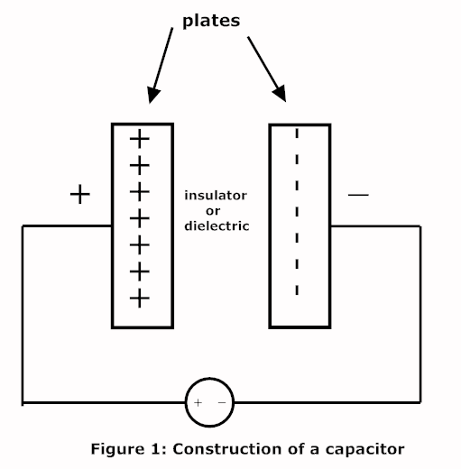
Equation for Capacitor
Consider two parallel plates capacitor having air b/w them,

Slide 5
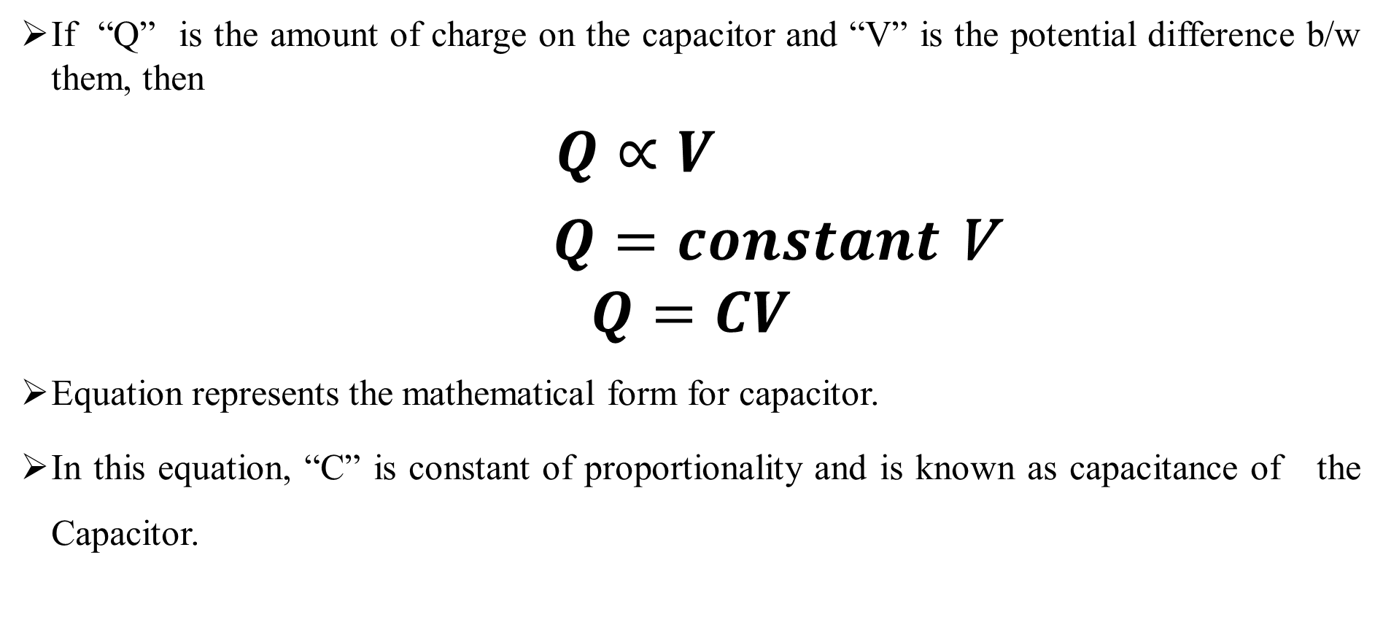
Equation for Capacitor
If “Q” is the amount of charge on the capacitor and “V” is the potential difference b/w them, then
$Q∝V$
$Q=constant$V
$$Q=CV$$
Equation represents the mathematical form for capacitor.
In this equation, “C” is constant of proportionality and is known as capacitance of the Capacitor.

Slide 6
Unit of Capacitor
Q=CV
C=Q/V
C=coulomb/volt=Farad
The SI unit of electrical capacitance, equal to the capacitance of a capacitor in which one coulomb of charge causes a potential difference of one volt.

Slide 7
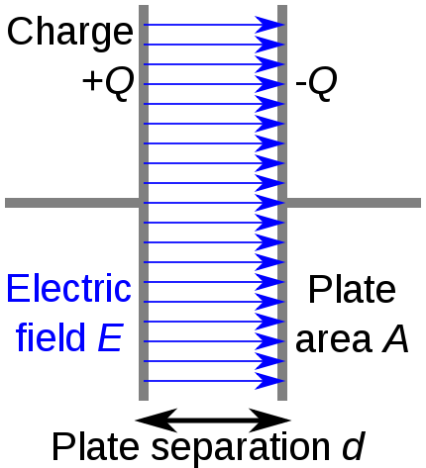
Capacitance of a parallel plate capacitor
Consider a parallel plate capacitor having separation “d” ,

Slide 8

Capacitance of a parallel plate capacitor
$$ε_{°}$$
Let the medium b/w the two plate be air of permittivity “ “
As each plate behaves like infinite sheet of charge, so the magnitude of electric field intensity for these plates is given by;
The capacitance of the capacitor is given by;
C=Q/V
$$ε=\frac{δ}{ε_{°}}$$

Slide 9

Capacitance of a parallel plate capacitor
Now if “ “ is the surface charge density then;
$δ$ =charge/area
=Q/A
Q = A
Putting the value of Q in equation C=Q/V , we get;
C= A/V
we also known that;
=V/d
$$δ$$
$$δ$$
$$δ$$
$$δ$$
$$ε$$

Slide 10
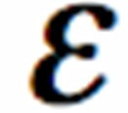
Capacitance of a parallel plate capacitor
V= d
Putting the value of V in equation of C= A/V , we get;
C= A/ d
Now putting the value of ;
C= A/( / )d
C=A /d
This equation represents the capacitance of a parallel plate capacitor having air as medium b/w them.

Slide 11
Capacitance of a parallel plate capacitor
If the medium b/w the plates is other than air, then we replaced by
C´=A /d

Slide 12
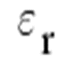
Show that C´>C
For air ,we have;
C=A /d
For a medium other then air, we have;
C=A /d
Now to compare “ C ” and “ C´ ”,we introduce relative permittivity ,which is given by;
= /
=

Slide 13
Show that C´>C
Putting the value of in equation of C´, we get;
C´=A /d
C´= [A /d]
Now putting equation of C in equation of C´, we get;
C´= C
For air , =1 and for material other than air, >1

Slide 14
Show that C´>C
As >1,so
C´> C
This shows that for dielectric medium ,the capacitance of a capacitor increases.

Slide 15
Energy Stored in an Electric field
For charging a capacitor work must be done, due to this work an electron transfers from one plate to another plate.
In this way ,an electric field is setup b/w the two plates of the capacitor.
If “dw” is the amount of work to transfer amount of charge “dQ”, then;
V=dw/dQ
dw=dQ V
As Q=CV
V=Q/C
Putting the value of V in the equation of dw,
dw=dQ.Q/c

Slide 16
Energy Stored in an Electric field
dw=1/c(Q dQ)
dw=1/c Q dQ
w=1/c(Q²/2)
w=Q²/2C
This work is stored in the form of P.E “U” in the capacitor, so w=U;
U=Q²/2C

Slide 17
Energy Stored in an Electric field
As Q=CV
Putting this value in the equation of U , we get;
U=C²V²/2C
U=1/2(CV²)
This represents the amount of P.E stored in the capacitor in terms of “C” and “v”.

Slide 18
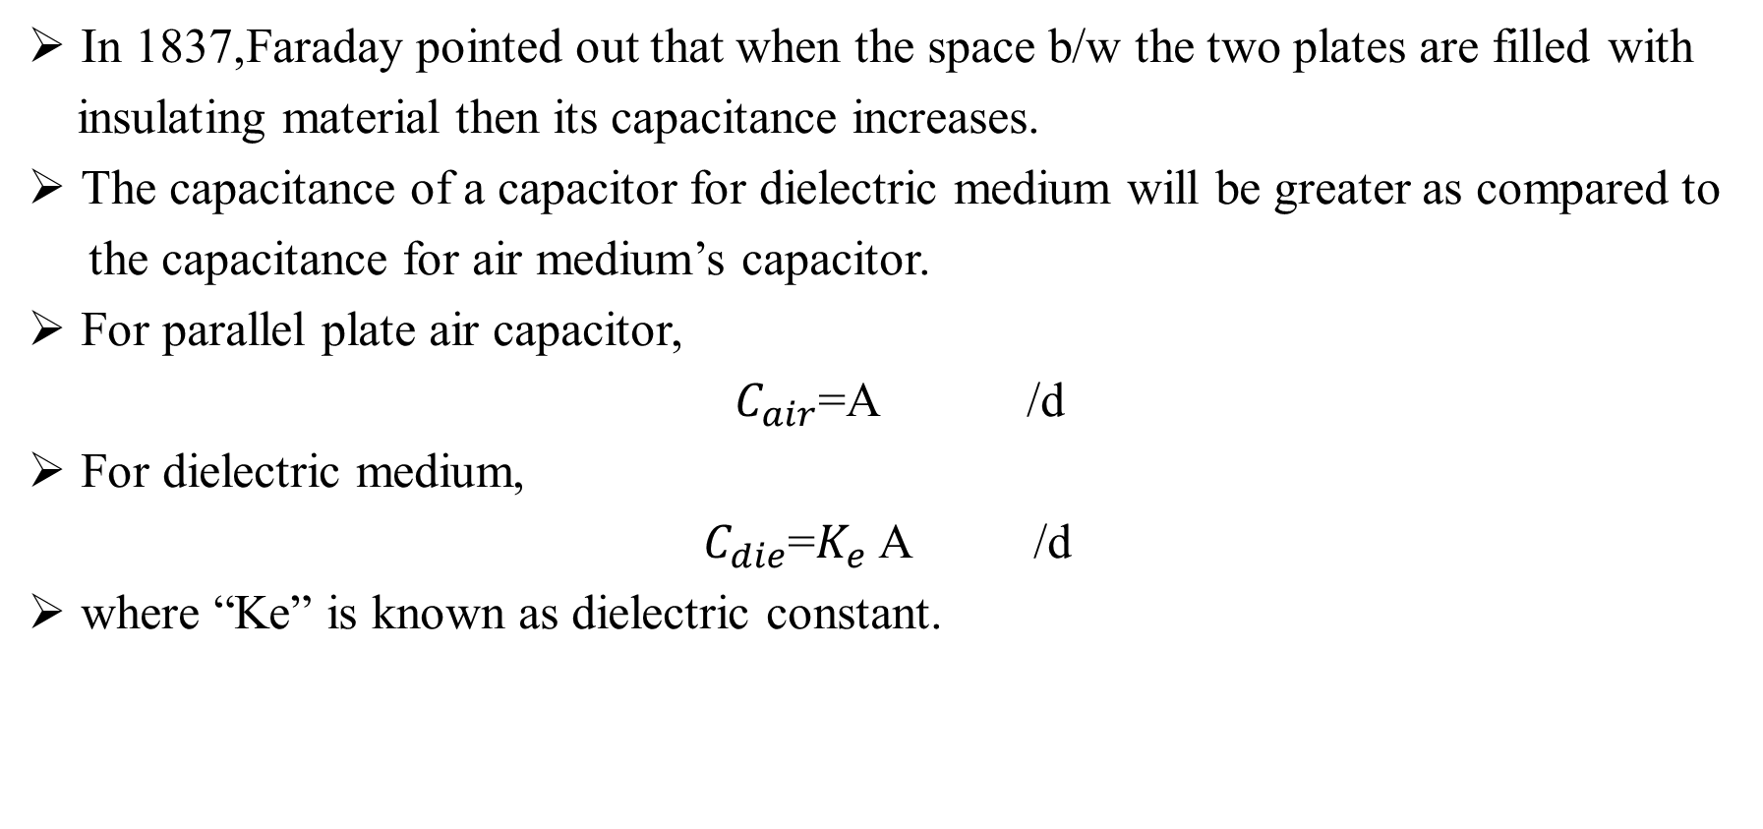
Capacitor with Dielectric
In 1837,Faraday pointed out that when the space b/w the two plates are filled with
insulating material then its capacitance increases.
The capacitance of a capacitor for dielectric medium will be greater as compared to
the capacitance for air medium’s capacitor.
For parallel plate air capacitor,
$C_{air}$=A /d
For dielectric medium,
$C_{die}$=$K_{e}$ A /d
where “Ke” is known as dielectric constant.

Slide 19
Capacitor with Dielectric
If we combine these equation, we get;
Cdie=Ke Cair
As the value of Ke is greater than 1,then the equation becomes;
Cdie>Cair
we can also find the value of Ke like
Ke=Cdie/Cair

Slide 20
Example
Calculate the charge stored on a 3-pF capacitor with 20V across it.
Find the energy stored in the capacitor.
Solution;
As Q=CV
Energy stored;

