Slide 2
Intro: Engr. Saleha Durrani B.Sc. Electrical Engineering from UET Pesh. Masters in Communications from UET Pesh.

Slide 3
Subject: Electronic Devices. Lecture # 2.

Slide 4
Energy Bands
Valance band of an atom represents a band of energy levels and the valance electrons are confined to that band.
Free Electrons: “ When an electron acquires additional energy it leaves the valance shell and becomes a free electron (and exists in what is known as conduction band.)
Band Gap: “ The difference in energy between the valance band and the conduction band is called the Energy gap or the Band gap.”

Slide 5
Energy Bands

Slide 7
Covalent Bond
A covalent bond, also called a molecular bond, is a chemical bond that involves the sharing of electron pairs between atoms.
These electron pairs are known as shared pairs or bonding pairs, and the stable balance of attractive and repulsive forces between atoms, when they share electrons, is known as covalent bonding.

Slide 8
Silicon
Sand is the major resource of silicon!!

Slide 9
Silicon
It is an element with four electrons in its valance shell, so it is called tetravalent.
Each valance electron forms a ‘Covalent bond’ with the neighboring valance electron of Silicon.

Slide 10
Each valance electron forms a ‘Covalent bond’ with the neighboring valance electron of Silicon.
Covalent Bond

Slide 11
Germanium

Slide 12
Covalent Bond

Slide 13
Let us see what are Intrinsic & Extrinsic Semiconductors.
Intrinsic & Extrinsic
Semiconductors.

Slide 14
Intrinsic Semiconductors
An Intrinsic semiconductor is a pure semiconductor
Example
A Silicon crystal is an intrinsic semiconductor if every atom in the crystal is a silicon atom.

Slide 15
Doping a Semiconductor
“Adding impurity to an intrinsic crystal to alter its electrical conductivity is called Doping.”
Or we can say that “Doping is a technique to increase conductivity of semiconductors by the controlled addition of impurities to the intrinsic(pure) semiconductor materials”.
This process increases the number of current carriers(electrons or holes)

Slide 16
Extrinsic Semiconductors
“A doped semiconductor is called an extrinsic semiconductor.”

Slide 18
Dopant
“The impurity added to the pure semiconductor is called dopant”

Slide 19
Types of Extrinsic(Impure) Semiconductor Materials
There are two types of extrinsic semiconductors
1. n type semiconductor material
2. p type semiconductor material
1

Slide 20
N type semiconductor
To increase the number of conduction band electrons in intrinsic silicon, pentavalent impurity atoms are added.
Pentavalent Impurities:
There are atoms with five valance electrons such as
Arsenic (As),
Phosphorus (P),
Bismith(B) &
Antimony (Sb).
Each pentavalent atom ( here Antimony) forms a covalent bond with four adjacent silicon atoms, leaving one extra electron ( conduction electron).

Slide 21
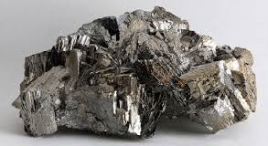
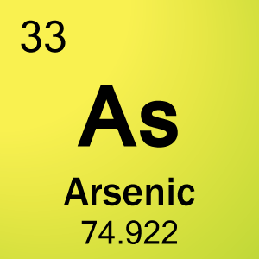
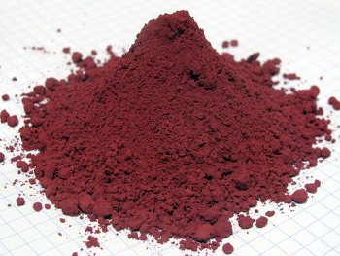
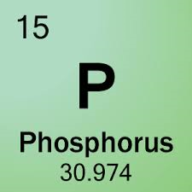
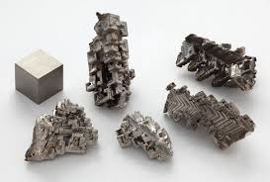
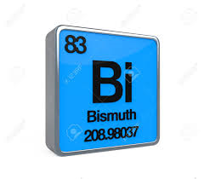
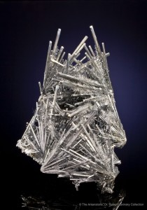
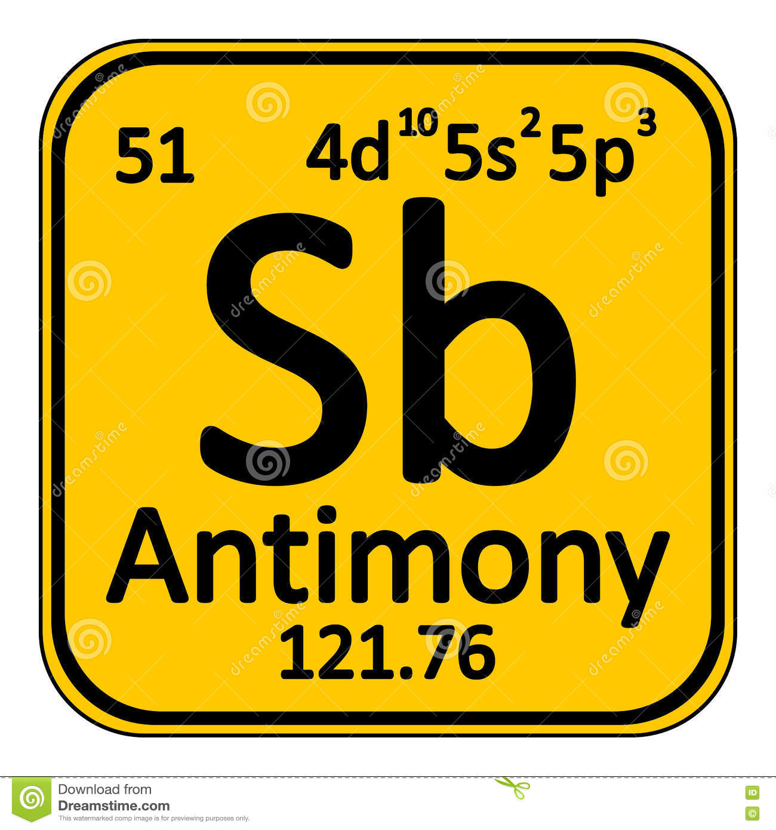
Penta valent Impurities
1.Arsenic (As),
2.Phosphorus (P),
3.Bismith (B) &
4. Antimony (Sb).

Slide 22
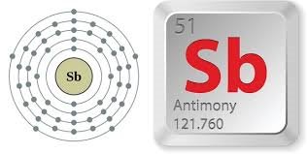

Slide 23
Donor Atom:
As the pentavalent atom gives an extra electron therefore it is called donor atom.

Slide 24
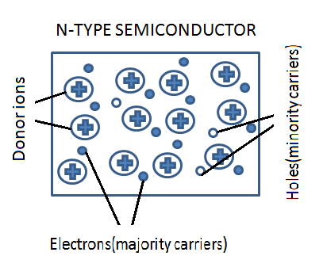
N type material
Minority Carriers: Holes
Majority Carriers: Electrons

Slide 25
P type material
To increase the number of holes in intrinsic silicon, trivalent impurity atoms are added (doped) to the pure silicon atoms.
Trivalant Impurities:
There are atoms with three valance electrons such as
Boron (B),
Indium (In) &
Gallium (Ga).
Each trivalent atom ( here Boron)) forms a covalent bond with three adjacent silicon atoms, leaving one extra hole.

Slide 26
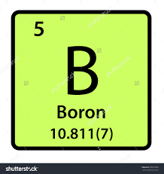
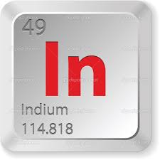
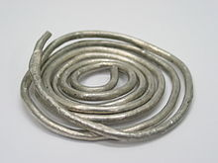
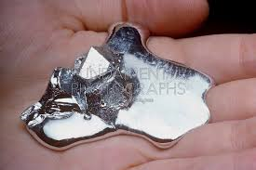
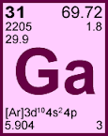
Trivalent Impurities
Boron (B),
Indium (In) &
Gallium (Ga).

Slide 27
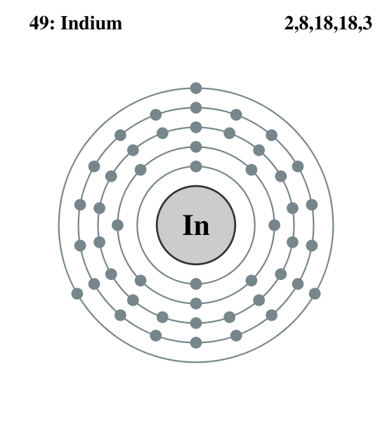

Slide 28
Acceptor Atom:
As the trivalent atom takes an electron (creates a hole), it is often referred to as acceptor atom.

Slide 30
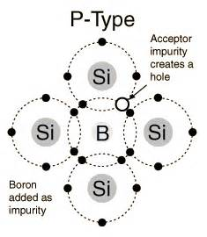
p type material
Minority Carriers: Holes
Majority Carriers: Electrons

Slide 34
Ions
An ion is an atom or a molecule in which the total number of electrons is not equal to the total number of protons, giving the atom or molecule a net positive or negative electrical charge.

Slide 35
1. Junction is a point where two or more things are joined.
Example: "the junction of the two rivers"
synonyms: | join, joint, intersection, link, bond, weld, seam, coupling, connection, union, juncture;
2. In electronics ,junction is a region of transition in a semiconductor between
a part where conduction is mainly by electrons and a part where it is mainly
by holes.

Slide 36
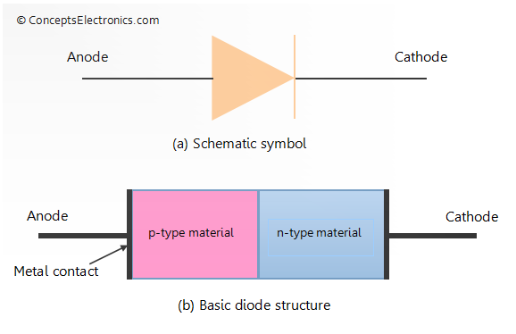
Diode
PN junction: If a piece of silicon is doped so that one part is n-type and the other part is p-type, a pn junction forms at the boundary between the two regions and a diode is created.

Slide 37
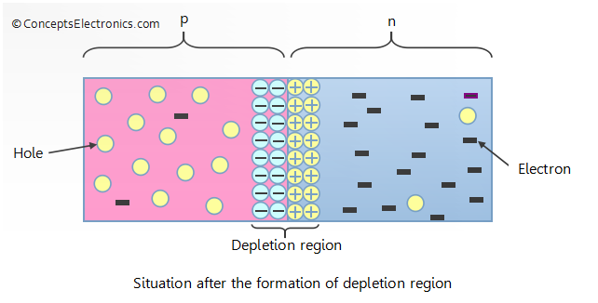
Formation of Depletion Region
Process: At the instinct of pn junction formation, the free electrons near the junction in n region begin to defuse across the junction into the p region where they combine with holes near the junction.

Slide 39
Forward Bias

Slide 40
Barrier Potential

Slide 41
Types of Currents
1. Electron current
2. Conventional current

Slide 42
1. Electron flow & Electron Current
The flow of electrons is termed as electron current. Electrons flow from the negative terminal to the positive.
Electron Flow is what actually happens and electrons flow out of the negative terminal, through the circuit and into the positive terminal of the source.

Slide 43
2. Conventional Current
Conventional current, or in other words the standard current, is measured in the opposite direction of the flow of the negative charges (i.e. electrons).

Slide 44
Biasing
Biasing, in general, refers to the application of DC voltage across the terminals of device to establish certain operating condition for the device.
Speaking of diode biasing in simple language, it simply means that external voltage is applied across the two terminals of the diode. Diode biasing can be done in two different ways.

Slide 45
Forward Bias
When the positive terminal of the battery is connected to the p-type material and the negative terminal of the battery is connected to the n-type material, such a connection is called forward bias.

Slide 47
Reverse Bias
When the positive terminal of the battery is connected to n-type material and the negative terminal of the battery is connected to p-type material, such a connection is called reverse bias.

Slide 48
Reverse Bias

Slide 50
Bipolar Junction Transistor (BJT)
“A Bipolar Junction Transistor is a specially constructed , three terminal semiconductor device containing two pn junctions”.
A transistor has three doped regions
Emitter
Base
Collector

Slide 51
Doping Levels: Emitter is heavily doped
Collector is intermediate
Base is lightly doped
Emitter < Collector < Base

Slide 52
Two Types of BJTs
1. NPN Transistor
2. PNP Transistor

Slide 53
NPN Transistor
When a p type material is sandwiched between two n type materials it is referred to as NPN transistor.

Slide 54
NPN Transistor

Slide 56
Emitter Base junction: Forward Biased
Collector Base junction: Reverse Biased
NPN Transistor is like two back to back Diodes:
1.Emitter Base Diode or Emitter Diode
2.Collector Base Diode or Collector Diode

Slide 57
Formula for Emitter Current:
Formula for Emitter Current:
IE = IC + IB

Slide 58
Emitter Base Junction: Forward Biased (by applying VEE)
Majority Carrier Diffusion ( electrons of n type material)
Collector Base Junction: Reverse Biased (by applying VCC)
Minority carrier diffusion (holes of p type base)

Slide 59
PNP Transistor
When a n type material is sandwiched between two p type materials it is called pnp transister

Slide 60
Structures Symbols

Slide 61
Assignment # 2. Date: 11th March. 2018
Q1.a) Draw the circuit diagrams of forward & reverse bias circuits of a simple pn junction diode.
b) What are the four differences between them (forward & reverse bias)?
c) What is depletion region?
…………………………………………………………………………………………..
Q 2. Compare the thickness levels of emitter, base and collector of a BJT.
…………………………………………………………………………………………

Slide 62
Quiz # 1.
In Next class there will be a quiz!!

