Slide 1
Lecture 2
Instructor: Engr. Syed Ashraf Ali

Slide 2
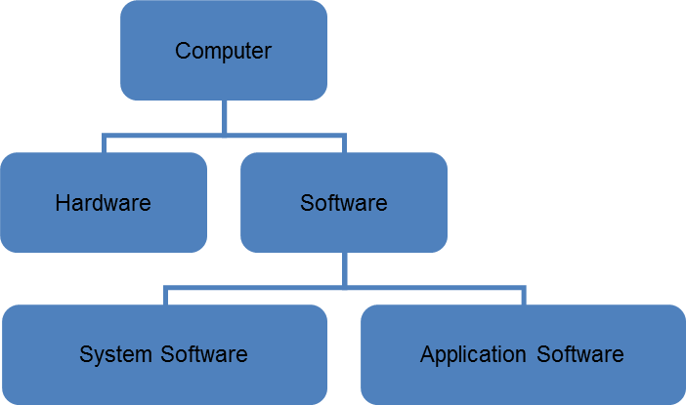
Computer System

Slide 3
Hardware
A computer's hardware consists of electronic devices; the parts you can see and touch.
The term "device" refers to any piece of hardware used by the computer such as a keyboard, monitor, modem, mouse, etc.

Slide 4
Hardware Types
A computer's hardware are categorized as follows;
Processor,
Memory,
Input and output (I/O) devices,
Storage devices.

Slide 5
CPU ( Central Processing Unit)
The central processing unit or (CPU) is the "brain" of your computer.
It contains the electronic circuits that cause the computer to follow instructions from memory.
The CPU contains three main parts, all housed in a single package (Chip);
Control Unit (CU),
Arithmetic Logic Unit (ALU),
Memory.

Slide 6
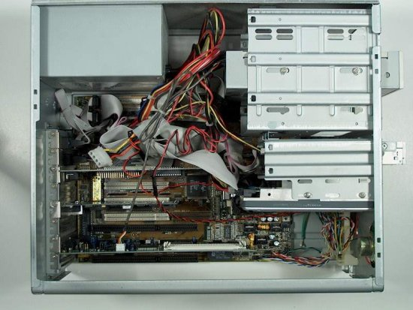
A Look Inside ..
power supply
CD-ROM drive
floppy drive
cards
hard drive
motherboard

Slide 7
A Look Inside…
All the major components;
Power Supply,
Motherboard,
Memory,
Card Slots,
Cards,
CPU, heat sink and fan,
Drives (floppy, hard drive and CD-ROM).

Slide 8
Functionality of these components
Power Supply; supplies power to all the circuitry and devices.
Motherboard; acts as a manager for everything on the computer – connects all the components together.
CPU; Central Processing Unit – does all the work of computing.

Slide 9
Functionality of these components
RAM; Random Access Memory – (short-term memory) holds data and program instructions that the computer is currently using.
Hard Drive; (long-term memory) holds all of the information that needs to be stored.
Floppy and CD-ROM drives; allow you to give data to the computer and take data away from the computer.

Slide 10
Functionality of these components
Card Slots; Allows other components to be added to the computer.
Network Card; (telephone) allows computer to talk to other computers over a wire.

Slide 11
Memory
Memory consists of chips attached to the motherboard.
Memory holds data and program instructions as the CPU works with it.
This memory is called Random Access Memory (RAM).
The CPU can find any piece of data in RAM, when it needs it for processing.
RAM is volatile, meaning it holds data only when the power is on. When the power is off, RAM's contents are lost.

Slide 12
How Memory is Measured
The smallest usable unit of measure for memory is byte – the amount of memory required to hold one character, like the letter A or the numeral 2.
Computers work with larger chunks of data, measured in multiple bytes as shown below;
Unit Approx. Value Actual Value
(bytes) (bytes)
Kilobyte (KB) 1,000 1,024
Megabyte (MB) 1,000,000 1,048,576
Gigabyte (GB) 1,000,000,000 1,073,741,824
Terabyte (TB) 1,000,000,000,000 1,099,511,627,776

Slide 13
Input and Output Devices
Input devices accept data and instructions from the user or from another computer system.
The keyboard and mouse are examples of input devices.
Output devices return processed data back to the user or to another computer system.
The printer and monitor are examples.
Communications devices (such as modems and network interface cards) perform both input and output, allowing computers to share information.

Slide 14
Storage Devices
Storage devices hold data not currently being used by the CPU.
Data is commonly stored on a magnetic or optical disk.
Each type uses a special medium for storing data on its surface.
A disk drive is a device that reads data from and writes data to a disk.
The most common optical storage devices are CD-ROM and DVD-ROM drives.

Slide 15
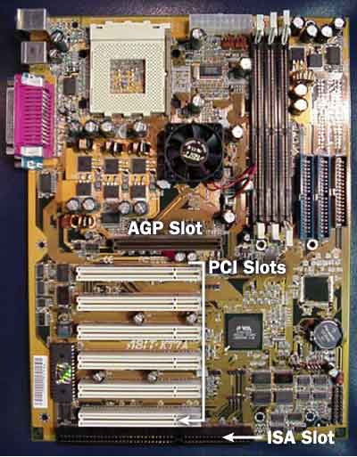
Motherboard; AGP Slot (Accelerated Graphics Port). PCI Slot (Peripheral Component Interconnect). ISA Slot (Industry Standard Architecture).

Slide 16
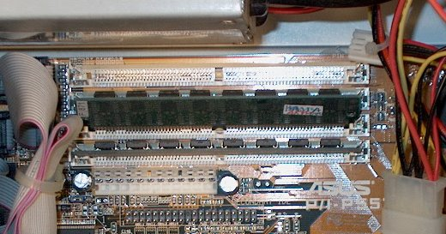
RAM

Slide 17
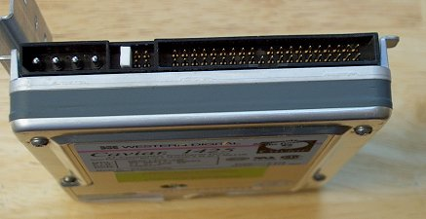
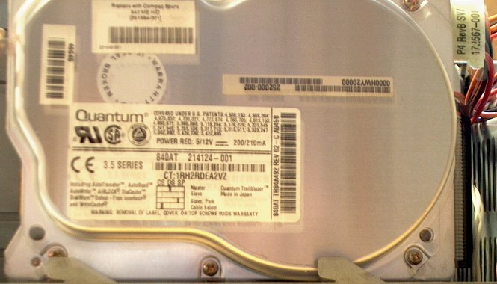
Hard Drive

Slide 18
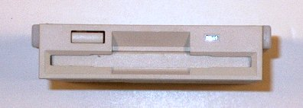
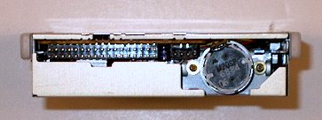
Floppy Drive

Slide 19
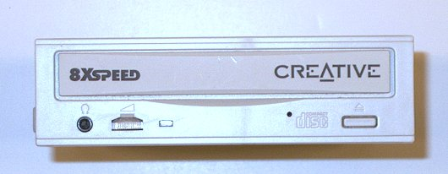
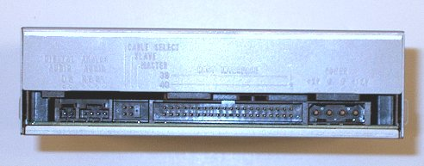
CD-ROM Drive

Slide 20
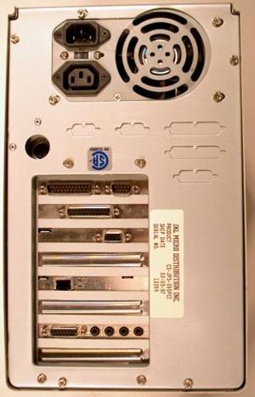
Back of Computer
Remove these screws

Slide 21
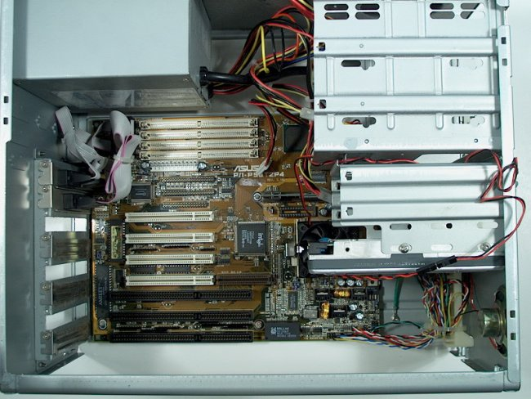

Slide 22
Major Peripherals
Keyboard,
Mouse,
Hard Disk,
Floppy Disk,
CD ROM,
Printer,
Scanner.

Slide 23
Keyboard
Keypad contains;
Alphabets,
Numbers,
Special Symbols,
Function Keys.
qwerty Keyboard (Typewriter Keyboard).
On key press it sends a code (ASCII Code) to the CPU.

Slide 24
Mouse
Pointing & Click Device.
Two / Three Buttons.
Wheel / Optical Mouse.

Slide 25
Hard Disk
Magnetic Memory Device.
Non-removable storage device.
Several Circular Magnetic Disks are housed in a single case.
Data is stored as 1’s & 0’s.

Slide 27
Floppy Disk
Magnetic Memory Device.
Removable storage.
A single circular Mylar plastic disk, coated with magnetic material is packed in a protective plastic casing.
Typical size is 3.5” & Capacity is 1.44MB.

Slide 28
CD ROM
Optical Device.
Removable Storage.
Read Only Memory.
Typical Capacity is 550 MB – 800MB.
Related Terms;
CD Writer,
CD RW.

Slide 29
Software
Set of instructions written in any programming language to solve the problems and to control the hardware is known as Software.
The logical parts of the computer are known as software.
The process to create the software is known as software development.
Any newer part of the software is known as its version.
The person who develop the software is known as;
Software developer,
Software programmer,
Software Engineer,
Programmer.

Slide 30
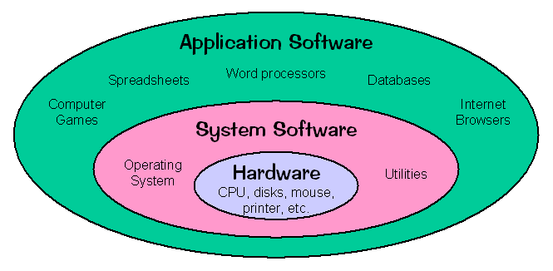
Software Types
System Software.
Application Software.

Slide 31
System Software
Software which is used to perform the basic functionality of the computer or in other words bridge between user & hardware.
Also known as Operating System.
After assembling the hardware first of all we install system software on the PC to make it functional.
It is an necessary part in the operating of the computer.
We cant make Personal Computer functional without the system software.

Slide 32
System Software
Is collection of programs designed to operate, control and extend the processing capabilities of the computer itself.
Usually developed by computer manufacturers in a low level language.
Makes operation of computer more effective and efficient.
Help hardware components work together and provide support for the development and execution of the application software.

Slide 33
System Software
Programs included in system software package are known as system programs and the programmers who develop those programs are known as system programmer.
Examples are;
Operating systems,
Utilities programs,
Communication software,
Assembler, interpreter etc.

Slide 34
Types of System Software
Operating System,
Utilities (service programs),
Device drivers,
Language translators.

Slide 35
Operating System
Programs that coordinate computer resources.
provide a user interface and run applications.
Handles technical tasks.
Every computer has an operating system.
Performs three types of functions;
Manages computer resources,
Provides user interface,
Runs applications.

Slide 36
Utility Programs
Help to perform maintenance or correct problems with a computer system.
Common types of utility programs;
Hardware utilities,
Virus-detection and recovery utilities,
File-compression utilities,
Backup,
Uninstall.

Slide 37
Features of System Software
Features of System Software are following;
Close to system,
Fast in speed,
Difficult to design,
Difficult to understand,
Less interactive,
Smaller in size,
Difficult to manipulate,
Generally written in low level language.

Slide 38
Application Software
Those software which used to perform the specific tasks of the computer are known as application software.
This software perform only a single task.
They comes in different categories;
Anti Viruses,
Norton Anti virus.
Text Editing,
Notepad, WordPad, MS Word.
Presentation Making,
MS PowerPoint.
Calculation Software,
MS Excel.
Compress Software,
WinZip, WinRAR.

Slide 39
Application Software
Features of Application Software;
Consists of programs designed to make users more productive and/or assist with personal tasks,
Helps users solve particular problems,
In most cases, application software resides on the computer’s hard disk,
Application software can also be stored on CDs, DVDs, and flash or keychain storage devices.

Slide 40
Application Software
Categories of Application Software;
Business Software,
Graphic & Multimedia,
Home / Personal / Education,
Communication.

Slide 41
Software & Hardware - Relationship
Complementary to each other (both are necessary for the computer).
Hardware is a one time expense (except in case of upgrade) whereas software is a continuing expense,
Upgrades refer to renewing or changing components like increasing the memory, hard disk capacity or adding speakers, modem etc.
Software cannot be utilized without supporting hardware.

Slide 42
Software & Hardware – Relationship
A software acts as an interface between the user and the hardware.
To get a particular job done on the computer, relevant software should be loaded into the hardware.
Hardware without set of programs to operate upon cannot be utilized and is useless.

