Slide 1
Lecture 2
Clustering
Association Rule Mining
Regression
Dataset creation (Practical)

Slide 2
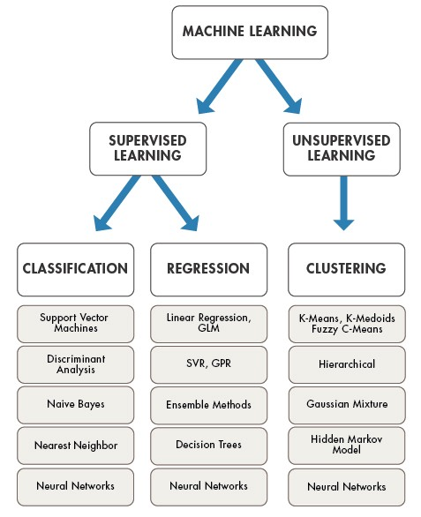
Machine Learning
Hierarchy

Slide 3
What is clustering?
Imagine you’re a marketing manager, and you have a new product to sell.
You’re sure the product would bring a huge profit, as long as it is sold to the right people.
So, how can you tell who’s best suited for the product from your company’s large customer base?
That’s where clustering comes to your aid.

Slide 4
Clustering cont..
Clustering helps divide data into a number of subsets.
Each of these subsets contain data that is similar to one another.
These subsets are known as clusters.
Now that the data from your customer base is divided into clusters, you can take an informed decision on who you think is best suited for this product.

Slide 5
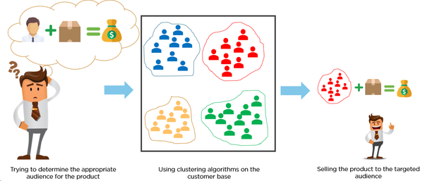

Slide 6
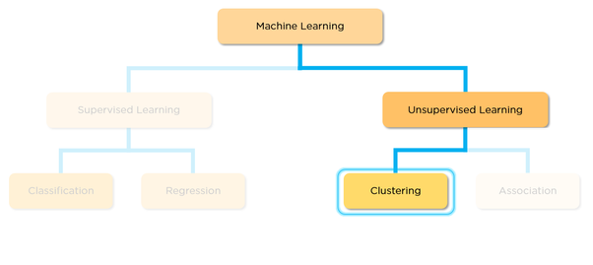
Clustering, falling under the category of unsupervised machine learning, is a one of the problems that machine learning algorithms solve.

Slide 7
Clustering only uses the input data, to determine patterns, anomalies or similarities in its input data.
Now a good clustering algorithm aims to create clusters whose:
intra-cluster similarity is high (The data that is present inside the cluster is similar to one another)
inter-cluster similarity is less (Each cluster holds data that isn’t similar to the other)

Slide 8
In fields like e-shopping, healthcare and financial services, etc.
clustering is used for statistical data analysis.
Different clusters reveal different details about the objects, making it different from classification or regression, where there’s some prior knowledge of the result.
A type of clustering algorithm is the K - means clustering algorithm.
It is used to classify or to group objects based on attributes/features into K number of groups.
K is positive integer number. It helps determine what a given object, based on its similarity to the objects it is compared to.

Slide 9
Euclidean Distance Based Clustering in 3-D space.
Intracluster distances
are minimized
Intercluster distances
are maximized

Slide 10
Clustering: Application 1
Market Segmentation:
  Goal: subdivide a market into distinct subsets of customers where any subset may conceivably be selected as a market target to be reached with a distinct marketing mix.
  Approach:
    Collect different attributes of customers based on their geographical and lifestyle related information.
    Find clusters of similar customers.
    Measure the clustering quality by observing buying patterns of customers in same cluster vs. those from different clusters.

Slide 11
Clustering: Application 2
Document Clustering:
  Goal: To find groups of documents that are similar to each other based on the important terms appearing in them.
  Approach: To identify frequently occurring terms in each document. Form a similarity measure based on the frequencies of different terms. Use it to cluster.
  Gain: Information Retrieval can utilize the clusters to relate a new document or search term to clustered documents.

Slide 12
Illustrating Document Clustering
Clustering Points: 3204 Articles of Los Angeles Times.
Similarity Measure: How many words are common in these documents (after some word filtering).

Slide 13
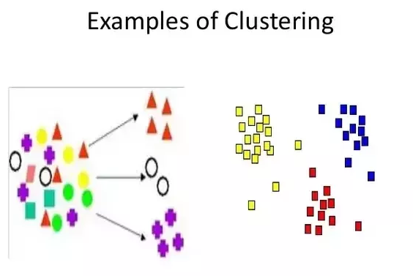

Slide 14
Applications :
Marketing: finding groups of customers with similar behavior given a large database of customer data containing their properties and past buying records;
Biology: classification of plants and animals given their features;
Libraries: book ordering;
Insurance: identifying groups of motor insurance policy holders with a high average claim cost; identifying frauds;
City-planning: identifying groups of houses according to their house type, value and geographical location;
Earthquake studies: clustering observed earthquake epicenters to identify dangerous zones;
WWW: document classification; clustering weblog data to discover groups of similar access patterns.

Slide 15
Association Rule Mining
What Association Rule Mining Aims to Achieve?
Association Rule Mining is one of the ways to find patterns in data. It finds:
features (dimensions) which occur together
features (dimensions) which are “correlated”

Slide 16
Association Rule Discovery: Definition
Given a set of records each of which contain some number of items from a given collection;
  Produce dependency rules which will predict occurrence of an item based on occurrences of other items.
Rules Discovered:
{Milk} --> {Coke}
{Diaper, Milk} --> {Beer}

Slide 17
Association Rule Discovery: Application 2
Supermarket shelf management.
  Goal: To identify items that are bought together by sufficiently many customers.
  Approach: Process the point-of-sale data collected with barcode scanners to find dependencies among items.
  A classic rule --
    If a customer buys diaper and milk, then he is very likely to buy beer.
    So, don’t be surprised if you find six-packs stacked next to diapers!

Slide 18
Association Rule Discovery: Application 3
Inventory Management:
  Goal: A consumer appliance repair company wants to anticipate the nature of repairs on its consumer products and keep the service vehicles equipped with right parts to reduce on number of visits to consumer households.
  Approach: Process the data on tools and parts required in previous repairs at different consumer locations and discover the co-occurrence patterns.

Slide 19
Regression
Predict a value of a given continuous valued variable based on the values of other variables, assuming a linear or nonlinear model of dependency.
Greatly studied in statistics, neural network fields.
Examples:
  Predicting sales amounts of new product based on advertising expenditure.
  Predicting wind velocities as a function of temperature, humidity, air pressure, etc.
  Time series prediction of stock market indices.

Slide 20
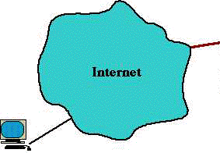
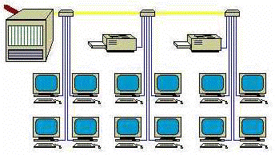
Deviation/Anomaly Detection
Detect significant deviations from normal behavior
Applications:
  Credit Card Fraud Detection
  Network Intrusion
  Detection
Typical network traffic at University level may reach over 100 million connections per day

Slide 21
Challenges of Data Mining
Scalability
Dimensionality
Complex and Heterogeneous Data
Data Quality
Data Ownership and Distribution
Privacy Preservation
Streaming Data

Slide 22
Practical Demo
Lets Get a Dataset !!

